Slide 1
WasteService
Thomas Ambrogini

Slide 2
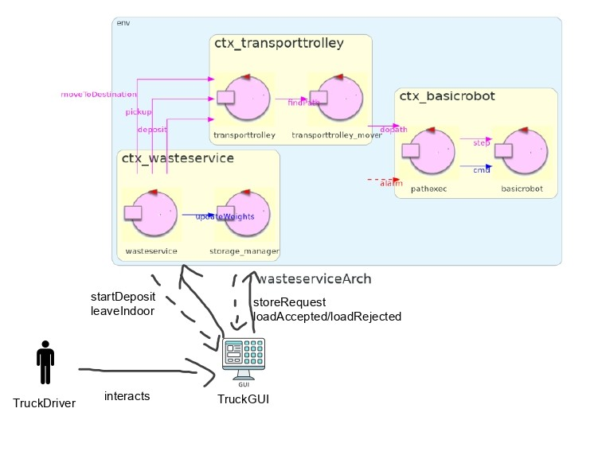

Slide 3
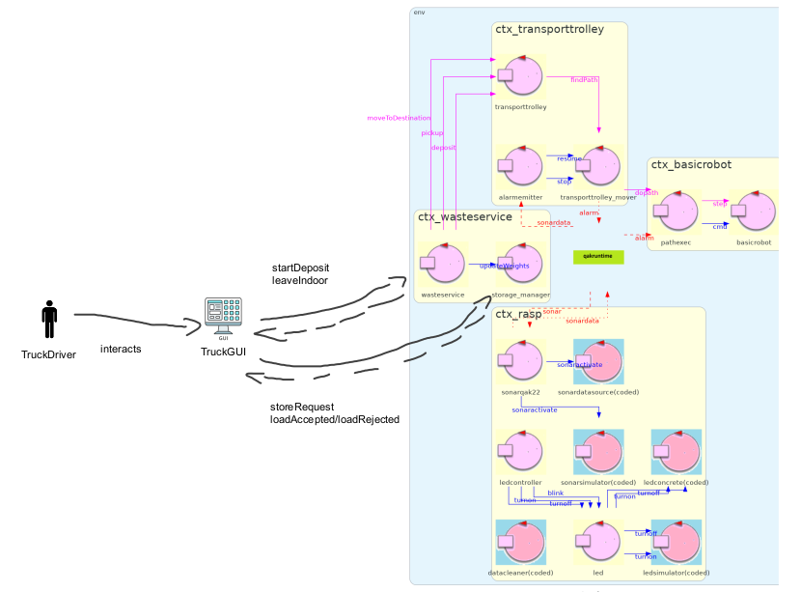

Slide 4
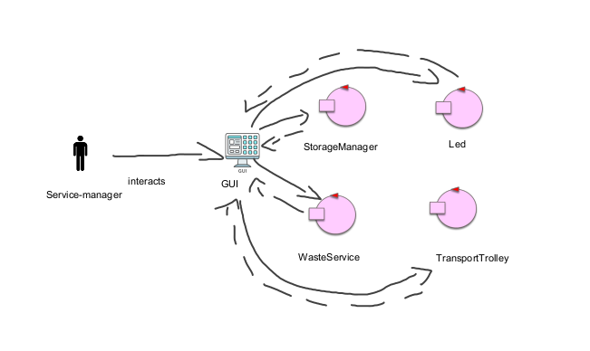
Final Architecture

