Slide 1

yac stacks
Portable Services
Tom Jackson
Nordstrom

Slide 2



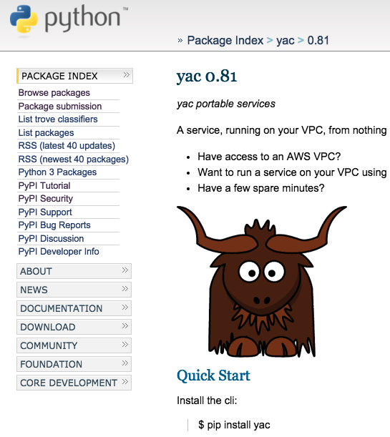

Slide 3







My Challenge

Slide 4
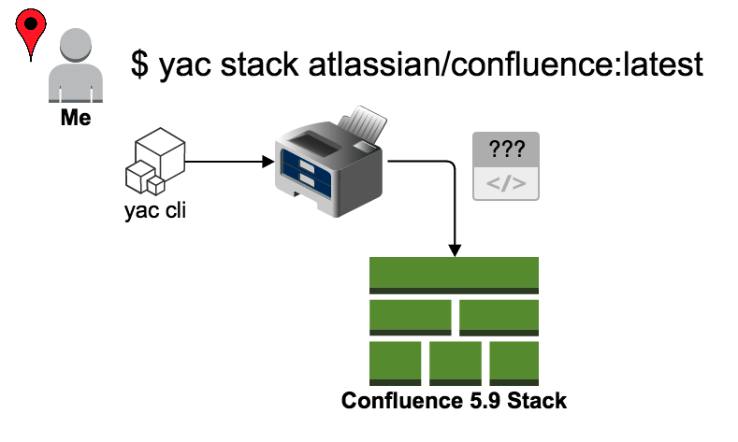
My Dream Scenario

Slide 5
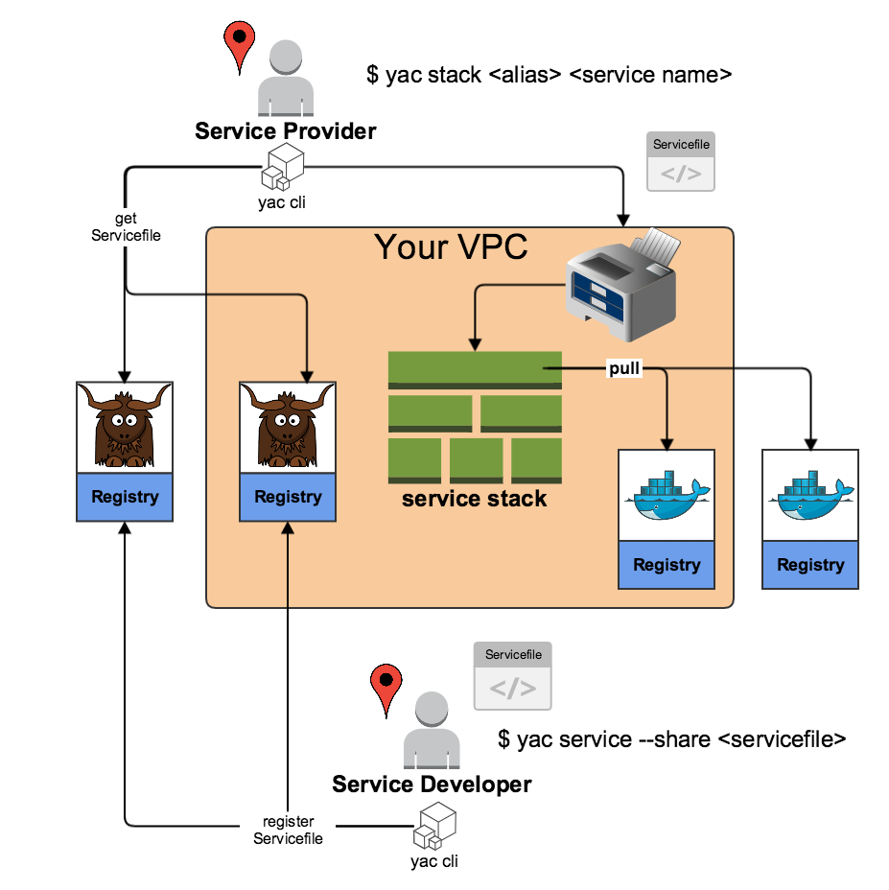

Slide 6
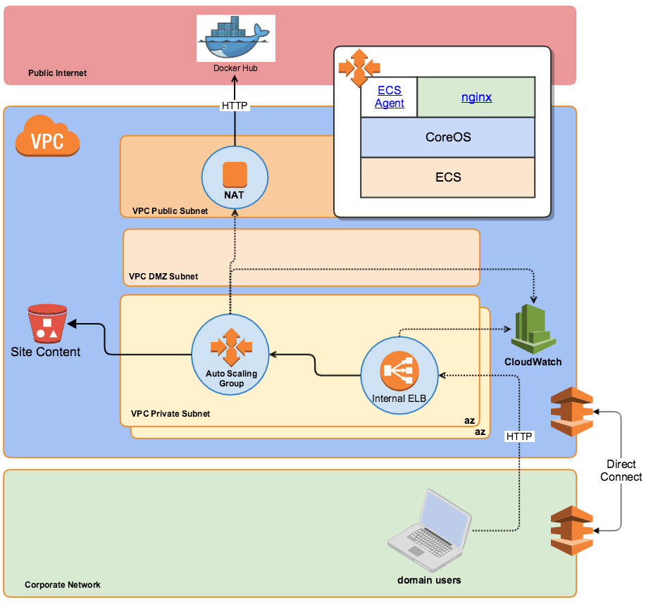

Slide 7
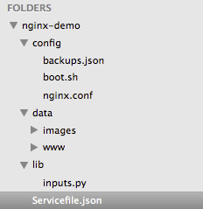
Servicefile for nginx Demo Service
Section | Purpose | #
service-name | unique name + version | 4
service-description | for browsing | 8
stock-resources | e.g. asg, e-elb | 4
service-params | name/value pairs | 16
service-inputs | scripted name/value pairs | 8
stack-template | for sending to printer | rem
deploy-at-boot | files to deploy before booting | 25
 | Total | 185

Slide 8
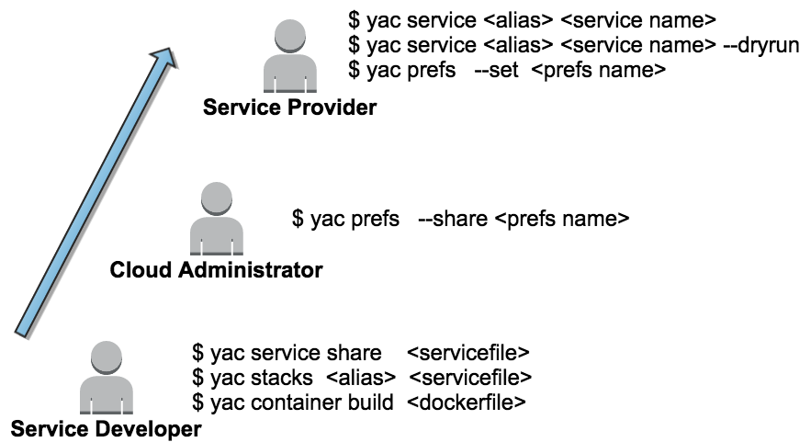
yac workflows

Slide 9
Learn More
yac package on PyPi
yac-stacks on atlassian.net
yac registry on atlassian.net
yac on bitbucket
@ridgelinetom

