Slide 1
Storage Item Trade (SIT)
That is where our platform comes in it gives the users the opportunity to sell these old items that are just sitting in storage.

Slide 2
Project Idea
We want to develop an ecommerce site for buying and selling items they belong which they are no longer using. It is also convenient way of getting rid of used items at home and make some money off those items e.g. old laptops, like books from past classes etc. and also offers other users the opportunity to buy item for cheap.

Slide 3
List of main entities
Users
Products
Items
Orders
Messages

Slide 4
User
Shall be able to register and login
Users can use one account for both buying and selling
Can search for items
Can click order item to place an order
Can message seller to arrange for item pickup and payment
Shall be able to upload items for sale

Slide 5
User
User shall be able to receive messages from users interested in buying items
User shall be able to see all the purchases items
User shall be able to see all the uploaded items for sale

Slide 6
Additional Technologies
IDE Visual Studios Code, sublime
Frameworks Express js, bootstrap, react native
Others: Whatsapp group, github

Slide 7
System architecture and technology used
Server Host: Mac OS, Windows 10
Operating system: Windows, Mac
Database: MySQL
Web Server: Node JS
Server side language JavaScript

Slide 8
Seller and buyer scenario
Seller can upload the items and buyer can see the items. Buyer can send message to Seller that he/she interested to buy that product. If both are agreed seller will create an order for the buyer at that moment product will no more public, it will move to buyer transaction list and after the transaction completed seller will change the status to sold. And buyer can send the rating to seller so that everyone can see it before buying any stuff.

Slide 9
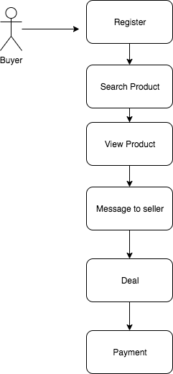
Buyer Use cases

Slide 10
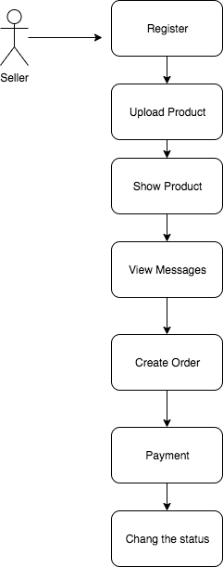
Seller Use cases

