Slide 1


Slide 2

CREDIT DEFAULT
ORIGINAL DATA

Slide 3
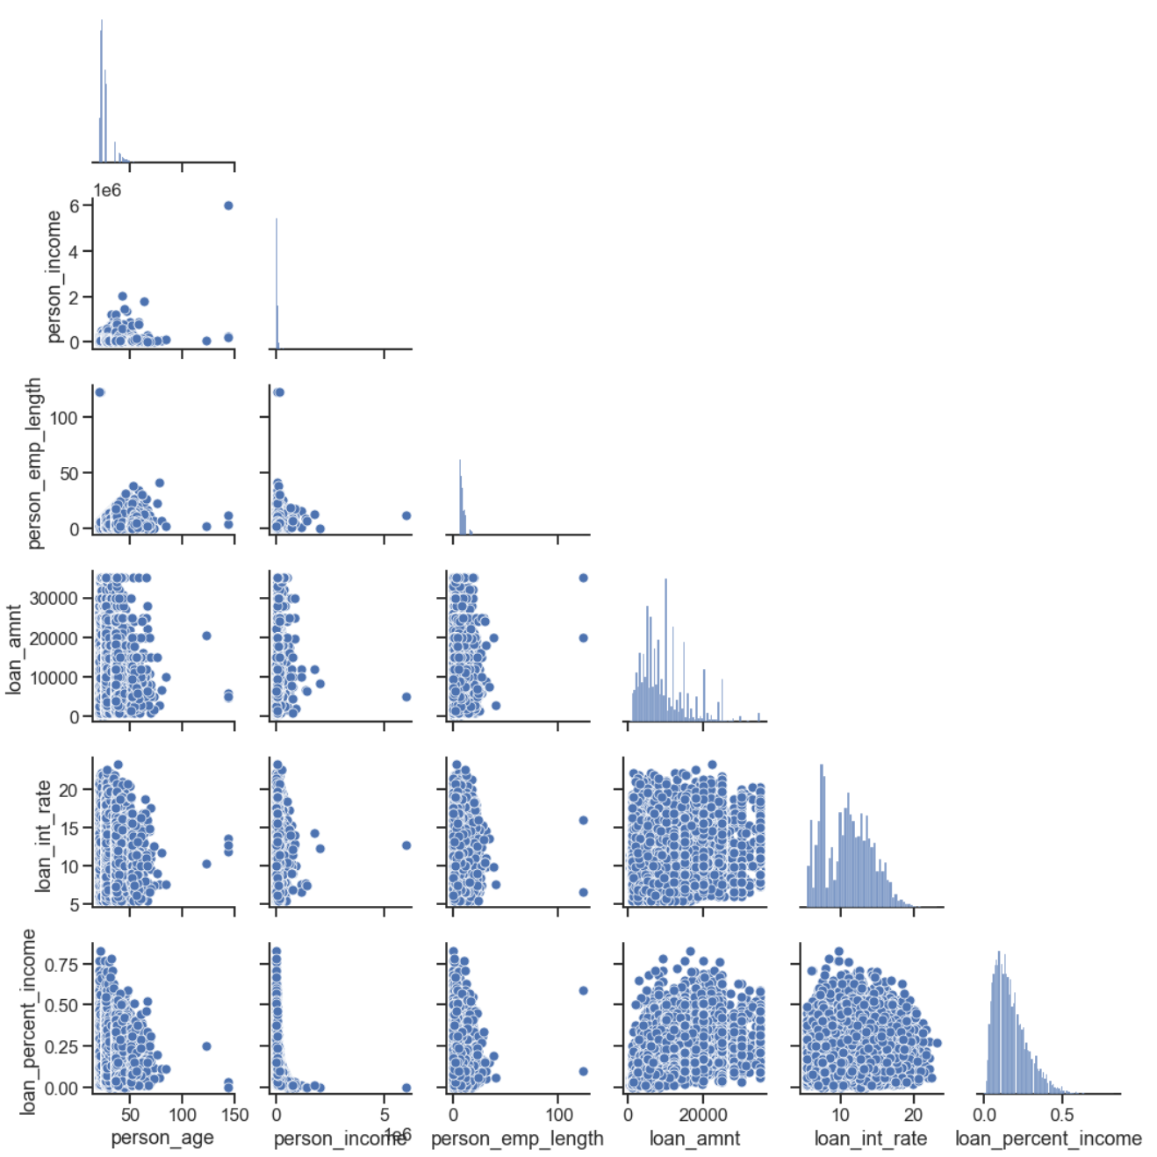
ORIGINAL DATA

Slide 4
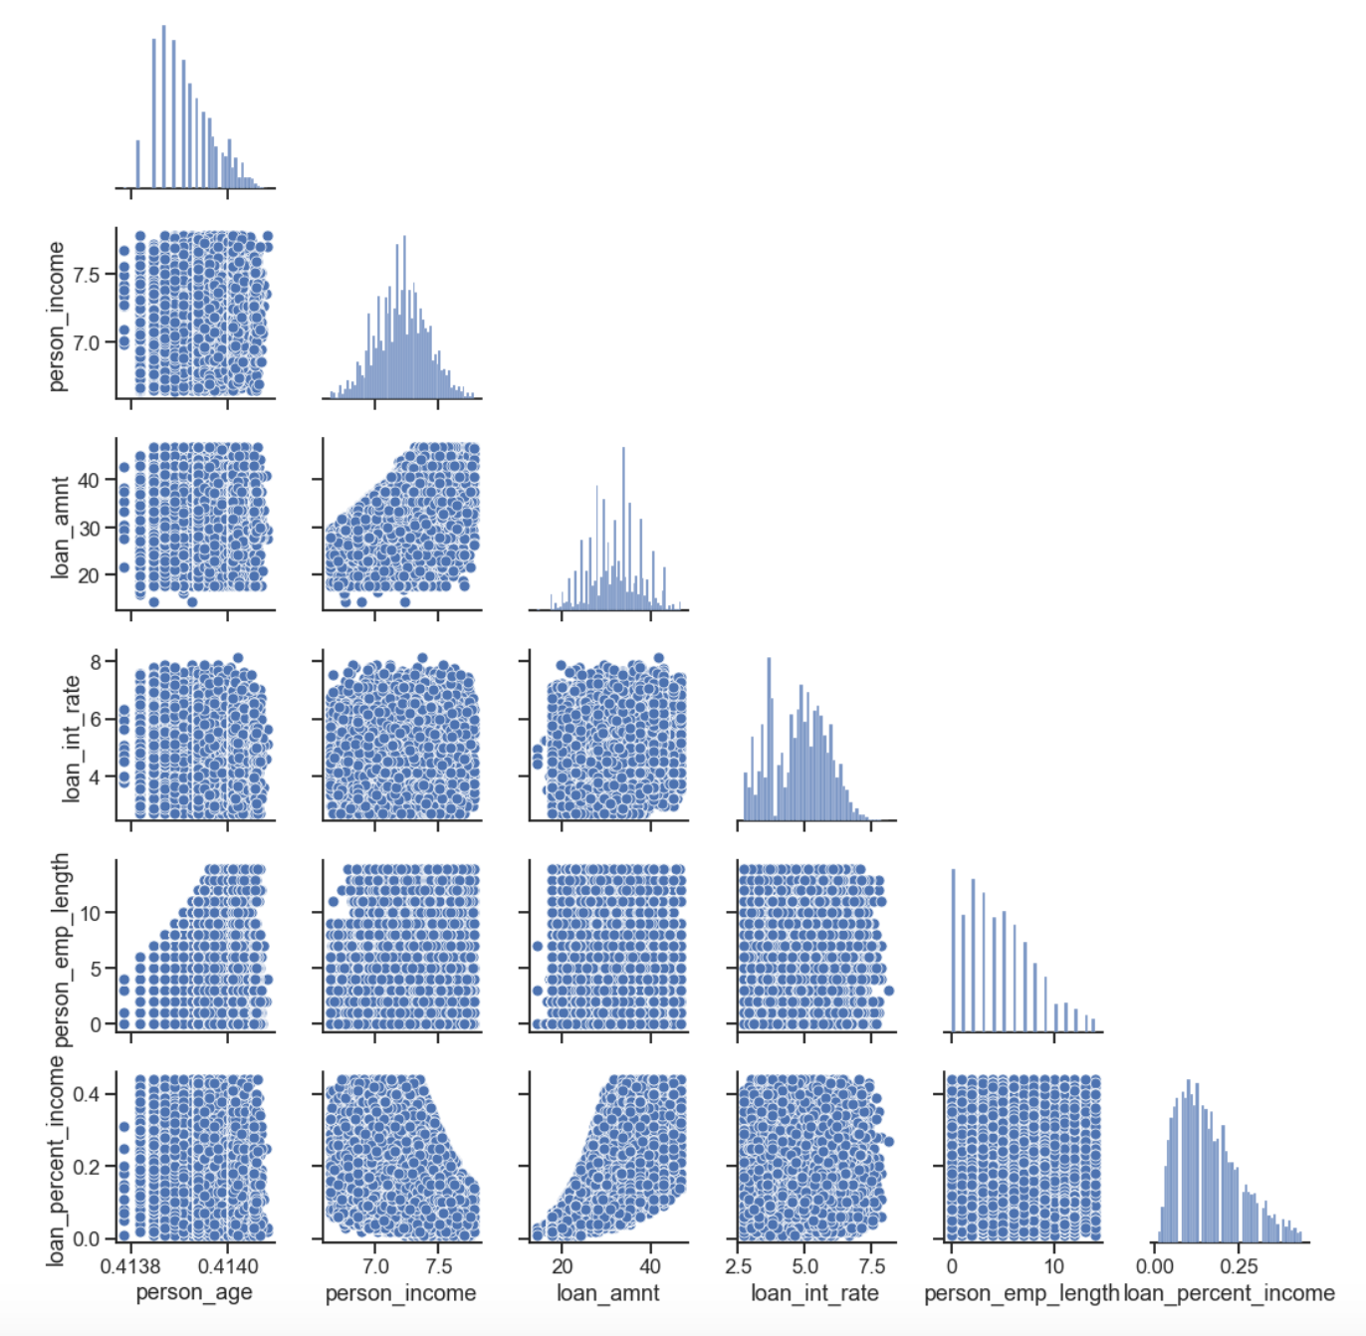
After boxcox
and standardization

Slide 5
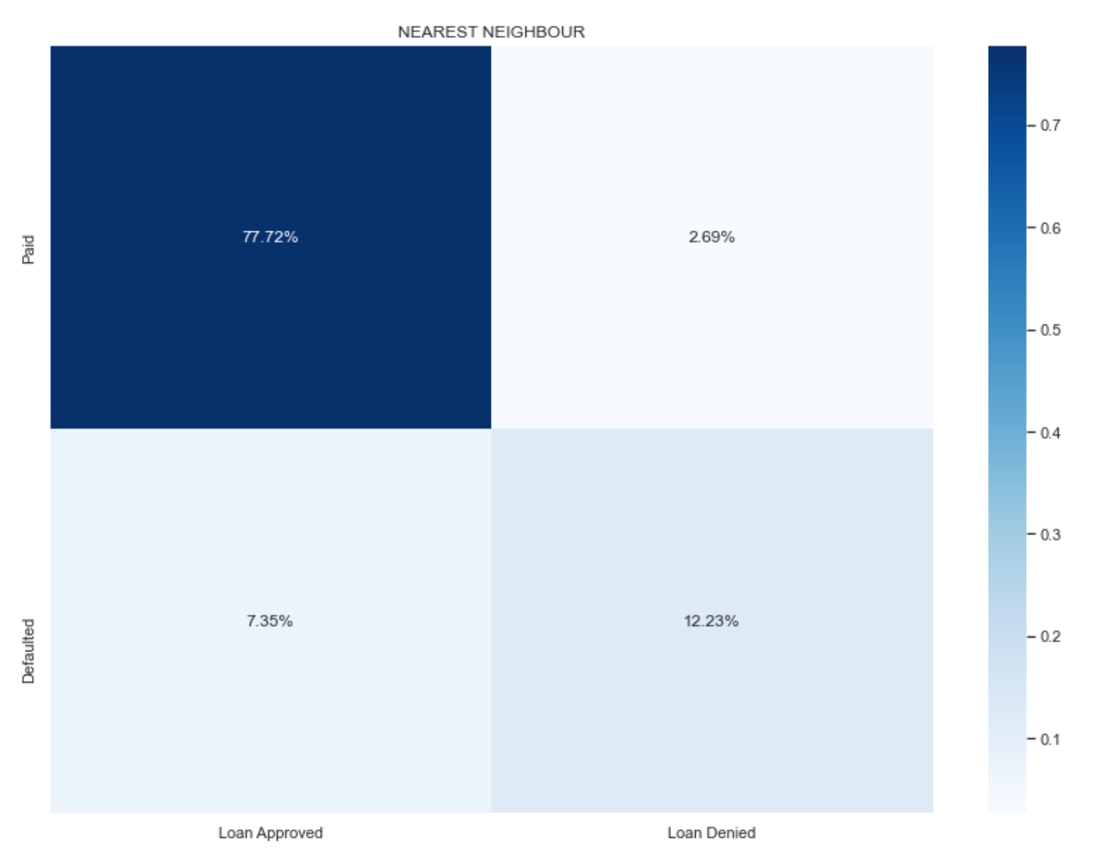

Slide 6
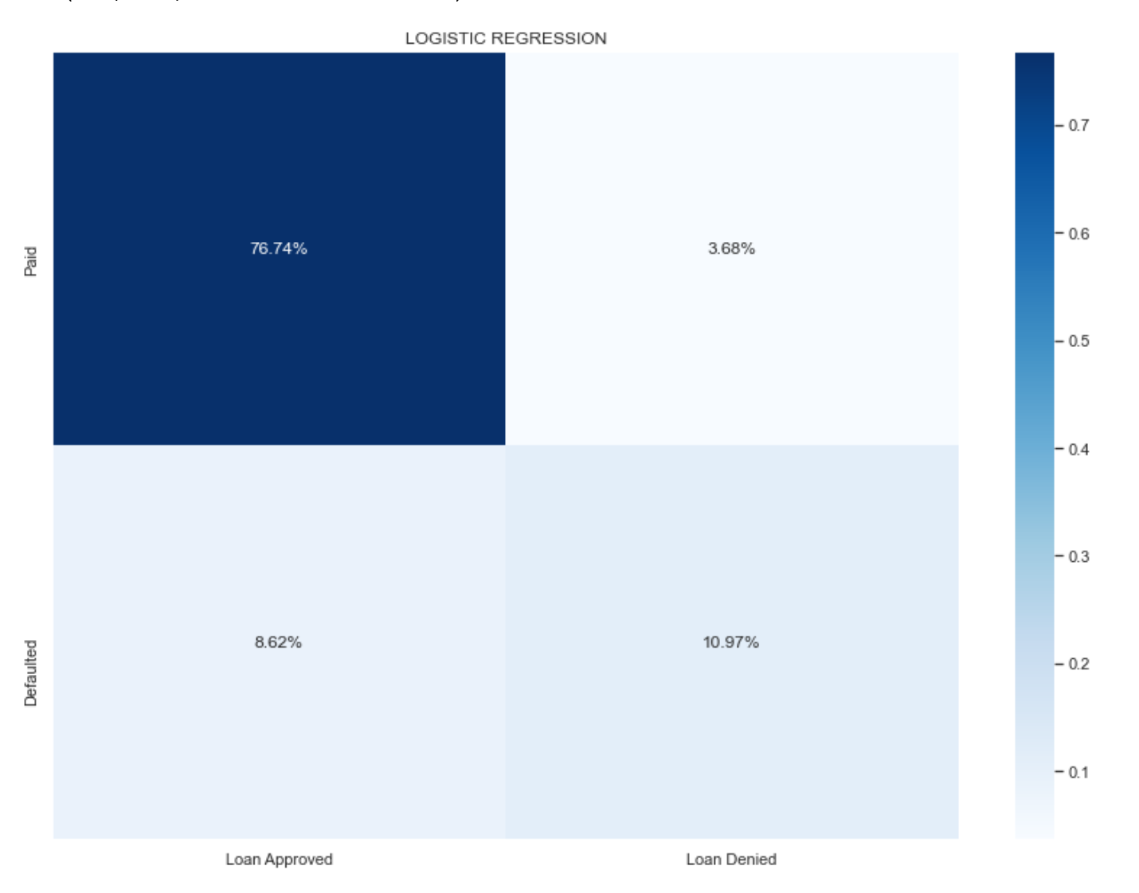

Slide 7
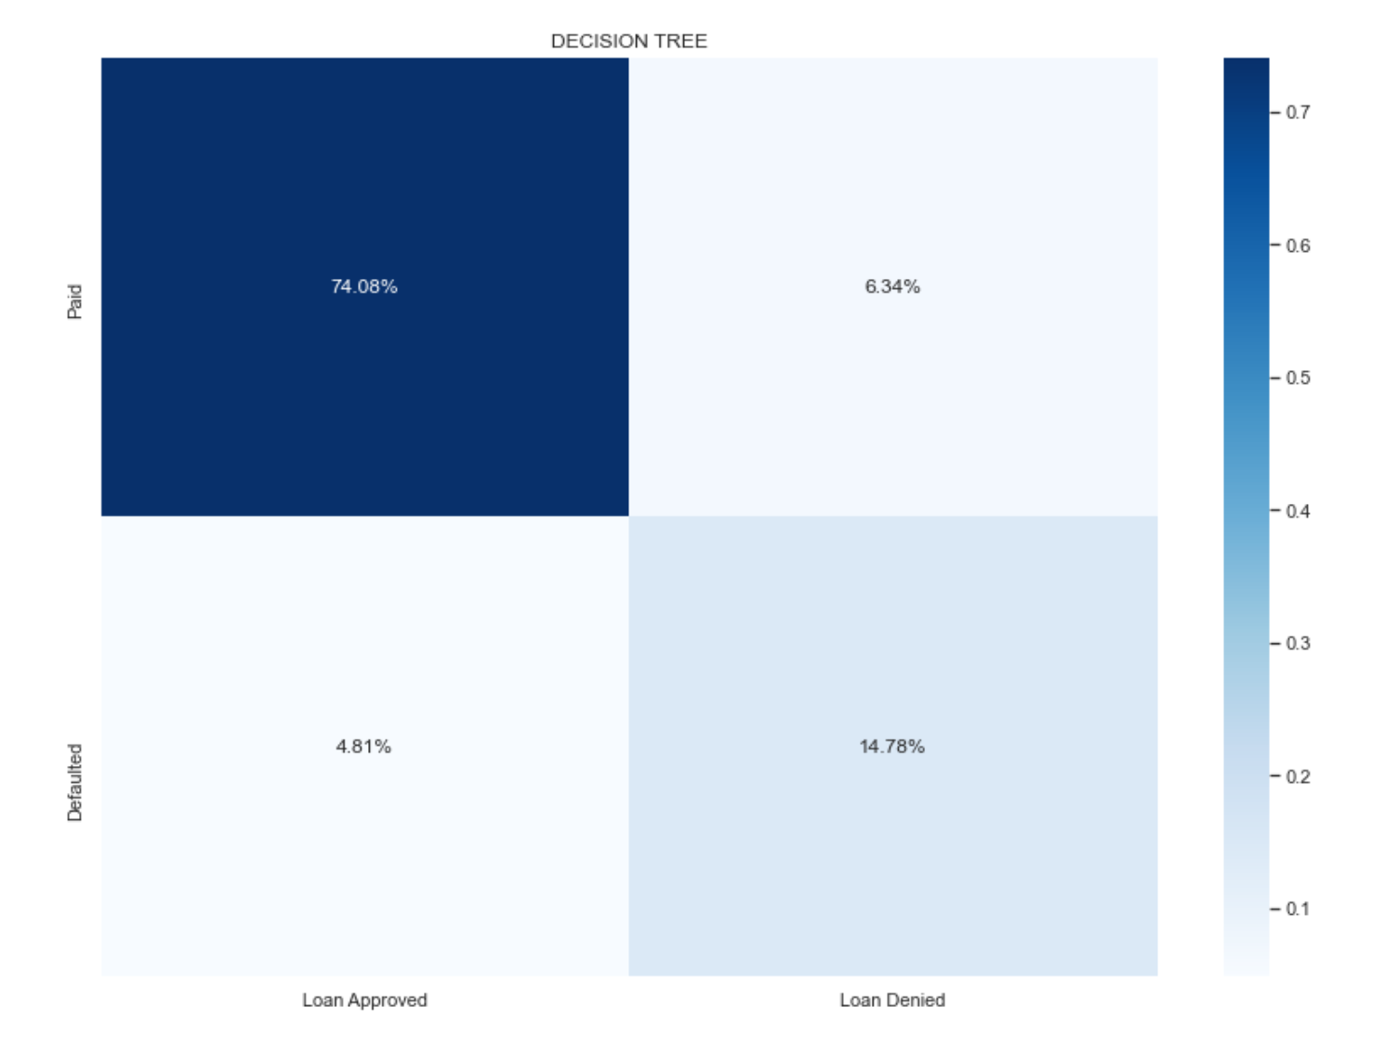

Slide 8
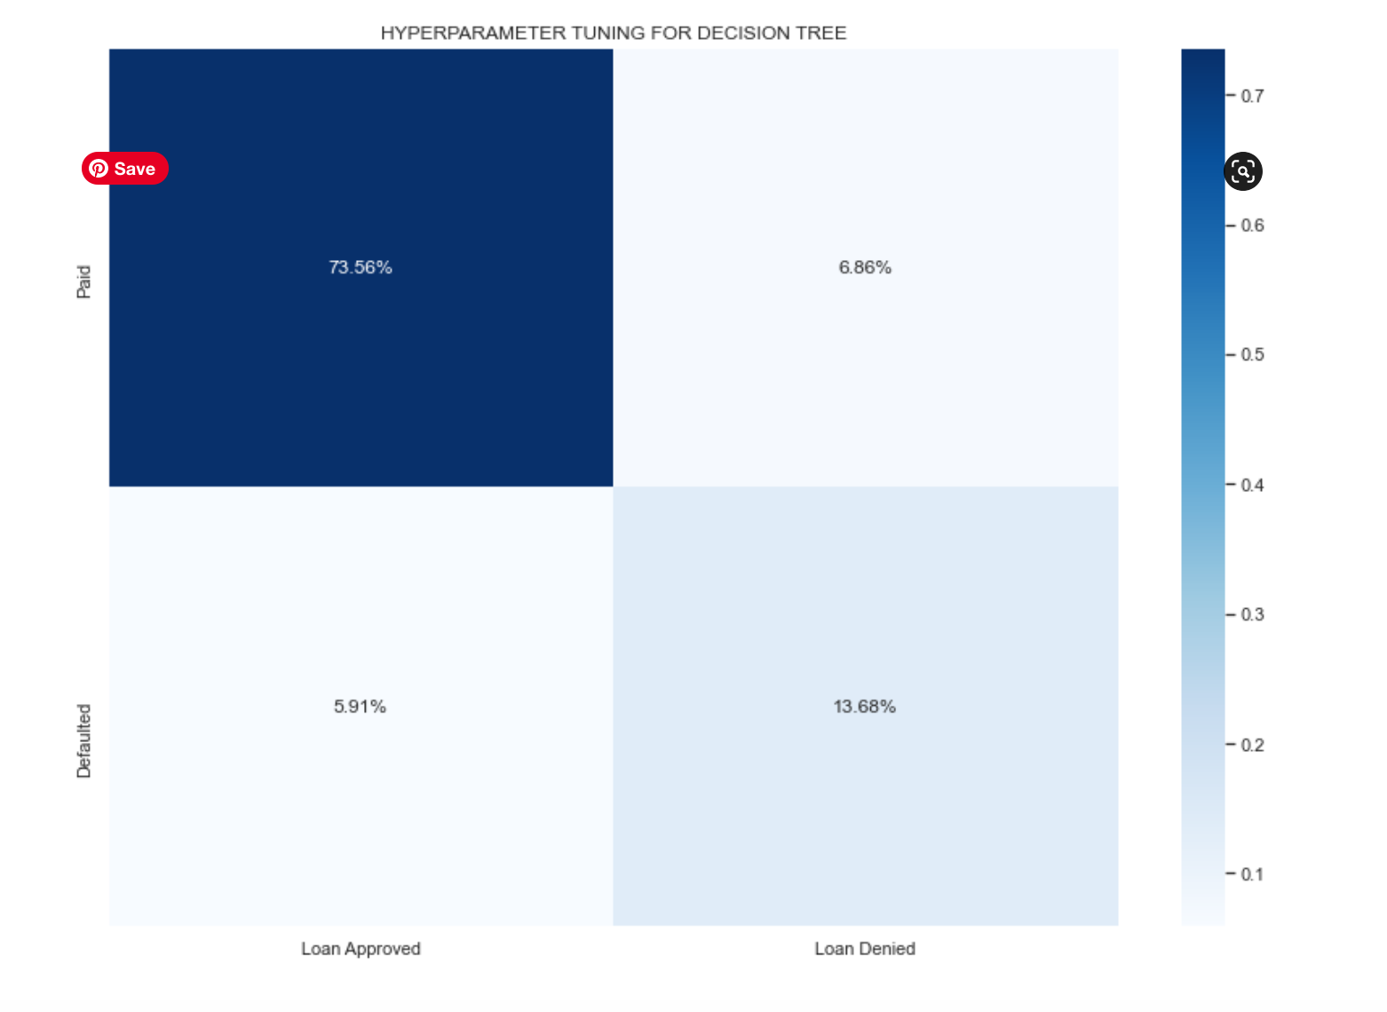

Slide 9
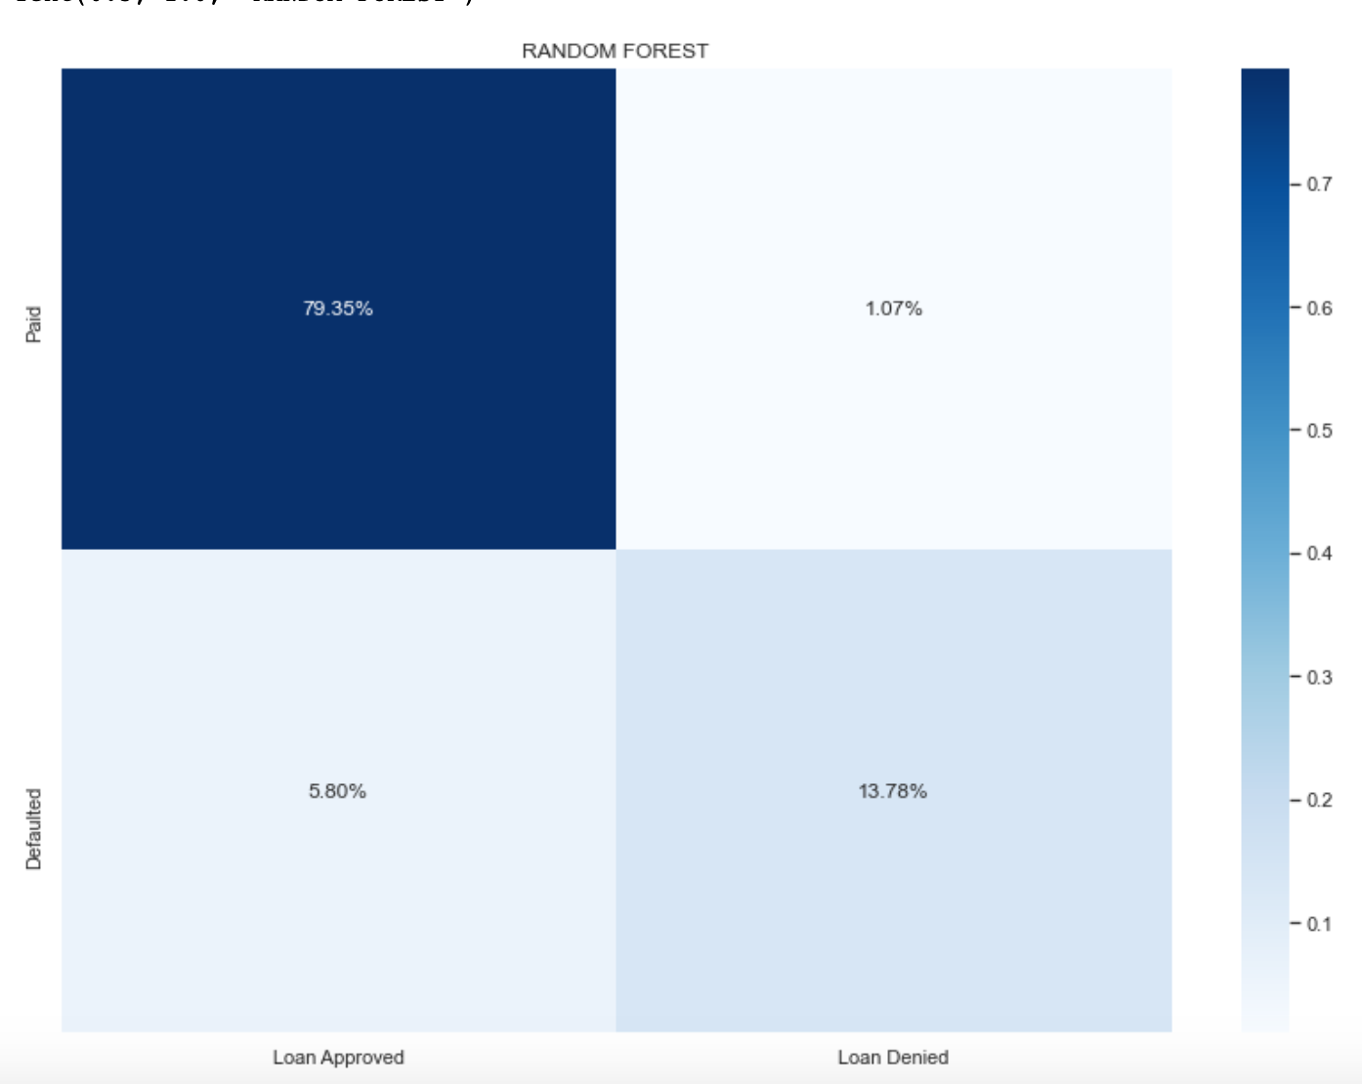

Slide 10


Slide 11


