Slide 1
Do trabeculae keep the heart from sticking?
Thomas Chia
Notes:
Opening: textbooks sometimes say the trabeculae carneae stop the ventricular walls from sticking together by suction. This talk asks whether that claim survives being written as physics, and tests it at three levels of fidelity.

Slide 2
problem setup
The textbook claim: trabeculae keep the ventricle walls from sticking together, the way a suction cup sticks to glass. As far as we can find, nobody has actually tested it.
SMOOTH DISK, RADIUS R, GAP H
Δp ≈ 3μR²ḣ / h³
At end systole the walls near the apex come within a fraction of a millimetre of each other. In early diastole they have to separate, and blood, a viscous fluid, has to flow sideways into that thin gap.
Δp is the suction needed to open the gap, μ the blood viscosity and ḣ the opening speed.
μ = 3.5 mPa·s, R = 10 mm, ḣ = 5 cm/s:
h = 0.5 mm gives about 3 mmHg
h = 0.2 mm gives about 49 mmHg
Physically this is a squeeze film (Stefan adhesion), the reason two wet glass slides are hard to pull apart. The pressure needed grows with the inverse cube of the gap, so halving the gap makes opening eight times harder.
For scale, early diastole only has about 2.5 mmHg available to pull blood toward the apex.
Hypothesis: the grooves between trabeculae act as drainage channels, so blood only travels a short distance across each ridge instead of across the whole wall.
2
Notes:
Restate the textbook claim as a mechanism. The h to the minus three dependence is the whole story: a smooth wall that empties to a few tenths of a millimetre would need tens of mmHg to reopen at physiological speeds, far above the early diastolic driving gradient of about 2.5 mmHg.

Slide 3
Prior work never tests the suction role
Study | What was modelled | Walls near apposition?
Kulp et al. 2011, MICCAI | CT driven LV flow around trabeculae, visualisation | No
Lantz et al. 2016, J Biomech Eng | Patient CFD with papillary muscles and trabeculae | No
Paun et al. 2017, IJNMBE | Ellipsoid geometry: trabeculae and stroke volume, no flow | No
Sacco et al. 2018, Front Physiol | Rigid wall LV CFD, detailed vs smoothed endocardium | No (rigid walls)
Vedula 2017; Lee 2018; Battista 2018 | Embryonic flow and how trabeculae form | No
Meyer et al. 2020, Nature | Trabecular complexity, genetics and performance | No film model
Across PubMed, only 18 records pair trabeculae with CFD or intraventricular flow in the left ventricle. They study rigid or wide open cavities, or how trabeculae form in the embryo. None models the thin film between walls that are nearly touching, which is exactly where the suction claim would apply.
3 · PubMed searches, October 2026; full references on the last slide
Notes:
The simulation literature on trabeculae is small and recent. It looks at pressure drop, shear and vortices in rigid or open cavities, or at embryonic morphogenesis. Nobody has modelled the near contact regime where the suction claim would apply, so there is no prior quantitative test to build on.

Slide 4
Three tiers of fidelity
TIER 1
TIER 2
TIER 3
Lubrication film
2D ventricle
3D apposed walls
Do grooves matter at all?
Does the benefit survive inside a beating ventricle?
Does it hold in 3D, with walls pulled apart by recoil?
A lubrication model of the thin blood film between two walls pulling apart, comparing a smooth wall with grooved and branching (fractal) surfaces.
A 2D flow simulation through whole heartbeats, with valves, filling and washout, comparing a trabeculated ventricle with two smooth controls.
A fully resolved 3D patch of nearly touching wall, then a simple model calibrated against it to reach realistic gaps.
Each tier is first checked against problems with known exact answers, and each one picks up the question the previous tier could not answer.
4
Notes:
Tier 1 asks whether grooves matter at all. Tier 2 asks whether the benefit survives inside a whole ventricle, with washout and filling. Tier 3 asks whether the mechanism holds in 3D, with inertia, and when the walls are opened by a recoil stress rather than forced.

Slide 5
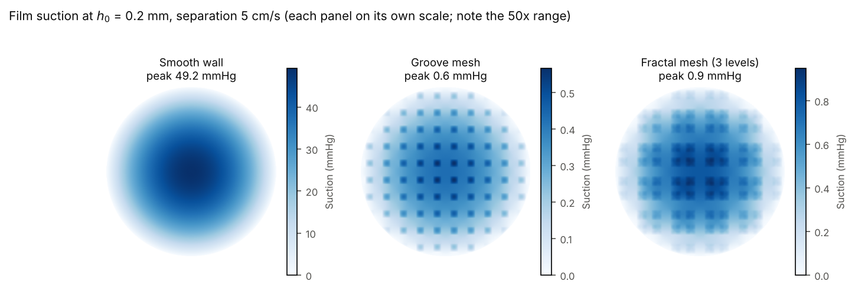
Tier 1: the film between apposed walls
We solve the Reynolds lubrication equation, the standard model for a thin viscous film, ∇·(h³∇p / 12μ) = ḣ, over a 10 mm patch of apposed wall, with zero pressure at the rim where the film meets the open cavity. Each map shows the suction in the film at a 0.2 mm gap and the same opening speed: smooth wall 49 mmHg, groove mesh 0.6 mmHg, fractal mesh 0.9 mmHg.
5 · Each panel on its own colour scale; grooves deeper than they are wide are treated as rectangular ducts; verified against the exact Stefan solution to under 1%
Notes:
Same opening speed, same 0.2 mm crest gap. The smooth wall builds a single bowl of suction peaking near 49 mmHg. The groove network breaks the film into small islands, each drained by the grooves around it, so the peak falls to well under 1 mmHg.

Slide 6
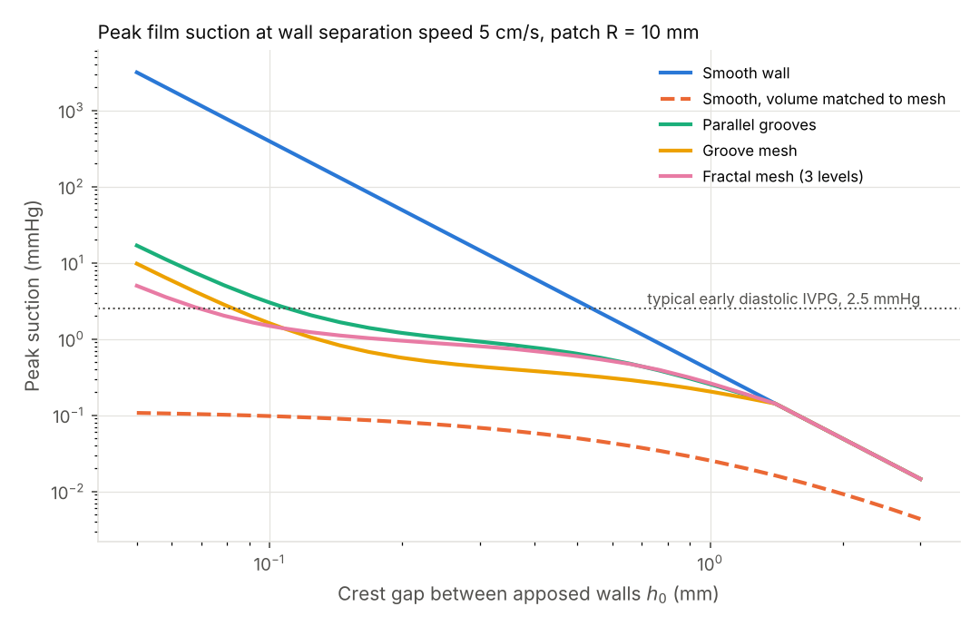
A smooth wall would stick, but only at small gaps
Each curve is the peak suction needed to pull the walls apart at 5 cm/s, against the crest gap, the distance between the tips of opposing walls.
Smooth wall: 3 mmHg at 0.5 mm, 49 mmHg at 0.2 mm, 394 mmHg at 0.1 mm. Early diastole only supplies about 2.5 mmHg.
Grooved walls cut that force 45 to 530 fold, holding suction near 1 mmHg.
Takeaway: suction only matters below about half a millimetre, and there grooves make all the difference.
6 · Separation speed 5 cm/s, patch radius 10 mm
Notes:
The crossover with the early diastolic gradient sits near half a millimetre. Below that a smooth wall needs more than the available driving pressure; trabecular grooving keeps the film at or below about 1 mmHg down to 0.2 mm.

Slide 7
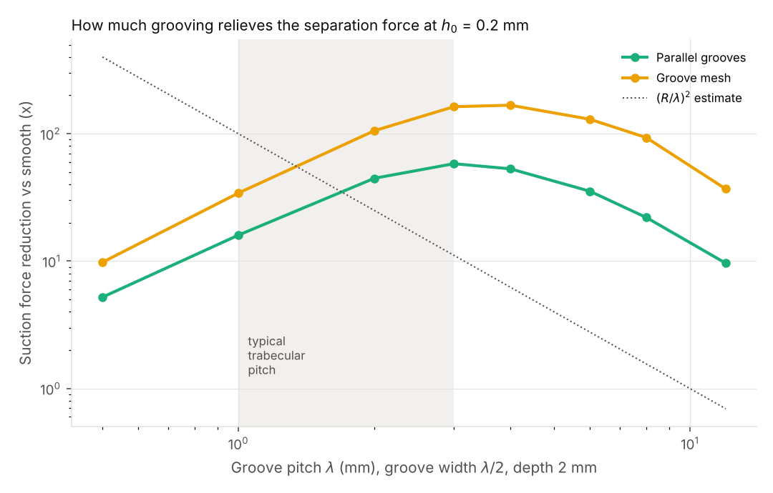
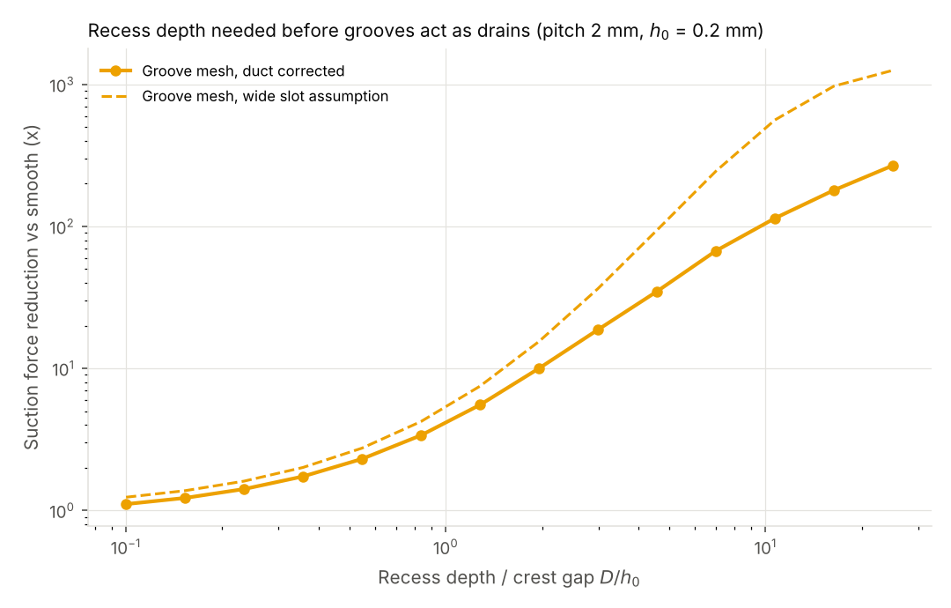
Groove spacing and depth both matter
Left: relief versus pitch, the spacing between grooves. Relief peaks at 3 to 4 mm (about 165 fold), and real trabeculae, spaced 1 to 3 mm apart, sit on the rising side of that peak. Grooves that are too coarse leave large islands of film; grooves that are too fine become narrow ducts that cannot carry the flow. Right: relief versus recess depth. A groove only drains once it is several gaps deep, about five gaps for a thirty fold relief.
7 · Crest gap 0.2 mm, 2 mm deep recesses
Notes:
Coarse grooves leave large islands of film; very fine grooves become narrow ducts that cannot carry the inflow. Depth matters more than roughness: a groove needs to be about five gaps deep for a thirty fold relief.

Slide 8
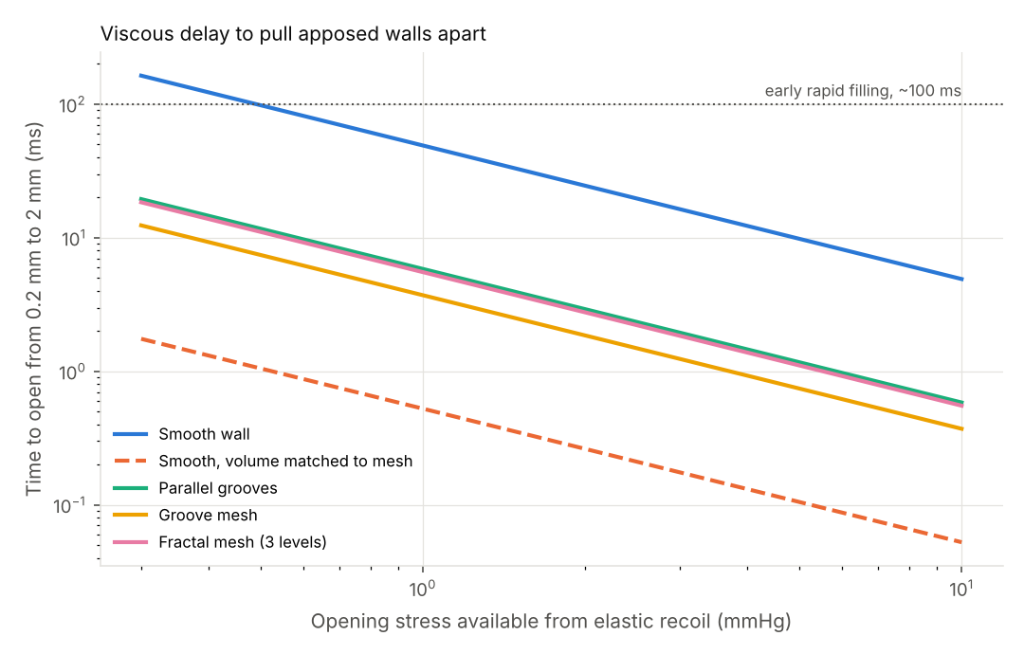
The caveat that set up Tier 2
Each curve is the time for the walls to open from 0.2 mm to 2 mm under a steady opening stress.
At 1 mmHg a smooth wall needs about 49 ms; grooved walls only 4 to 6 ms.
The catch: a smooth wall that simply empties less, so the cavity holds the same blood as the trabeculated one (the volume matched control), opens faster than any grooved surface.
So the real question is whether grooves beat emptying less. That needs a whole beating ventricle, which is Tier 2.
8 · Quasi static Tier 1 estimate, no wall or fluid inertia
Notes:
The volume matched control reframes the hypothesis: trabeculae are not the most volume efficient way to avoid suction. What they might do is let the crests come into near contact while keeping drainage open. Whether that beats simply emptying less needs filling and washout, which only a whole ventricle can answer.

Slide 9
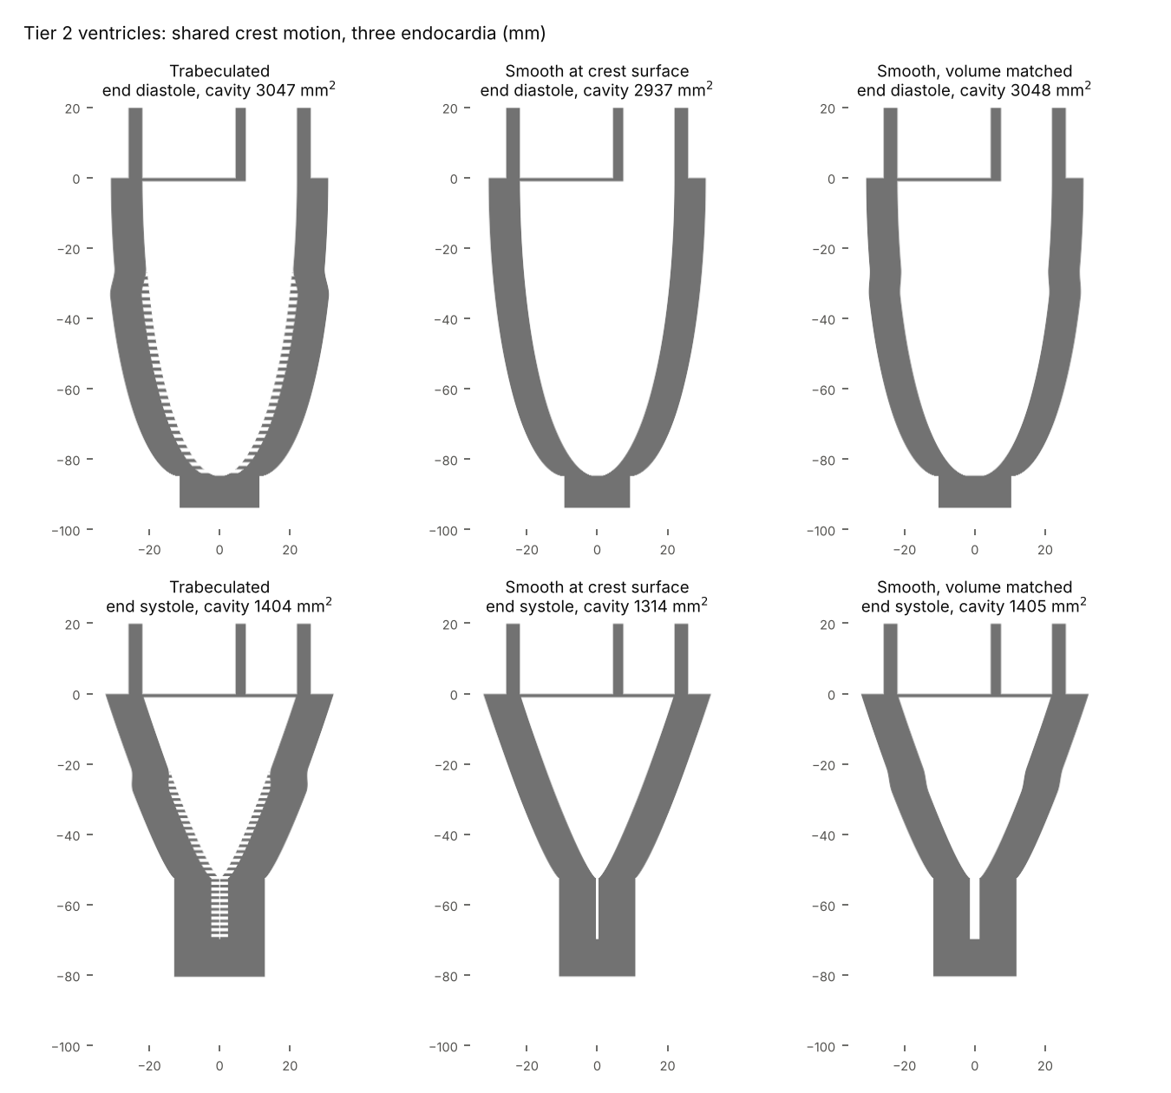
Tier 2: a ventricle through a full cardiac cycle
A 2D slice through the long axis of the left ventricle, run for three 0.8 s heartbeats on a 0.25 mm grid, with the mitral and aortic valves opening on schedule.
The wall motion is prescribed, not computed: the apical quarter squeezes down to a thin slit at end systole.
Three versions share the same crest motion. Trabeculated: ridges with recesses between them. Smooth at crest: a smooth wall where the trabecular tips are, so it empties further. Smooth, volume matched: a smooth wall placed so the cavity holds the same blood as the trabeculated one.
Gaps thinner than 0.75 mm are too small for the grid, so the Tier 1 film model handles them as a subgrid closure.
9 · Pseudo spectral Navier Stokes with Brinkman penalized walls; myocardial area conserved
Notes:
The volume matched control has the same end diastolic and end systolic cavity areas as the trabeculated ventricle, so it isolates the effect of the recesses from the effect of emptying further.

Slide 10
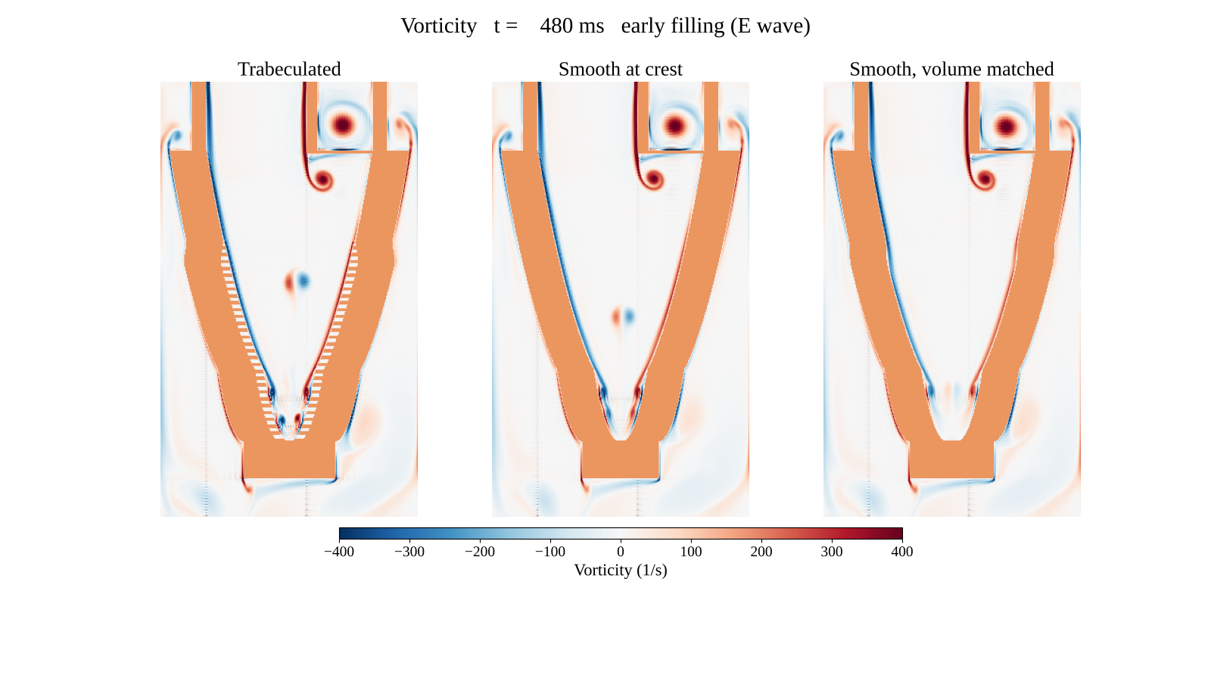
Simulation: one cardiac cycle in three ventricles
Colour shows vorticity, how fast the blood is spinning: red one way, blue the other.
Watch the mitral jet roll up into a vortex that travels toward the apex during filling, and the small vortices that peel off the apical slit as it reopens.
In the trabeculated ventricle the ridges break up the layer of blood along the wall.
10 · Vorticity, 0.25 mm grid; phase of the cycle shown at the top of each frame
Notes:
Point out three things as it plays: the shear layers on the walls during ejection, the vortex ring shed by the mitral jet in early filling, and the small vortices that peel off the apical slit as it reopens. In the trabeculated ventricle the ridges break up the near wall layer.

Slide 11
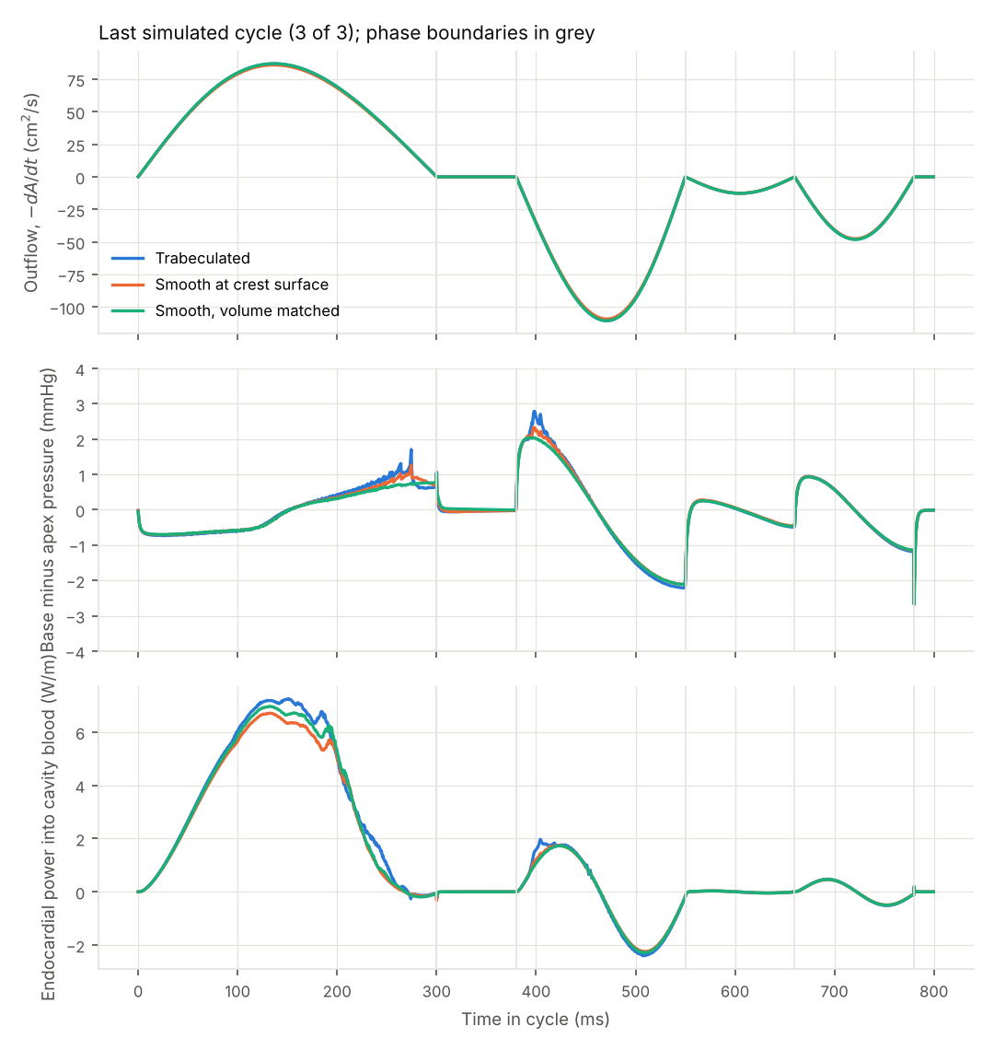
Trabeculae trade a little energy for better washout
Third cycle | Trabeculated | Smooth crest | Smooth vol.
E wave gradient, mmHg | 2.8 | 2.3 | 2.0
Dissipation, mJ/m | 27.2 | 22.0 | 16.6
Diastolic work, mJ/m | −34.7 | −33.2 | −37.4
Film, 0.2 mm gap, mmHg | 0.21 | 6.3 | 0.016
Blood left after 3 beats | 17.2% | 17.3% | 20.7%
The E wave gradient is the base to apex pressure difference that pulls blood in during early filling; 2 to 3 mmHg emerges from the flow on its own. Dissipation is energy lost to friction in the blood.
Versus smooth crest: the same washout, but trabeculae remove a 6 mmHg film penalty. Versus volume matched: about 8% more filling energy, but about 17% less old blood left after three beats.
11 · Energies per metre of depth because the model is 2D; more negative diastolic work means cheaper filling
Notes:
Against the smooth wall that empties to the same gap, trabeculae remove a 6 to 36 mmHg film penalty with identical washout. Against the volume matched wall, they cost about 8 percent more diastolic energy and more dissipation, but leave about 17 percent less old blood after three beats.

Slide 12
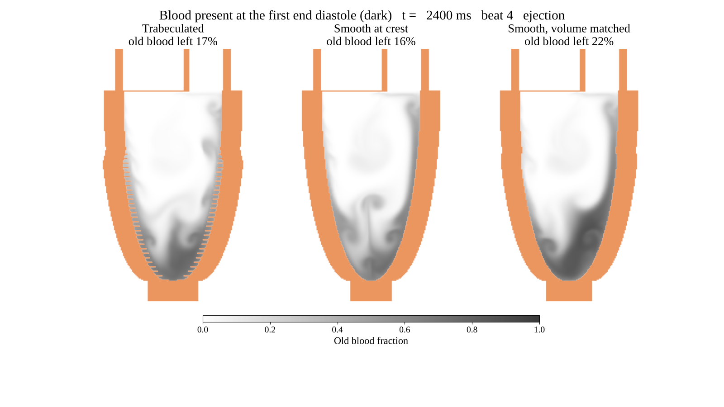
Simulation: washing out the old blood over three beats
Dark shading marks the blood that was in the ventricle at the first end diastole. Each beat ejects some of it and fresh blood from the mitral valve replaces it.
Old blood lingers at the apex in all three ventricles.
The ridges stir the layer next to the wall, so after three beats 17.2% of the old blood remains with trabeculae, versus 20.7% in the volume matched smooth ventricle.
12 · The video uses a coarser 0.5 mm grid; the quoted percentages are from the production 0.25 mm runs
Notes:
The old blood lingers at the apex in all three. The trabecular ridges stir the near wall layer, so the recesses hold less old blood at end diastole than the smooth control’s equivalent layer, even though flow inside them is slower. The video uses the coarser grid; the quoted numbers are from the production 0.25 mm runs.

Slide 13
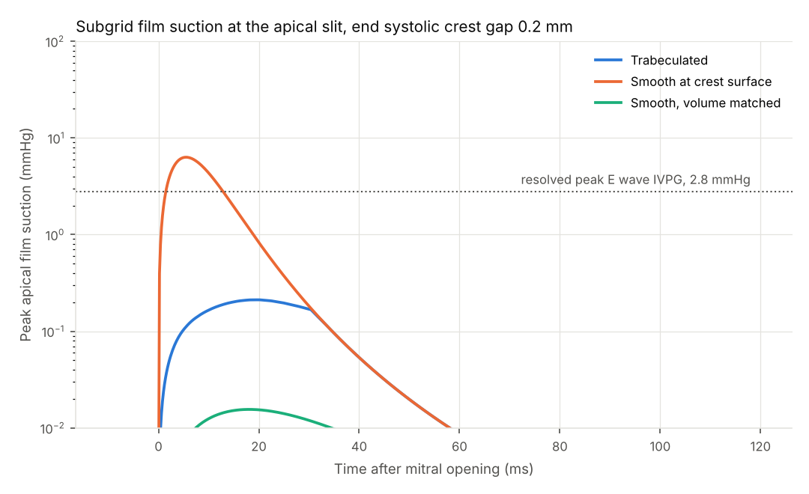
Under forced motion, the smooth apex does a lot worse
Here the walls are forced to follow the Tier 2 motion, and we ask how much suction the thin apical film generates as the apex reopens.
Smooth at crest: 6.3 mmHg about 6 ms after the mitral valve opens, more than twice the 2.5 mmHg gradient that drives filling.
At a 0.1 mm gap this climbs to 36 mmHg and eats about a fifth of the energy spent on filling.
Trabeculated: about 0.2 mmHg at every gap we tried.
13 · One way closure on Tier 2 kinematics; Tier 3 revisits it with pressure driven walls
Notes:
This closure assumes the walls follow the prescribed motion no matter what the film does. Tier 3 removes that assumption and finds the smooth apex cannot actually keep up.

Slide 14
Tier 3: the apex in 3D, with walls that push back
Resolved 3D patch
Reduced model
Two 12 mm walls nearly touching in open blood, on a 0.1 mm grid. One wall is smooth or carries a connected mesh of grooves, 2 mm apart and 1.5 mm deep.
F = −C(h) ḣ (r₀ + κ Re) − Mₐ(h) ḧ
C(h) is the viscous film resistance from Tier 1. Mₐ(h) is the added mass, the blood the walls must drag along as they move. κ Re corrects for fluid inertia and is fitted to the 3D runs.
The walls are either opened at a set speed (8 to 80 mm/s), or given the mass of real myocardium and pulled apart by a recoil stress while the blood pushes back on them (two way coupling).
This cheap model can then run at 0.1 to 0.5 mm gaps, too thin for any 3D grid here.
Two solver fixes came first: the walls had been moving 12% too slowly, and the effective wall surface sat up to 0.85 cells off; both are now within 0.1 cell.
14 · Re is the squeeze Reynolds number, inertia relative to viscosity in the film; a CT derived 3D ventricle would need trabecular resolution imaging and HPC
Notes:
Before the fixes, the effective wall sat up to 0.85 cells off the surface, which alone was worth a factor of two in film force because force scales as h to the minus three.

Slide 15
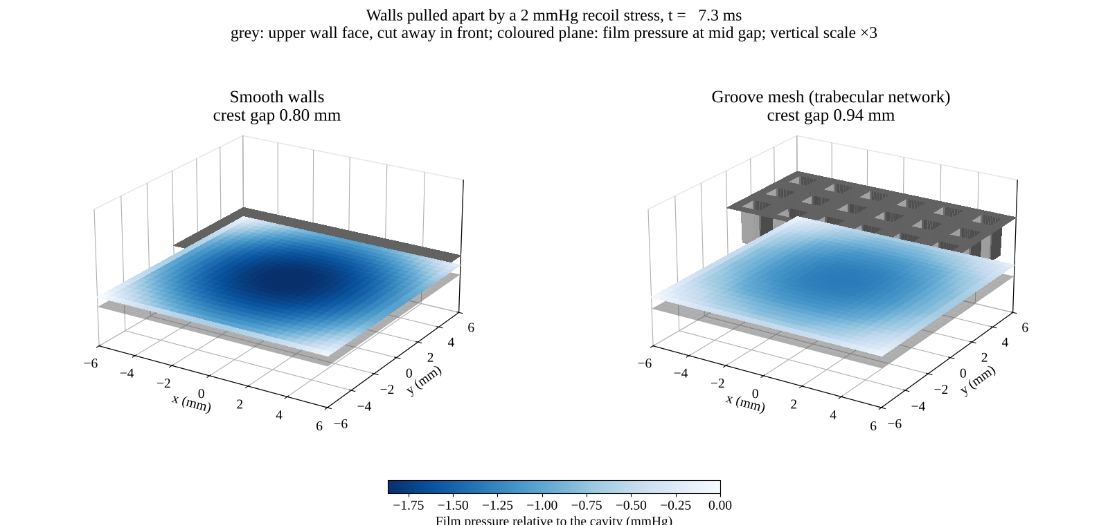
3D simulation: apposed walls pulled apart
Both walls start 0.6 mm apart and are pulled by the same 2 mmHg recoil. The coloured plane is the pressure in the film halfway between them.
Smooth wall: a deep bowl of suction spreads across the whole patch and holds the walls back.
Grooved wall: the groove network breaks the film into small islands, so suction stays weak and the walls separate sooner.
15 · Two way coupled 3D run, 0.1 mm grid; upper wall cut away in front to show the film
Notes:
Both walls start 0.6 mm apart and are pulled by the same 2 mmHg recoil. The smooth film develops a deep bowl of suction across the whole patch and holds the walls back; the groove network breaks the film into islands and lets them separate sooner.

Slide 16
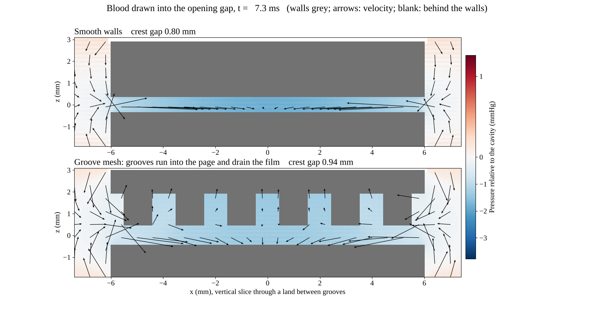
3D simulation: how the grooves drain the film
A vertical cut through the gap as the walls open. Colour is pressure; arrows show where the blood flows.
Smooth wall: blood travels all the way in from the rim, so strong suction builds in the middle.
Grooved wall: blood arrives through the grooves and only spreads across the short flat lands between them.
In 3D the grooves form a connected network open to the cavity, which a 2D slice like Tier 2 cannot show.
16 · Vertical slice through a land, 0.1 mm grid
Notes:
This is the 3D answer to the Tier 2 artifact. In the 2D ventricle, opposing ridges dammed the apical slit. In 3D the grooves form a connected network open to the cavity, so the film drains along them.

Slide 17
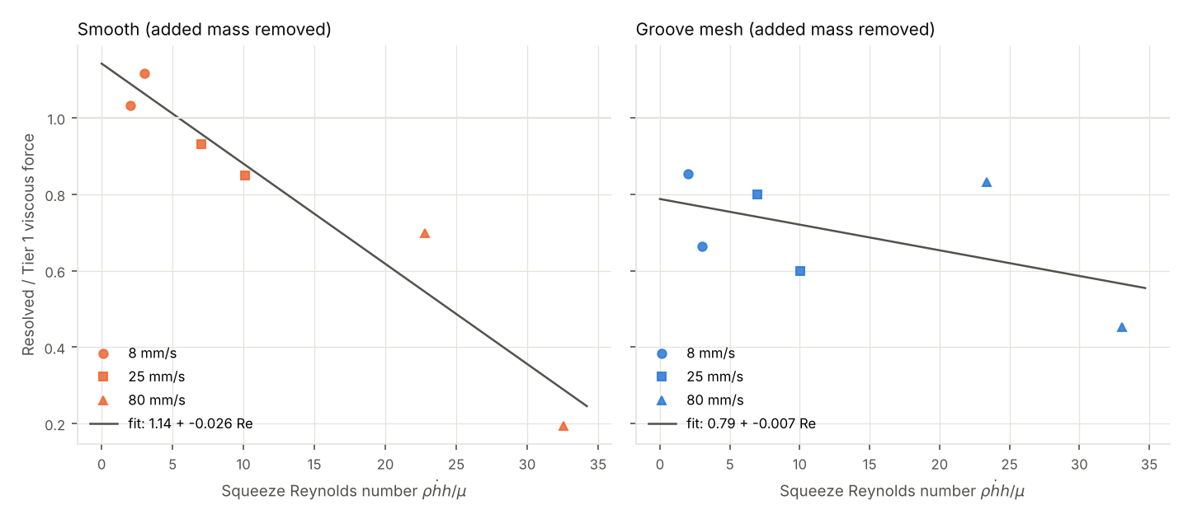
Checking Tier 1 against the full 3D simulation
Each point is the film force from the 3D simulation divided by the Tier 1 prediction, against the squeeze Reynolds number Re; a ratio of 1 means Tier 1 is exact. Smooth wall: 1.14 − 0.026 Re, so Tier 1 is right to within about 7%, and inertia slightly lowers the suction rather than raising it. Groove mesh: 0.79 − 0.007 Re, so the real 3D network drains about 20% better than Tier 1 assumed.
17 · Added mass removed; ratios change under 5% between 0.2, 0.15 and 0.1 mm grids
Notes:
Two takeaways. Tier 1 is right for a smooth wall at low Reynolds number, and inertia then cuts the suction rather than adding to it. And in 3D the trabecular recesses drain; the dammed slit seen in the 2D Tier 2 slice is an artifact of the slice.

Slide 18
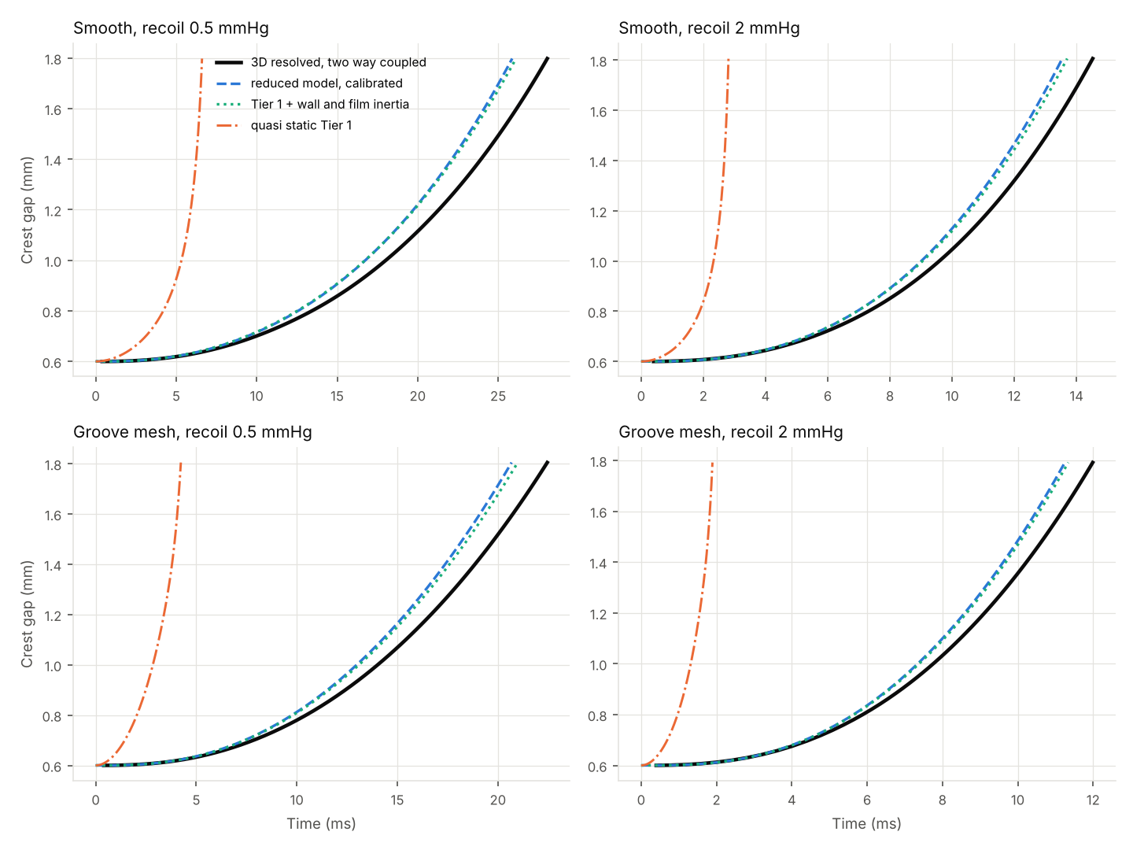
When recoil pulls the walls, inertia sets the clock
Nothing is prescribed here: a recoil stress pulls walls with the mass of real myocardium, and the film pushes back.
Solid black is the full 3D simulation, dashed blue our reduced model, and dash dot orange Tier 1 on its own.
The reduced model matches the 3D opening within 6 to 8% in all four cases; Tier 1 alone opens 72 to 84% too fast.
Takeaway: the mass of the wall and of the blood it drags along, not viscosity alone, sets the opening time. With the model validated, we can trust it at gaps too thin to simulate.
18 · Recoil 0.5 and 2 mmHg, walls 10.6 kg/m², resolvable gaps 0.6 to 1.8 mm
Notes:
This is the validation that licenses carrying the reduced model to physiological gaps, which no grid here can resolve.

Slide 19
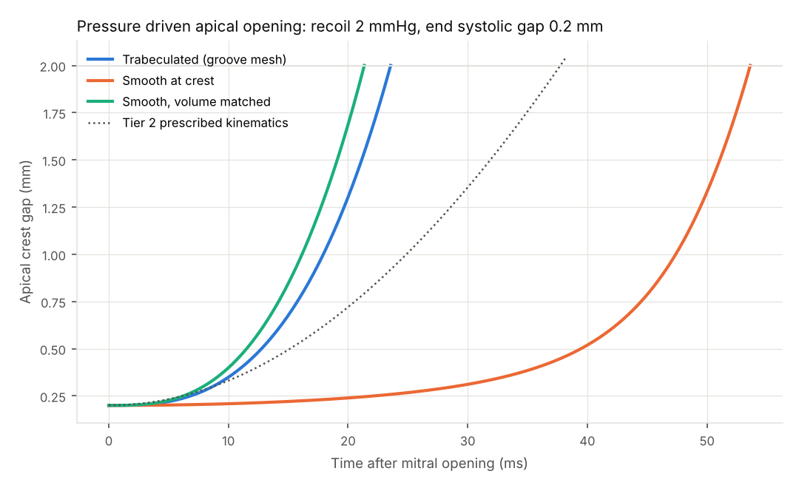
A smooth apex at near contact reopens late
Open to 2 mm, ms | 2 mmHg, 0.2 mm | 1 mmHg, 0.1 mm
Walls only | 17 | 23
Trabeculated | 24 | 32
Smooth, vol. | 21 | 28
Smooth, crest | 54 | 211
Tier 2 assumed | 38 | 39
Time for the apex to open to 2 mm after the mitral valve opens, for two cases of recoil stress and starting gap. Walls only is the fastest possible opening, with no film at all.
The smooth crest apex reopens 8 to 189 ms late, while the trabeculated apex stays within 3 to 9 ms of the walls only limit.
19 · Calibrated reduced model; patch radius 8.75 mm, walls 10.6 kg/m², recoil rising over 20 ms
Notes:
Pressure driven, the smooth wall’s penalty shows up as delay, not just suction. At 2 mmHg and a 0.1 mm gap its apex is still only 0.2 mm open at peak filling. Tier 2’s prescribed motion for that ventricle was physically unreachable; the trabeculated and volume matched walls both open faster than Tier 2 assumed, so their results stand.

Slide 20
WHAT THE THREE TIERS SUPPORT
Trabeculae let the apex empty to near contact and still reopen on time.
The film is real. A smooth wall emptied to a few tenths of a millimetre needs far more pressure to reopen than diastole supplies, and the 3D simulation confirms the Tier 1 numbers.
Grooves drain it. Trabecular recesses work as connected drainage channels that keep the film near 1 mmHg, and in 3D they work even better than Tier 1 predicted.
The cost is delay. Pulled by realistic recoil, a smooth apex at 0.1 to 0.2 mm stays shut tens to hundreds of ms into filling; a trabeculated apex opens nearly on time.
One caveat: a smooth heart that simply empties less also avoids suction. Compared with it, trabeculae cost slightly more energy to fill but wash out old blood better.
20
Notes:
This is the strongest defensible form of the textbook claim. Not “trabeculae prevent suction”, but “trabeculae permit near apposition without adhesion”.

Slide 21
Limitations and next steps
Limits
Next
Tier 2 is a 2D slice with prescribed wall motion.
Let the Tier 2 apex open under recoil instead of on a fixed schedule.
Tier 3 is a 12 mm patch where only one wall is grooved, and the walls are rigid.
Groove both walls, with irregular and tapered recesses like real trabeculae.
Recoil stress and wall mass are order of magnitude estimates, not measurements.
Trabecular resolution imaging (ex vivo MRI, CT) for a 3D ventricle.
The 3D calibration rests on six fits per surface, with 8 to 12% scatter.
Measure how close the apical walls actually come at end systole in vivo.
21
Notes:
The single most important unknown is how close real apical walls come at end systole. Everything hinges on whether that gap falls below about half a millimetre.

Slide 22
References
Meyer et al. Genetic and functional insights into the fractal structure of the heart. Nature 2020. doi:10.1038/s41586-020-2635-8
Sacco et al. LV trabeculations decrease wall shear stress and increase the intraventricular pressure drop in CFD simulations. Front Physiol 2018. doi:10.3389/fphys.2018.00458
Sacco et al. Roles of detailed endocardial structures on right ventricular haemodynamics. Int J Numer Method Biomed Eng 2018. doi:10.1002/cnm.3115
Lantz et al. Patient specific simulation of cardiac blood flow from high resolution CT. J Biomech Eng 2016. doi:10.1115/1.4034652
Kulp et al. Patient specific interactions between trabeculae and blood flow. MICCAI 2011. doi:10.1007/978-3-642-23623-5_59
Paun et al. Relationship between LV size and the amount of trabeculations. Int J Numer Method Biomed Eng 2018. doi:10.1002/cnm.2939
Morud et al. The effect of chordae tendineae on systolic flow. Comput Biol Med 2019. doi:10.1016/j.compbiomed.2019.04.020
Vedula et al. Mechanobiologic forces in zebrafish cardiac development. PLoS Comput Biol 2017. doi:10.1371/journal.pcbi.1005828
Lee et al. Hemodynamic forces initiate cardiac trabeculation. JCI Insight 2018. doi:10.1172/jci.insight.96672
Battista et al. Fluid dynamics in heart development: hematocrit and trabeculation. Math Med Biol 2018. doi:10.1093/imammb/dqx018
Visoiu et al. How the trabecular layer impacts on LV function. J Cardiol 2024. doi:10.1016/j.jjcc.2024.08.008
Petersen et al. Excessive trabeculation of the left ventricle. JACC Cardiovasc Imaging 2023. doi:10.1016/j.jcmg.2022.12.026
22 · Retrieved from PubMed; code and results: github.com/thomas-chia/heart-trabeculae
Notes:
All references were retrieved and checked on PubMed in October 2026.

