Slide 1
HEfinder: Locating homing endonucleases within genome sequences

Slide 2
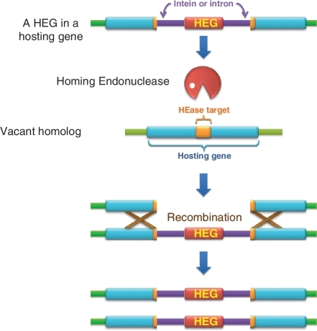
Homing Endonuclease Background
Within inteins and type I introns– confer horizontal mobility
Double stranded cut in HEG− allele on homologous chromosome
DNA repair fills in once vacant allele with HEG (and surrounding intein/intron)

Slide 3
So, Why Should we Care about them?
Found widely In bacteria, archaea, unicellular eukaryotes, eukaryotic cp/mtDNA
Biotech potential- double stranded cut at a specific locus

Slide 4
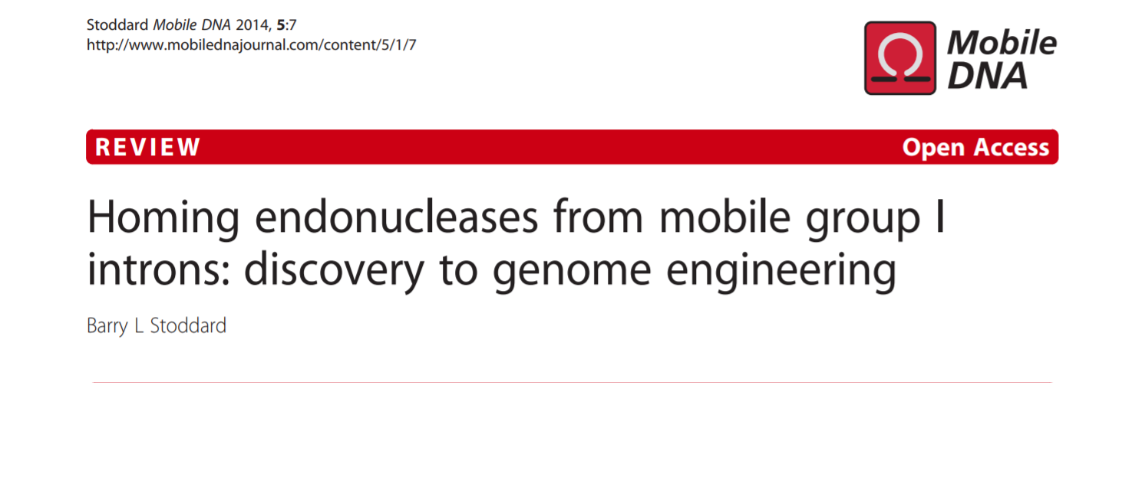
So, Why Should we Care about them?

Slide 5
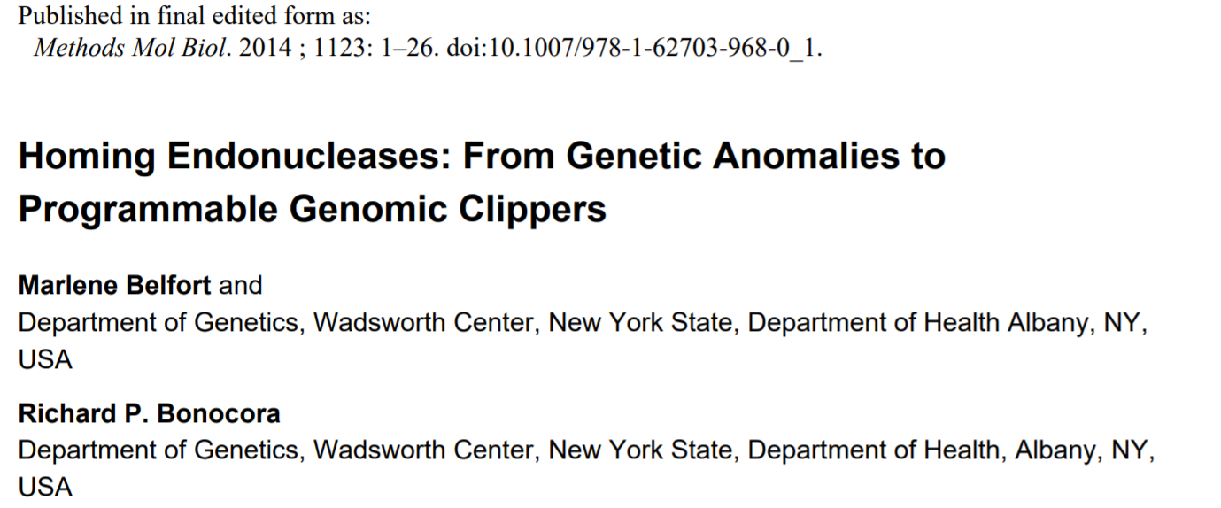
So, Why Should we Care about them?

Slide 6

So, Why Should we Care about them?

Slide 7
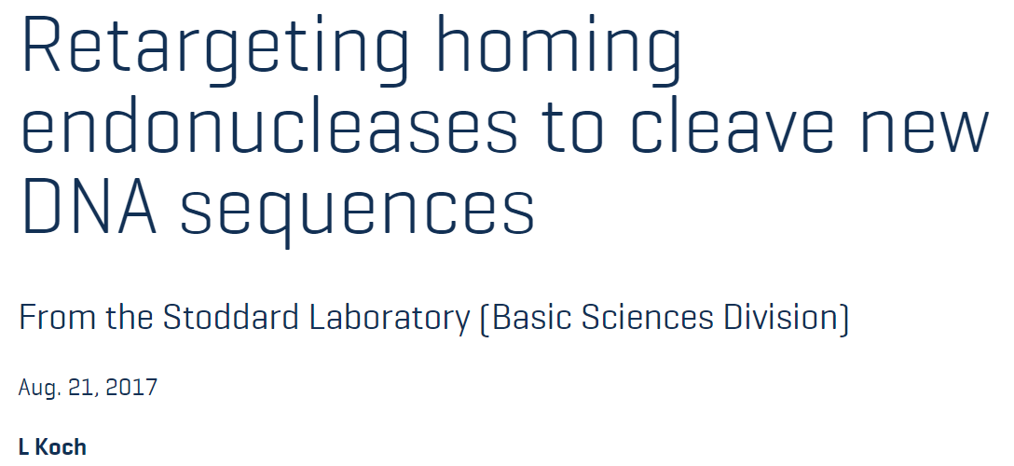
So, Why Should we Care about them?

Slide 8
What We Need:
tool to identify homing endonucleases within a genome sequence input

Slide 9
HEfinder Overview
First step- create representative homing endonuclease database
Major homing endonuclease groups (largest: LAGLIDADG, GIY-YIG, HNH, His-Cys) have little sequence similarity to each other.
We need representatives from each group

Slide 10



Building Our endonuclease database
Create Representative Homing Endonuclease Database
Seed sequences
PSIblast
Database of protein sequences of ~3000 Homing Endonucleases
LAGLIDADG
PSIblast-to-fasta Python Script
GIY-YIG
HIS-CYS
HNH

Slide 11
Input
Python3 script, called from command line
Required parameter:
genome sequence in fasta format
Optional Parameters:
-b Should we use E value or bit score for our significance cutoff (default E value)
-c What is our significance cutoff (default: for e value 1, for bitscore 50)
-o Should we make a multiple sequence file of the sections of the genome that match

Slide 12
General Procedure
Take 6 frame translation of genome query and blast against our homing endonuclease database, imposing a culling limit to reduce repetitiveness (different homing endonucleases mapping to the same place)
Parse data, make file of significant subsequences of genome and visualizations of the significant results

Slide 13
Visualization Output
Example of interactive graph
Also outputs blast table, and table with just significant results

Slide 14
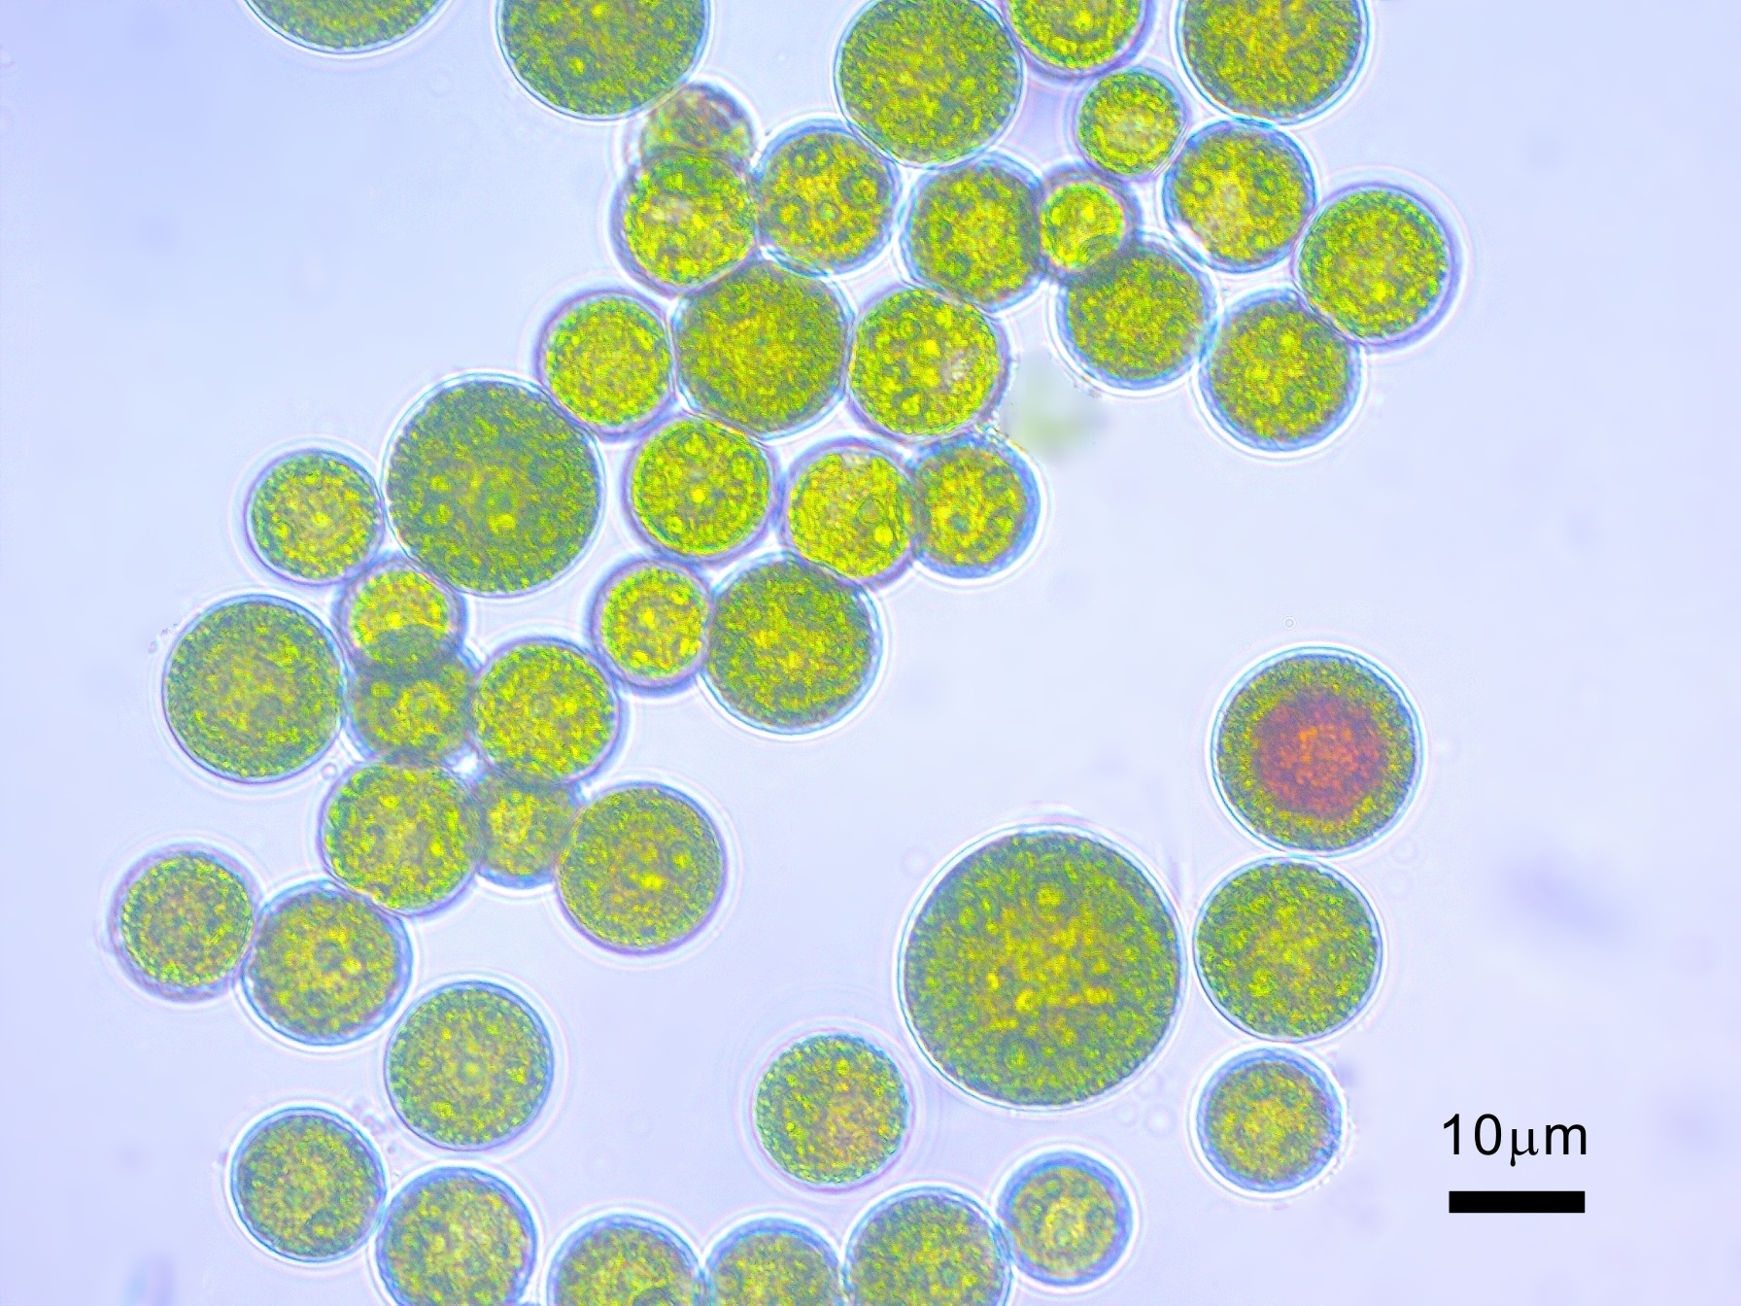
Testing HEfinder
Haematococcus Lacustris chloroplast
Why?
Fully sequenced
Large (1.35 MB)
Lots of annotated homing endonucleases (8 unique)

Slide 15
Testing Methodology
Run Hefinder on defaults against Haematococcus Lacustris chloroplast
Take sections of genome output file that matched homing endonuclease, run a blastx against the non redundant database

Slide 16
Testing Methodology
For now, strict definition of true positive:
true positive: top result from blastx is one of the 8 annotated homing endonucleases
If it doesn’t match one of these 8, we consider it a false positive
Evaluate how well culling limit is removing redundant hits

Slide 17
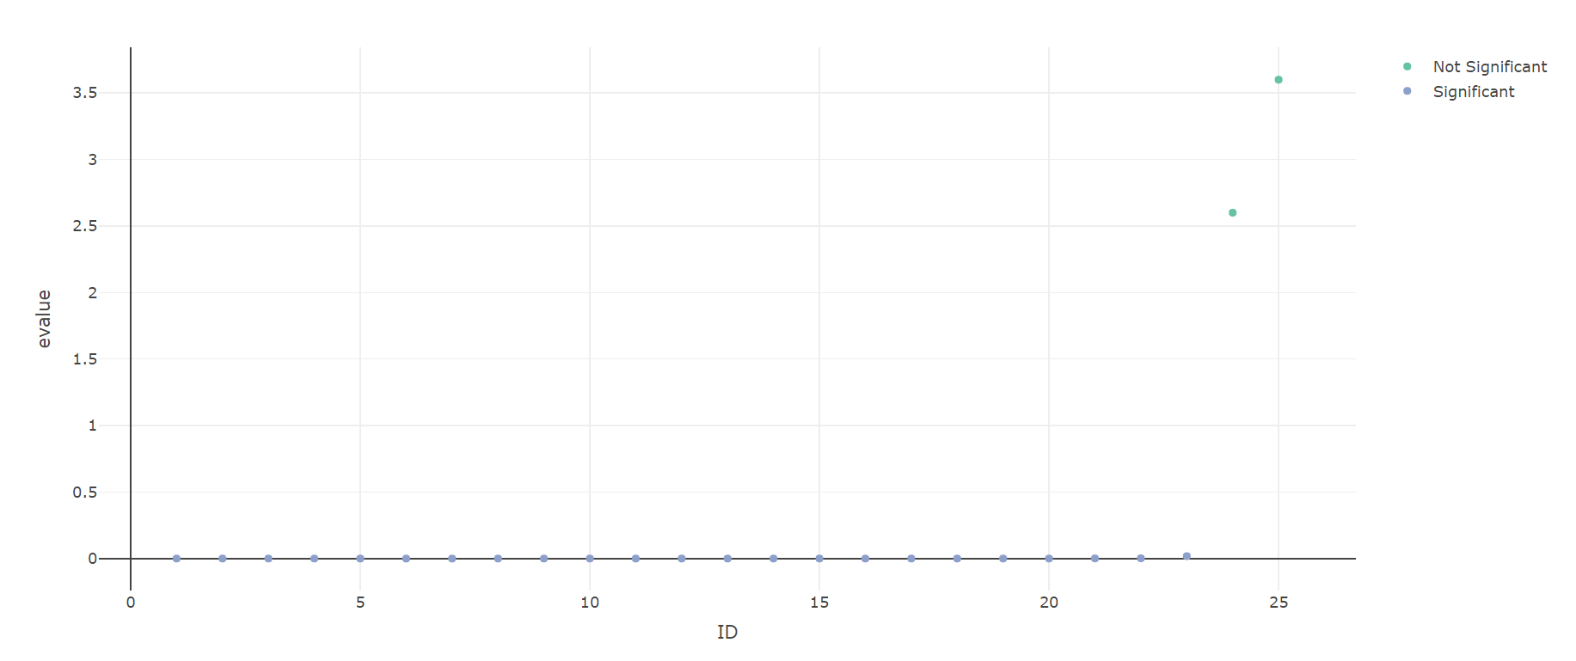
Did we find our 8?
Hits in blue below matched homing endonuclease with E value below our cutoff.

Slide 18
1

Slide 19
1
2

Slide 20
1
2
3

Slide 21
1
2
3
4

Slide 22
1
2
3
4
5

Slide 23
1
2
3
4
5
6

Slide 24
1
2
3
4
5
6
7

Slide 25
1
2
3
4
5
6
7
8

Slide 26
So, what about everybody else?
None are annotated as Homing Endonucleases
Two are found outside of coding regions
Take false positives, Run Blastp (or Blastx for noncoding) against NR database.

Slide 28
matches LAGLIDADG endonuclease
from C. thermophilum, e value of 10^-38
matches putative LAGLIDADG homing endonuclease from S pluvialis Algae, e value of 10^-48
matches HNH endonuclease C nivalis, e value of 3e-16
matches putative HNH endunuclease C. radiata 4e-17
matches HNH endonuclease C nivalis, e value of 1e-30
matches putative reverse transcriptase, intron maturase and HNH endonuclease from B. giganteus algae, e value of 2e-175
matches HNH endonuclease from C. nivalis algae, e value 8e-158

Slide 29
All very significantly match to other homing endonucleases within other algae
None are explicitly labeled as homing endonucleases (HE within protein, or misannotated)
E values of ones found in non coding region tended to be less significant (both approximately 4*10^-4)

Slide 30
What I’m thinking about now
“no examples have been reported of homing endonuclease genes within genomes of [multicellular eukaryotes] .”
-Stoddard, B. L. (2011). Homing endonucleases: From microbial genetic invaders to reagents for targeted DNA modification. Structure.
“HEs are small proteins (< 300 amino acids) found in bacteria, archaea, and in unicellular eukaryotes”
-Belfort, M., & Bonocora, R. P. (2014). Homing endonucleases: From genetic anomalies to programmable genomic clippers. Methods in Molecular Biology, 1123, 1–26
No active HE’s in multicellular Eukaryotic genomes? I find this hard to believe.
We cannot prove activity. But…

Slide 31
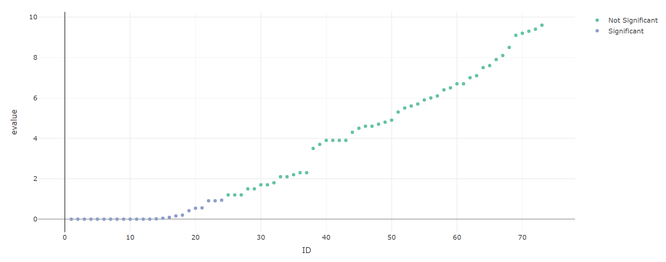
What I’d like to do next
D. Disodium slime mold (near and dear to my heart). has multicellular phase of life
Blastx NR match to HE, E value 1*10^-70

Slide 32
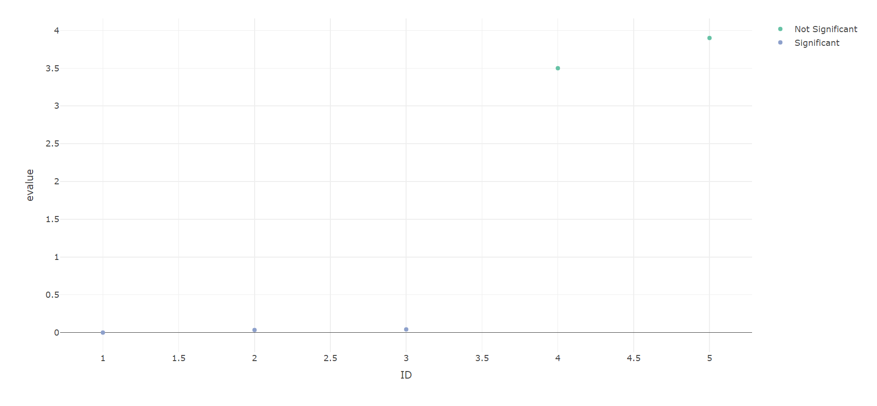
Human chromosome 20
Section of MCM protein. NR blastx matches homing endonuclease from Bolocera tuediae mitochondria, e value 2*10^-14

Slide 33
Conclusions
Hefinder seems to work
Algae chloroplasts are replete with homing endonucleases
While I can’t prove active homing endonucleases in multicellular eukaryotic genomes, there are certainly close homologs to active homing endonucleases in the two organisms I tried (wet lab hypotheses)

