Slide 1
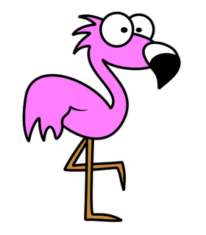
FlappyMingo!
Kyle Williams and Thomas Franceschi

Slide 2

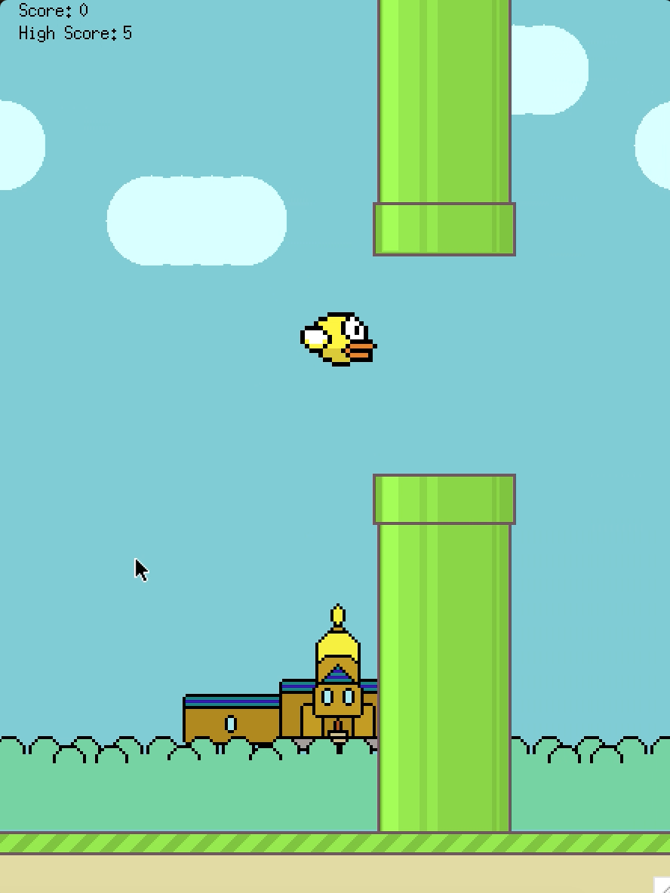
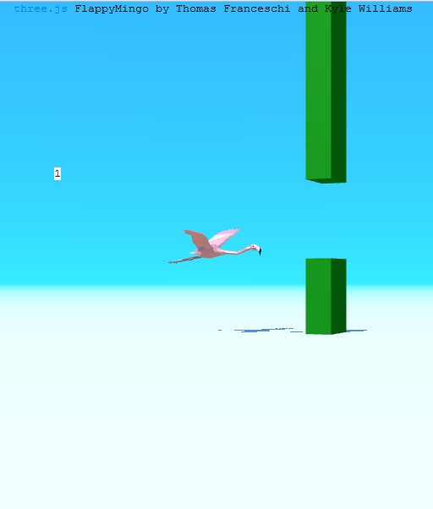
Background
Flappy Bird mobile game
Our C implementation with gfx library
Now a bigger, better implementation in WebGl with three.js

Slide 3

Overview
Adopted three.js code from master folder
Implemented moving blocks, hit detection, game “physics”, and scoring capability
Works best on Firefox

Slide 4

Key Functions
onKeyDown() -> spacebar hit to make the flamingo flap, also hit arrow keys to adjust the directional lighting
jumpFunc() -> simulates bird flap upwards to move through openings in the blocks
movePipes() -> recalutes block x coordinates to simulate movement of bird across the screen
Flamingo model is created in init() function with the four blocks
detectHit() -> returns true if pipe is hit
setScore() -> increments score if user does not hit pipe,
and displays on browser page
Demo...

Slide 5

Summary
Implemented some game functions to turn a three.js model into a representation of a popular mobile game
If we had more time, we could add more fun features:
Color change of bird when reaching certain score
Saving high score
Serving the game on a Raspberry Pi

Slide 6

Questions?

