Slide 1
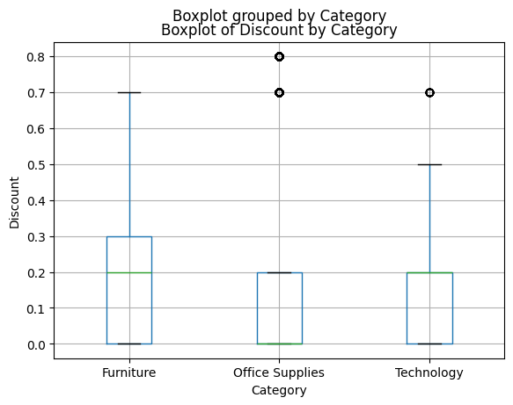
Regional Performance Anomaly Detection — Key Findings
Q1 (Region × Sub-Category margin): no statistical outliers detected — expected, since aggregation smooths extremes.
Q2 (order-level discount): 703 of 9,994 orders (~7%) flagged as unusually high discount vs. their Category norm — concentrated in Office Supplies at 70–80% discount.
Source: Superstore Sales Dataset | Method: IQR-based outlier detection

