Slide 1
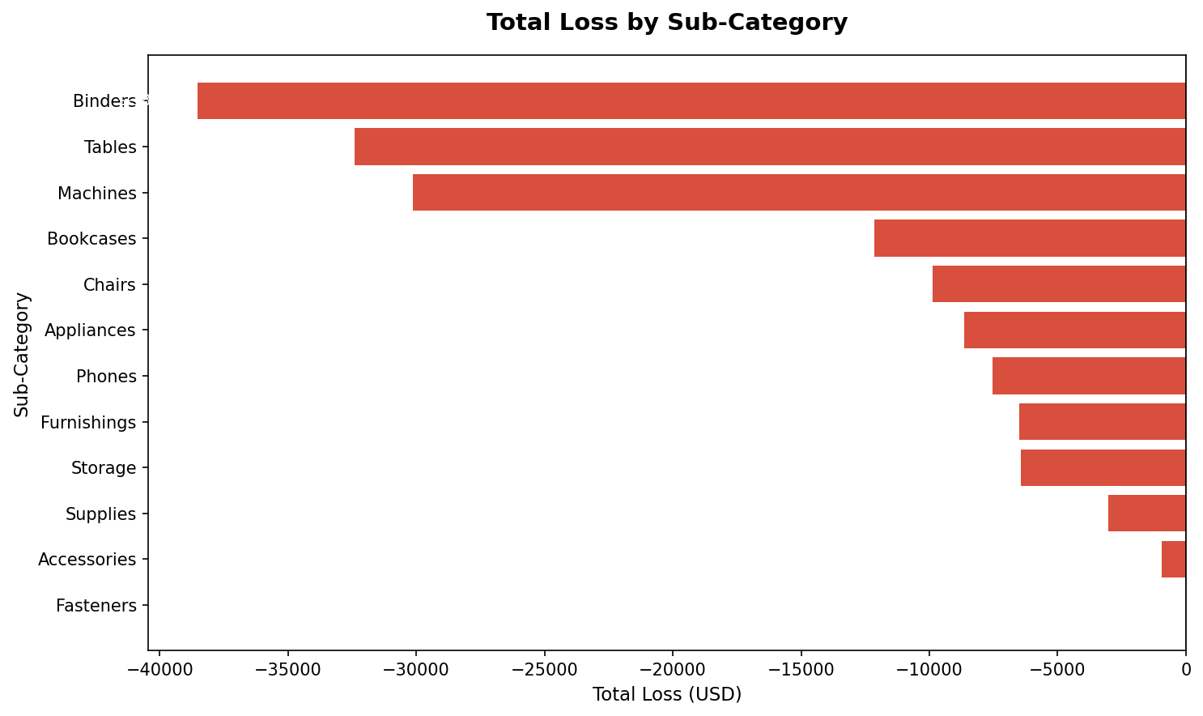
Monthly Loss Report
Source: Superstore Sales Dataset | Loss-making orders only

