Slide 1
Orbital(dd)excitations of undoped cuprates using RIXS
Jinu Thomas

Slide 2
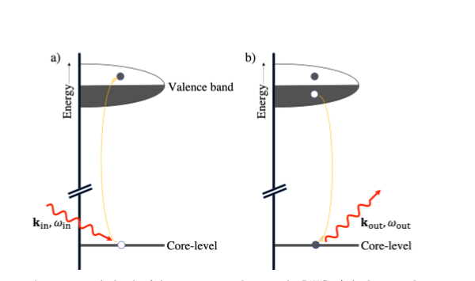
RIXS - Technique
Resonant Inelastic X-Ray Scattering
High energy photons
Resonant if the energy difference coincides core level excitations.

Slide 3

RIXS Cross-Section – Geometrical parameter
2 – Step process
2p states have strong LS coupling but 3d states do not.
Tq is the polarization operator.
Outgoing polarization need to be summed over since it’s not measured.
Dipole Transition is allowed

Slide 4

Dipole Matrix Elements
The matrix elements simplifies to the above equation.
For polarization of light along x, y or z axis these integrals become constants
How long does it take for a grad student to calculate these values?
4 weeks ☹!
2 weeks to realize that symbolic variables are useless in Matlab and switch to matrix operations
1 week to account for spins and realize ‘pi’ should not be used as a variable in matlab
1 week to realize that dΩ = sin(θ)dφdθ and not dφdθ
The entire time to figure out what the prefactor is:

Slide 5
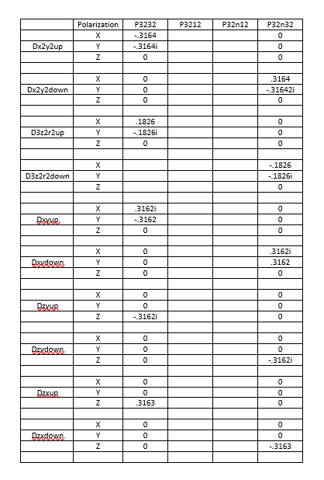
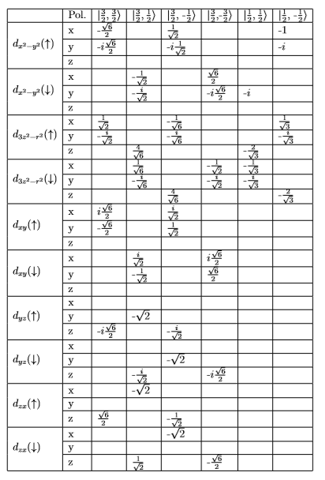
Dipole Matrix Elements – But why are they different?

Slide 6
Dipole Matrix Elements
All Matrix Elements are multiplied by √15

Slide 7
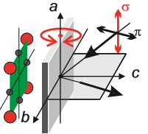
RIXS Cross- Section- Geometry
Incoming polarization is known.
Path of the incoming and outgoing photons are fixed.

Slide 8
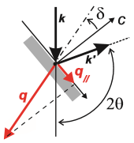
What parameters are controlled? - I
δ for tilting of the material
Rotation w.r.t to z axis.

Slide 9
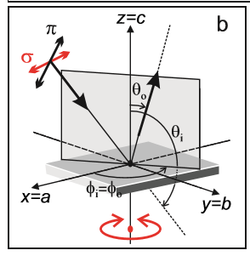
What parameters are controlled? - II
Φ for incident and outgoing rays (but are equal)
Rotation of the material with respect to the x axis.
Currently showing δ=0

Slide 10
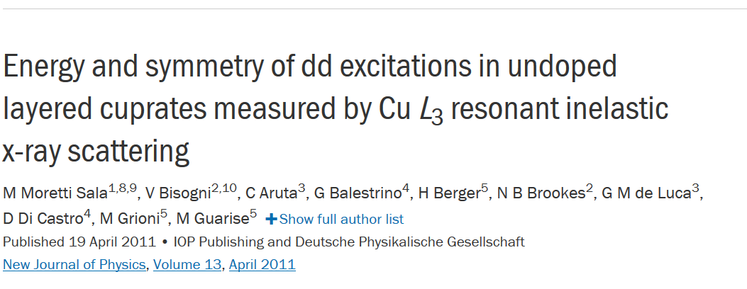
Project – Fall 2019

Slide 11
Motivation
High T_{c} superconductivity in Cuprates
Forming Cooper Pairs
Low Energy Excitaions
Phonon excitations (90 meV)
Spin excitations (300 meV)
Orbital (dd) excitations (~1.5ev)
Symmetry changes of occupied Cu-3d orbitals
No consensus on theoretical and experimental values exist.
Electronic Structure of Cuprates

Slide 12
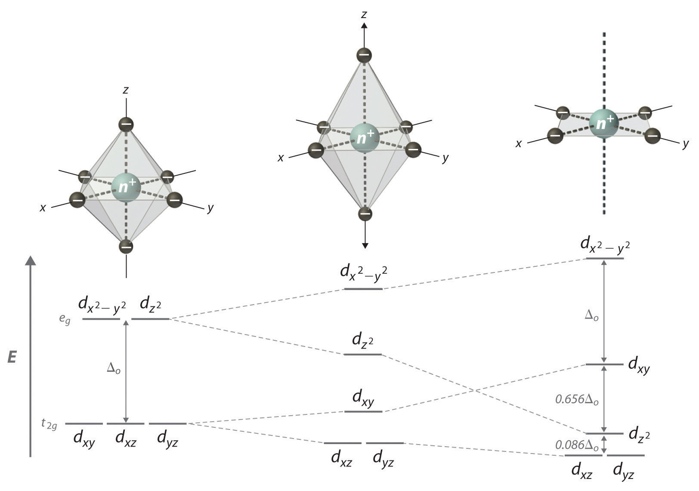
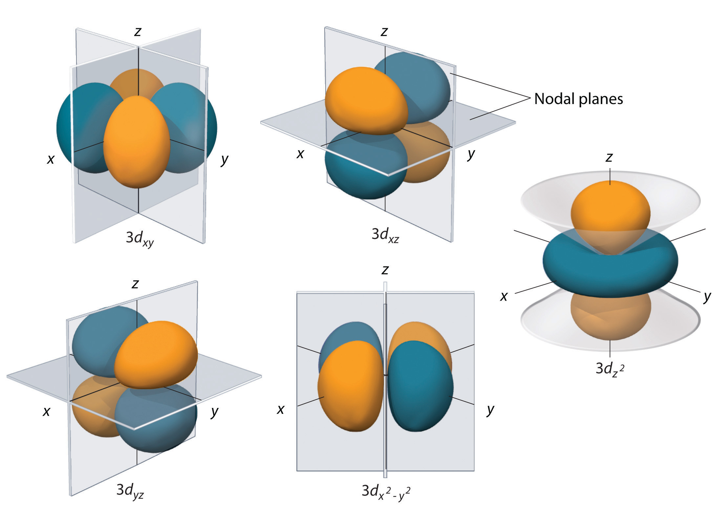
Tetrahedral Distortion to Crystal Structure
Source : LibreTexts on Chemistry

Slide 13
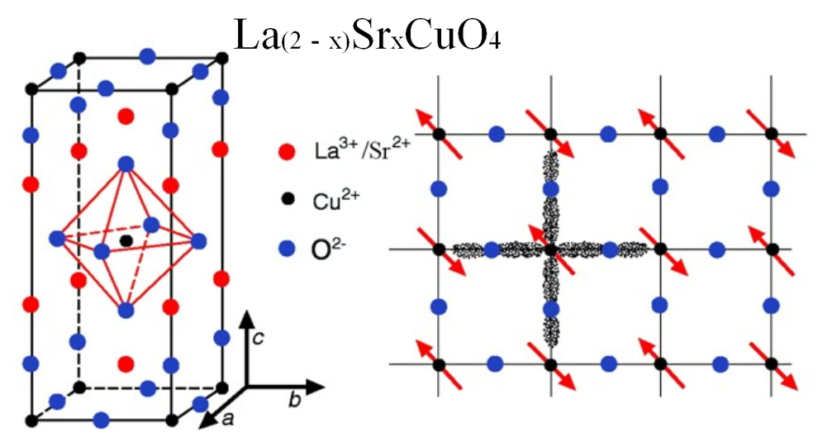
Cuprate Structure
Single Ion Model
Atomic States of Cu²⁺ Ion
3d⁹
Hole Excitation
Source: Presentation High Temperature Superconductivity: D. Orgad Racah Institute, Hebrew University, Jerusalem

Slide 14
RIXS - Technique
Resonant Inelastic X-Ray Scattering
High energy photons
Resonant if the energy difference coincides core level excitations.

Slide 15
RIXS – Theory
Light – Matter interaction.
QED
Low energy approximation of QED
E_{photon} << M_{electron}
E_{system} << Electron-positron pair creation energy
Charge is conserved
Photon interacting with an electron in the presence of an atomic potential

Slide 16

RIXS – Transition Rate
Electron-photon interaction is treated as a perturbation
Initial and Final states are product states

Slide 17
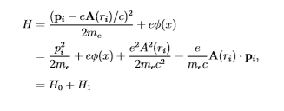


Hamiltonian
Thomson Scattering neglected.

Slide 18


Transition Operator
In the Dipole limit
Wavelength of the radiation >> Atomic Size
r_{i} = R_{i} + r

Slide 19
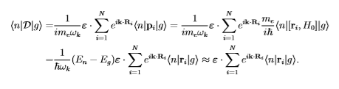

Transition Operator in Real space
Index is dropped because each transition process is localized.

Slide 20


Transition operator with Absorption and Emission

Slide 21

RIXS Cross-section

Slide 22
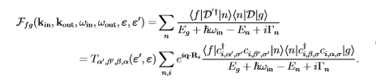

Scattering Amplitude
Atomic Scattering Factor

