Slide 1
An intro to the R tidyverse: dplyr,ggplot2, and some Twitter conference data visualization
Dr. Thomas E. Keller
@tek_keller

Slide 2
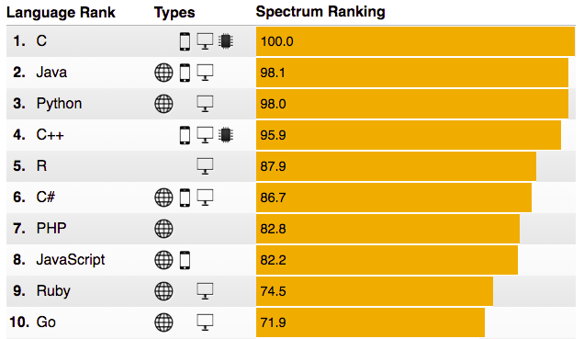
R, bolstered by interest in data-science, has grown

Slide 3
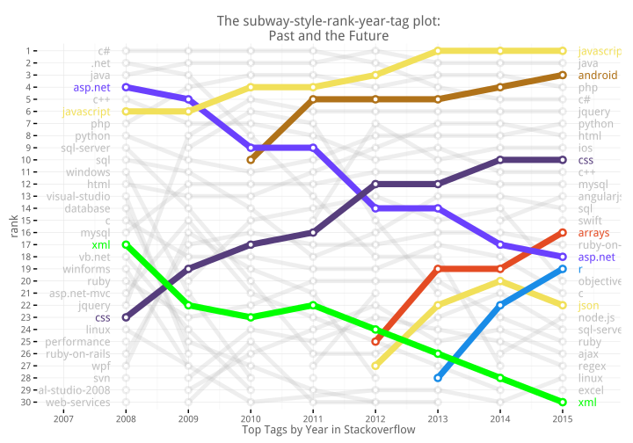
R gets on the subway

Slide 4
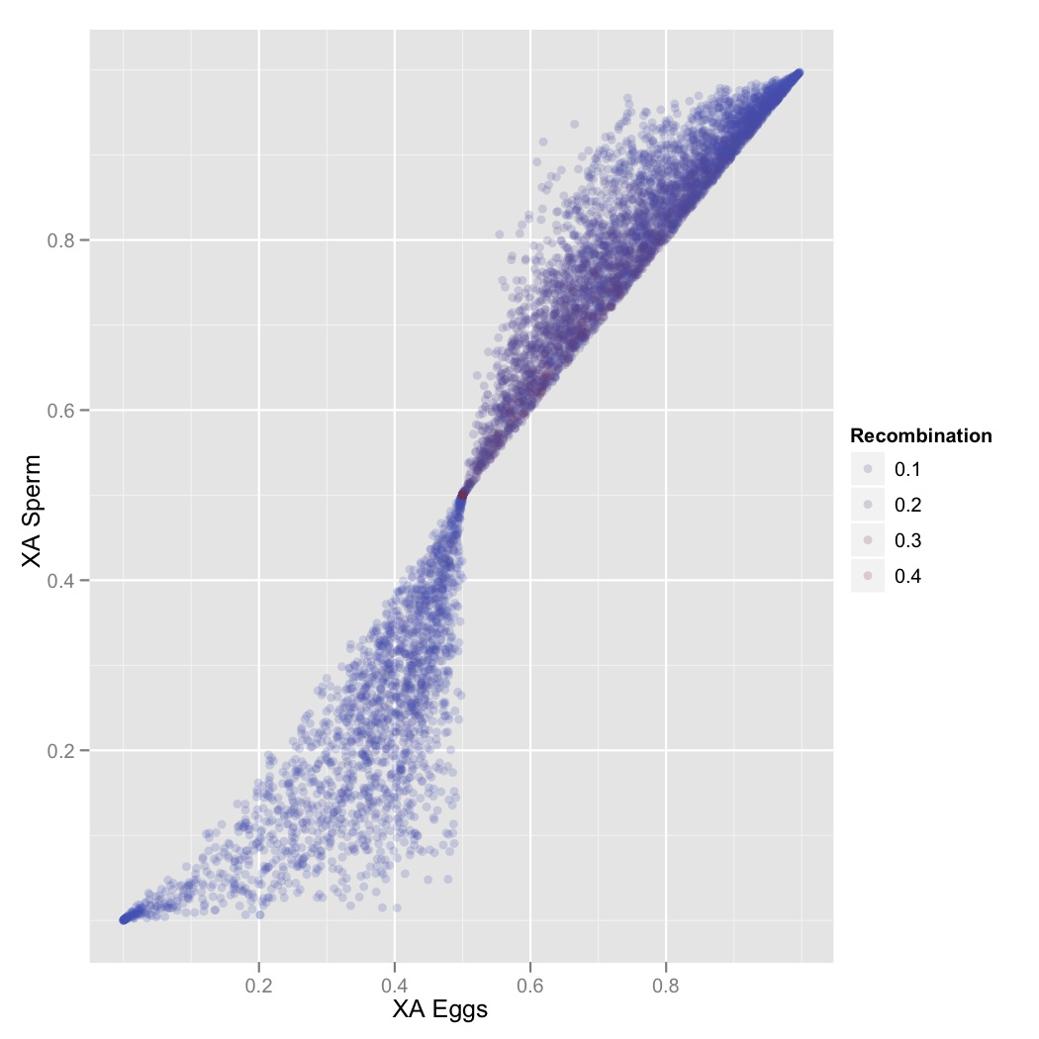
Why [R]?
Advanced techniques
A powerful research tool
Repeatable code
Price
PRICE
PRICE
Slide by
Sam Scarpino

Slide 5
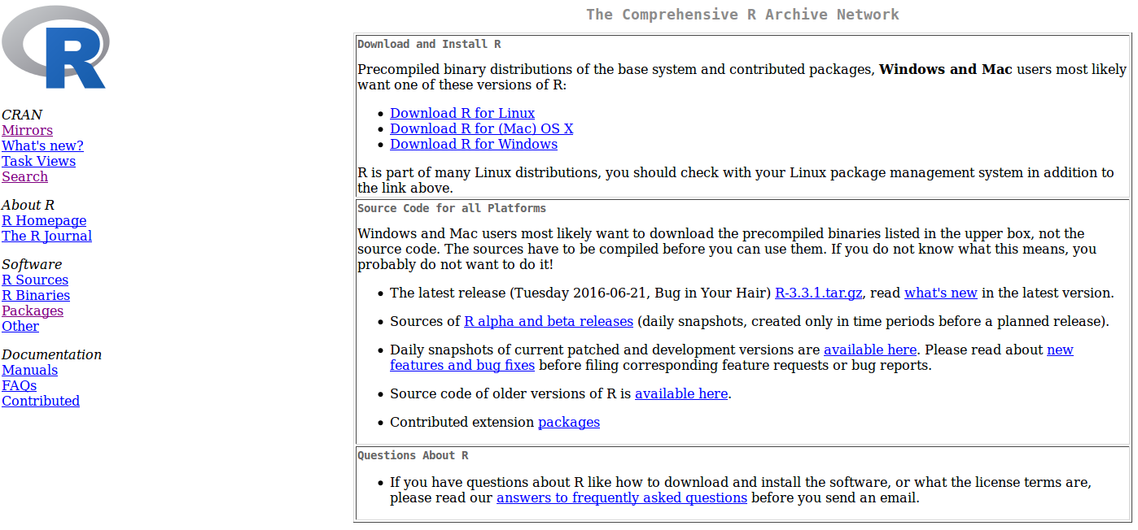
R Cran – core binaries & host of the zillions of libraries for specialized stats and visualizations

Slide 6
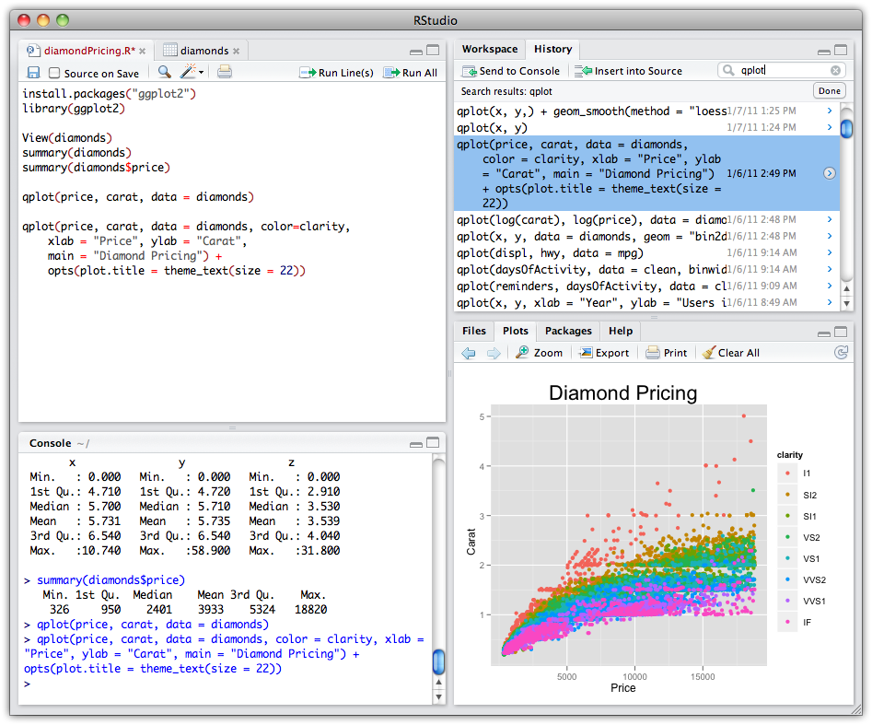
RStudio
http://rstudio.org/
Slide by
Sam Scarpino

Slide 7
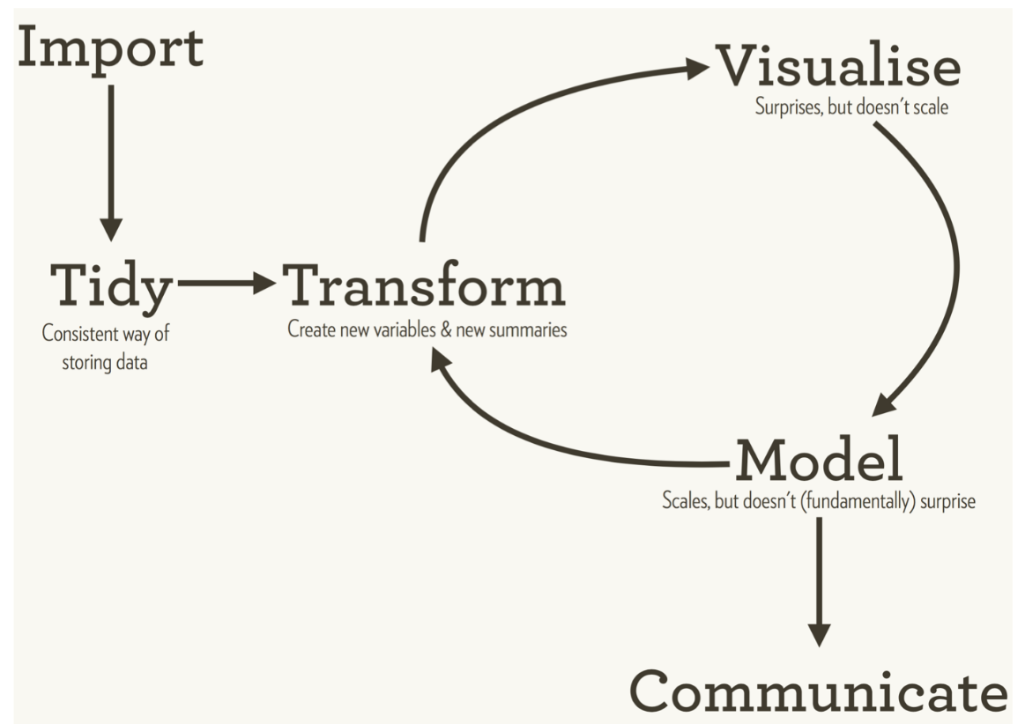
Stastistical analysis cycle (Wickham)

Slide 8
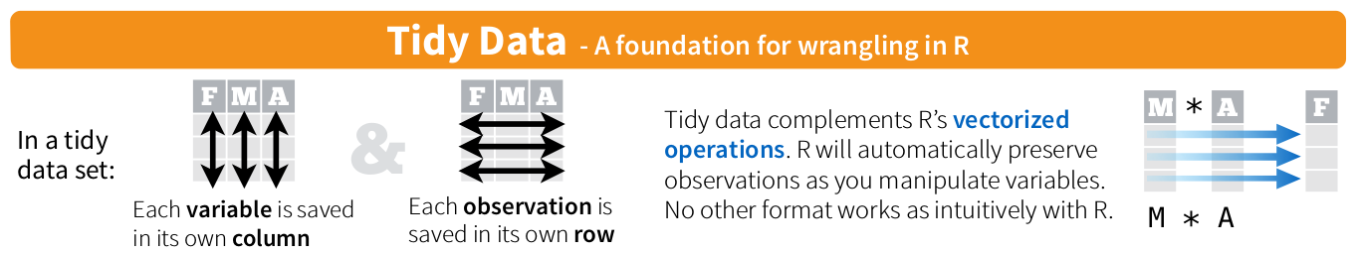
Tidy that data (one observ. Per row)

Slide 9
Untidy (No, Bad)
#> country year type count
#> 1 Afghanistan 1999 cases 745
#> 2 Afghanistan 1999 population 19987071
#> 3 Afghanistan 2000 cases 2666
#> 4 Afghanistan 2000 population 20595360
#> 5 Brazil 1999 cases 37737
#> 6 Brazil 1999 population 172006362
One
Observation

Slide 10
Tidy!
One
Observation
#> country year cases population
#> 1 Afghanistan 1999 745 19987071
#> 2 Afghanistan 2000 2666 20595360
#> 3 Brazil 1999 37737 172006362
#> 4 Brazil 2000 80488 174504898
#> 5 China 1999 212258 1272915272
#> 6 China 2000 213766 1280428583

Slide 11
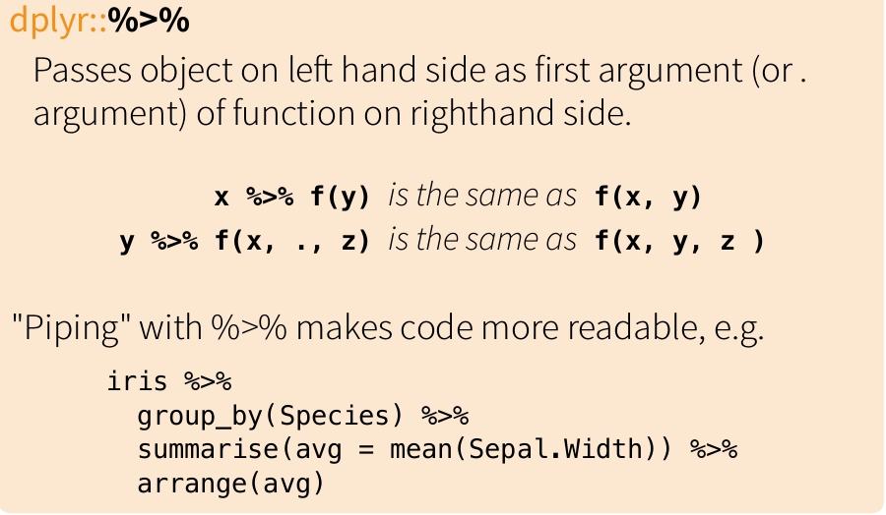
The pipe (think linux pipe)

Slide 12
Twitter Mining with R
Key libraries
  twitteR, streamR to download from twitter
    ROAuth to actually get authorized to use your account
    twitteR is fine for short term things, but for large, sustained analyses use streamR (downloading 100k stream of #rio2016, etc)
      TwitteR is limited to 1 week window of twitter search API
  Tidytext, wordcloud, lubridate, ggraph
    Breaking down tweets into words and doing sentiment analysis, in a “tidy” fashion
    Lubridate for date parsing (it is a nightmare in R)
    Ggraph -plot networks with ggplot

Slide 13
Resources
http://r4ds.had.co.nz/
http://docs.ggplot2.org/current/
The ggplot2 book (v2 is out)!
https://github.com/hadley/ggplot2-book
#rstats on twitter is great, not huge egos, helpful
Stack overflow

