Slide 1



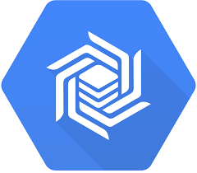

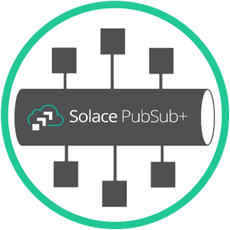





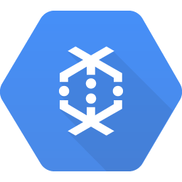






Cloud
BigQuery
Solace
PubSub+
Apache
Beam
Cloud
Bigtable
Cloud Machine
Learning
Apache
Cassandra
Data Runners
MongoDB
Redis
Cloud
Dataflow
Apache
Spark
Apache
Apex
Apache
Flink

Slide 2









Cloud
Beam
Dataflow
iPaaS
Apache Beam
Cloud Dataflow
Cassandra
Redis
MongoDB
BigQuery
BigTable
ML
Cloud assets
Datacenter assets
HybridEdge
Kafka Connect
JMS
MQ
CDC
Kafka Cluster

Slide 3

Open/Messaging
Protocols
Solace
message broker
AWS APIGateway
Web Hook
Interface
REST
Delivery
Endpoint
Solace
Queue
AWS Resource

Slide 4



Internal APIGateway
w/ VPC endpoint in
closed security group
IAM Role generated
Allowing specific resource access
Can be across AWS account
Application
send/receive
JMS for example
Data written to SQS
for example
Solace message broker
w/ Rest Delivery Endpoint

Slide 5
IAM Role generated
Allowing specific resource access
Can be across AWS account
External APIGateway
Secured with App Token
Application
send/receive
JMS for example
Data written to SQS
for example
Solace message broker
w/ Rest Delivery Endpoint

