Slide 1
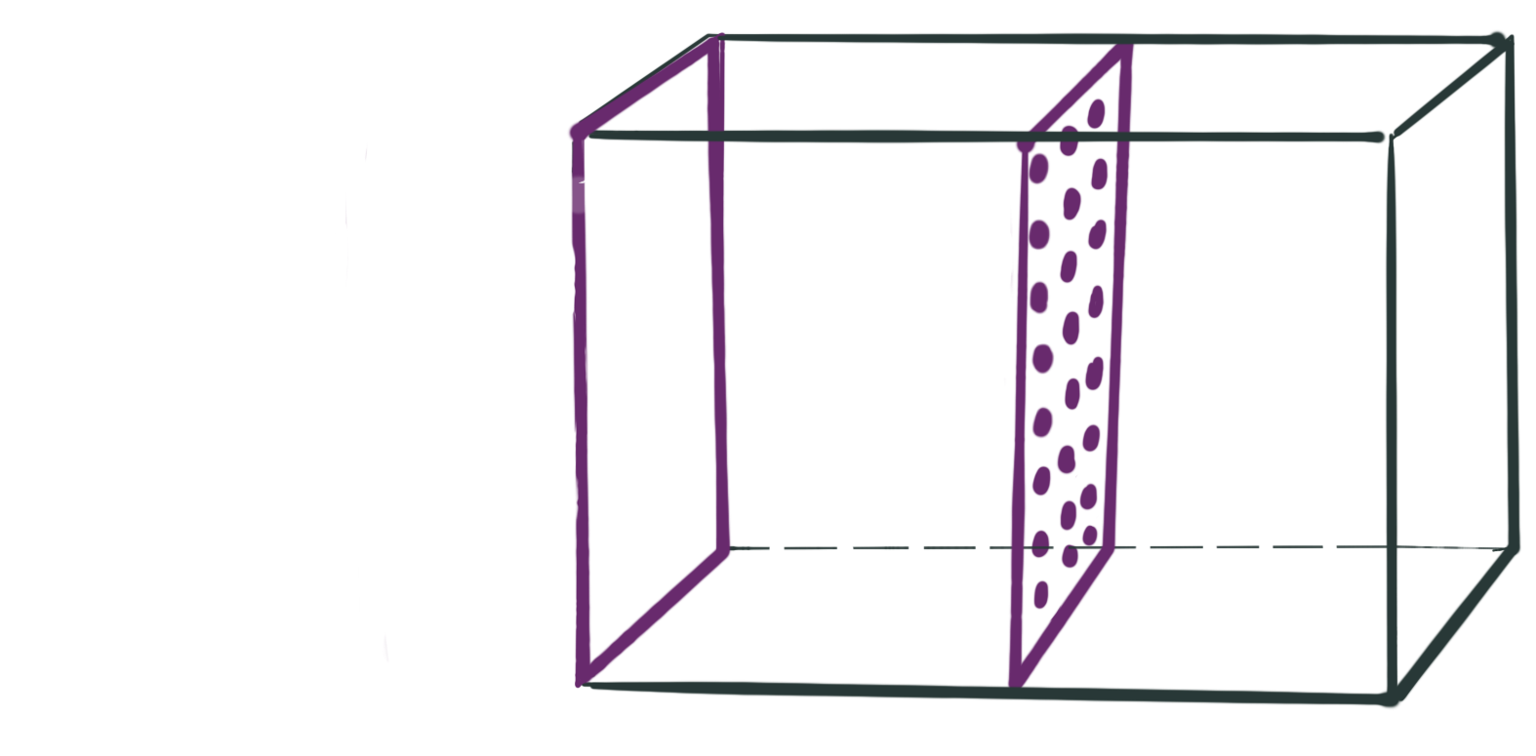


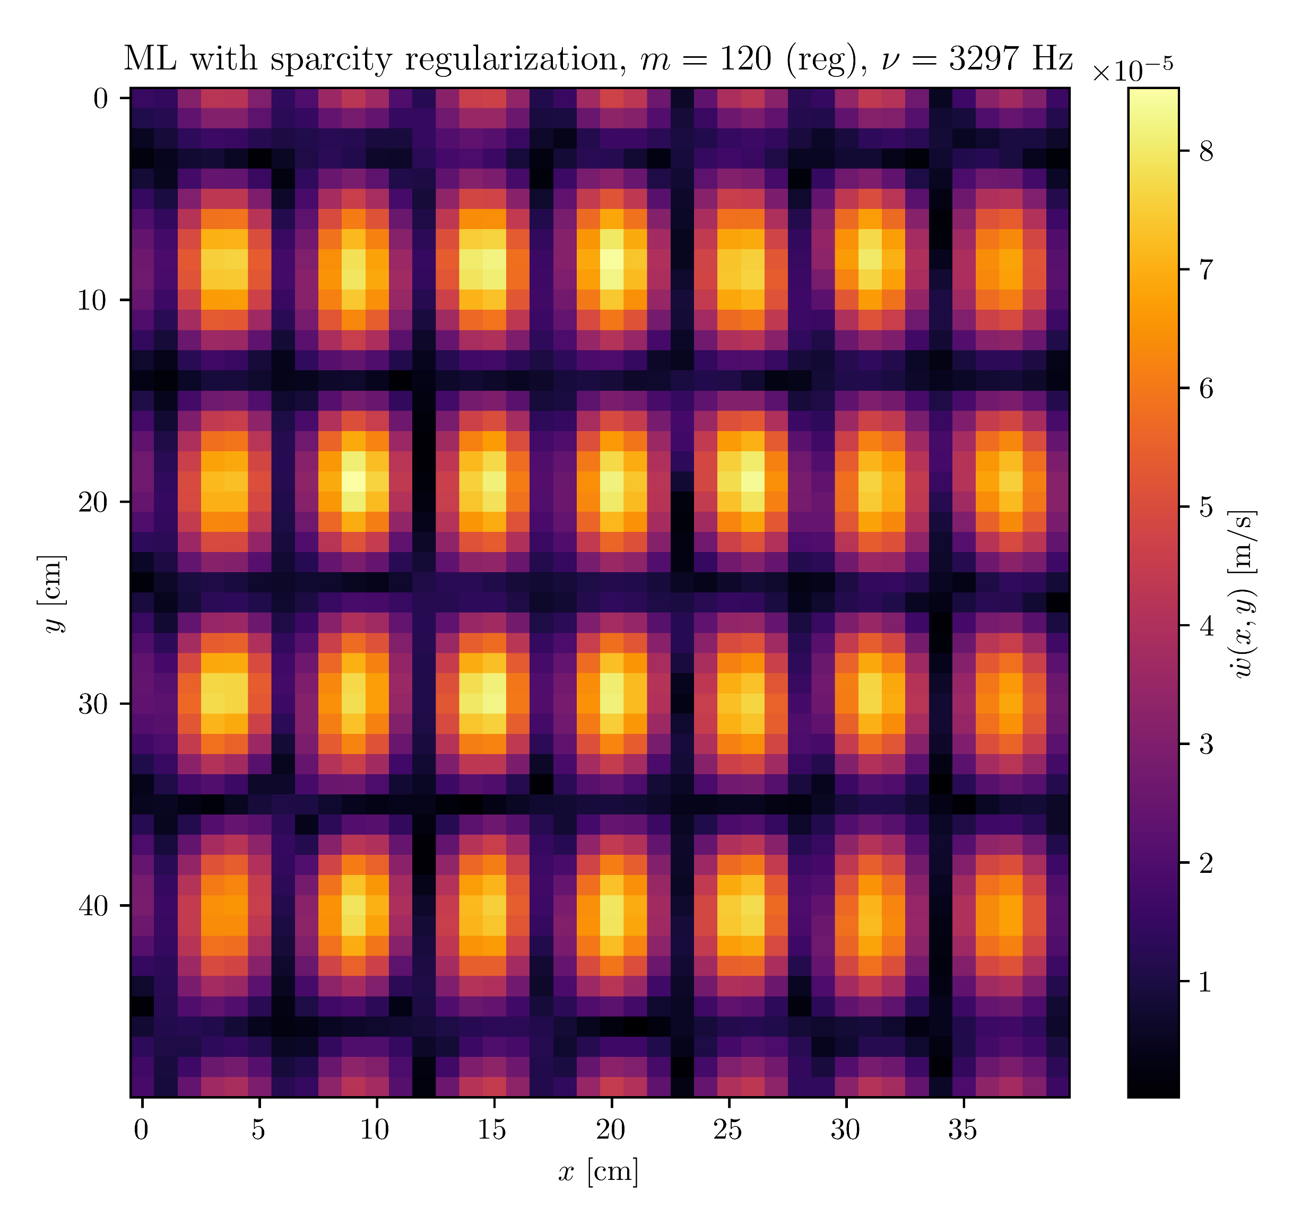
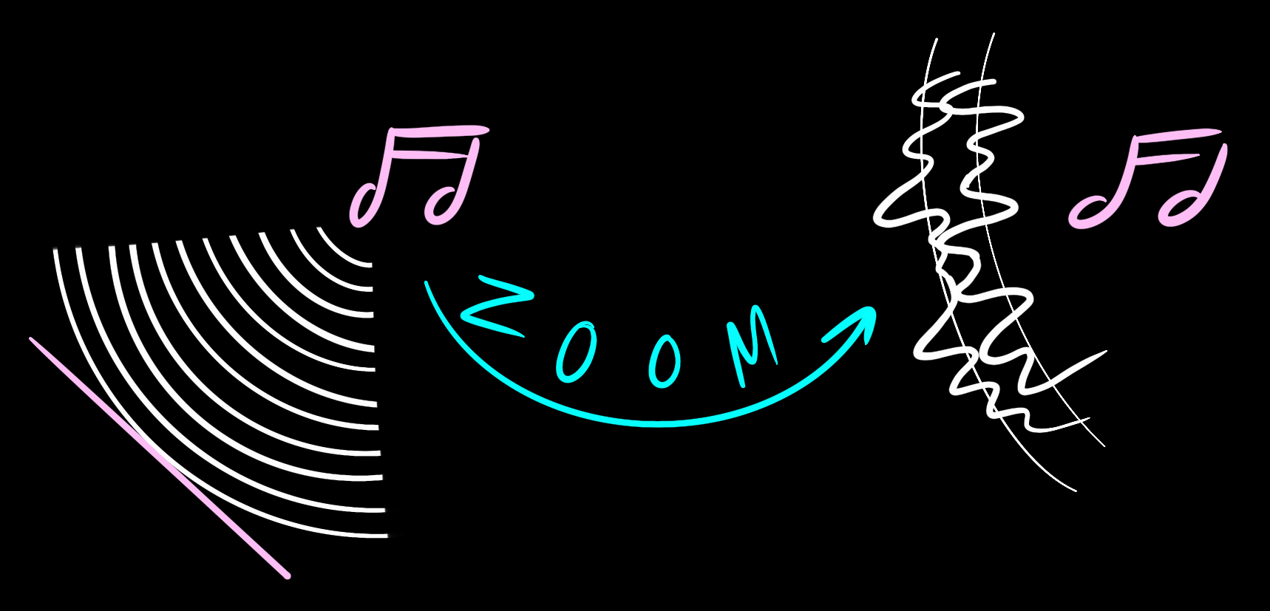



Sound-Based
Imaging
Not only can we see with our eyes. We can also see sound.
Regularization Approaches in Near-field Acoustic Holography
Hologram
Results
Source
Vibrating plane
Based on the hologram, how does the plane source look? i.e. Where are the sources?
Evanescent Waves
Propagating waves
Why to use regularization?
This is an ill-posed problem. Small changes in the hologram yield big changes in the source field.
Thomas Martinod
Nicolás Guarín-Zapata

