Slide 1



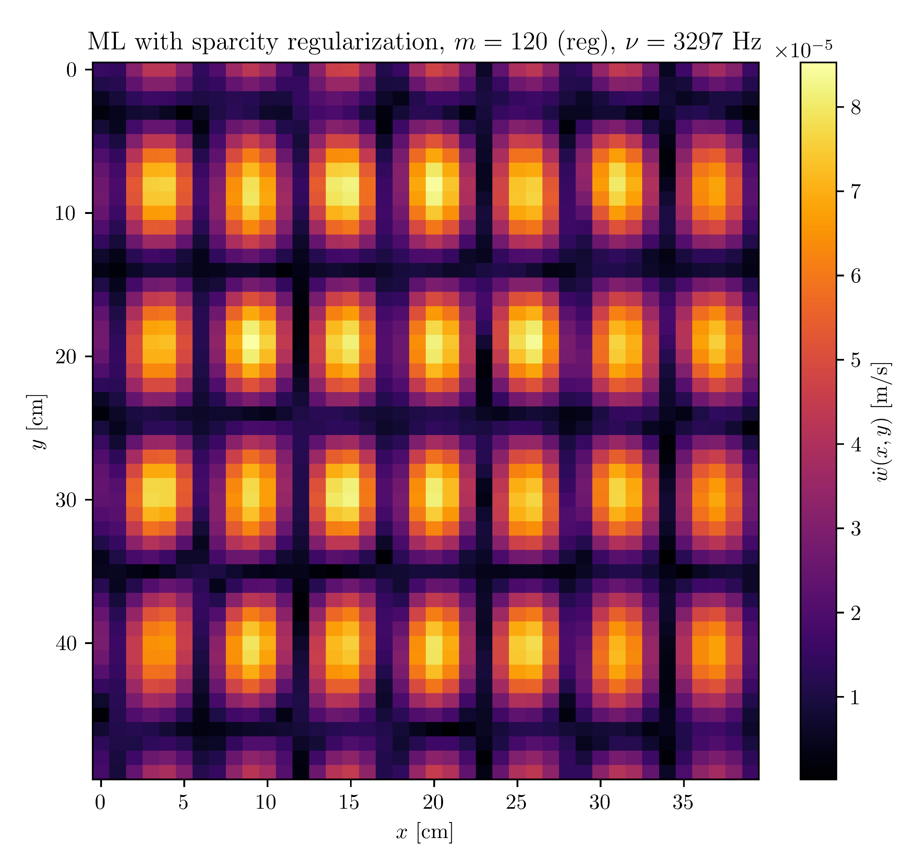
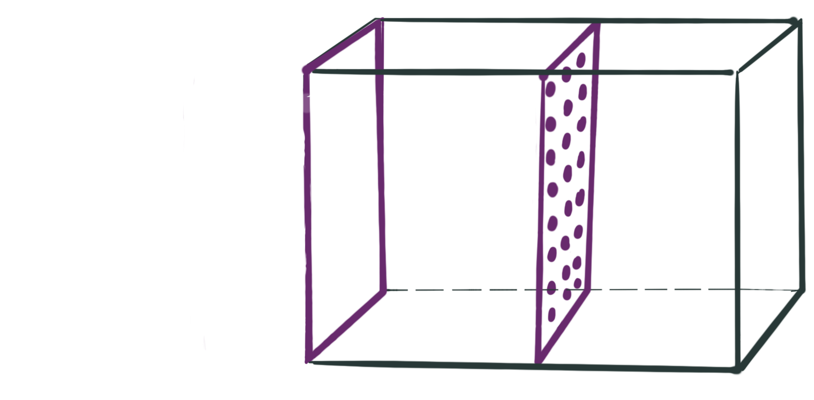


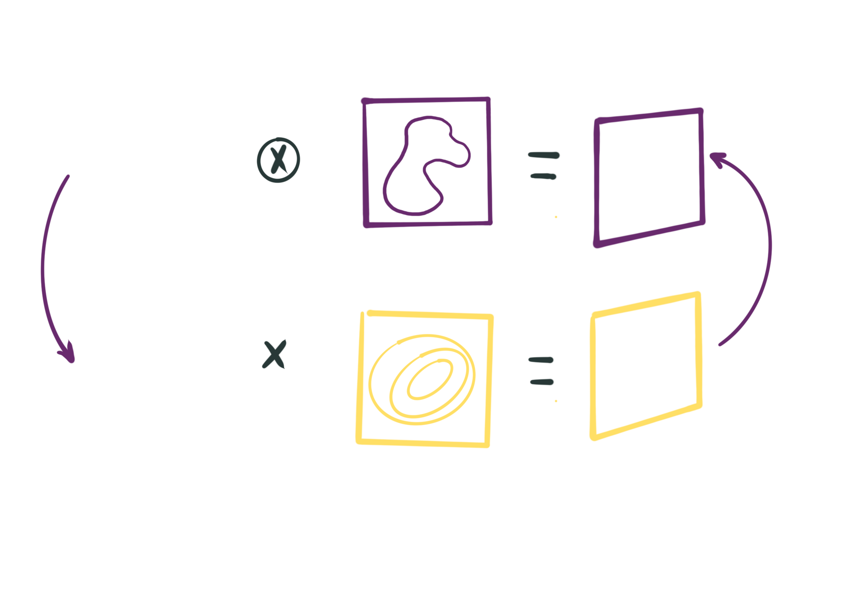
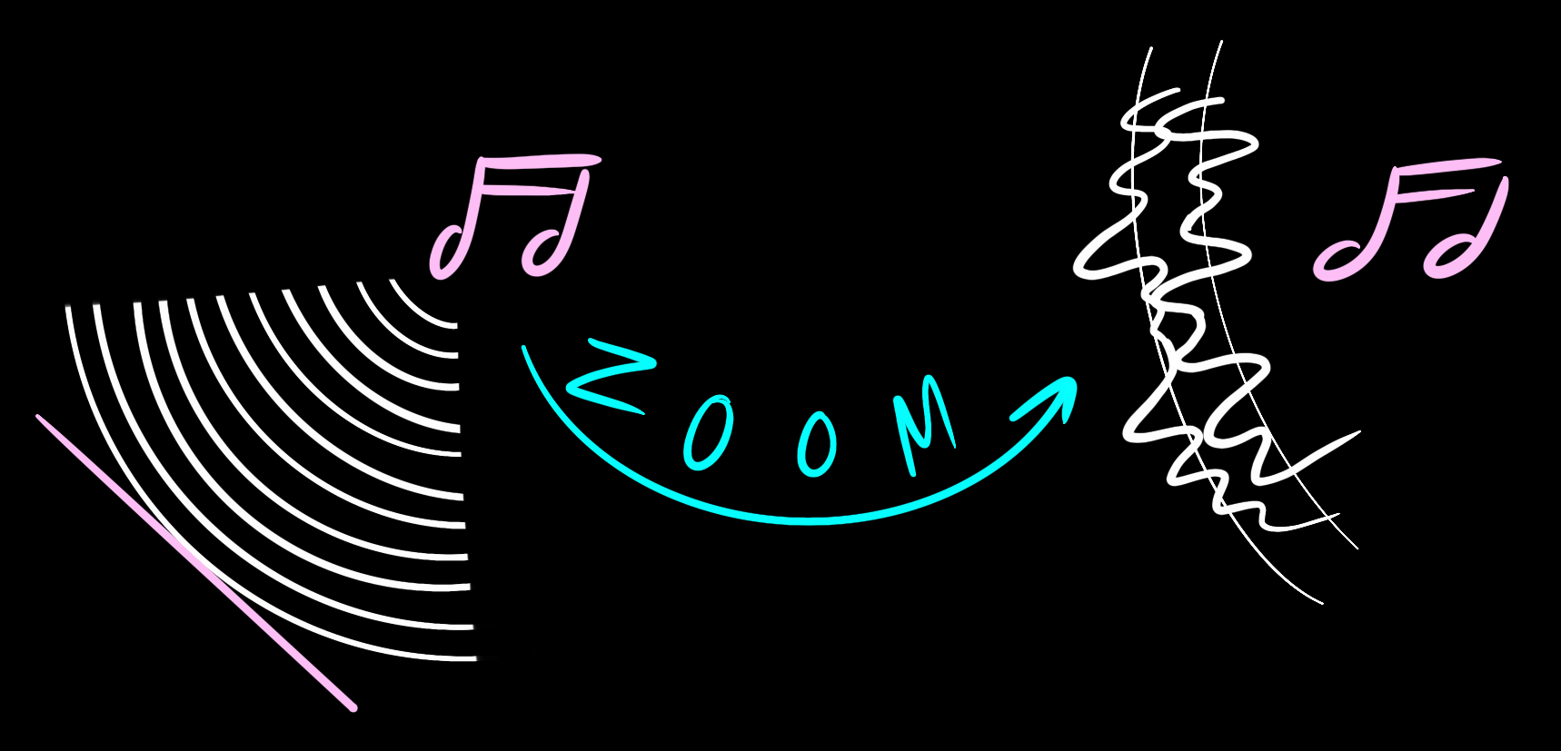










My first advanced project…
By: Thomas Martinod
Tutor: Nicolás Guarín
Sound-Based
6. What you should take home
Imaging:
Not only can we see with our eyes, we can also see sound. NAH is an inverse, ill-posed problem that requires regularization which tries to find sound sources based on forward measurements.
Also, you just saw some really cool pixelated figures.
Regularization Approaches in Near-field Acoustic Holography (NAH)
5. The results
1. The problem
Hologram
Source
Vibrating plane
Near-field acoustic holography (NAH) is a method for solving the inverse problem: Based on the hologram measurements, how does the plane source look? i.e. Where are the sources?
It is important the measurements are close to the source (so that we don’t miss anything).
4. The algorithm
Propagator
Regularization
Evanescent Waves
3. The Regularization Methods
Propagating waves
Tikhonov:
2. Why to use regularization?
Sparcity:
The NAH problem is an ill-posed problem, in the Hadamard sense. Small changes in the measurements yield big changes in the source field.
ML:
Finding for maximizing contrast
Green’s
Functions:

