Slide 1
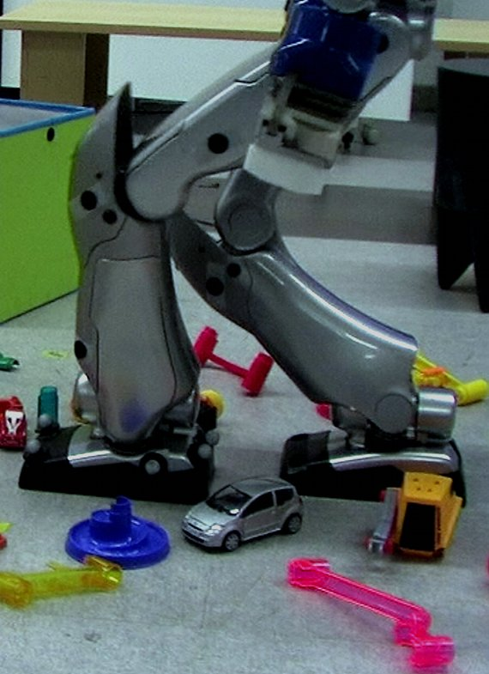
Trajectory Following for Legged Robots
Thomas Moulard, Florent Lamiraux, Olivier Stasse
LAAS-CNRS, Université de Toulouse,
7 avenue du Colonel Roche, 31077 Toulouse cedex 4, France
Legged robots tend to drift and are difficult to localize.
We propose a control scheme achieving closed-loop trajectory tracking.
Real-time trajectory reshaping is computed while preserving robot balance.
Validated on the HRP-2 humanoid robot using a motion capture system.
HRP-2 realizing closed-loop trajectory tracking in a constrained environment.

