Slide 1
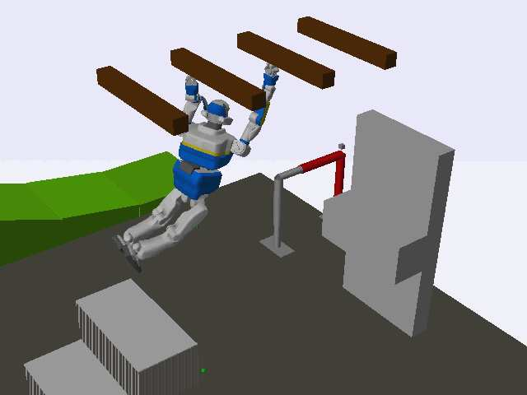
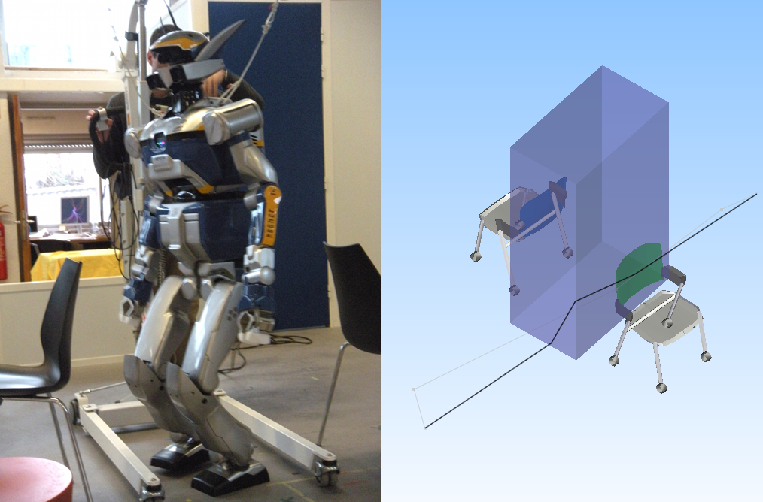
RobOptim: an Optimization
Framework for Robotics
RobOptim eases efficient numerical opimization problems resolution in C++.
Applications: motion generation, posture optimization, etc.
Integrated with state-of-the-Art solvers such as CFSQP, Ipopt, NAG.
Robotics-oriented cost functions and constraints built-in.
Extensible design.
Open-Source (LGPL-2).
Visit the project webpage: http://www.roboptim.net/

