Slide 1
Crowdsourced Mutual Funds
July 20, 2017
Sarah Blanchard, Kim Holmgren, Peter Murray, Thomas Pontikes and Jessica Sickles
Greenhouse Intern Project Summer 2017

Slide 2
Agenda
Market Trend
Proposed Solution
Benefits
Costs

Slide 3




Market Trend Toward Customization
140
270
>3,000
5
>200
>50
Notes:
Kim
since 1970:
The number of new vehicle models has risen from 140 to 270.
The number of TV channels has gone from 5 to over 200.
Consumers can find over 3,000 types of beers and 50 different brands of bottled water
So what are we seeing? Increase in demand for customization to each individual’s taste

Slide 4
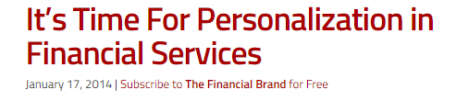
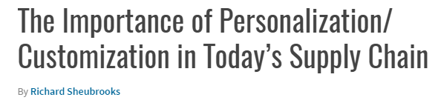
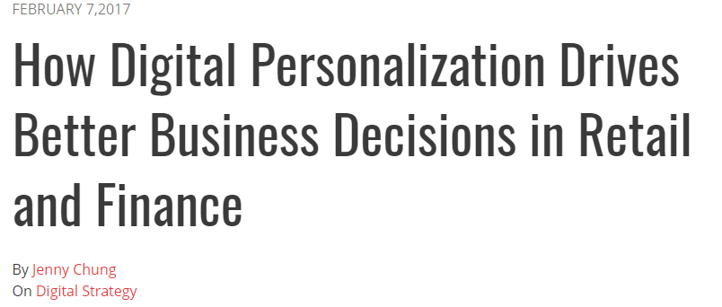
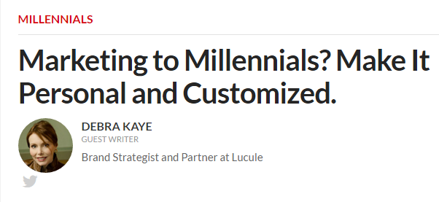
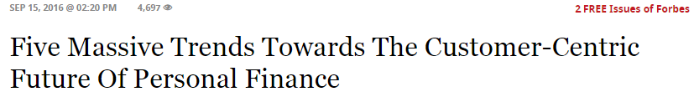
Demand for Customization in Financial Services
Notes:
Kim
And this is not limited to consumer goods - In market research conducted by GfK 40% of consumers with over $10,000 in deposits said they would be more inclined to continue their relationship with their primary bank if they offered products where the economics of the product could be personalized.
A shift is taking place in the industry from a product centric off-the-rack approach to a Chipotle-style made to order approach that involves the customer in the development of the product rather than only its purchase. It’s incredibly important to respond quickly to this market demand and take advantage of the benefits it has to offer, like customer loyalty, trust, and satisfaction.
Source:
https://thefinancialbrand.com/37391/bank-personalization-product-development/

Slide 5


Crowdsourced Mutual Funds
Ideas of One
Ideas of Many
Notes:
Sarah
Product centric to customer centric

Slide 6

Crowdsourcing
Crowdsourcing allows for the collection of ideas and content from a large group, specifically an online community, rather than traditional employees.
Notes:
We used the idea of a creating a crowd sourced mutual fund to create our prodct demonstration. One of the many current trends is the concept of crowd sourcing. Crowd sourcing is the concept of gathering ideas and services from a large group of people specifically the online community. By expanding the talent pools good ideas are heard by amny. These ideas create a personalized product. In a time of the educated investor, millianieals are becoming more educated on their financial decsions than ever before. Not only are milenials going online to participate in these actitives, people of all ages are.
Sarah
Increasingly enterprises are using crowdsourcing to expand talent pools, obtain ideas beyond current employees to online communities and the public
Be more in touch with the consumer
Low cost compared to hiring a professional
High number of people doing work for you
Idea is heard
Good ideas → personalized products
Advent of the educated investor
Millenials most educated generation
-And it’s not just millenials who are getting more into social media. A study by Pew Research shows that the number of Internet users 50 years and older has nearly DOUBLED over the last year and is now at 42%. This group has been deemed “social media mavens” to describe this group, who are eager to try new things, use social media to seek and pass on advice (including financial advice), and have higher than average net worth
PC https://www.bing.com/images/search?view=detailV2&ccid=eQPDfFMC&id=FBD20BC1CAFC208644A94102BD25A463C836416E&thid=OIP.eQPDfFMChYPzw9sh8Fc2gAEsD2&q=crowd+sourcing&simid=608029759967136335&selectedIndex=55&ajaxhist=0

Slide 7
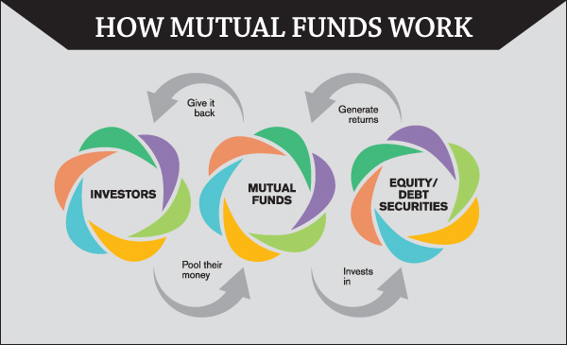
Brief Overview – Mutual Funds
Professionally managed
Diversified
Cost Efficient
Notes:
PC Credit: https://www.google.com/search?q=mutual+funds&source=lnms&tbm=isch&sa=X&ved=0ahUKEwj2npy8r__UAhWBeCYKHarjAYAQ_AUICSgE&biw=1366&bih=652#imgrc=EYPf49JHI_0-2M:&spf=1499712248929
Sarah
We are tech interns, even though this is a huge part of what Fidelity does we’ll go over briefly what they are
Mutual funds are a practical, cost-efficient way to build a diversified portfolio of stocks, bonds, or short-term investments. With nearly 70 years in the business, Fidelity offers the tools and experience to help you build an investment strategy that matches your investing style.
an investment program funded by shareholders that trades in diversified holdings and is professionally managed.
https://www.investor.gov/investing-basics/investment-products/mutual-funds
Types
Why do people buy mutual funds?
Mutual funds are a popular choice among investors because they generally offer the following features:
Professional Management. The fund managers do the research for you. They select the securities and monitor the performance.
Diversification or “Don’t put all your eggs in one basket.” Mutual funds typically invest in a range of companies and industries. This helps to lower your risk if one company fails.
Affordability. Most mutual funds set a relatively low dollar amount for initial investment and subsequent purchases.
Liquidity. Mutual fund investors can easily redeem their shares at any time, for the current net asset value (NAV) plus any redemption fees.
What types of mutual funds are there?
Most mutual funds fall into one of four main categories – money market funds, bond funds, stock funds, and target date funds. Each type has different features, risks, and rewards.
Money market funds have relatively low risks. By law, they can invest only in certain high-quality, short-term investments issued by U.S. corporations, and federal, state and local governments.
Bond funds have higher risks than money market funds because they typically aim to produce higher returns. Because there are many different types of bonds, the risks and rewards of bond funds can vary dramatically.
Stock funds invest in corporate stocks. Not all stock funds are the same. Some examples are:
Growth funds focus on stocks that may not pay a regular dividend but have potential for above-average financial gains.
Income funds invest in stocks that pay regular dividends.
Index funds track a particular market index such as the Standard & Poor’s 500 Index.
Sector funds specialize in a particular industry segment.
Target date funds hold a mix of stocks, bonds, and other investments. Over time, the mix gradually shifts according to the fund’s strategy. Target date funds, sometimes known as lifecycle funds, are designed for individuals with particular retirement dates in mind.
What are the benefits and risks of mutual funds?
Mutual funds offer professional investment management and potential diversification. They also offer three ways to earn money:
Dividend Payments. A fund may earn income from dividends on stock or interest on bonds. The fund then pays the shareholders nearly all the income, less expenses.
Capital Gains Distributions. The price of the securities in a fund may increase. When a fund sells a security that has increased in price, the fund has a capital gain. At the end of the year, the fund distributes these capital gains, minus any capital losses, to investors.
Increased NAV. If the market value of a fund’s portfolio increases, after deducting expenses, then the value of the fund and its shares increases. The higher NAV reflects the higher value of your investment.
All funds carry some level of risk. With mutual funds, you may lose some or all of the money you invest because the securities held by a fund can go down in value. Dividends or interest payments may also change as market conditions change.
A fund’s past performance is not as important as you might think because past performance does not predict future returns. But past performance can tell you how volatile or stable a fund has been over a period of time. The more volatile the fund, the higher the investment risk.

Slide 8
Demo
Notes:
Tom

Slide 9
Benefits
Attract
Customers
Retain
Customers
Satisfy
Customers
Notes:
Jess
Savings and ROI
Fidelity – customer centric
Attract
One of the biggest business challenges is bringing in new customers. “Brand Keys, a research firm that studies customer loyalty, found that personalization is 30% of what draws a person to a brand today, as opposed to only six percent in 1997.” Taking advantage of this opportunity to personalize for customers will result in higher sales and more revenue for the company.
Retain
Once we have customers how do we keep them? Make ourselves impossible to replace. No other firm offers this specific product developed by our own customers.
(Fidelity becomes harder to replace – no other firm offers the product)
Satisfy
Other benefits of personalization
Improving customer satisfaction, which drives loyalty
Help customer believe firm appreciates him or her nd increase transparency, raising trust

Slide 10
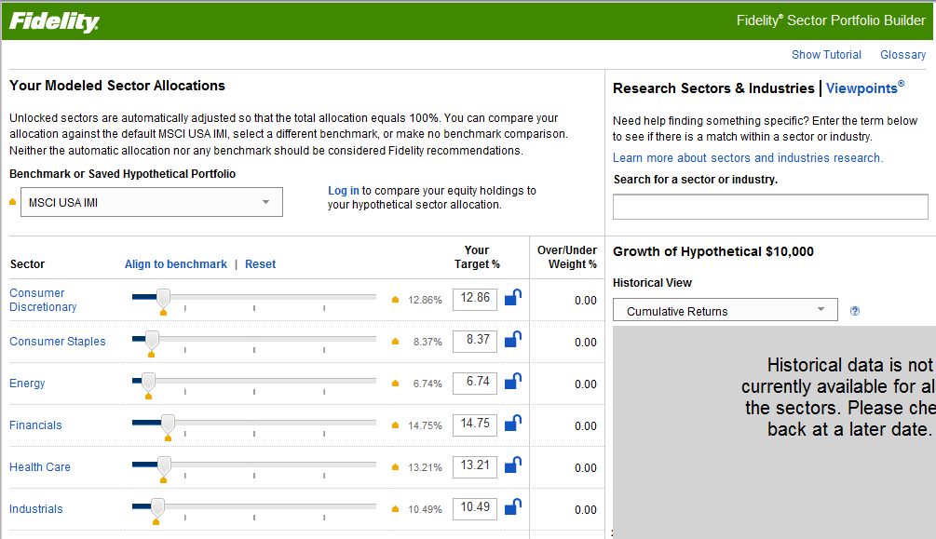
Feasibility
Integration
Fidelity Investments Community
The Sector Portfolio Builder
Competition’s use of crowdsourcing
Notes:
Peter
INTEGRATION
-Fidelity has some tools that prove that it is possible to do something like this
-Fidelity Investments Community provides a forum for crowdsourcing ideas and giving or getting investment advice for PI customers. About 20% of members are active monthly
-Sector Portfolio Builder provides personalized solutions to investment needs using EXISTING Fidelity products
-All of these could combine nicely into one personalized investing tool
COMPETITION
-Read these:
– http://www.matthias-schubert.com/social-media-banken/crowdsourcing-and-open-innovation-at-banks-and-financial-services
– https://www.ideaconnection.com/open-innovation-success/Financial-Institution-Banks-on-Crowdsourcing-Success-00467.html
– http://www.banktech.com/payments/crowdsourcing-development-of-financial-products-a-new-path-to-customer-engagement/d/d-id/1295846?
-If they can do it we can and should be doing it to keep up in the market

Slide 11

Costs
Development
3-6 Months
Enhancements
15 Hours/Week
Monitoring Ideas
As Needed
Notes:
Peter
-We estimate based on our time beginning to develop this tool that it would take 3-6 months to fully develop
-We’d also estimate that 15 hours a week should be spent on bug fixes and enhancements
-A final cost would be the financial analyst. We can’t forecast the number of hours to be spent reviewing and researching ideas because it’s highly dependent on the quantity and quality of ideas received through this platform

Slide 12

Ideas for expansion
Mobile App
Multiple user collaboration on an idea
Further data pulled about proposed portfolio
Integrated customization platform
Compare to existing Fidelity funds

Slide 13
Questions

