Slide 1
Crowdsourced Mutual Funds
July 20, 2017
Sarah Blanchard, Kim Holmgren, Peter Murray, Thomas Pontikes and Jessica Sickles
Greenhouse Intern Project Summer 2017

Slide 2
Agenda
Market Trend
Proposed Solution
Benefits
Costs
Notes:
Kim

Slide 3




Market Trend Toward Customization
140
270
>3,000
5
>200
>50
Notes:
Kim
since 1970:
The number of new vehicle models has risen from 140 to 270.
The number of TV channels has gone from 5 to over 200.
Consumers can find over 3,000 types of beers and 50 different brands of bottled water
So what are we seeing? Increase in demand for customization to each individual’s taste

Slide 4
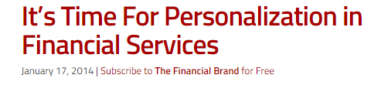
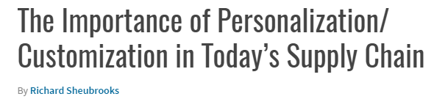
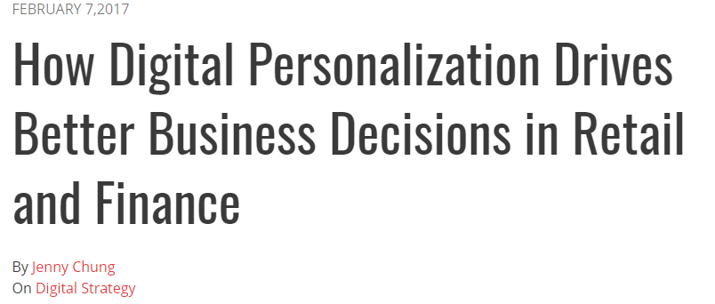
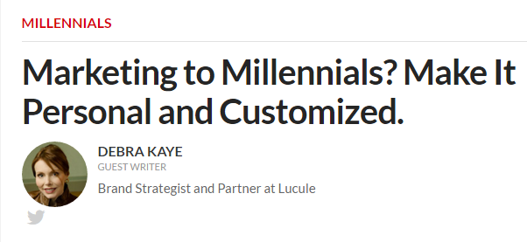
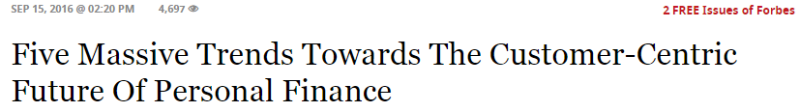
Demand for Customization in Financial Services
Notes:
Kim
And this is not limited to consumer goods - In market research conducted by GfK 40% of consumers with over $10,000 in deposits said they would be more inclined to continue their relationship with their primary bank if they offered products where the economics of the product could be personalized.
A shift is taking place in the industry from a product centric off-the-rack approach to a Chipotle-style made to order approach that involves the customer in the development of the product rather than only its purchase. It’s incredibly important to respond quickly to this market demand and take advantage of the benefits it has to offer, like customer loyalty, trust, and satisfaction.
Source:
https://thefinancialbrand.com/37391/bank-personalization-product-development/

Slide 5


Crowdsourced Mutual Funds
Product Focused
Customer Focused
Notes:
Sarah
Product centric to customer centric

Slide 6

Crowdsourcing
Crowdsourcing allows for the collection of ideas and content from a large group, specifically an online community, rather than traditional employees.
Notes:
Sarah
Current Market Trend: Crowd Sourcing
Collect ideas from a broad community
Community = individual investor
Educated Investor: Time to understand where their money is going
Online advice seek and share - open to financial advice
not only millennials, In general age 50 and up use has doubled to 42% in the past year
Example in the Financial Industry:
Barclays – Barclaycard - using it for new features and services
WestPac New Zealand - crowd sourced applications and chose one the allowed for 3D imagery to be used to check balances
Commonwealth Bank - Idea Bank – new services for the bank
PC: http://www.meducom.ca/wp-content/uploads/2016/07/Crowdsourcing.png

Slide 7
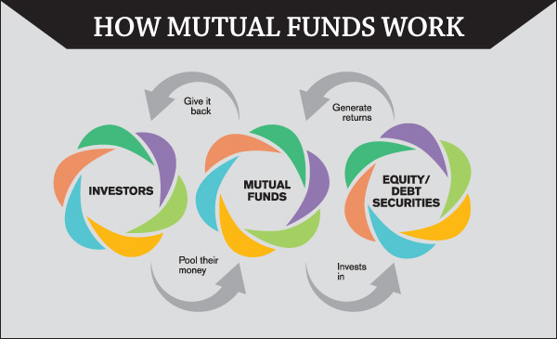
Brief Overview – Mutual Funds
Professionally managed
Diversified
Cost Efficient
Notes:
Sarah
Mutual Fund:
Professionally managed
Contains stocks, bonds or short term investments
Relatively low cost - $2000 initial investment , $50 a month in subsequent purchases
Cost efficient and diversified
not all the eggs in one basket
protects the investor
PC : https://www.google.com/search?q=mutual+funds&source=lnms&tbm=isch&sa=X&ved=0ahUKEwj2npy8r__UAhWBeCYKHarjAYAQ_AUICSgE&biw=1366&bih=652#imgrc=EYPf49JHI_0-2M:&spf=1499712248929

Slide 8
Demo
Notes:
Tom

Slide 9
Benefits
Attract
Customers
Retain
Customers
Satisfy
Customers
Notes:
Jess
Savings and ROI
Fidelity – customer centric
Attract
One of the biggest business challenges is bringing in new customers. “Brand Keys, a research firm that studies customer loyalty, found that personalization is 30% of what draws a person to a brand today, as opposed to only six percent in 1997.” Taking advantage of this opportunity to personalize for customers will result in higher sales and more revenue for the company.
Retain
Once we have customers how do we keep them? Make ourselves impossible to replace. No other firm offers this specific product developed by our own customers.
(Fidelity becomes harder to replace – no other firm offers the product)
Satisfy
Other benefits of personalization
Improving customer satisfaction, which drives loyalty
Help customer believe firm appreciates him or her nd increase transparency, raising trust

Slide 10
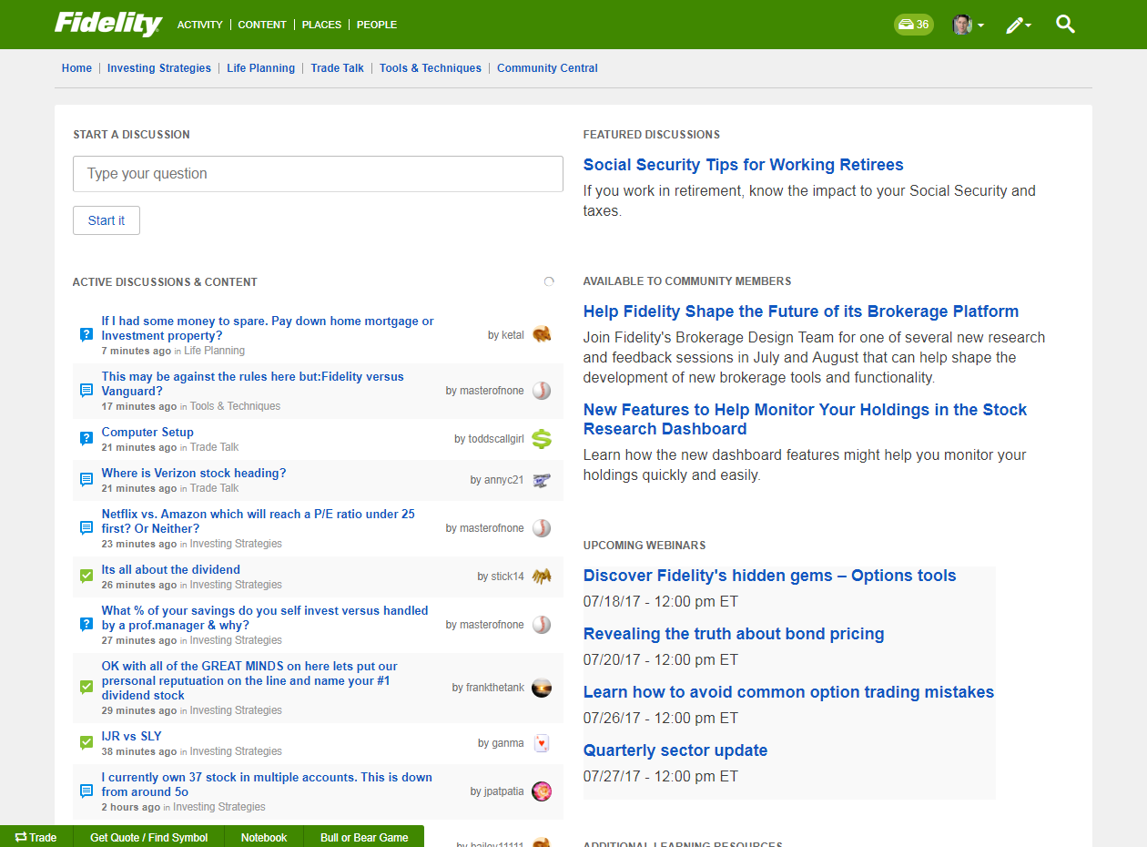
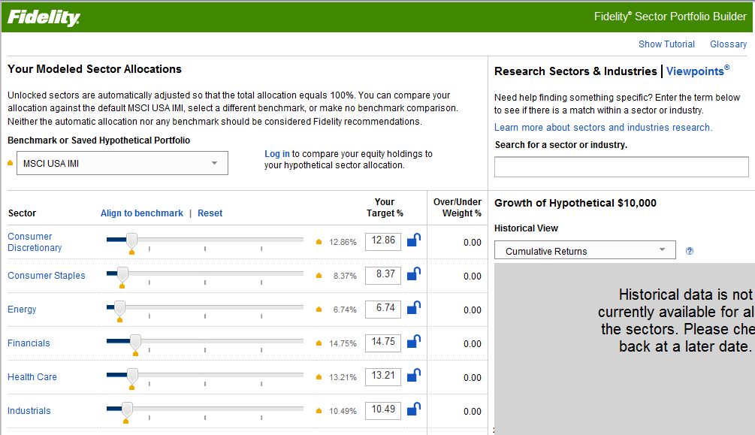
Feasibility
Integration
Fidelity Investments Community
The Sector Portfolio Builder
Competition’s use of crowdsourcing
Notes:
Peter
INTEGRATION
-Fidelity has some tools that prove that it is possible to do something like this
-Fidelity Investments Community provides a forum for crowdsourcing ideas and giving or getting investment advice for PI customers. About 20% of members are active monthly
-Sector Portfolio Builder provides personalized solutions to investment needs using EXISTING Fidelity products
-All of these could combine nicely into one personalized investing tool
COMPETITION
-Read these:
– http://www.matthias-schubert.com/social-media-banken/crowdsourcing-and-open-innovation-at-banks-and-financial-services
– https://www.ideaconnection.com/open-innovation-success/Financial-Institution-Banks-on-Crowdsourcing-Success-00467.html
– http://www.banktech.com/payments/crowdsourcing-development-of-financial-products-a-new-path-to-customer-engagement/d/d-id/1295846?
-If they can do it we can and should be doing it to keep up in the market

Slide 11
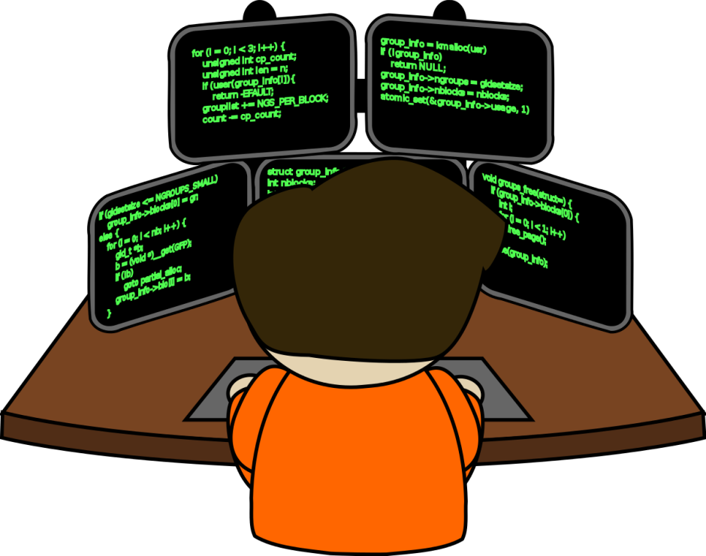
Costs
Development
3-6 Months
Enhancements
15 Hours/Week
Monitoring Ideas
As Needed
Notes:
Peter
-We estimate based on our time beginning to develop this tool that it would take 3-6 months to fully develop
-We’d also estimate that 15 hours a week should be spent on bug fixes and enhancements
-A final cost would be the financial analyst. We can’t forecast the number of hours to be spent reviewing and researching ideas because it’s highly dependent on the quantity and quality of ideas received through this platform

Slide 12

Ideas for expansion
Mobile App
Multiple user collaboration on an idea
Further data pulled about proposed portfolio
Integrated customization platform
Compare to existing Fidelity funds

Slide 13
Questions

