Slide 1
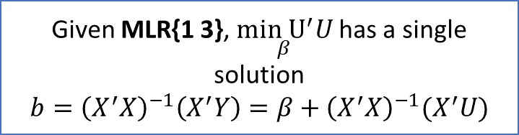

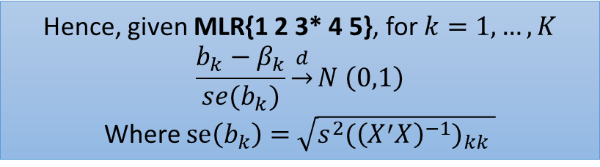




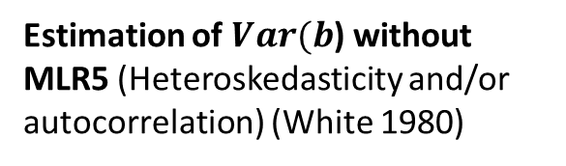
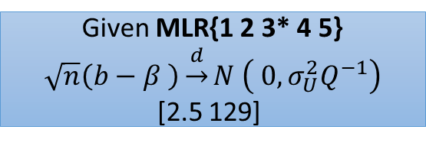

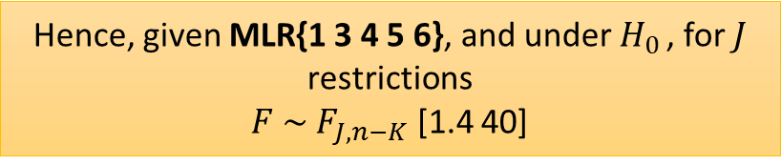

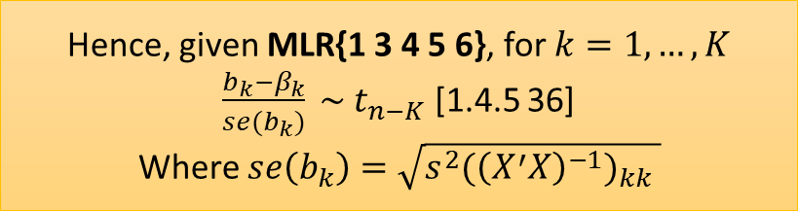




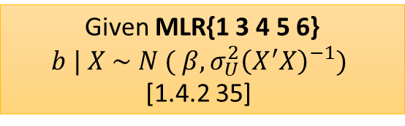


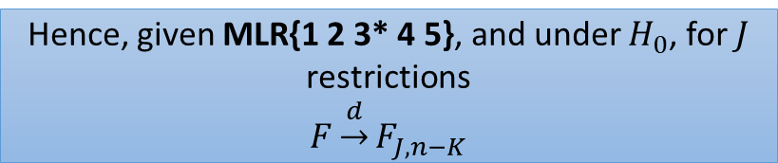




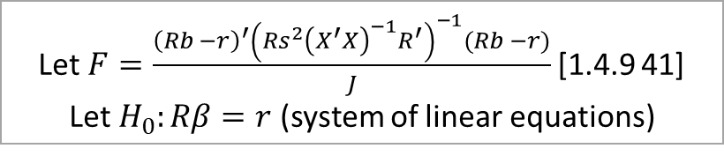
Let$F=\frac{{\left(Rb −r\right)}^{′}{\left(Rs^{2}{\left(X^{′}X\right)}^{−1}R^{′}\right)}^{−1}(Rb −r)}{J}$ [1.4.9 41]
Let $H_{0}:Rβ=r$ (system of linear equations)
Estimation of $Var(b$) without MLR5 (Heteroskedasticity and/or autocorrelation) (White 1980)
Hence, given MLR{1 3 4 5 6}, and under $H_{0 }$, for $J$ restrictions
$F \sim F_{J,n−K}$ [1.4 40]
Hence, given MLR{1 2 3* 4 5}, and under $H_{0}$, for $J$ restrictions
$$F\underset{→}{d}F_{J,n−K}$$
Given MLR{1 3 4}
$Var\left[b\right|X ]=$ $σ_{U}^{2}{\left(X^{′}X\right)}^{−1}\left(X^{′}ΩX\right){\left(X^{′}X\right)}^{−1}$
Given MLR{1 2 3* 4}
$\sqrt{n}(b−β) \underset{→}{d}$ $N(0,σ_{U}^{2}Q^{−1}Q^{∗}Q^{−1})$
Where $Q^{∗}=plim\frac{X^{′}ΩX}{n}$
Hence, given MLR{1 3 4 5 6}, for $k=1,…,K$
$\frac{b_{k}−β_{k}}{se(b_{k})} \sim t_{n−K}$ [1.4.5 36]
Where $se\left(b_{k}\right)=$ $\sqrt{s^{2}{{(\left(X^{′}X\right)}^{−1})}_{kk} }$
Hence, given MLR{1 2 3* 4 5}, for $k=1,…,K$
$$\frac{b_{k}−β_{k}}{se(b_{k})}\underset{→}{d}N \left(0,1\right)$$
Where $se\left(b_{k}\right)=$ $\sqrt{s^{2}{{(\left(X^{′}X\right)}^{−1})}_{kk} }$
Inference (finite sample)
Given MLR{1 3 4 5 6}
$$b | X \sim N ( β, σ_{U}^{2}{\left(X^{′}X\right)}^{−1})$$
[1.4.2 35]
Inference without MLR6 (Asymptotics)
Given MLR{1 2 3* 4 5}
$$\sqrt{n}\left(b−β \right)\underset{→}{d}N \left( 0, σ_{U}^{2}Q^{−1}\right)$$
[2.5 129]
MLR5
MLR3*
$Q =\underset{n→∞}{plim}{\frac{X^{′}X}{n}}$ has rank $K$ i.e. is positive definite
MLR4’
$$E\left[U ∣ X\right]=0$$
Var$\left[b| X\right]= σ_{U}^{2}{\left(X^{′}X\right)}^{−1}$
MLR3 + Q is finite
MLR{2 4’}
MLR5
Where $E\left[UU^{′}\right|X]=σ_{U}^{2}Ω,$we have $Ω=I$
MLR1
$$Y=Xβ+U$$
MLR2
{$X_{i},Y_{i}\} \sim iid$
MLR3
$X$ is an $n×K$matrix with rank $K$
MLR6
$$U | X \sim N[0, σ_{U}^{2}I]$$
MLR4
$$∀i E\left[u_{i} \right|X]=0$$
Given MLR{1 3}, $\underset{β}{min U^{′}U}$has a single solution
$b={\left(X^{′}X\right)}^{−1}\left(X^{′}Y\right)=β+{\left(X^{′}X\right)}^{−1}(X^{′}U)$
Given MLR{1 2 3* 4}
$$b\underset{→}{p}β$$
[2.1 113]
Given MLR{1 3 4}
$$E\left[b∣X\right]=β$$
[1.1 27]
Given MLR{1 3 4 5}
Var$\left[b | X\right]=σ_{U}^{2}{\left(X^{′}X\right)}^{−1}$
[1.1 27]
Algebra
Estimation of $b$ under classical assumptions
Given MLR{1 2 3* 4 5}
$s^{2}\underset{→}{p}σ_{U}^{2}$
[2.2 115]
Given MLR{1 3 4 5}
$${E[s}^{2}∣X]=σ_{U}^{2}$$
[1.2 30]
Let $s^{2}=\frac{{\hat{U}}^{′}\hat{U}}{n−K}$
Estimation of $σ_{U}^{2}$
Notes:
I made a big diagram describing some assumptions (MLR1-6) that are used in linear regression. In my diagram, there are categories (in rectangles with dotted lines) of mathematical facts that follow from different subsets of MLR1-6. References in brackets are to Hayashi (2000). [[diagram]]
A couple of comments about the diagram are in order.
UU,YY are a n×1n×1 vectors of random variables. XX may contain numbers or random variables. ββ is a K×1K×1 vector of numbers.
We measure: realisations of YY, (realisations of) XX. We do not measure: ββ, UU. We have one equation and two unknowns: we need additional assumptions on UU.
We make a set of assumptions (MLR1-6) about the joint distribution f(U,X)f(U,X). These assumptions imply some theorems relating the distribution of bb and the distribution of ββ.
Note the difference between MLR4 and MLR4’. The point of using the stronger MLR4 is that, in some cases, provided MLR4, MLR2 is not needed. To prove unbiasedness, we don’t need MLR2. For finite sample inference, we also don’t need MLR2. But whenever the law of large numbers is involved, we do need MLR2 as a standalone condition. Note also that, since MLR2 and MLR4’ together imply MLR4, clearly MLR2 and MLR4 are never both needed. But I follow standard practise (e.g. Hayashi) in including them both, for example in the asymptotic inference theorems.
Note that since X’X is a symmetric square matrix, Q has full rank K iff Q is positive definite; these are equivalent statements. Furthermore, if X has full rank K, then X’X has full rank K, so MLR3* is equivalent to MLR3 plus the fact that Q is finite (i.e actually converges). (see Wooldridge 2010 p. 57).
Note that Q could alternatively be written E[X’X]
Note that whenever I write a plim and set it equal to some matrix, I am assuming the matrix is finite. Some treatments will explicitly say Q is finite, but I omit this.
In the diagram, I stick to the brute mathematics, which is entirely independent of its (causal) interpretation.¹

Slide 2










The instrument matrix $Z (n×K)$(just-identified case) is obtained by taking $X$ and replacing each column for which we have an instrument by the values of the instrument.
The IV estimator
$$b_{IV}={\left(Z^{′}X\right)}^{−1}\left(Z^{′}Y\right)$$
can be expressed as
$$b_{IV}=β+ {\left(Z^{′}X\right)}^{−1}\left(Z^{′}U\right)$$
Under MLR{1 3* 5} and IV2-5:
$${\sqrt{n}(b}_{IV}−β)\underset{→}{d}N(0,σ_{U}^{2}Q_{ZX}^{−1}Q_{ZZ}Q_{XZ}^{−1})$$
MLR3*
$Q =\underset{n→∞}{plim}{\frac{X^{′}X}{n}}$ has rank $K$ i.e. is positive definite
IV4’
$$E\left[U\right|Z]=0$$
IV{2 4’}
MLR5
$$E\left[UU^{′}\right|X=σ_{U}^{2}I$$
MLR1
$$Y=Xβ+U$$
IV2
{$X_{i},Y_{i},Z_{i}\} \sim iid$
IV3
$$Q_{ZZ}=\underset{n→∞}{plim}{n^{−1}(Z^{′}Z)}$$
has rank $K$
IV4
$$∀i E\left[u_{i} \right|Z]=0$$
IV5 (relevance)
$Q_{ZX}=\underset{n→∞}{plim}{n^{−1}(Z^{′}X)}$ has rank $K$
In the over-identified case, the 2SLS proposal is to use as instruments
$$\hat{X}=Z{\left(Z^{′}Z\right)}^{−1}\left(Z^{′}X\right)$$
(The predicted value of $X$ from a first-stage regression $X=ZΘ+E$.)
The 2SLS estimator is
$$b_{2SLS}={\left({\hat{X}}^{′}X\right)}^{−1}\left({\hat{X}}^{′}Y\right)$$
$$={{(X}^{′}Z {\left(Z^{′}Z\right)}^{−1}Z^{′}X)}^{−1}({(X}^{′}Z {\left(Z^{′}Z\right)}^{−1}Z^{′}Y)$$
Under MLR{1 3* 5} and IV2-5:
$${\sqrt{n}(b}_{2SLS}−β)\underset{→}{d}N(0,σ_{U}^{2}{\left(Q_{XZ}Q_{ZZ}^{−1}Q_{ZX}\right)}^{−1})$$

Slide 3

X
$$Y ≔Xβ+U$$
U

