Slide 1
NYC Covid-19 Facility Statuses
Thomas Westfall
IBM Cloud sponsored by Power Systems Academic Initiative

Slide 2
Problem Statement
Found 5 datasets on NYC OpenData, listing closure statuses of NYC playgrounds, skate parks, adult exercise equipment, dog runs, and athletic facilities.
Each dataset had differences that made usage difficult, especially when comparing different facility types with each other.
Goal: create a database that allowed more efficient access of these facilities’ closure statuses, particularly to normalize each dataset to make comparisons easier.

Slide 3
Attributes
Attributes that all five facility types shared:
Name
Type
Borough
Editdate
Latitude and longitude
Status
Closure type (if applicable)
Unique attributes
I.e for AthleticFacilities
Primary sport
Field number
nets/goals/etc removed
etc

Slide 4
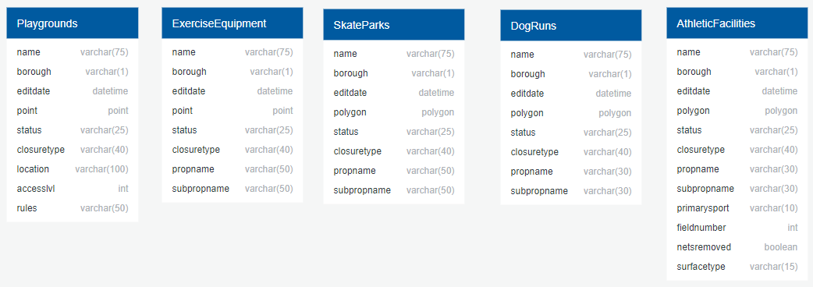
Pre Normalization Tables

Slide 5
1st Normal Form
Had to normalize latitude and longitude.
Problem: Latitude and longitude were stored together through two different ways in the datasets:
1. As a point, i.e POINT (-73.93606682793899 40.83789503019744)
2. As a polygon, i.e POLYGON ((-73.96959755080432 40.80666743779172, -73.96953070433936 40.80679464974061, -73.96924691966811 40.80670855159077, -73.96931452809766 40.80657989290665, -73.96959755080432 40.80666743779172))
I decided to normalize these different values into two decimal columns, latitude and longitude

Slide 6
2nd & 3rd Normal Form
After normalizing to 1st NF, I decided to generalize the shared attributes into one table, called places.
To avoid partial and transitive dependencies, added an id attribute to places and made that the primary key, which would serve as primary key and foreign key for the individual facility tables.

Slide 7
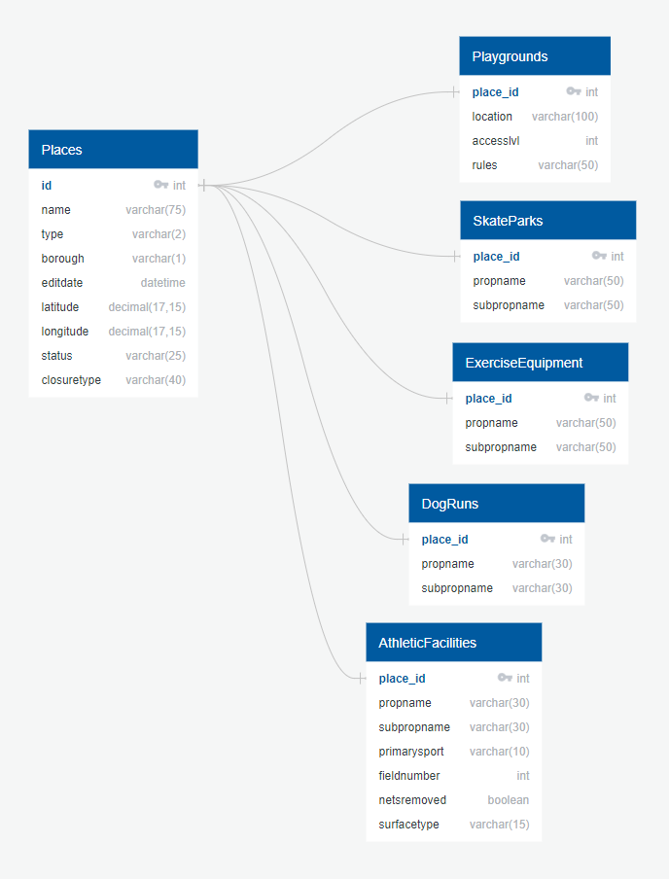

Slide 8

ETL Process
Used a Python library called Pandas to normalize the datasets.
Pandas can take in csvs and turn them into “dataframes”, a data type they have that allows for easy data manipulation.
Once the input data was normalized to the schema I created, I turned it back into a csv, which could then loaded by mysql into a table.

