Slide 1
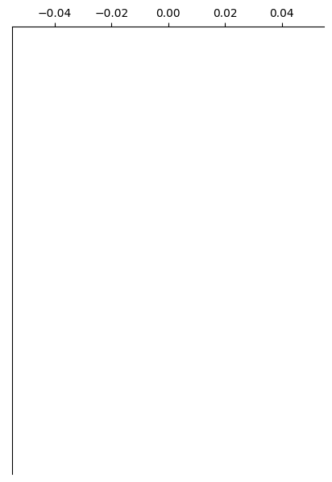
Control
Overlay

Slide 2
Control
Overlay

