Slide 1
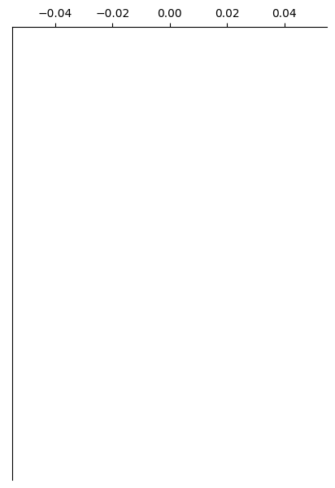

Control
Overlay

Slide 2

Control
Overlay

