Slide 1
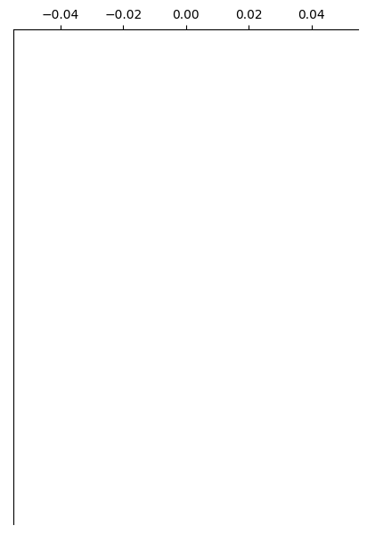

Control
Overlay

Slide 2
Control
Overlay

