Slide 1
Project Demo
Quantum algorithm on a
subclass of circulant graphs
第二組

Slide 2
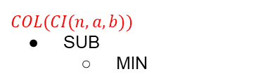
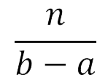
COL(CI(n,a,b))
Subdivide the vertices into consecutive chunks
SUB(Vi) , for i = 1,...,
2-1: Find_MIN(/MAX)_One_Index()
2-2: is_any_one_quantum()
is_any_one_quantum() to search over SUB(Vi)

Slide 3
I/O Introduction
input: graph CI(n,a,b), boolean function f
output:
graph collision: T/F (quantum and classical result)

Slide 4

2. array representing whether each chunk has collision or not
(one calculated by classical approach, one by quantum approach)

Slide 5
is_any_one_quantum(low_idx,high_idx,f)
index: 0 1 2 3 4 5 6 7
input: (0,7,f = 01011001)
measures 1/3/4/7 with high probability
output: f[measured index]

Slide 6
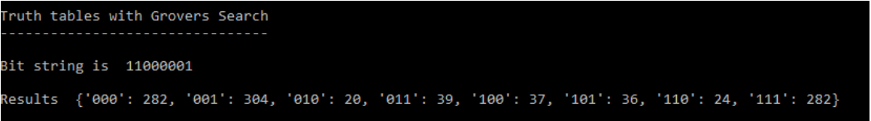
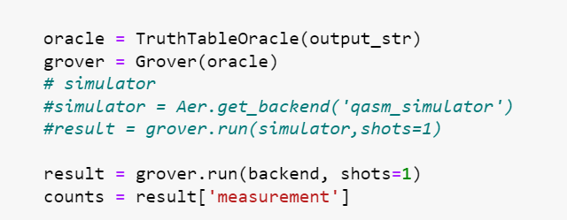
Example Input and Output
Bit string is 1100001
Results:{‘000’: 282,‘001’: 304,‘010’: 20,‘011’: 39,‘100’: 37,‘101’: 36,‘110’: 24,’111’:282}
https://quantumcomputinguk.org/tutorials/truth-tables-with-grovers-search-in-qiskit?fbclid=IwAR0vvGg0ch-ecO1raq1zmX4HBAhcAzTtzkg5cjwYMhfMLb71ZdOplBziMfM

Slide 7
Find_MIN(/MAX)_One_Index(low_idx,high_idx,f)
1.grover() can find the index of 1
2.keep reducing the range of searching
ex.f = 01011001 output = 4
search f = 0101
index: 0 1 2 3 4 5 6 7 grover()
index: 0 1 2 3

Slide 8
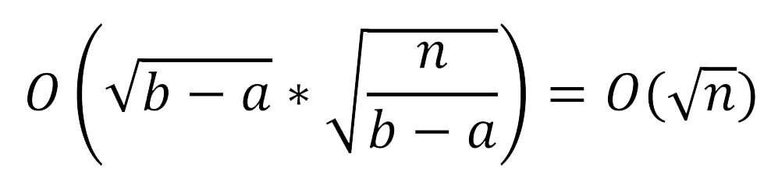

Time Complexity(ideal)
With grover search
there are chunks
(size = b-a)
 | Classical | Quantum
check_input | O(1) | O(1)
plot | O(n) | O(n)
find_min(/max)_one_idx | O((b-a)* )
is_any_one | O((b-a)* )
total | O(n)

Slide 9
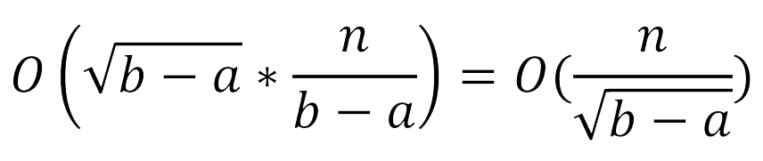
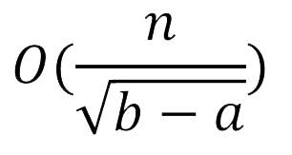
Time Complexity(real)
(size = b-a)
We see every chunks
 | Classical | Quantum
check_input | O(1) | O(1)
plot | O(n) | O(n)
find_min(/max)_one_idx | O((b-a)* )
is_any_one | O((b-a)* )
total | O(n)

