Slide 1
Graph Collision Problem
Group 2 張原嘉 林宸漢 林鈺翔

Slide 2
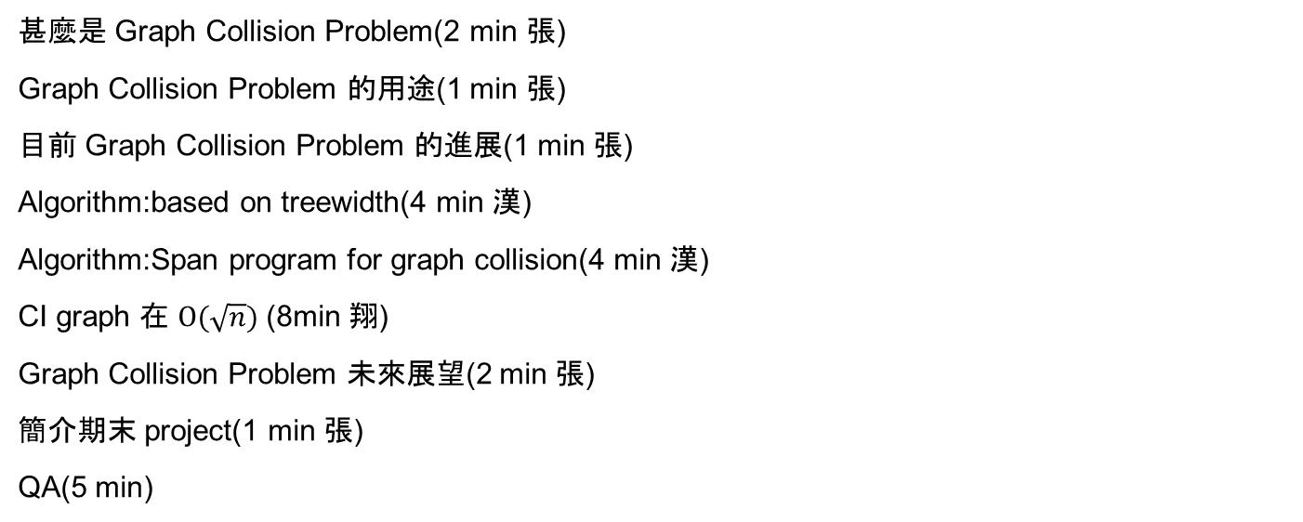
大綱
甚麼是 Graph Collision Problem(2 min 張)
Graph Collision Problem 的用途(1 min 張)
目前 Graph Collision Problem 的進展(1 min 張)
Algorithm:based on treewidth(4 min 漢)
Algorithm:Span program for graph collision(4 min 漢)
CI graph 在 $O(\sqrt{n})$ (8min 翔)
Graph Collision Problem 未來展望(2 min 張)
簡介期末 project(1 min 張)
QA(5 min)

Slide 3
甚麼是 Graph Collision Problem?

Slide 4
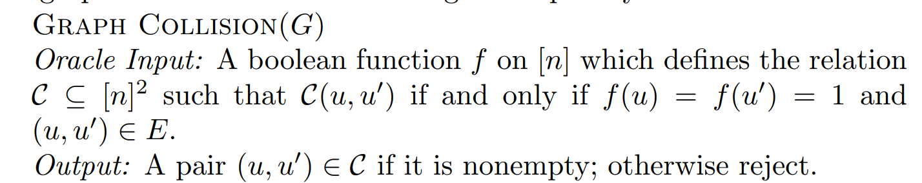
Graph Collision Problem
Magniez, F., Santha, M., Szegedy, M.: Quantum algorithms for the triangle problem. SIAM Journal on Computing 37(2), 413–424 (2007)

Slide 5
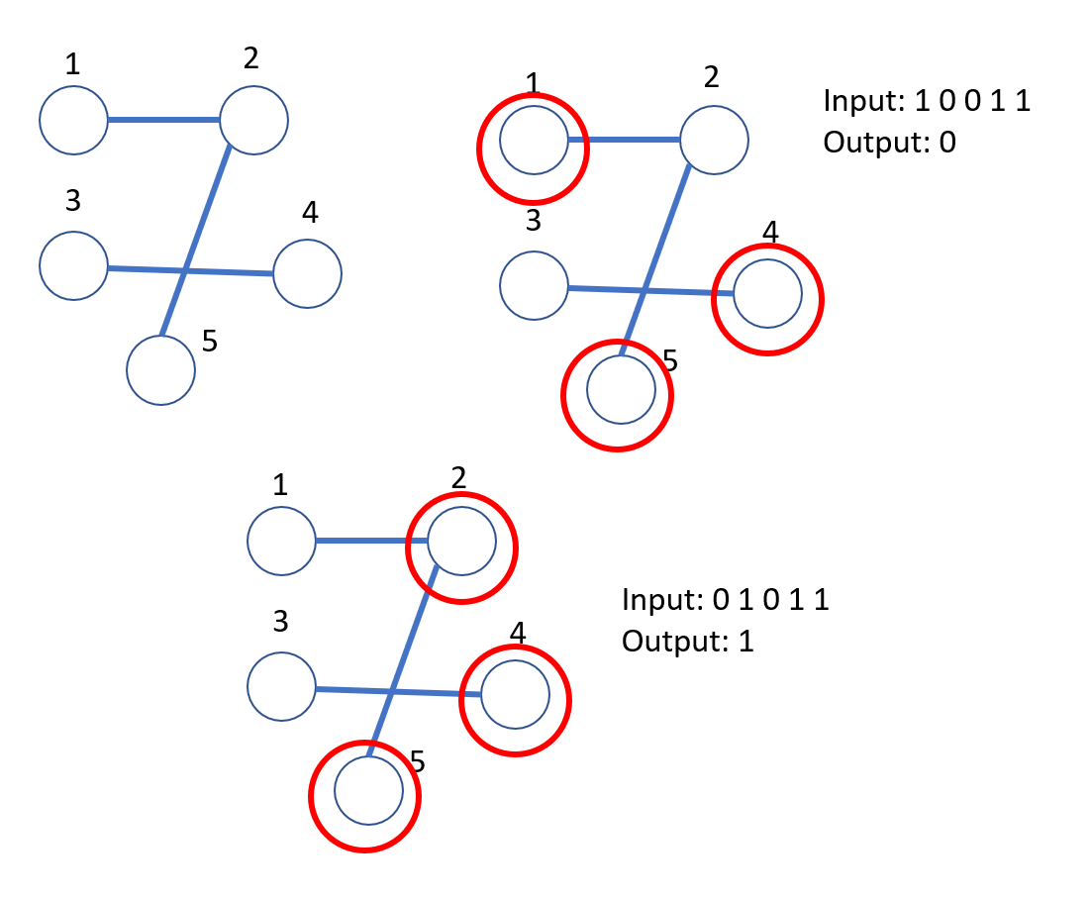

Slide 6
Graph Collision Problem 的用途

Slide 7
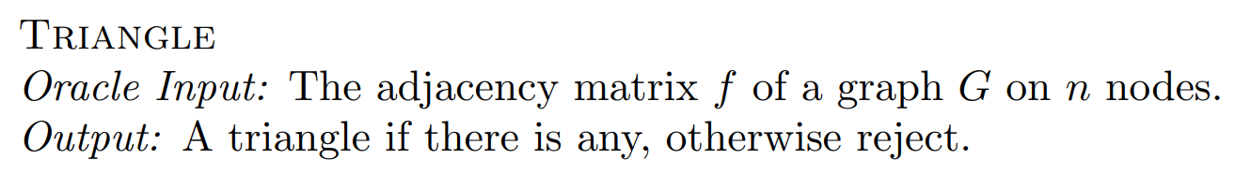
Subproblem of Triangle Finding
Magniez, F., Santha, M., Szegedy, M.: Quantum algorithms for the triangle problem. SIAM Journal on Computing 37(2), 413–424 (2007)

Slide 8
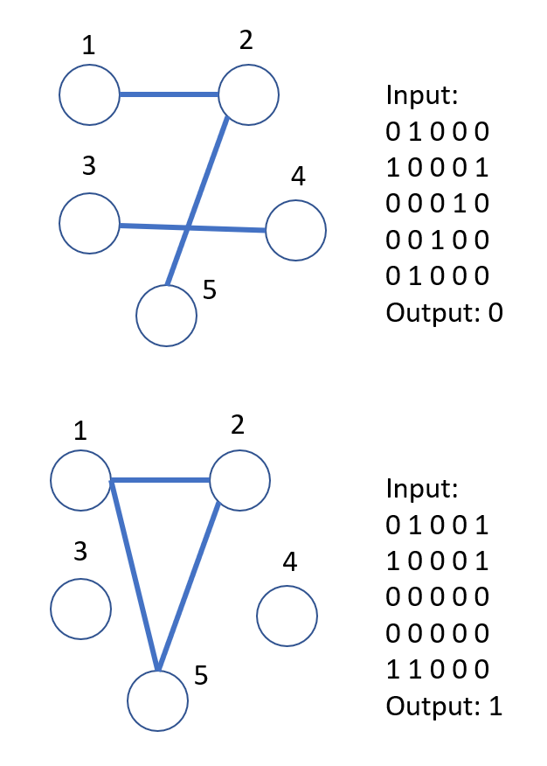

Slide 9
Triangle Finding 的用途
in connection with matrix multiplication

Slide 10
目前 Graph Collision Problem 的進展

Slide 11
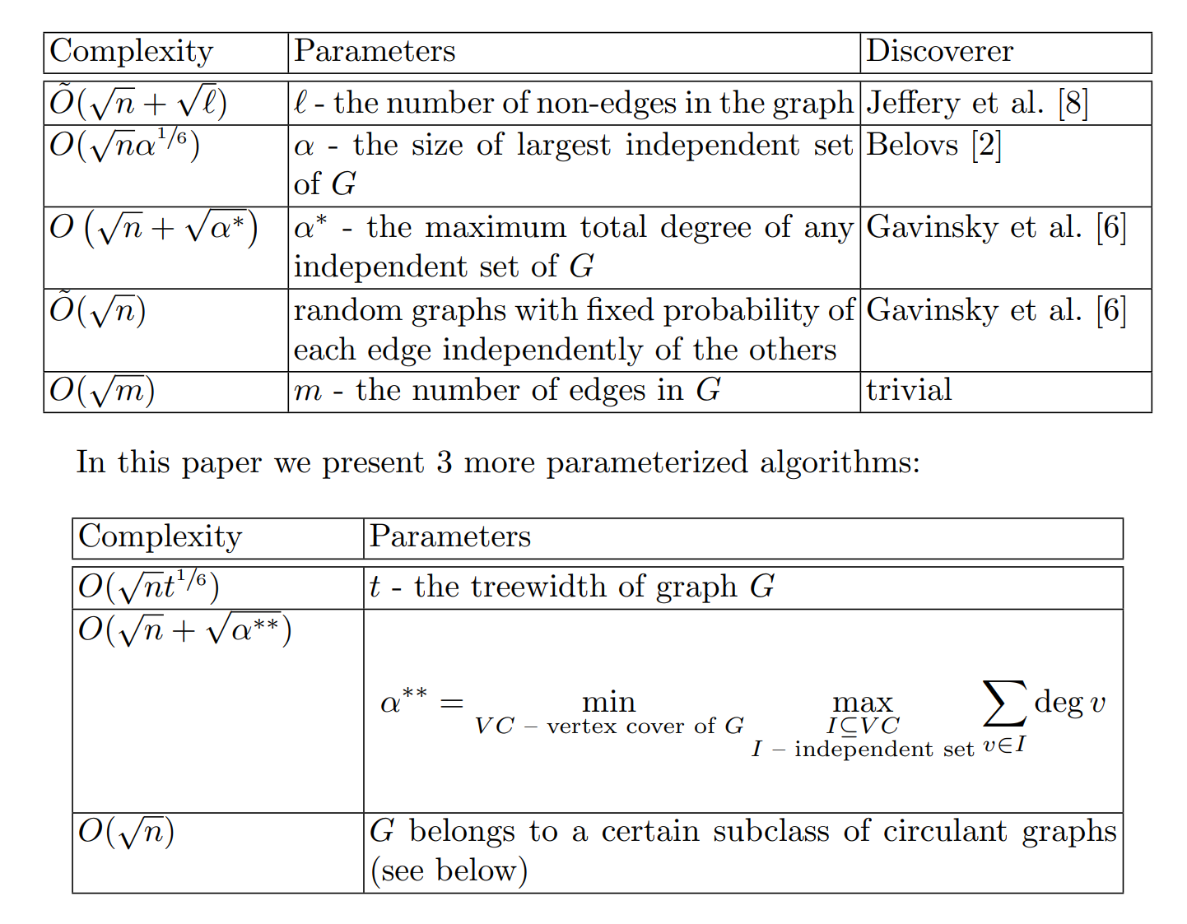
Andris Ambainis, Kaspars Balodis, Jānis IraidsRaitis Ozols, Juris Smotrovs. Parameterized Quantum Query Complexity of Graph Collision. arXiv:1305.1021

Slide 12
Algorithm:Graph collision based on treewidth

Slide 13
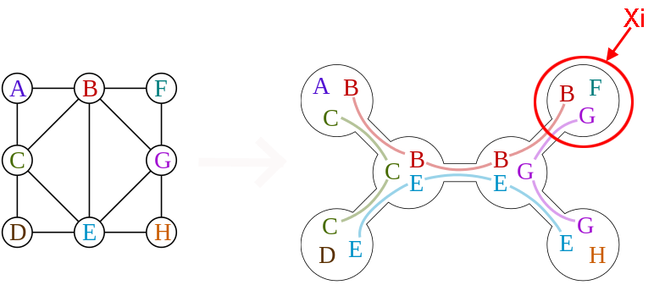

Tree Decomposition:definition
1.The union of all sets $X_{i}$ equals $V$.
https://en.wikipedia.org/wiki/Treewidth

Slide 14
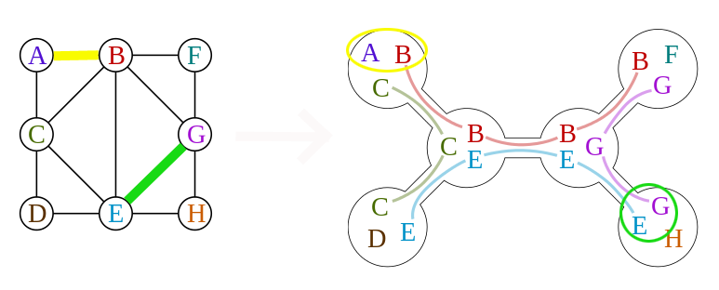

Tree Decomposition:definition
2.For every edge $\left(V,W\right)$ in the graph, there is a subset $X_{i}$ that contains both $V$ and $W$.
https://en.wikipedia.org/wiki/Treewidth

Slide 15
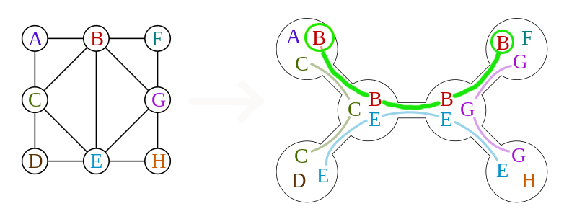

Tree Decomposition:definition
3.If $X_{i}$ and $X_{j}$ both contain a vertex $V$, then all nodes $X_{k}$ in the (unique) path contain $V$ as well.
https://en.wikipedia.org/wiki/Treewidth

Slide 16
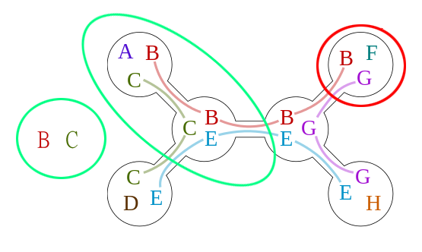

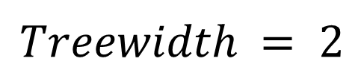
Treewidth & Smoothness
$$Treewidth = 2$$
Treewidth = $t$:
$max(\left|X_{i}\right|)−1$ = $t$
Smooth:
1.all $\left|X_{i}\right|=t+1$
2.$\left|X_{i}∩X_{j}\right|=t$
https://en.wikipedia.org/wiki/Treewidth
Notes:
tree decomposition 是NP-hard的問題
任何的tree decomposition都可轉換成另一個Smoothness 的tree decomposition

Slide 17
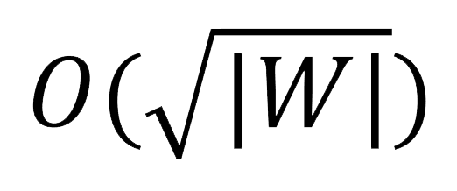
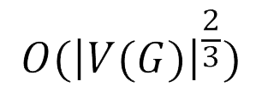
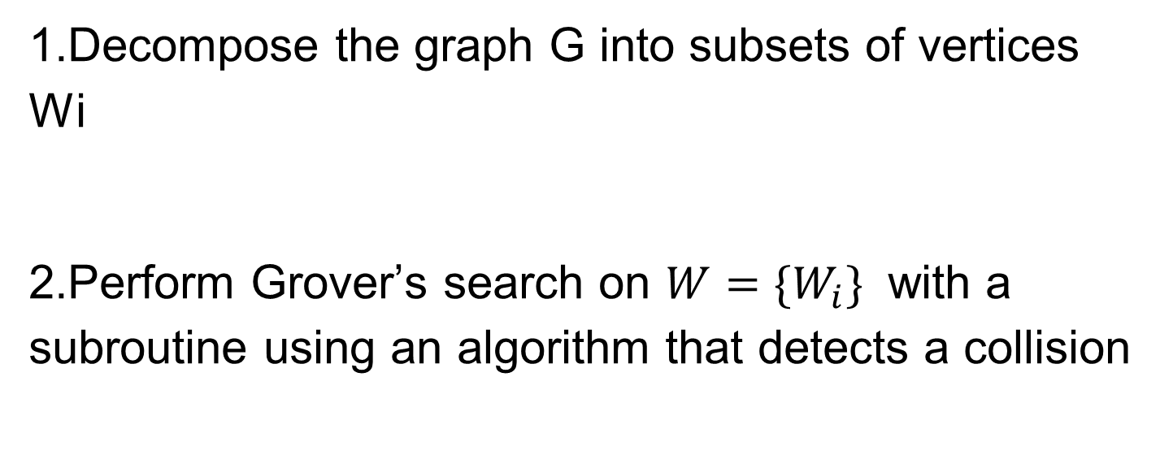
Algorithm
1.Decompose the graph G into subsets of vertices Wi
2.Perform Grover’s search on ${W=\{W}_{i}\}$ with a subroutine using an algorithm that detects a collision
Ref [2]
Notes:
O(n^(2/3)) 有一位先人於2007完成

Slide 18
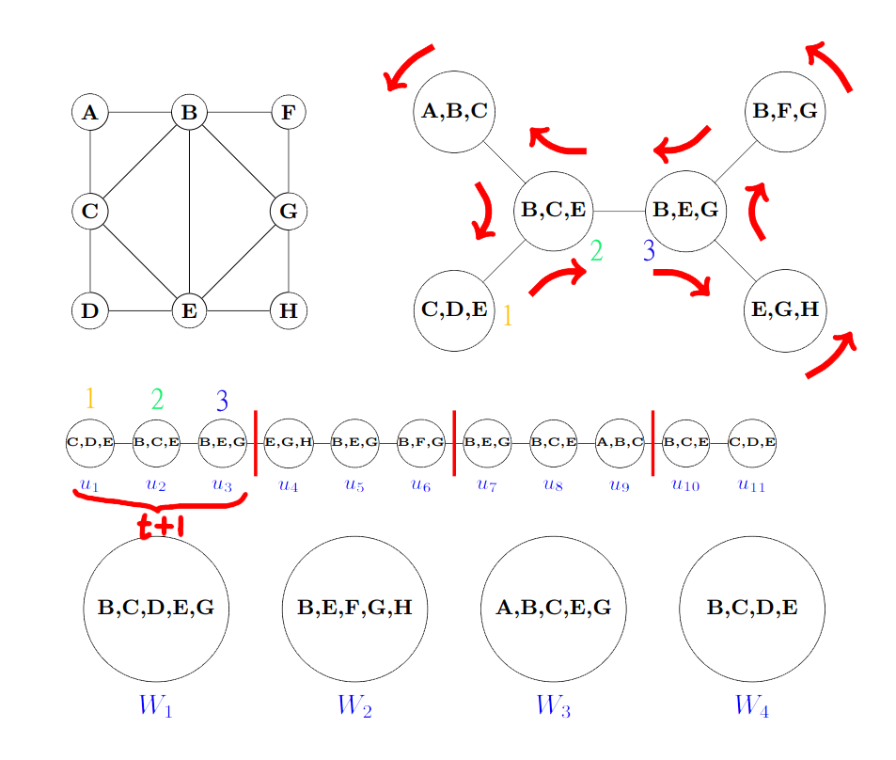
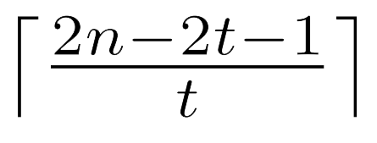

Lemma
G
$$\left|W\right|=$$
$$\left|W_{i}\right|≤2t−1$$
U
W
Andris Ambainis, Kaspars Balodis, Jānis IraidsRaitis Ozols, Juris Smotrovs. Parameterized Quantum Query Complexity of Graph Collision. arXiv:1305.1021
Notes:
每條edge最多被走2次
smoothness特性，node彼此間差1個element

Slide 19
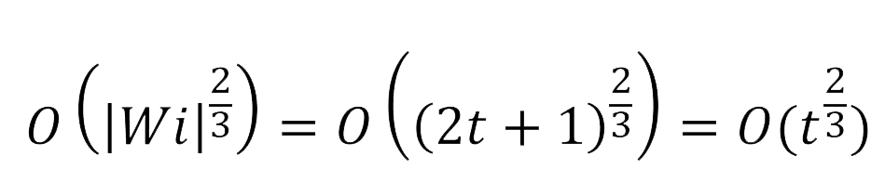
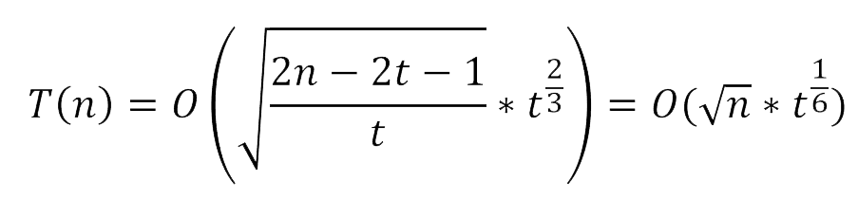

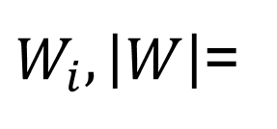
Time Complexity
Each $\left|W_{i}\right|$ need
queries
There are
$W_{i},\left|W\right|$=
Ref [2]

Slide 20
Algorithm:Span program for graph collision

Slide 21
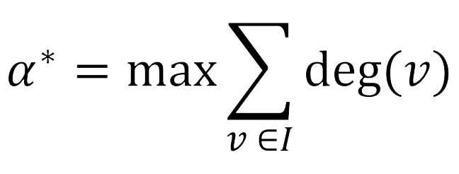

Improvement of an algorithm
Discovered by Gavinsky, Ito in 2012.
Def:
Ref [2]
Notes:
I是independent set of G
deg 是看一個node身上有接幾條edge

Slide 22
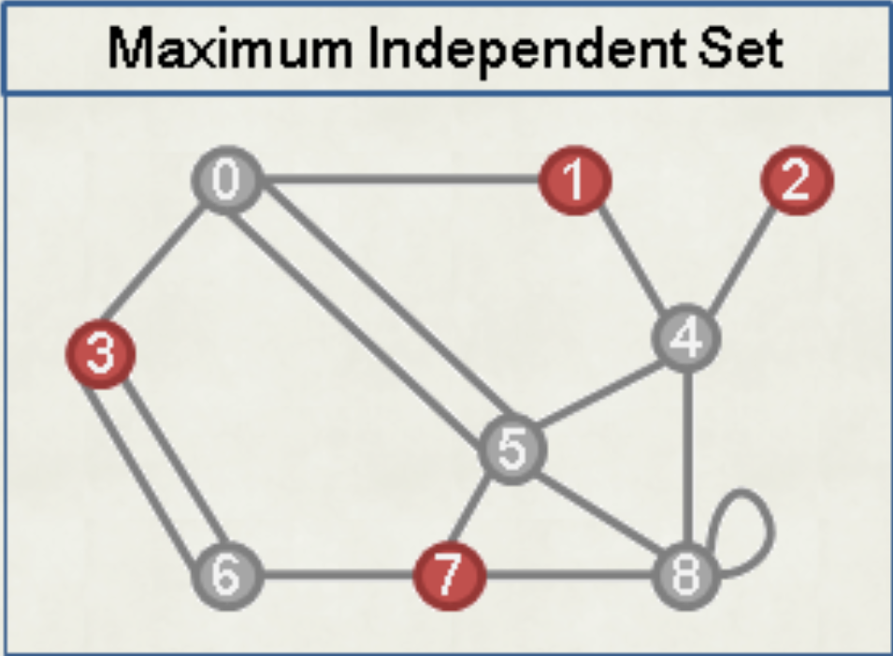
independent set
Def:a set of vertices in a graph, no two of which are adjacent.
https://web.ntnu.edu.tw/~algo/Domination.html
Notes:
有一個set，裡面存一些vertices，但vertices彼此間均沒有edge相連

Slide 23
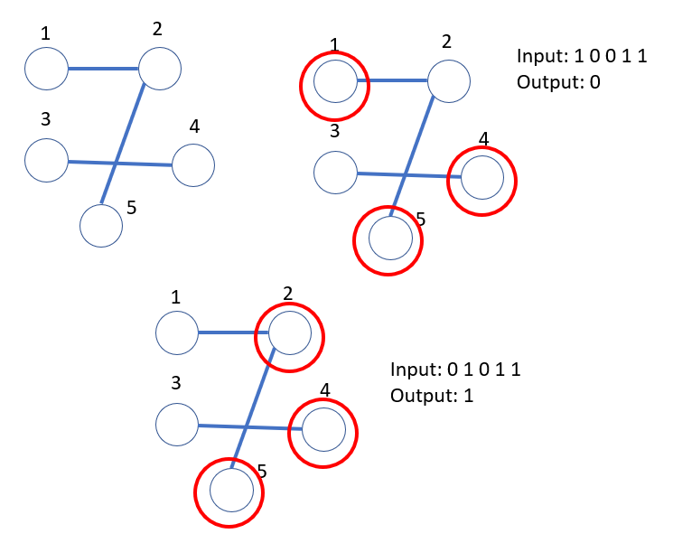
Another way to view Graph Collision
Independent Set
not Independent Set

Slide 24
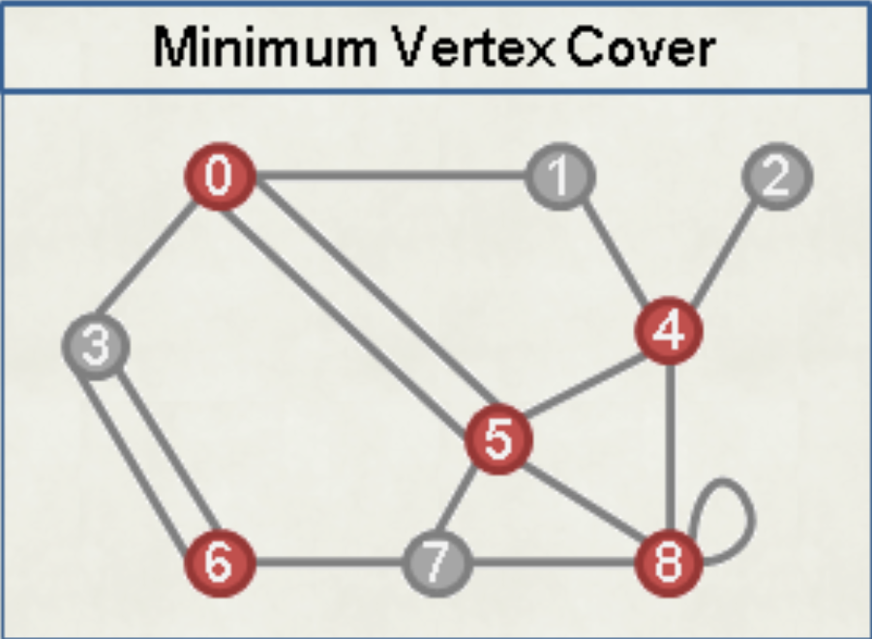
Vertex Cover
Def:a set of vertices that includes at least one endpoint of every edge of the graph
https://web.ntnu.edu.tw/~algo/Domination.html
Notes:
稱set = A，裡面存一些vertices，所有的edge，至少有一邊的端點是 in set A

Slide 25
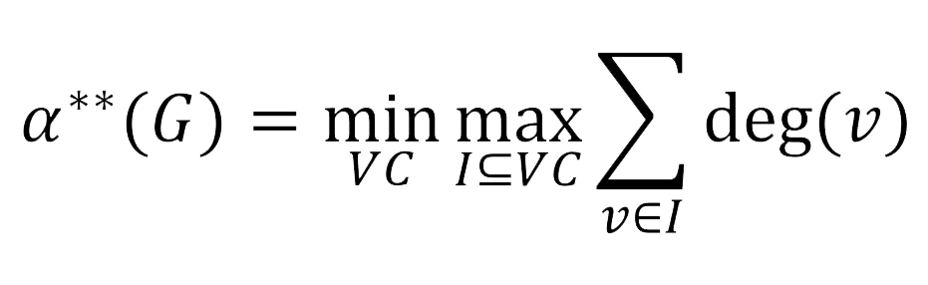
Time complexity
Def:
Ref [2]

Slide 26
Quantum algorithm for a subclass of circulant graphs

Slide 27
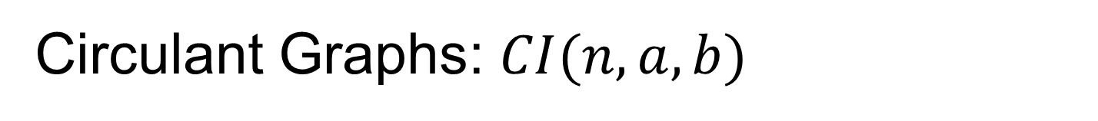
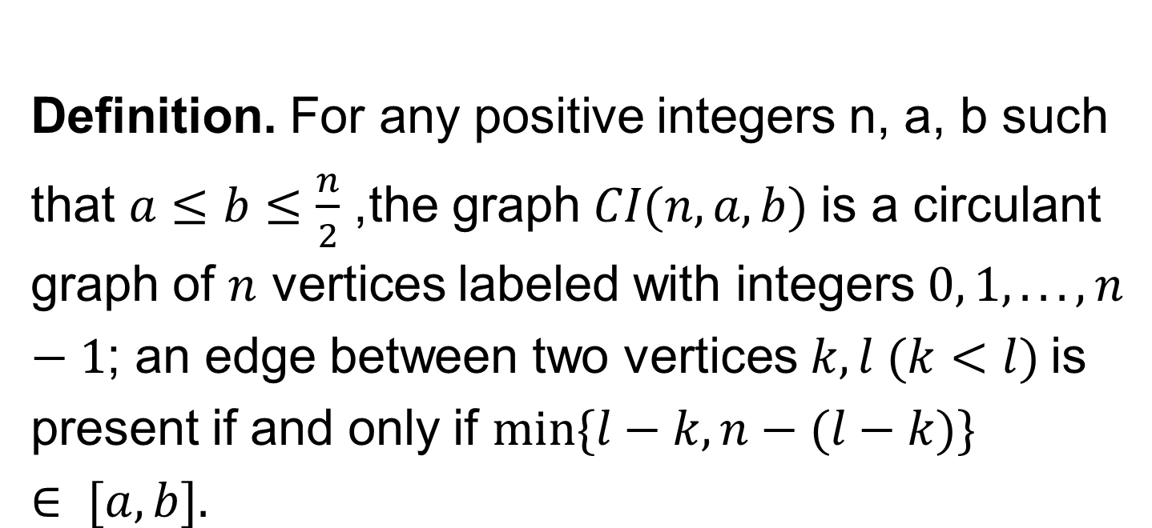
Circulant Graphs: $CI(n,a,b)$
Definition. For any positive integers n, a, b such that $a≤b≤\frac{n}{2}$, the graph $CI(n, a, b)$is a circulant graph of $n$ vertices labeled with integers $0, 1, . . . , n−1$; an edge between two vertices $k, l (k<l)$is present if and only if $min⁡\{l−k, n−(l−k)\} ∈ [a, b].$

Slide 28
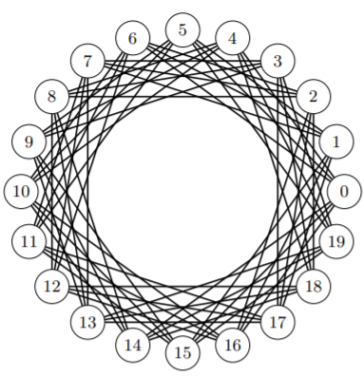
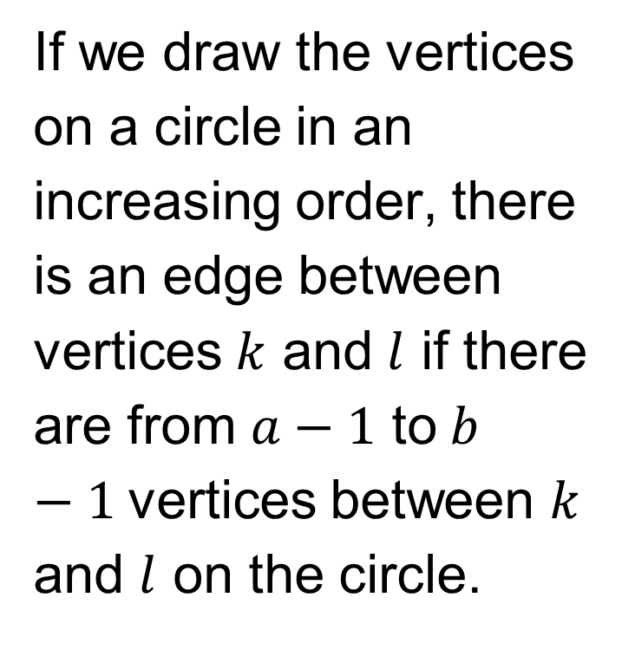
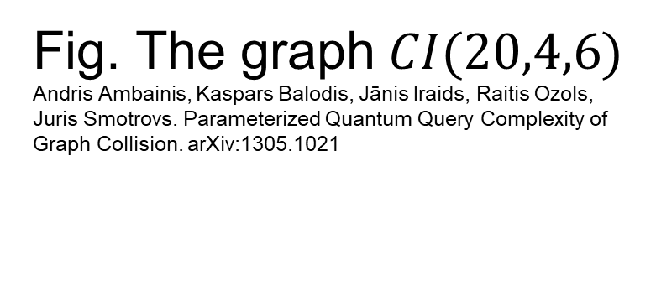
If we draw the vertices on a circle in an increasing order, there is an edge between vertices $k$ and $l$ if there are from $a−1$ to$b−1$vertices between $k$ and $l$ on the circle.
Fig. The graph $CI(20,4,6)$
Andris Ambainis, Kaspars Balodis, Jānis Iraids, Raitis Ozols, Juris Smotrovs. Parameterized Quantum Query Complexity of Graph Collision. arXiv:1305.1021

Slide 29


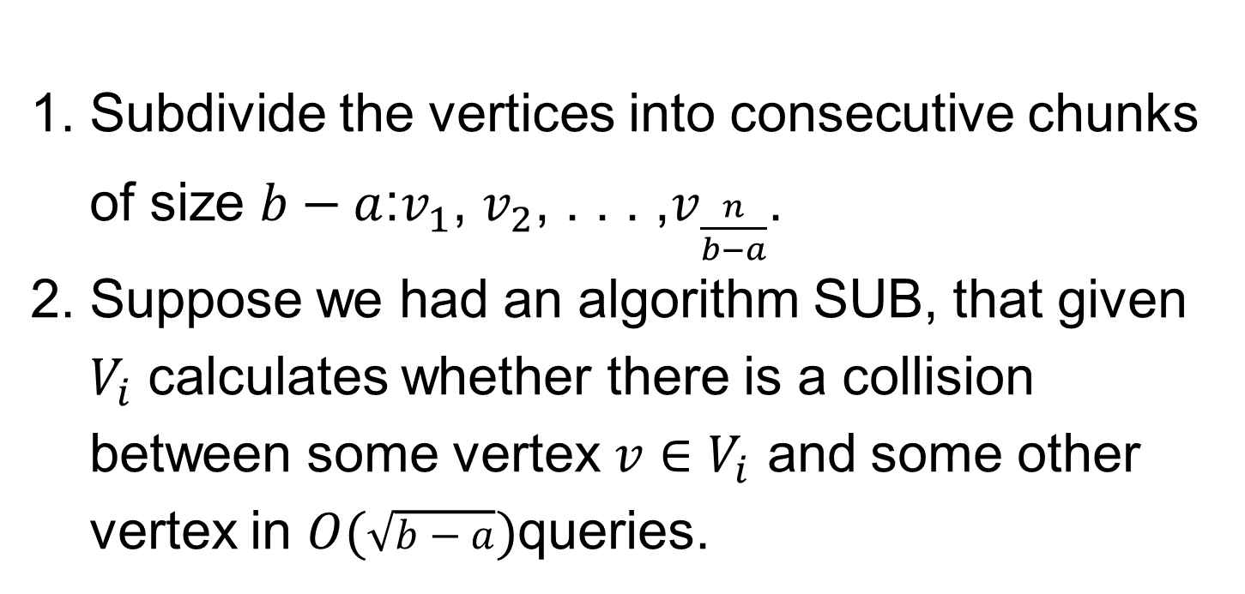
The algorithm for $COL(CI(n, a, b))$
$$COL(CI(n, a, b))$$
SUB
MIN
find_max
Subdivide the vertices into consecutive chunks of size $b−a$:$v_{1}$, $v_{2}$, . . . ,$v_{\frac{n}{b−a}}$.
Suppose we had an algorithm SUB, that given $V_{i}$ calculates whether there is a collision between some vertex $v∈V_{i}$ and some other vertex in $O(\sqrt{b−a})$queries.

Slide 30
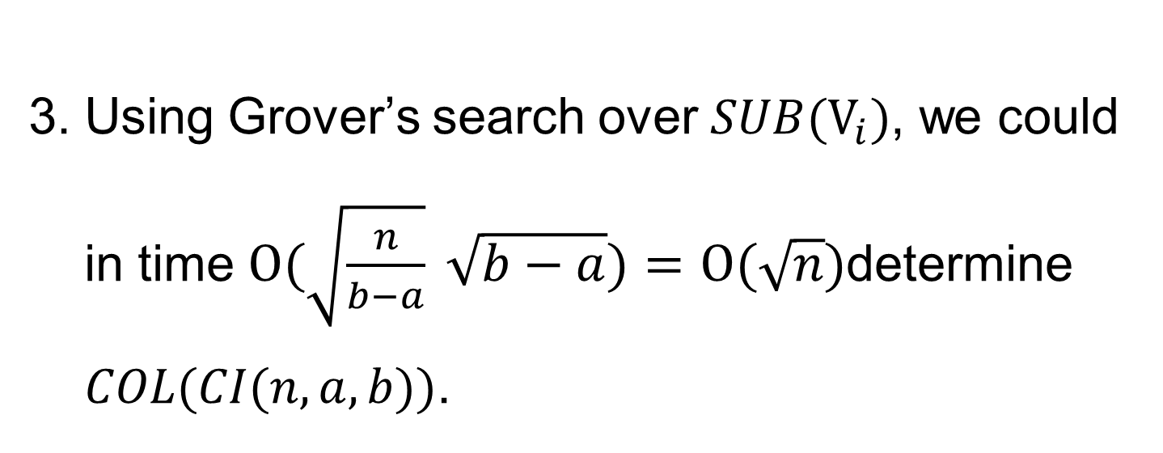
Using Grover’s search over $SUB(V_{i})$, we could in time $O(\sqrt{\frac{n}{b−a}} \sqrt{b−a})=O(\sqrt{n})$determine $COL(CI(n, a, b))$.

Slide 31
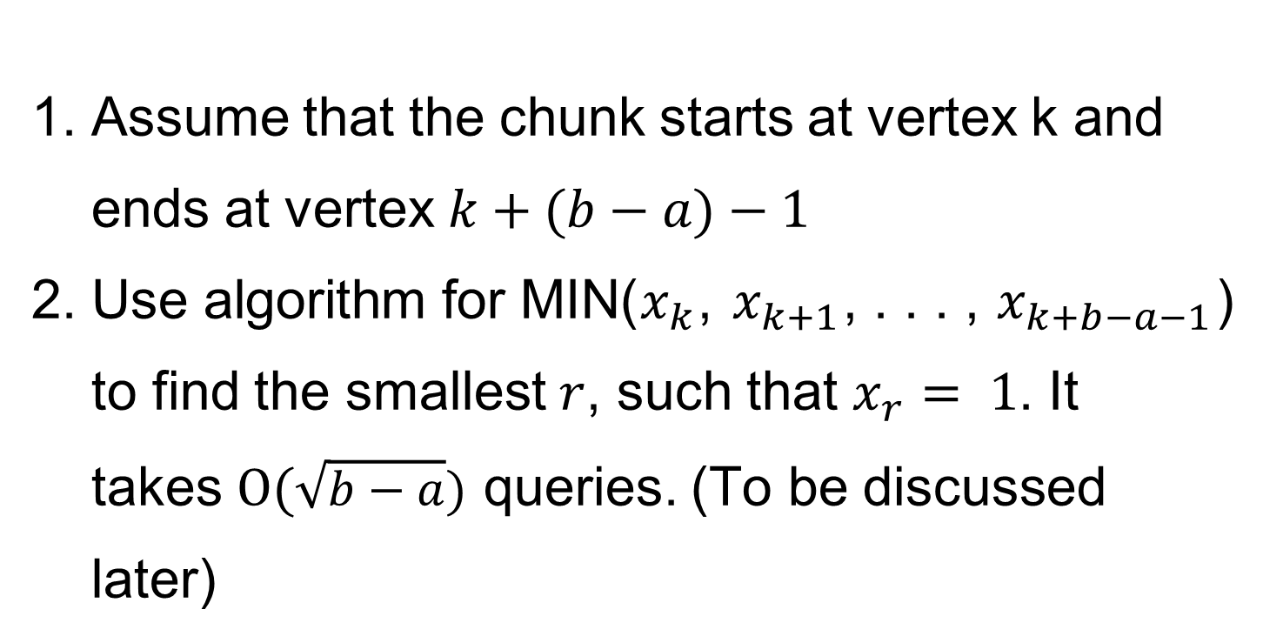

The Algorithm SUB
$$COL(CI(n, a, b))$$
SUB
MIN
find_max
Assume that the chunk starts at vertex k and ends at vertex $k+(b−a)−1$
Use algorithm for MIN($x_{k}$, $x_{k+1}$, . . . , $x_{k+b−a−1}$) to find the smallest $r$, such that $x_{r}$ $= 1$. It takes $O(\sqrt{b−a})$ queries. (To be discussed later)

Slide 32
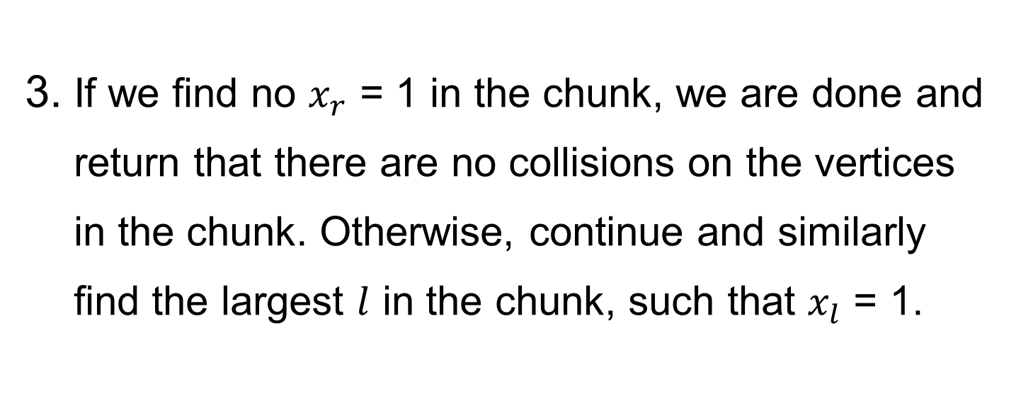
If we find no $x_{r}$ = 1 in the chunk, we are done and return that there are no collisions on the vertices in the chunk. Otherwise, continue and similarly find the largest $l$ in the chunk, such that $x_{l}$ = 1.

Slide 33
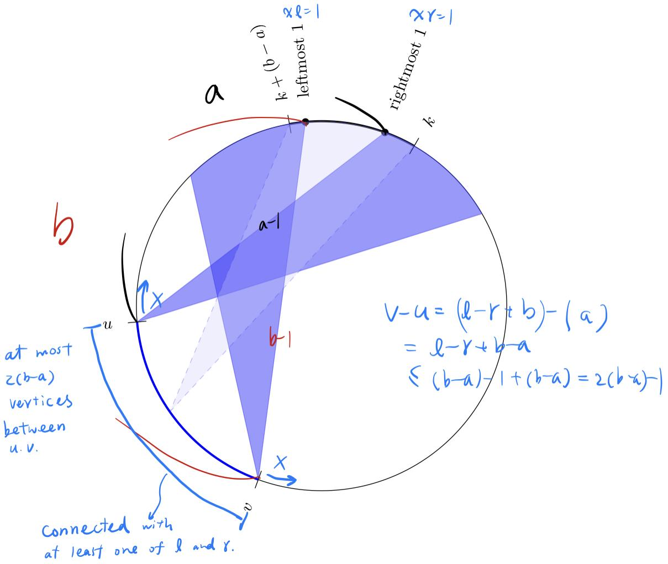
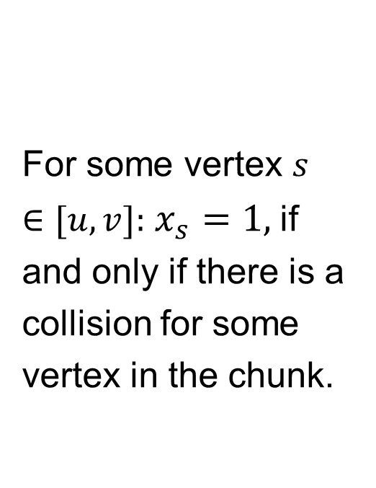
For some vertex $s∈[u, v]:$ $x_{s}=1,$if and only if there is a collision for some vertex in the chunk.
Andris Ambainis, Kaspars Balodis, Jānis IraidsRaitis Ozols, Juris Smotrovs. Parameterized Quantum Query Complexity of Graph Collision. arXiv:1305.1021

Slide 34
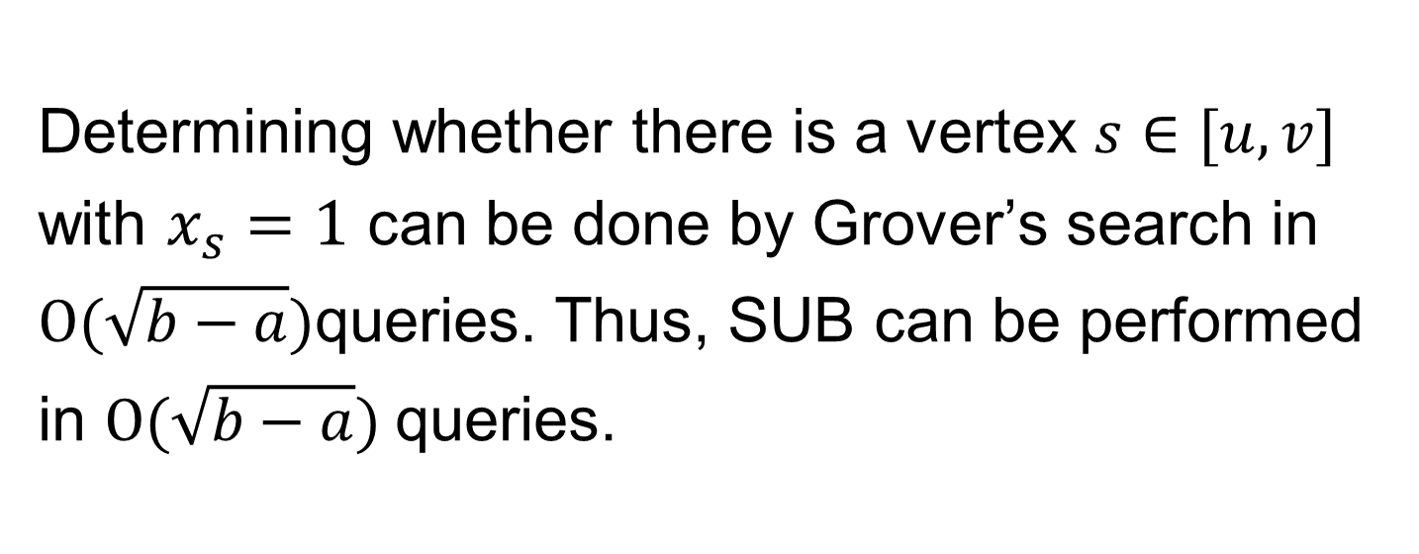
Determining whether there is a vertex $s∈[u, v]$ with $x_{s}=1$ can be done by Grover’s search in $O(\sqrt{b−a})$queries. Thus, SUB can be performed in $O(\sqrt{b−a})$queries.

Slide 35
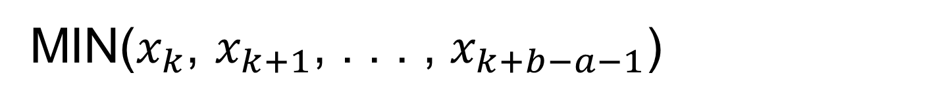

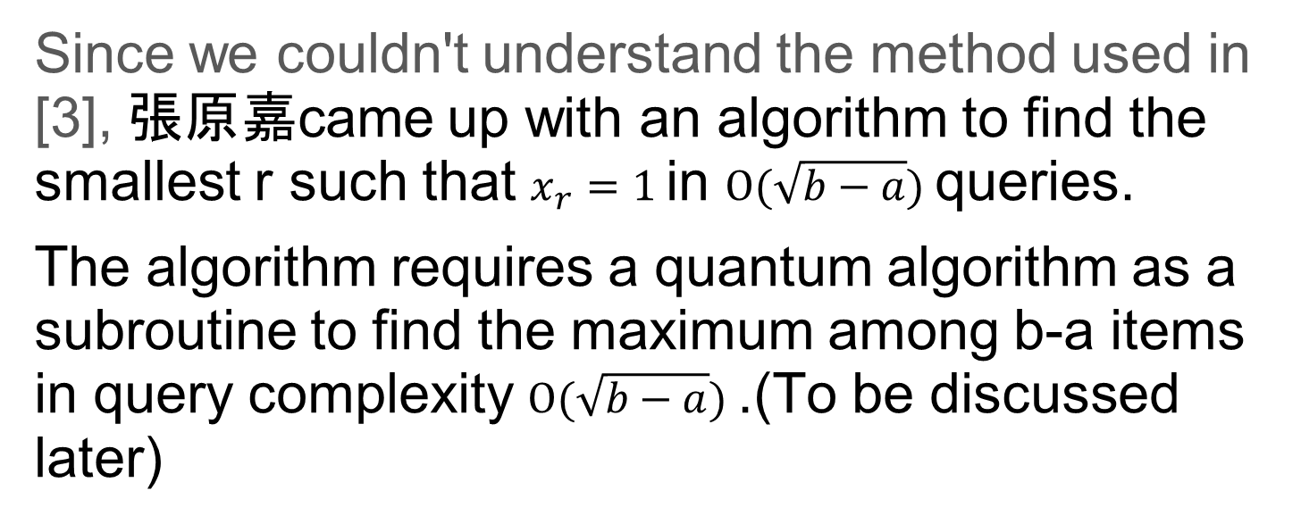
MIN($x_{k}$, $x_{k+1}$, . . . , $x_{k+b−a−1}$)
$$COL(CI(n, a, b))$$
SUB
MIN
find_max
Since we couldn't understand the method used in [3], 張原嘉came up with an algorithm to find the smallest r such that $x_{r}=1$in $O(\sqrt{b−a})$queries.
The algorithm requires a quantum algorithm as a subroutine to find the maximum among b-a items in query complexity $O(\sqrt{b−a})$.(To be discussed later)

Slide 36
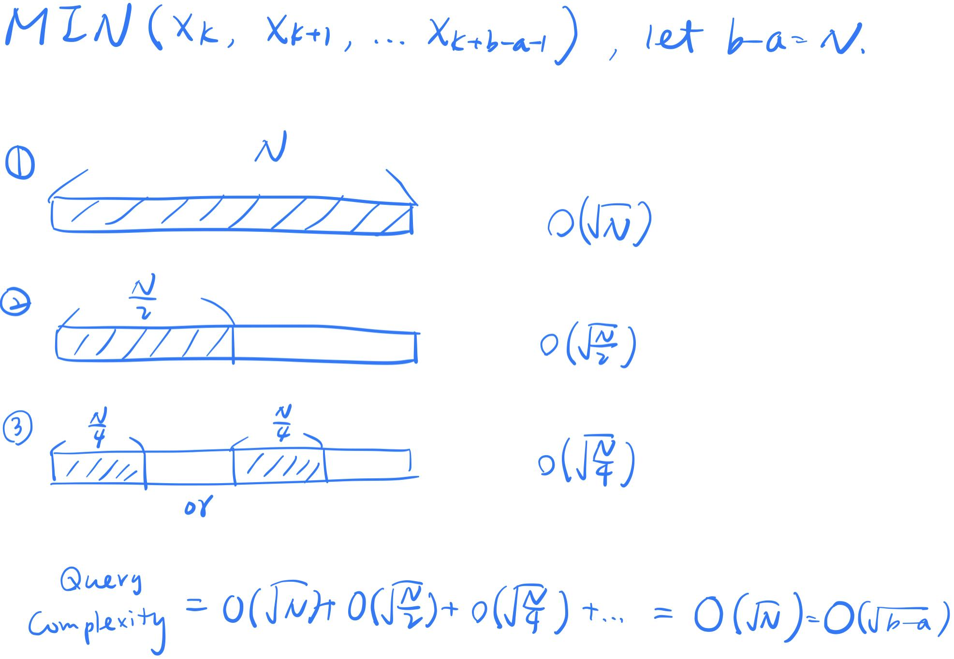
goal: find xr = 1

Slide 37

Quantum Algorithm for finding the Maximum
$$COL(CI(n, a, b))$$
SUB
MIN
find_max
Idea: This algorithm starts out with an initial guess of the index of the maximum and using Grover’s search algorithm, finds out a new element which is the index of one of the elements greater than the initial indexed element. The new index forms our new guess and the whole procedure is repeated.

Slide 38
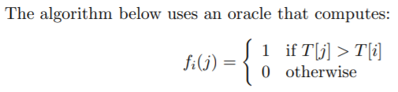

Ashish Ahuja, Sanjiv Kapoor, A Quantum Algorithm for finding the Maximum

Slide 39

According to [4],This algorithm takes $O\left(\sqrt{N}\right)= O(\sqrt{b−a})$steps by exploiting the property of quantum states.

Slide 40
Graph Collision Problem 未來展望

Slide 41

$$Θ\left(\sqrt{n}\right)?ω\left(\sqrt{n}\right)?$$
By Grover Search, we have lower bound $Ω(\sqrt{n})$
on Graph Collision Problem.
Is there exist an $Θ\left(\sqrt{n}\right)$algorithm for all graph?
Yes? No?

Slide 42
Andris Ambainis, Kaspars Balodis, Jānis IraidsRaitis Ozols, Juris Smotrovs. Parameterized Quantum Query Complexity of Graph Collision. arXiv:1305.1021

Slide 43

It remains unknown
Andris Ambainis, Kaspars Balodis, Jānis IraidsRaitis Ozols, Juris Smotrovs. Parameterized Quantum Query Complexity of Graph Collision. arXiv:1305.1021

Slide 44
簡介期末 project

Slide 45
實作 CI Graph 的 Graph Collision Problem
main alogrithm
SUB
Find Min Index
Find Max Value
Grover Search

Slide 46
Reference
Magniez, F., Santha, M., Szegedy, M.: Quantum algorithms for the triangle problem. SIAM Journal on Computing 37(2), 413–424 (2007)
Andris Ambainis, Kaspars Balodis, Jānis IraidsRaitis Ozols, Juris Smotrovs. Parameterized Quantum Query Complexity of Graph Collision. arXiv:1305.1021
Christoph Durr, Peter Hoyer. A quantum algorithm for finding the minimum, http://arxiv.org/abs/quant-ph/9607014v
Ashish Ahuja, Sanjiv Kapoor, A Quantum Algorithm for finding the Maximum
https://en.wikipedia.org/wiki/Treewidth
https://web.ntnu.edu.tw/~algo/Domination.html

Slide 47
QA

