Slide 1
CS4255 – 2022
Project

Slide 2
Basics
Form groups of 3 – email me (a.urhan@tudelft.nl)
Implement FastTree algorithm
Price at al. FastTree: Computing Large Minimum Evolution Trees with Profiles instead of a Distance Matrix. Molecular Biology and Evolution, vol 26 (7). 2009.
Project sessions
Every Friday - in person or on Teams?

Slide 3
Submission
Must include:
Your code, with meaningful comments to help follow (per group)
A readme file/documentation explaining how to run your code (per group)
A 7-10 minutes long video (per group) where you explain your work
No template, be creative!
1-page reflection (per student) on the project, should include:
What parts of your project you were involved in
Experience working as a group
What you learned doing this project

Slide 4
Submission
On SurfDrive – links available on Teams
Submit the group package in a single zip file, should be easy to identify the group
The individual 1-page reflection must be submitted independently per student in the same FileDrop
DEADLINE: 14-01-22 NOON

Slide 5
Grading
Rubric available on Teams

Slide 6
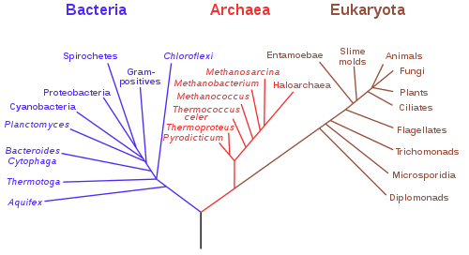
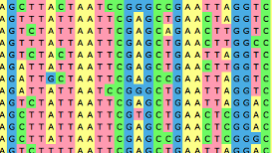
FastTree
Build phylogenetic trees – fancy neighbor joining
multiple sequence alignment phylogenetic tree

Slide 7
FastTree
Data on Teams Project channel
Real input: fasttree-input.aln
Small testing data: test-small.aln

Slide 8
FastTree
3 main components – increasing in complexity
Neighbor joining with profiles
Nearest neighbor interchange
Top-hits heuristic

Slide 9
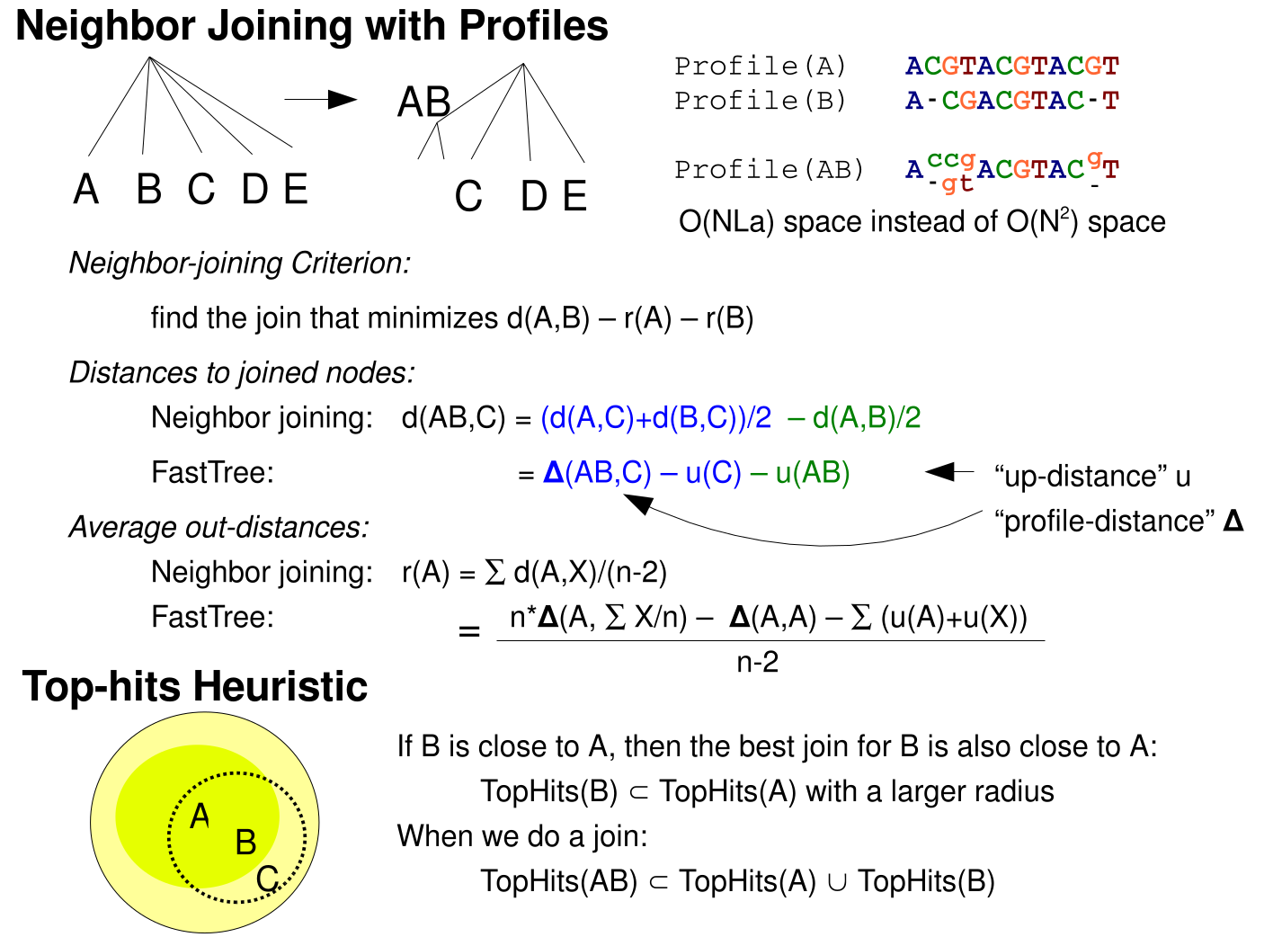
1. Neighbor joining with profiles
Sequence alignment implies distance – nucleotide differences
Use profiles instead of distance
A 4×n matrix, n is the alignment length

Slide 10

1. Neighbor joining with profiles
Computing distances
Profile distance to the new node formed by joining A and B:
Distance between internal nodes
Up-distance – u(i)
Average distance of the node from its children
Should be 0 for leaves

Slide 11


1. Neighbor joining with profiles
Neighbor joining criterion
Average out-distance

Slide 12
1. Neighbor joining with profiles
Important points
Log-correction of distances
Branch lengths (at the end)

Slide 13
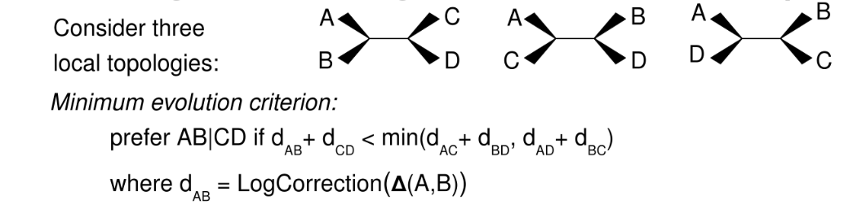
2. Nearest neighbor interchanges
Improve topology
Uses log-corrected profile distances

Slide 14
3. Top-hits heuristic
Avoid computing all pairwise distances and consider all possible joins
Compute the 2m top hits of node A (2 is a safety factor). Then, for each node B within the top m hits of A that does not already have a top-hits list, estimate the top hits of B by comparing B to the top 2m hits of A.

Slide 15
Bonus points
Handling gaps in profile distances
Correct log-correction of distances
Local bootstrap during nearest neighbor interchange
Local hill-climbing search to find better join
Output in actual newick format

Slide 16
Final tips
Read through the main paper AND the supplementary material
Start with the NJ algorithm and then add the profile distances
There is NO SINGLE CORRECT SOLUTION

