Slide 1
Analyzing student activity
in the Computer Programming course
T20
Lanxiang Zhang, Jian Zhang, Yucui Wu, Xinyue Zhang

Slide 2
Our team
Lanxiang Zhang-Computer Science MSc, 1st year
Jian Zhang-Computer Science MSc, 1st year
Yucui Wu-Computer Science MSc, 1st year
Xinyue Zhang-Computer Science MSc, 1st year

Slide 3
project owner
Reimo Palm
Institute of Computer Science
Chair of Programming Languages and Systems
Lecturer in Informatics

Slide 4
What problem and Why need to solve it ?
Predict the final score based on their early activity
Classify the students based on their typical study patterns
Students can adjust their learning status in time
Teachers can promptly identify students who need help
Revealing effective learning strategies

Slide 5
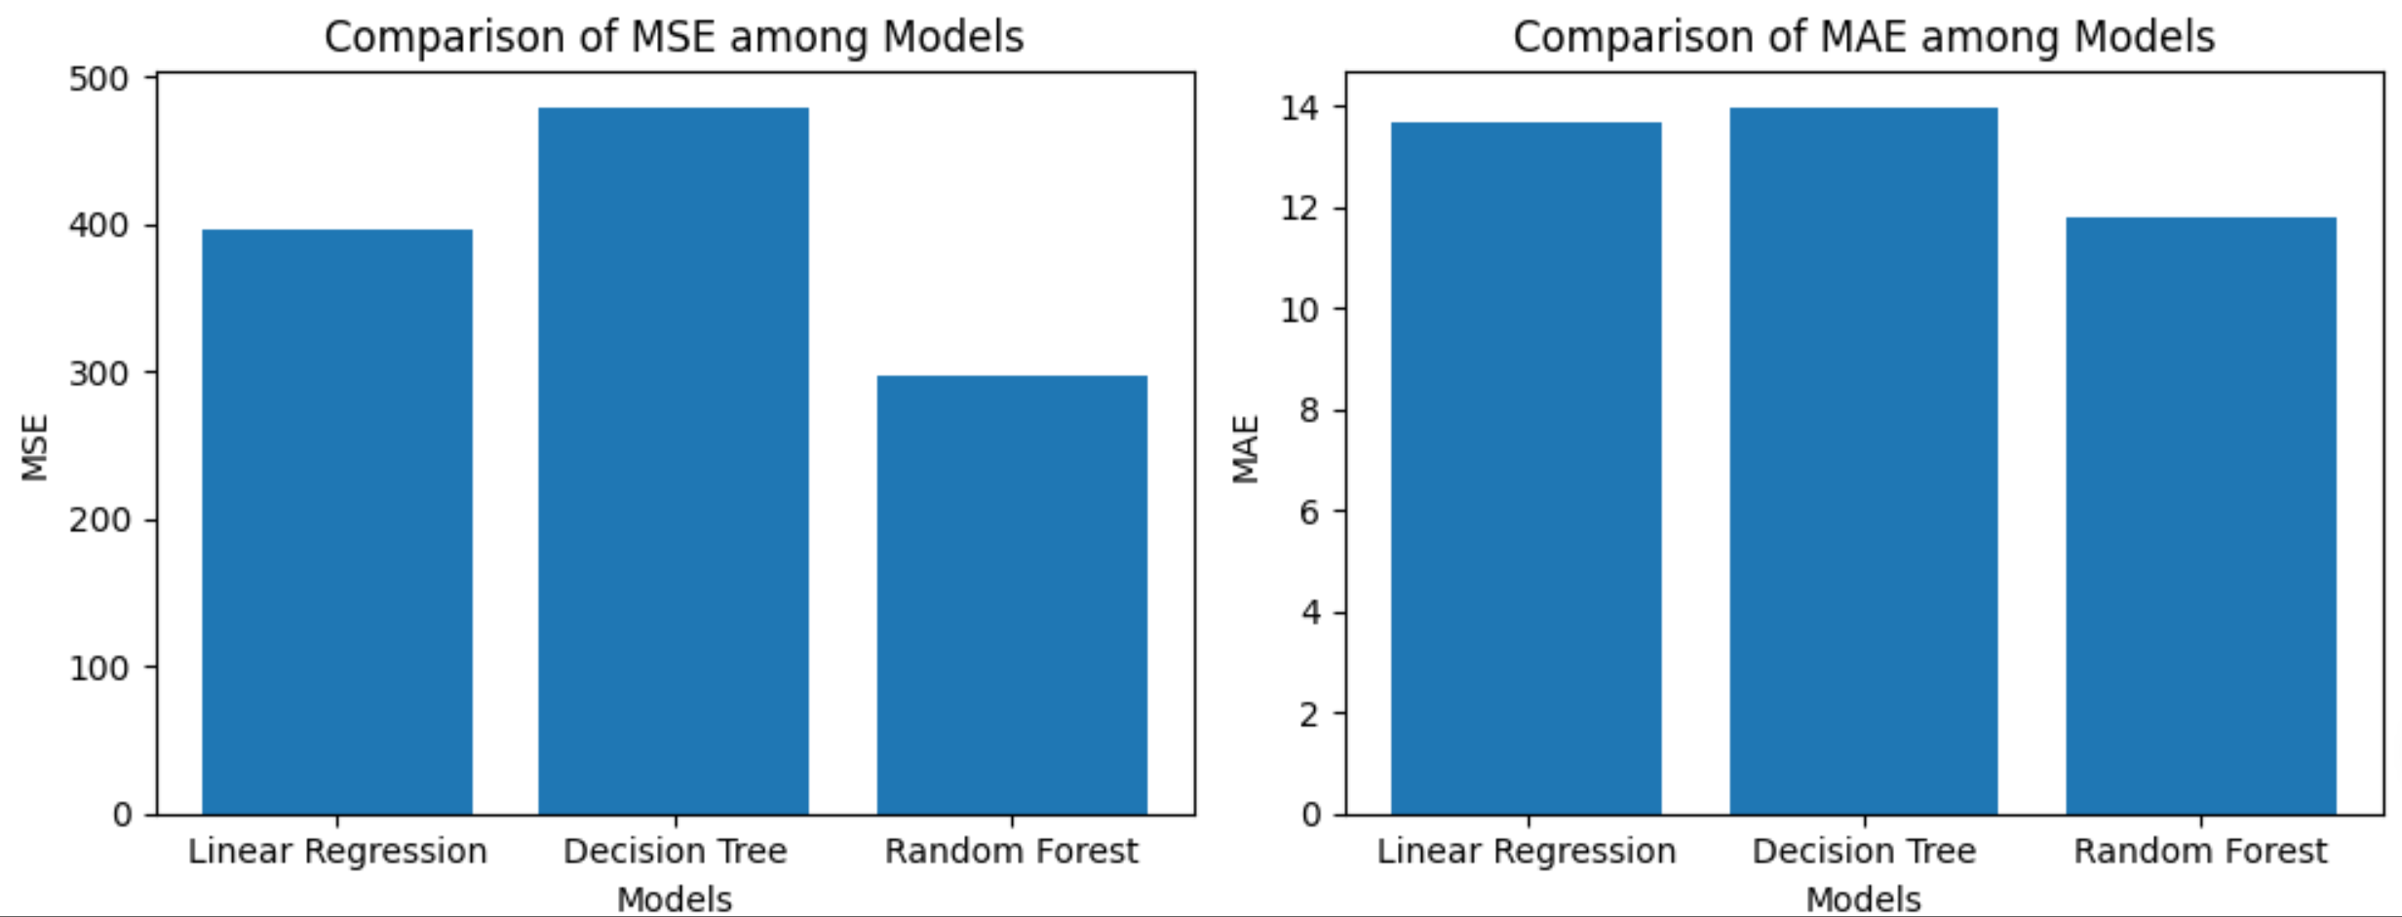
progress so far & problems
Indentified the data cleaning rules
Merging data.csv and log.csv
train models on predicting the students’ final score
- linear regression
- decision tree
- random forest(obtained the best performance)
Notes:
data cleaning:
for log.csv we only keep the highest score which before the deadline
for data.csv we replace - with NaN, delete the data that does not participate in any activity or got F due to other activtiy and delete the data that got A in the pre-exam
data merging:
problem??

Slide 6
Future
What feature should we use when we classify the students
- the sum of attempts and the relationship with the final grade
- the sum of attempts and the relationship with the activity score
What model should we use when classify the students
- random forest
- K-Nearest Neighbors

Slide 7
THANK YOU
Q&A

