Slide 1
Practical Concurrent and Parallel Programming 10
Thomas Dybdahl Ahle
IT University of Copenhagen
October 2019-10-31

Slide 2
Plan for today
What’s wrong with lock-based atomicity
Transactional memory STM, Multiverse library
A transactional bank account
Transactional blocking queue
Composing atomic operations
transfer from one queue to another
choose first available item from two queues
Philosophical transactions
Other languages with transactional memory
Hardware support for transactional memory

Slide 3
Transactional memory
Based on transactions, as in databases
Transactions are composable
unlike lock-based concurrency control
Easy to implement blocking
no wait and notifyAll or semaphore trickery
Easy to implement blocking choice
eg. get first item from any of two blocking queues
Typically optimistic
automatically very scalable read-parallelism
unlike pessimistic locks
No deadlocks and usually no livelocks
Notes:
Transactions are all-or-nothing. At end: Mention that it is a new field of study

Slide 4
Transactions
Know from databases since 1981 (Jim Gray)
Proposed for programming languages 1986
(In a functional programming conference)
Became popular again around 2004
due to Harris, Marlow, Peyton-Jones, Herlihy
Haskell, Clojure, Scala, ... and Java Multiverse
A transaction must be
Atomic: if one part fails, the entire transaction fails
Consistent: maps a valid state to a valid state
Isolated: A transaction does not see the effect of any other transaction while running
(But not Durable, as in databases)
Notes:
Tim Harris, Simon Marlow, SPJ, Maurice Herlihy

Slide 5
Difficulties with lock-based atomicity
Transfer money from account ac1 to ac2
No help that each account operation is atomic
Can lock both, but then there is deadlock risk
Transfer an item from queue bq1 to bq2
No help that each queue operation is atomic
Locking both, nobody can put and take; deadlock
Get an item from either queue bq1 or bq2
(when both queues are blocking)
Should block if both empty
But just calling bq1.take() may block forever even if there is an available item in bq2
A la Herlihy & Shavit §18.2

Slide 6
Transactions make this trivial
Transfer amount from account ac1 to ac2:
Transfer one item from queue bq1 to bq2:
Take item from queue bq1 if any, else bq2:
atomic {
ac1.deposit(-amount);
ac2.deposit(+amount);
}
Pseudo-code
atomic {
T item = bq1.take();
bq2.put(item);
}
A la Herlihy & Shavit §18.2
atomic {
return bq1.take();
} orElse {
return bq2.take();
}

Slide 7
Transactional account
Acc
class Account {
private long balance = 0;
public void deposit(final long amount) {
atomic {
balance += amount;
}
}
public long get() {
atomic {
return balance;
}
}
public void transfer(Account that, final long amount) {
final Account thisAccount = this, thatAccount = that;
atomic {
thisAccount.deposit(-amount);
thatAccount.deposit(+amount);
}
} }
Pseudo-code
Composite transaction without deadlock risk

Slide 8
Transactional memory in Java
Multiverse Java library 0.7 from April 2012
Seems comprehensive and well-implemented
Little documentation apart from API docs
... and those API docs are quite cryptic
A transaction must be wrapped in
new Runnable() { ... } if returning nothing
new Callable<T>() { ... } if returning a T value
or just a lambda () -> { ... } in either case
Runs on unmodified JVM
Thus is often slower than locks/volatile/CAS/...
To compile and run:
$ javac -cp ~/lib/multiverse-core-0.7.0.jar TestAccounts.java
$ java -cp ~/lib/multiverse-core-0.7.0.jar:. TestAccounts

Slide 9
Transactional account, Multiverse
Acc
class Account {
private final TxnLong balance = newTxnLong(0);
public void deposit(final long amount) {
atomic(() -> balance.set(balance.get() + amount));
}
public long get() {
return atomic(() -> balance.get());
}
public void transfer(Account that, final long amount) {
final Account thisAccount = this, thatAccount = that;
atomic(() -> {
thisAccount.deposit(-amount);
thatAccount.deposit(+amount);
});
}
}
stm/TestAccounts.java
Composite transaction without deadlock risk

Slide 10
Consistent reads
Acc
Auditor computes balance sum during transfer
Must read both balances in same transaction
Does not work to use a transaction for each reading
Should print the sum only outside transaction
After the transaction committed
Otherwise risk of printing multiple times…
Multiverse: Does not work if deposit(amount) uses balance.increment(amount) ????
long sum = atomic(() -> account1.get() + account2.get()); System.out.println(sum);
stm/TestAccounts.java
Notes:
Question on why printing multiple times

Slide 11
How do transactions work?
A transaction txn typically keeps
Read Set: all variables read by the transaction
Write Set: local copy of variables it has updated
When trying to commit, check that
no variable in Read Set or Write Set has been updated by another transaction
if OK, write Write Set to global memory, commit
otherwise, discard Write Set and restart txn again
So the Runnable may be called many times!
How long to wait before trying again?
Exponential backoff: wait rnd.nextInt(2), rnd.nextInt(4), rnd.nextInt(8), ...
Should prevent transactions from colliding forever
Notes:
Side-effects:
Printing to a console
Sending a mail
Writing to a database
Writing to a file
Writing to a socket
Writing to a pipe

Slide 12
Nested transactions
By default, an atomic within an atomic reuses the outer transaction: So if the inner fails, the outer one fails too
Several other possibilities, see org.multiverse.api.PropagationLevel
Default is PropagationLevel.Requires: if there is a transaction already, use that; else create one

Slide 13
Multiverse transactional references
Only transactional variables are tracked
TxnRef<T>, a transactional reference to a T value
TxnInteger, a transactional int
TxnLong, a transactional long
TxnBoolean, a transactional boolean
TxnDouble, a transactional double
Methods, used in a transaction, inside atomic
get(), to read the reference
set(value), to write the reference
Several other methods, eg
getAndLock(lockMode), for more pessimism
await(v), block until value is v

Slide 14
Plan for today
What’s wrong with lock-based atomicity
Transactional memory STM, Multiverse library
A transactional bank account
Transactional blocking queue
Composing atomic operations
transfer from one queue to another
choose first available item from two queues
Philosophical transactions
Other languages with transactional memory
Hardware support for transactional memory

Slide 15
Lock-based bounded queue (wk 8)
BQ
class SemaphoreBoundedQueue <T> implements BoundedQueue<T> {
private final Semaphore availableItems, availableSpaces;
private final T[] items;
private int tail = 0, head = 0;
public void put(T item) throws InterruptedException {
availableSpaces.acquire();
doInsert(item);
availableItems.release();
}
private synchronized void doInsert(T item) {
items[tail] = item;
tail = (tail + 1) % items.length;
}
public T take() throws InterruptedException { ... }
...
}
Use semaphore to block until room for new item
Use lock for atomicity
TestBoundedQueueTest.java

Slide 16
Transactional blocking queue
BQ
class StmBoundedQueue<T> implements BoundedQueue<T> {
private int availableItems, availableSpaces;
private final T[] items;
private int head = 0, tail = 0;
public void put(T item) { // at tail
atomic {
if (availableSpaces == 0)
retry();
else {
availableSpaces--;
items[tail] = item;
tail = (tail + 1) % items.length;
availableItems++;
}
}
}
public T take() {
... availableSpaces++; ...
}
}
A la Herlihy & Shavit §18.2
Atomic action
Use retry() to block
Pseudo-code

Slide 17
Real code, using Multiverse library
BQ
class StmBoundedQueue<T> implements BoundedQueue<T> {
private final TxnInteger availableItems, availableSpaces;
private final TxnRef<T>[] items;
private final TxnInteger head, tail;
public void put(T item) { // at tail
atomic(() -> {
if (availableSpaces.get() == 0)
retry();
else {
availableSpaces.set(availableSpaces.get() + 1);
items[tail.get()].set(item);
tail.set((tail.get() + 1) % items.length);
availableItems.set(availableItems.get() + 1);
}
});
}
public T take() {
... availableSpaces.set(...); ...
}
}
Atomic action
stm/TestStmQueues.java
Use retry() to block
Notes:
Ask why retry blocks instead of restarts.

Slide 18
How does blocking work?
BQ
When a transaction executes retry() ...
The Read Set says what variables have been read
No point in restarting the transaction until one of these variables have been updated by other thread
Hence NOT a busy-wait loop
but automatic version of wait and notifyAll
or automatic version of acquire on Semaphore
Often works out of the box, idiot-proof
Must distinguish:
restart of transaction because could not commit
exponential backoff, random sleep before restart
an explicit retry() request for blocking
waits passively in a queue for Read Set to change

Slide 19
Atomic transfer between queues
static <T> void transferFromTo(BoundedQueue<T> from,
BoundedQueue<T> to)
{
atomic(() -> {
T item = from.take();
to.put(item);
});
}
stm/TestStmQueues.java
A direct translation from the pseudo-code
Can hardly be wrong

Slide 20
Blocking until some item available
static <T> T takeOne(BoundedQueue<T> bq1,
BoundedQueue<T> bq2) throws Exception
{
return myOrElse(() -> bq1.take(),
() -> bq2.take());
}
Do this
stm/TestStmQueues.java
or else that
If bq1.take() fails, try instead bq2.take()
Implemented using general myOrElse method
taking as arguments two Callables

Slide 21
Implementing method myOrElse
static <T> T myOrElse(Callable<T> either, Callable<T> orelse)
throws Exception
{
return atomic(() -> {
try {
return either.call();
} catch (org.multiverse.api.exceptions.RetryError retry) {
return orelse.call();
}
});
}
stm/TestStmQueues.java
Exposes Multiverse’s internal machinery
retry() is implemented by throwing an exception
Hand-made implementation
Because Multiverse’s OrElseBlock seems faulty...

Slide 22
Plan for today
What’s wrong with lock-based atomicity
Transactional memory STM, Multiverse library
A transactional bank account
Transactional blocking queue
Composing atomic operations
transfer from one queue to another
choose first available item from two queues
Philosophical transactions
Other languages with transactional memory
Hardware support for transactional memory

Slide 23
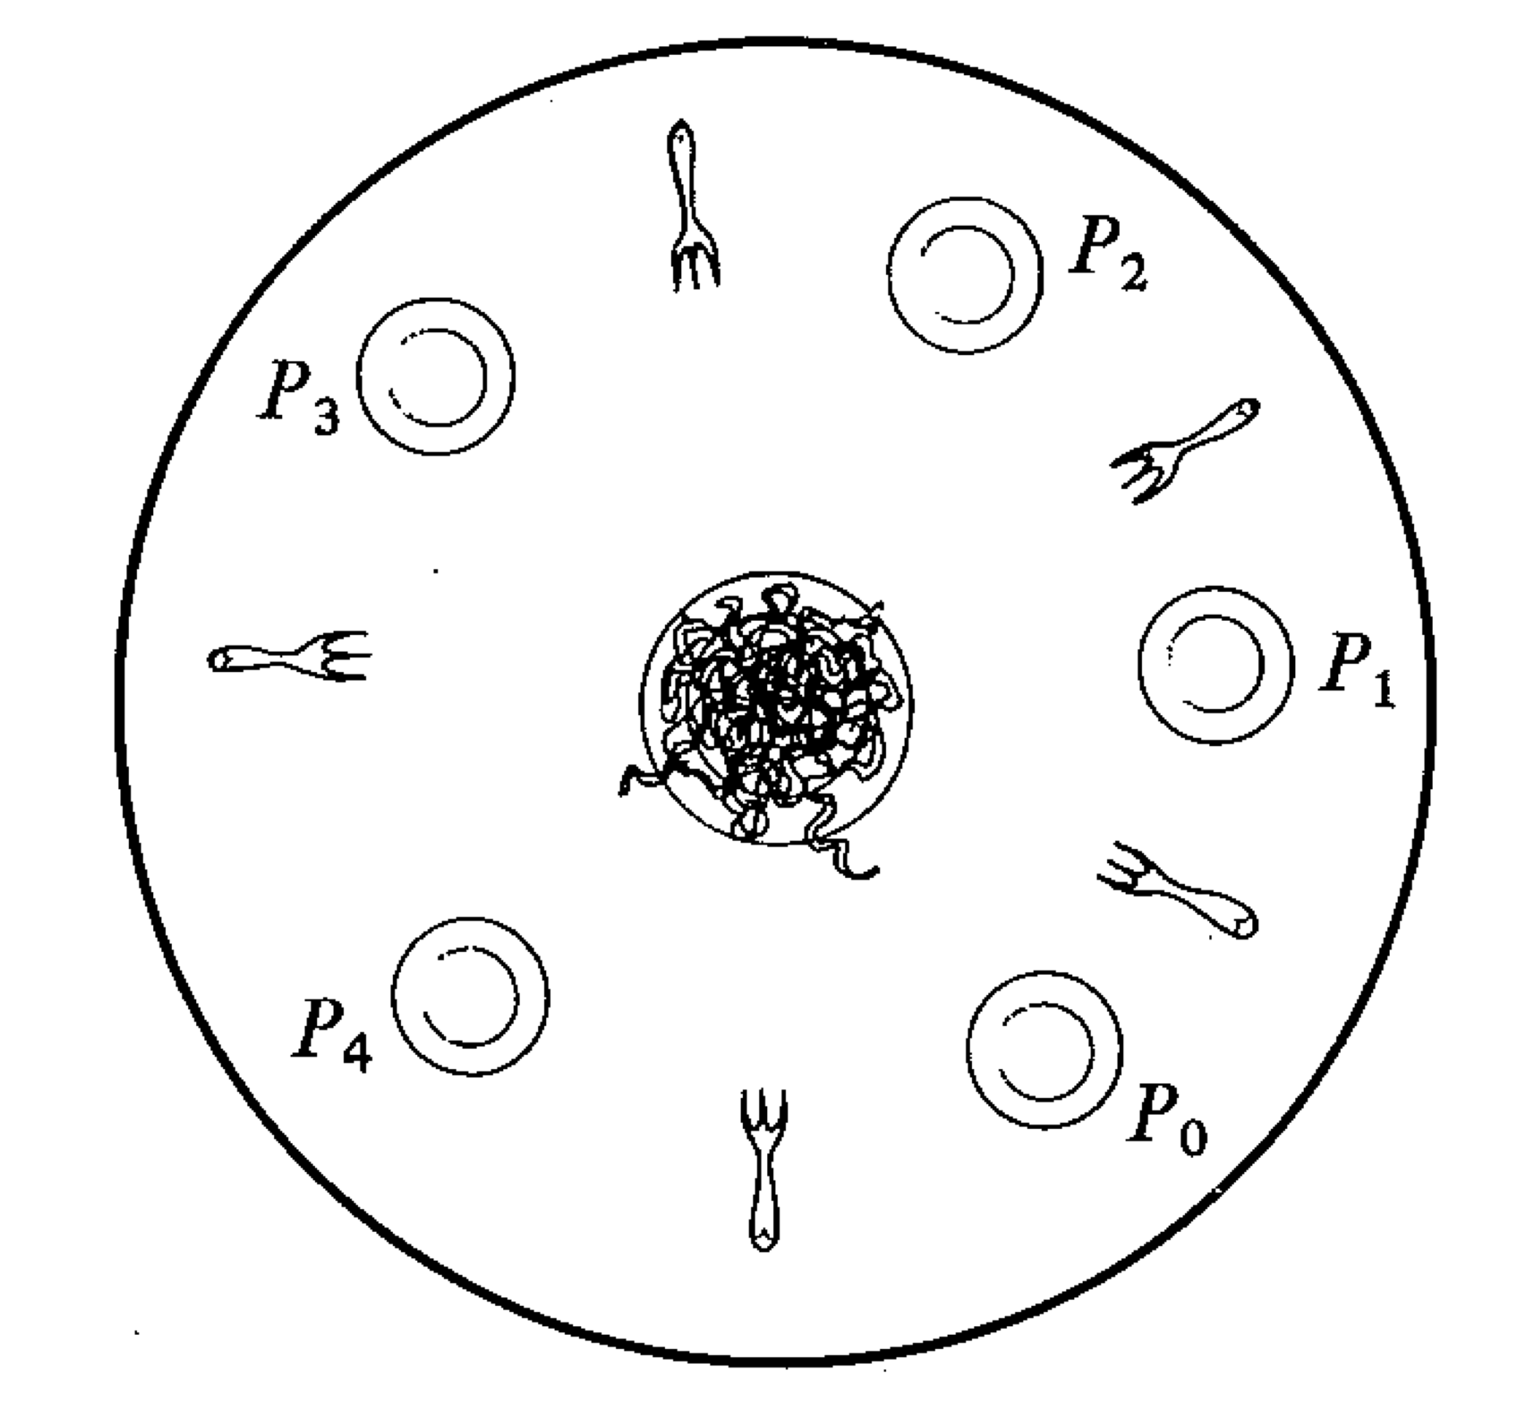
Philosophical Transactions
P Old
class Philosopher implements Runnable {
private final Fork[] forks;
private final int place;
public void run() {
while (true) {
int left = place, right = (place+1) % forks.length;
synchronized (forks[left]) {
synchronized (forks[right]) {
System.out.print(place + " "); // Eat
}
}
try { Thread.sleep(10); } // Think
catch (InterruptedException exn) { }
}
}
}
TestPhilosophers.java
Exclusive use of forks
Lock-based philosopher (wk 8)
Likely to deadlock in this version

Slide 24
TxnBooleans as Forks A
P A
class Philosopher implements Runnable {
private final TxnBoolean[] forks;
private final int place;
public void run() {
while (true) {
final int left = place, right = (place+1) % forks.length;
atomic(() -> {
if (!forks[left].get() && !forks[right].get()) {
forks[left].set(true);
forks[right].set(true);
} else
retry();
});
System.out.printf("%d ", place); // Eat
atomic(() -> {
forks[left].set(false);
forks[right].set(false);
});
try { Thread.sleep(10); } // Think
catch (InterruptedException exn) { }
}
}}
stm/TestStmPhilosophersA.java
Exclusive use of forks
Release forks

Slide 25
TxnBooleans as Forks B
P B
class Philosopher implements Runnable {
private final TxnBoolean[] forks;
private final int place;
public void run() {
while (true) {
final int left = place, right = (place+1) % forks.length;
atomic(() -> {
forks[left].await(false);
forks[left].set(true);
forks[right].await(false);
forks[right].set(true);
});
System.out.printf("%d ", place); // Eat
atomic(() -> {
forks[left].set(false);
forks[right].set(false);
});
try { Thread.sleep(10); } // Think
catch (InterruptedException exn) { }
}
}
}
stm/TestStmPhilosophersB.java
Exclusive use of forks
Release forks

Slide 26
Transaction subtleties
P C
What is wrong with this Philosopher?
Variant of B that “eats” inside the transaction
public void run() {
while (true) {
final int left = place, right = (place+1) % forks.length;
atomic(() -> {
forks[left].await(false);
forks[left].set(true);
forks[right].await(false);
forks[right].set(true);
System.out.printf("%d ", place);// Eat
forks[left].set(false);
forks[right].set(false);
});
try { Thread.sleep(10); } // Think
catch (InterruptedException exn) { }
}
}
BAD
Transaction has its own view of the world until commit
Other transactions may have taken all the forks!
Notes:
In general all kinds of bad things can happen inside an atomic bllock, so don’t do anything that can’t be undone!
Question: Suppose we move the printf outside the transaction at the end of it. Is that better, worse or inconsequential? <- Well, then we are eating with no forks… We also have no guarantee that no one else have taken them.

Slide 27
Optimism and multiple universes
A transaction has its own copy of data (forks)
At commit, it checks that data it used is valid
if so, writes the updated data to common memory
otherwise throws away the data, and restarts
Each transaction works in its own “universe”
until it succesfully commits
This allows higher concurrency
especially when write conflicts are rare
but means that a Philosopher cannot know it has exclusive use of a fork until transaction commit
Transactions + optimism = multiple universes
No I/O or other side effects in transactions!

Slide 28
Lazy vs. Eager
Lazy commit strategy:
Keep everything in transaction’s universe until commit
Conflict resolution at commit time
Keep redo log of what should be redone on retry
Eager commit strategy:
Commit changes upon making them
Detect conflicts as transaction proceeds
Conflict resolution happens at multiple places
Keep an undo log of things that need to be reverted on conflict

Slide 29
Lazy vs. Eager
Lazy:
Rollback is faster (just drop local data)
Slower commits (commits everything at once!)
Memory not inconsistent on crashes
Eager:
Rollback is slower
Conflicts detected earlier
Memory may be inconsistent on crashes

Slide 30
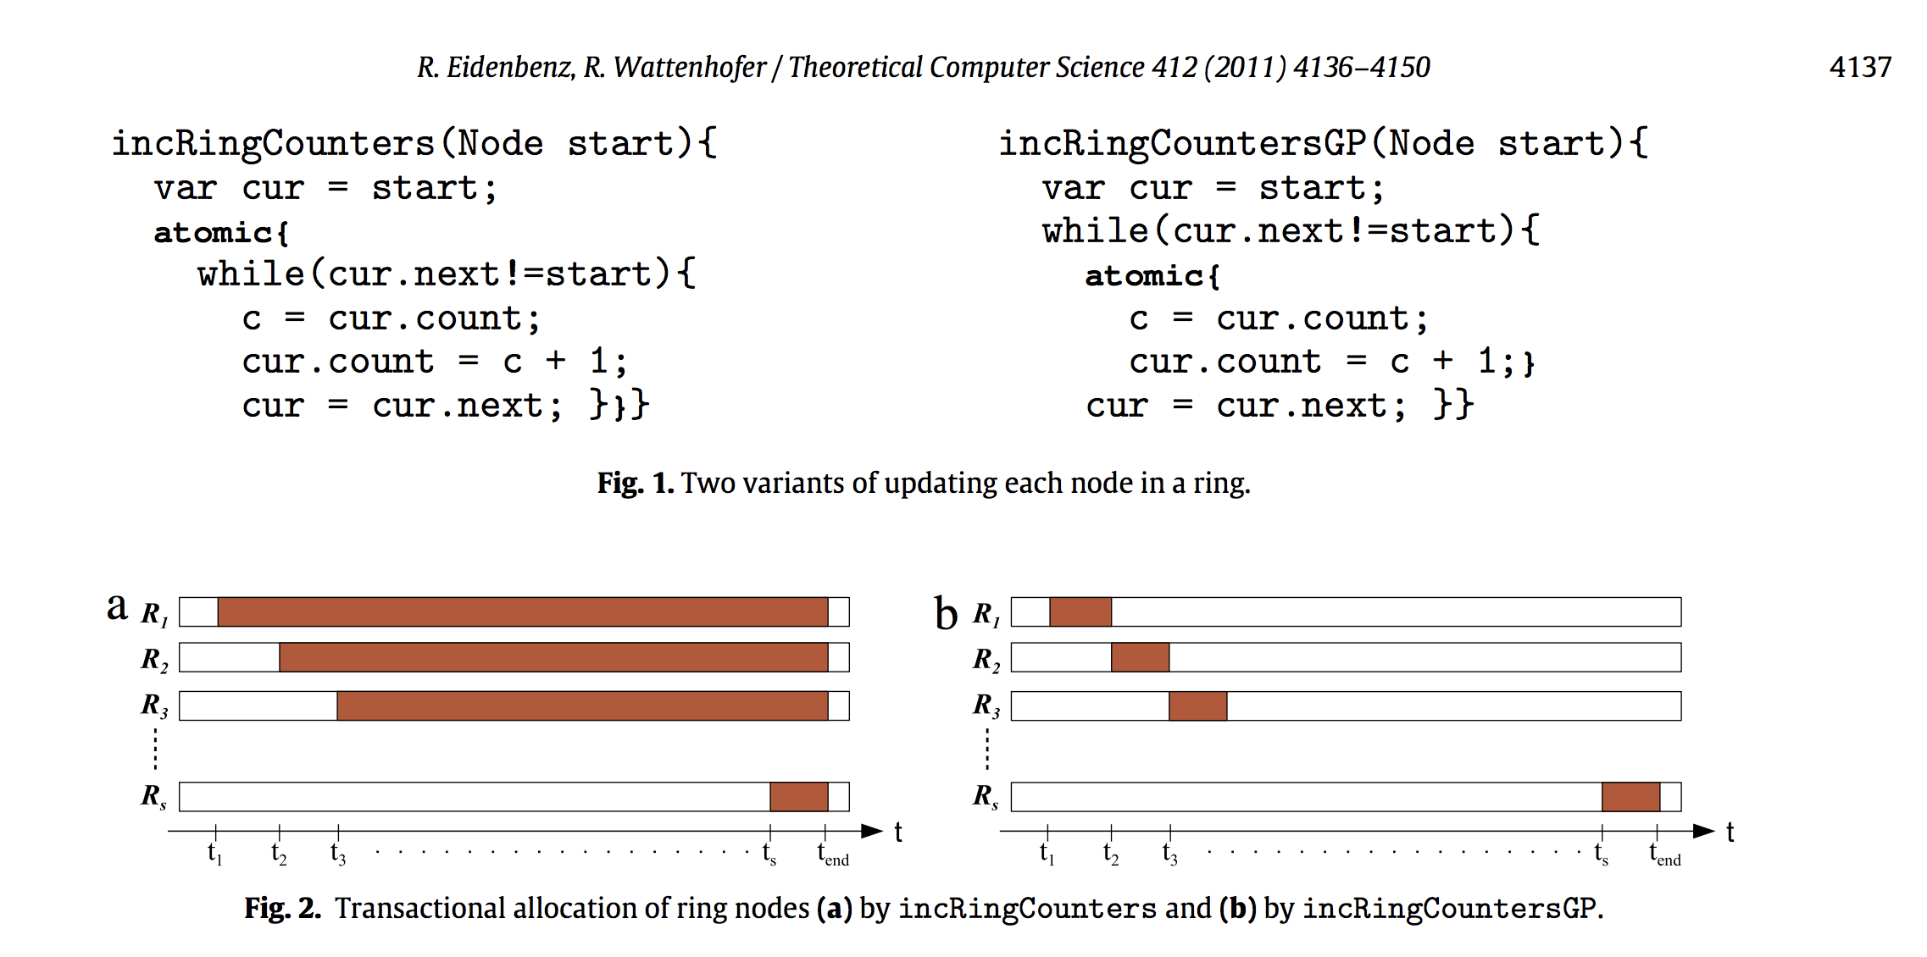
Why be a good citizen in a parallel world?

Slide 31
Optimistic Concurrency and Game Theory
View transactions as competing entities
Transactions have knowledge of system
E.g. long-running transactions get priority
Why should we keep transactions short?
Conversely, we also want fairness
Paper by Eidenbenz and Wattenhofer
Conclusion: Any deterministic policy can be gamed/exploited
Optimistic, cooperative concurrency (next week)
Notes:
TM is a type of optimistic concurrency…

Slide 32
Pessimistic Concurrency and Game Theory
Same principle applies to pessimistic concurrency
Why should I let go of a lock?
Keep holding on to object associated with lock
Security concern: Locking on this
Any code with a reference to your object can block everyone else
Use a private lock object instead
Notes:
(Pessimistic Concurrency means locking everything)

Slide 33
Hints and warnings
Transactions should be short
When a long transaction finally tries to commit, it is likely to have been undermined by a short one
... and must abort, and a lot of work is wasted
... and it restarts, so this happens again and again
For example, concurrent hash map
short: put, putIfAbsent, remove
long: reallocateBuckets – not clear it will ever succeed when others put at the same time
Some STM implementations avoid aborting the transaction that has done most work
Many design tradeoffs

Slide 34
Some languages with transactions
Haskell – in GHC implementation
TVar T, similar to TxnRef<T>, TxnInteger, ...
Scala – ScalaSTM, on Java platform
Ref[T], similar to TxnRef<T>, TxnInteger, ...
Clojure – on Java platform
(ref x), similar to TxnRef<T>, TxnInteger, ...
C, C++ – future standards proposals
Java – via Multiverse library
Creator Peter Ventjeer is on ScalaSTM team too
Java – DeuceSTM, other research prototypes
And probably many more ...

Slide 35
Transactional memory in perspective
Works best is a mostly immutable context
eg functional programming: Haskell, Clojure, Scala
Mixes badly with side effects, input-output
Requires transactional (immutable) collection classes and so on
Some loss of performance in software-only TM
Still unclear how to best implement it
Some think it will remain a toy, Cascaval 2008
... but they use C/C++, too much mutable data
Multicore hardware support would help
can be added to cache coherence (MESI) protocols

Slide 36
Hardware support for transactions
Eg Intel TSX for Haswell CPUs, since 2013
New XBEGIN, XEND, XABORT instructions
https://software.intel.com/sites/default/files/m/9/2/3/41604
Could be used by future JVMs, .NET/CLI, ...
Uses core’s cache for transaction’s updates
Extend cache coherence protocol (MESI, wk 7)
Messages say when another core writes data
On commit, write cached updates back to RAM
On abort, invalidate cache, do not write to RAM
Limitations:
Limited cache size, ...
Notes:
Remind students about course evaluation!

Slide 37
This week
Reading
Herlihy and Shavit sections 18.1-18.2
Harris et al: Composable memory transactions
Cascaval et al: STM, Why is it only a research toy
Eidenbenz and Wattenhofer: Good programming in transactional memory Game theory meets multicore architecture
Exercises
Show you can use transactional memory to implement histogram and concurrent hashmap
Read before next week
Goetz et al chapter 15

