Slide 1
Practical Concurrent and Parallel Programming 4
Thomas Dybdahl Ahle
IT University of Copenhagen
Friday 2019-09-18

Slide 2
Plan
Java 8 functional programming
Package java.util.function
Lambda expressions, method reference expressions
Functional interfaces, targeted function type
Java 8 streams for bulk data
Package java.util.stream
High-level parallel programming
Streams: primes, queens
Array parallel prefix operations
Class java.util.Arrays static methods

Slide 3
Materials
Java Precisely 3rd edition, MIT Press 2016
§11.13: Lambda expressions
§11.14: Method reference expressions
§23: Functional interfaces
§24: Streams for bulk data
§25: Class Optional<T>
Book examples are called Example154.java etc
Get them from the book homepage itu.dk/~sestoft/javaprecisely
Based on slides by Peter Sestoft

Slide 4
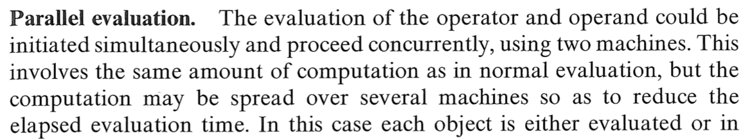
Parallel functional programming
1980’es: Language-driven parallel functional programming: dataflow, Peyton Jones, Roe, ...
Now: Technology-driven, “free lunch is over”: Multicore chips => Java needs parallelism => Java needs (parallelizable) streams => Java needs functional programming
Burge: Recursive programming techniques, 1975
Notes:
Simon Peyton Jones: Microsoft Cambridge, Glasgow
Paul Roe, Brisbane

Slide 5
New in Java 8
Lambda expressions
s -> s.length
Method reference expressions
String::length
Functional interfaces
Function<String,Integer>
Streams for bulk data
Stream<Integer> iStr = sStr.map(String::length)
Notice: String::length(s) <==> s.length();
Class::method(a,b) <==> a.method(b);
Parallel streams
iStr = sStr.parallel().map(String::length)
Parallel array operations
Arrays.parallelSetAll(arr, i -> sin(i/PI/100.0))
Arrays.parallelPrefix(arr, (x, y) -> x+y)

Slide 6
Functional programming in Java
Immutable data instead of objects with state
Recursion instead of loops
Higher-order functions that either
take functions as argument
return functions as result
Immutable
list of T
class FunList<T> {
final Node<T> first;
protected static class Node<U> {
public final U item;
public final Node<U> next;
public Node(U item, Node<U> next) { ... }
}
...
}
Example154.java
Notes:
In the first part of the exercises, you are going to implement your own functional list data structure, to get a feel of how functional programming can work in Java.

Slide 7
Immutable data
FunList<T>, linked lists of nodes
class FunList<T> {
final Node<T> first;
protected static class Node<U> {
public final U item;
public final Node<U> next;
public Node(U item, Node<U> next) { ... }
}
static <T> FunList<T> cons(T item, FunList<T> list) {
return new Node(item, list.first);
}
Example154.java
9
13
0
List of Integer
list1
Head
Tail
Notes:
Cons for ”construct”. It’s an old LISP thing. They also have car.

Slide 8
Existing data do not change
FunList<Integer> empty = new FunList<>(null),
list1 = cons(9, cons(13, cons(0, empty))),
list2 = cons(7, list1),
list3 = cons(8, list1),
list4 = list1.insert(1, 12),
list5 = list2.removeAt(3);
Example154.java
list1
9
13
0
list2
7
list3
8
list4
9
12
list5
7
9
13
Notes:
Notice null is what we use to represent the end of the list.

Slide 9
Recursion in insert
public FunList<T> insert(int i, T item) {
return new FunList<T>(insert(i, item, this.first));
}
static <T> Node<T> insert(int i, T item, Node<T> xs) {
return i == 0 ? new Node<T>(item, xs)
: new Node<T>(xs.item, insert(i-1, item, xs.next));
}
Example154.java
“If i is zero, put item in a new node, and let its tail be the old list xs”
“Otherwise, put the first element of xs in a new node, and let its tail be the result of inserting item in position i-1 of the tail of xs”

Slide 10
Immutable data: Bad and good
Immutability leads to more allocation
Takes time and space
But today allocators and garbage collectors are fast
Immutable data structures are automatically persistent
Immutable data can be safely shared
May actually lead to less allocation
Immutable data are automatically threadsafe
No (other) thread can change the data
And also due to visibility effects of final modifier
Subtle point

Slide 11
Lambda expressions 1
Example64.java
One argument lambda expressions:
Two-argument lambda expressions:
Function<String,Integer>
fsi1 = s -> Integer.parseInt(s);
... fsi1.apply("004711") ...
string -> int
Function that takes a string s and parses it as an integer
Calling the function
Same, written in other ways
Function<String,Integer>
fsi2 = s -> { return Integer.parseInt(s); },
fsi3 = (String s) -> Integer.parseInt(s);
fsi4 = Integer::parseInt
string * int -> int
BiFunction<String,Integer,String>
fsis1 = (s, i) -> s.substring(i, Math.min(i+3, s.length()));

Slide 12
Lambda expressions 2
Example64.java
Zero-argument lambda expression:
One-argument result-less lambda (“void”):
Supplier<String>
now = () -> new java.util.Date().toString();
Supplier<Date>
now2 = () -> java.util.Date::new;
unit -> string
string -> unit
Consumer<String>
show1 = s -> System.out.println(">>>" + s + "<<<”);
Consumer<String>
show2 = s -> { System.out.println(">>>" + s + "<<<"); };
Consumer<String>
show3 = System.out::println;
Notes:
Notee that now2 is not quite the same as now

Slide 13
Method reference expressions
BiFunction<String,Integer,Character> charat
= String::charAt;
System.out.println(charat.apply("ABCDEF", 1));
Same as (s,i) -> s.charAt(i)
Example67.java
Function<Integer,Character> hex1
= "0123456789ABCDEF"::charAt;
Conversion to hex digit
Class and array constructors
Function<Integer,C> makeC = C::new;
Function<Integer,Double[]> make1DArray = Double[]::new;
Notes:
Note the difference between :: on a class and on an object.

Slide 14
Targeted function type (TFT)
A lambda expression or method reference expression does not have a type in itself
Therefore must have a targeted function type
Lambda or method reference must appear as
Assignment right hand side:
Function<String,Integer> f = Integer::parseInt;
Argument to call:
stringList.map(Integer::parseInt)
In a cast:
(Function<String,Integer>)Integer::parseInt
Argument to return statement:
return Integer::parseInt;
TFT
map’s argument type is TFT
TFT
Enclosing method’s return type is TFT

Slide 15
Functions as arguments: map
Function map encodes general behavior
Transform each list element to make a new list
Argument f expresses the specific transformation
Could use Node directly, but this is more OO if you like that kind of thing…
static <T,U> Node<U> map(Function<T,U> f, Node<T> xs) {
return xs == null ? null
: new Node<U>(f.apply(xs.item), map(f, xs.next));
}
public <U> FunList<U> map(Function<T,U> f) {
return new FunList<U>(map(f, first));
}
Example154.java
Notes:
In general in the first exercise you’re gonna write everything twice this way. Just to make sure you hate object orientation a little more.

Slide 16
Calling map
7 9 13
FunList<Double> list8 = list5.map(i -> 2.5 * i);
17.5 22.5 32.5
FunList<Boolean> list9 = list5.map(i -> i < 10);
true true false

Slide 17
Functions as arguments: reduce
static <T,U> U reduce(U x0, BiFunction<U,T,U> op, Node<T> xs) {
return xs == null ? x0
: reduce(op.apply(x0, xs.item), op, xs.next);
}
list.reduce(x0, op) = x0  x1  ...  xn
if we write op.apply(x,y) as xy
Example: list.reduce(0, (x,y) -> x+y) = 0 + x1 + ... + xn
Q: Does our code compute (…(x0x1)…)xn or x0(x1(…xn)…))
Example154.java

Slide 18
Calling reduce
17.5 22.5 32.5
double sum = list8.reduce(0.0, (res, item) -> res + item);
Example154.java
72.5
double product = list8.reduce(1.0, (res, item) -> res * item);
12796.875
boolean allBig
= list8.reduce(true, (res, item) -> res && item > 10);
= list8.map(item -> item > 10)
.reduce(true, (res, val) -> res && val);
true
Q: Ever heard of map-reduce?
Notes:
The last example does a ”Map” and ”reduce”.

Slide 19
Tail recursion and loops
static <T,U> U reduce(U x0, BiFunction<U,T,U> op, Node<T> xs) {
return xs == null ? x0
: reduce(op.apply(x0, xs.item), op, xs.next);
}
Tail call
A call that is the func’s last action is a tail call
A tail-recursive func can be replaced by a loop
The Java compiler does not do that automatically
static <T,U> U reduce(U x0, BiFunction<U,T,U> op, Node<T> xs) {
while (xs != null) {
x0 = op.apply(x0, xs.item);
xs = xs.next;
}
return x0;
}
Loop version of reduce
Example154.java
Notes:
Tail call is when it’s the last thing done.
In some languages this is done automatically.
Also not in C#. All functional languages though, and sometimes C.

Slide 20
Java 8 functional interfaces
A functional interface has exactly one abstract method
Type of functions from T to R
interface Function<T,R> {
R apply(T x);
}
C#: Func<T,R>
F#: T -> R
Type of functions from T to void
interface Consumer<T> {
void accept(T x);
}
C#: Action<T>
F#: T -> unit
Notes:
Now for something completly different.

Slide 21
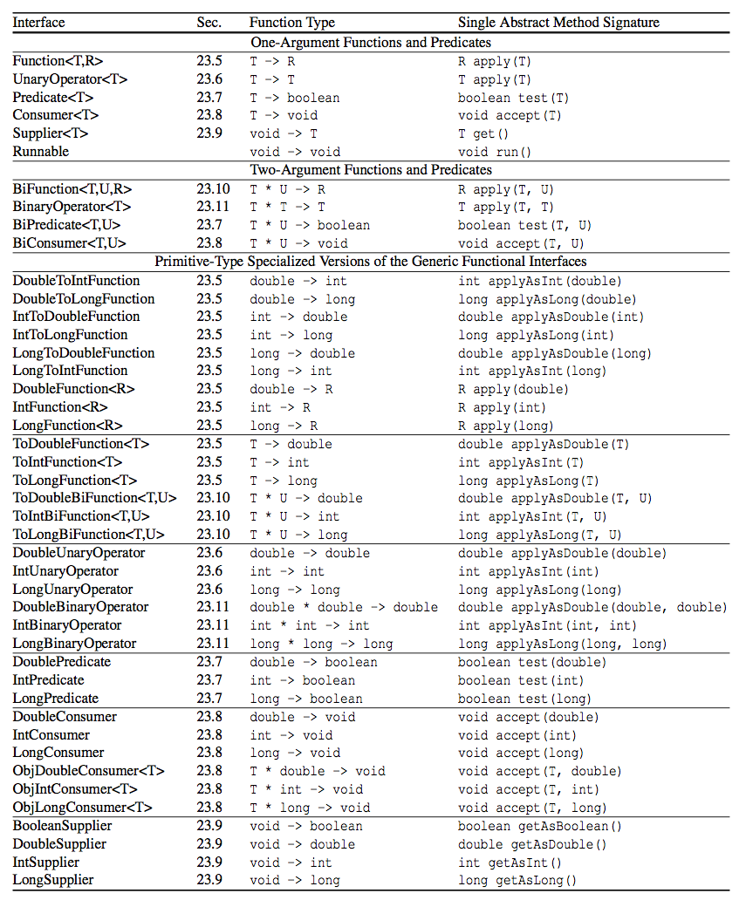
(Too) many functional interfaces
interface IntFunction<R> {
R apply(int x);
}
Use instead of Function<Integer,R>
to avoid (un)boxing
Primitive-type specialized interfaces
Java Precisely 3rd ed. page 125

Slide 22
Primitive-type specialized interfaces for int, double, and long
interface Function<T,R> {
R apply(T x);
}
Why both?
Why both?
interface IntFunction<R> {
R apply(int x);
}
What difference?
Function<Integer,String> f1 = i -> "#" + i;
IntFunction<String> f2 = i -> "#" + i;
Calling f1.apply(i) will box i as Integer
Allocating object in heap, takes time and memory
Calling f2.apply(i) avoids boxing, is faster
Purely a matter of performance

Slide 23
Functions that return functions
Conversion of n to English numeral, cases
n < 20 : one, two, ..., nineteen
n < 100: twenty-three, ...
n >= 100: two hundred forty-three, ...
n >= 1000: three thousand two hundred forty-three...
n >= 1 million: ...
n >= 1 billion: ...
Same pattern
private static String less100(long n) {
return n<20 ? ones[(int)n]
: tens[(int)n/10-2] + "-” + ones[(int)n%10]);
}
static LongFunction<String> less(long limit, String unit,
LongFunction<String> conv) {
return n -> n<limit ? conv.apply(n)
: conv.apply(n/limit) + " " + unit
+ " ” + conv.apply(n%limit);
}
Convert n < 100
Example158.java
Notes:
Se næste slide, der giver det mere mening.

Slide 24
Functions that return functions
Using the general higher-order function
Converting to English numerals:
static final LongFunction<String>
less1K = less( 100, "hundred", Example158::less100),
less1M = less( 1_000, "thousand", less1K),
less1B = less( 1_000_000, "million", less1M),
less1G = less(1_000_000_000, "billion", less1B);
Example158.java
public static String toEnglish(long n) {
return n==0 ? "zero" : n<0 ? "minus " + less1G.apply(-n)
: less1G.apply(n);
}
toEnglish(2147483647)
two billion one hundred forty-seven million
four hundred eighty-three thousand six hundred forty-seven

Slide 25
Streams for bulk data
Stream<T> is a finite or infinite sequence of T
Possibly lazily generated
Possibly parallel
Stream methods
map, flatMap, reduce, filter, ...
These take functions as arguments
Can be combined into pipelines
Java optimizes (and parallelizes) the pipelines well
Similar to
Iterators, but very different implementation
.NET Linq
Notes:
Maybe second part starts here?
The second part of the exercises will have you create stuff using streams.

Slide 26
Some stream operations
Stream<Integer> s = Stream.of(2, 3, 5)
s.filter(p) = the x where p.test(x) holds
s.filter(x -> x%2==0) gives 2
s.map(f) = results of f.apply(x) for x in s
s.map(x -> 3*x) gives 6, 9, 15
s.flatMap(f) = a flattening of the streams created by f.apply(x) for x in s
s.flatMap(x -> Stream.of(x,x+1)) gives 2,3,3,4,5,6
s.findAny() = some element of s, if any, or else the absent Option<T> value
s.findAny() gives 2 or 3 or 5
s.reduce(x0, op) = x0s0...sn if we write op.apply(x,y) as xy
s.reduce(1, (x,y)->x*y) gives 1*2*3*5 = 30

Slide 27
Similar functions are everywhere
Java stream map is called
map in Haskell, Scala, F#, Clojure, Python
Select in C#
Java stream flatMap is called
flatMap in Haskell, Scala
collect in F#
SelectMany in C#
mapcat in Clojure
Java reduce is a special (assoc. op.) case of
foldl in Haskell
foldLeft in Scala
fold in F#
Aggregate in C#
reduce in Clojure, Python

Slide 28
Counting primes on Java 8 streams
Our old standard Java for loop:
Sequential Java 8 stream:
Parallel Java 8 stream:
int count = 0;
for (int i=0; i<range; i++)
if (isPrime(i))
count++;
Classical efficient imperative loop
IntStream.range(0, range)
.filter(i -> isPrime(i))
.count()
Pure functional programming ...
IntStream.range(0, range)
.parallel()
.filter(i -> isPrime(i))
.count()
... and thus parallelizable and thread-safe

Slide 29
Performance results (!!)
Counting the primes in 0 ...99,999
Functional streams give the simplest solution
Nearly as fast as tasks and threads, or faster:
Intel i7 (4 cores) speed-up: 3.6 x
AMD Opteron (32 cores) speed-up: 24.2 x
Method | Intel i7 (ms) | AMD Opteron (ms)
Sequential for-loop | 9.9 | 40.5
Sequential stream | 9.9 | 40.8
Parallel stream | 2.8 | 1.7
Best thread-parallel | 3.0 | 4.9
Best task-parallel | 2.6 | 1.9

Slide 30
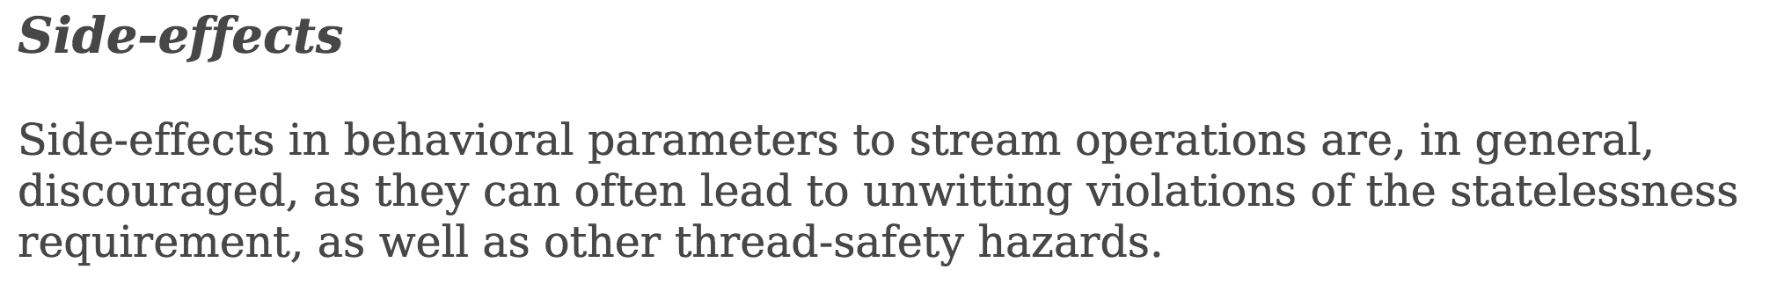
Purity: side-effect freedom
From the java.util.stream package docs:
Java compiler (types) cannot enforce purity
Java runtime cannot detect violation of purity
This means ”catastrophic”

Slide 31
Creating streams 1
Explicitly or from array, collection or map:
Finite, ordered, sequential, lazily generated
IntStream is = IntStream.of(2, 3, 5, 7, 11, 13);
String[] a = { "Hoover", "Roosevelt", ...};
Stream<String> presidents = Arrays.stream(a);
Collection<String> coll = ...;
Stream<String> countries = coll.stream();
Map<String,Integer> phoneNumbers = ...;
Stream<Map.Entry<String,Integer>> phones
= phoneNumbers.entrySet().stream();
Example164.java
Notes:
We’ll go through some of the examples from Peters book that you read for today.

Slide 32
Creating streams 2
Useful special-case streams:
IntStream.range(0, 10_000)
random.ints(5_000)
bufferedReader.lines()
bitset.stream()
Functional iterators for infinite streams
Imperative generators for infinite streams
StreamBuilder<T>: eager, only finite streams
Example164.java

Slide 33
Creating streams 3: generators
Generating 0, 1, 2, 3, ...
Functional
IntStream nats1 = IntStream.iterate(0, x -> x+1);
Example165.java
Most efficient (!!), and parallelizable
Imperative
IntStream nats2 = IntStream.generate(new IntSupplier() {
private int next = 0;
public int getAsInt() { return next++; }
});
Imperative, using final array for mutable state
final int[] next = { 0 };
IntStream nats3 = IntStream.generate(() -> next[0]++);
Q: What does this print?
System.out.println(nats1.sum());
Notes:
What happened to no side effects in streams?
It doesn’t print anything. Trick question!

Slide 34
Creating streams 4: StreamBuilder
Convert own linked IntList to an IntStream
Eager: no stream element output until end
Finite: does not work on cyclic lists
class IntList {
public final int item;
public final IntList next;
...
public static IntStream stream(IntList xs) {
IntStream.Builder sb = IntStream.builder();
while (xs != null) {
sb.accept(xs.item);
xs = xs.next;
}
return sb.build();
}
}
Example182.java
Notes:
It’s not good. Why waste all that memory?

Slide 35
Streams for backtracking
Generate all n-permutations of 0, 1, ..., n-1
Eg [2,1,0], [1,2,0], [2,0,1], [0,2,1], [0,1,2], [1,0,2]
Set of numbers not yet used
An incomplete permutation
public static Stream<IntList> perms(BitSet todo, IntList tail) {
if (todo.isEmpty())
return Stream.of(tail);
else
return todo.stream().boxed()
.flatMap(r -> perms(minus(todo, r), new IntList(r, tail)));
}
Example175.java
public static Stream<IntList> perms(int n) {
BitSet todo = new BitSet(n); todo.flip(0, n);
return perms(todo, null);
}
{ 0, ..., n-1 }
Empty permutation [ ]
Notes:
Minus removes r from the todo bitset.
Flatmap makes sure we return a list of permutations rather than a tree.
Boxed() is needed because flatMap on IntStream only supports functions giving new IntStreams (because of performance)

Slide 36
A closer look at generation for n=3
({0,1,2}, [])
({1,2}, [0])
({2}, [1,0])
({}, [2,1,0])
({1}, [2,0])
({}, [1,2,0])
({0,2}, [1])
({2}, [0,1])
({}, [2,0,1])
({0}, [2,1])
({}, [0,2,1])
({0,1}, [2])
...
Output to stream
Output to stream
Output to stream
Output to stream

Slide 37
A permutation is a rook (♜) placement on a chessboard
Uses each column (position) exactly once
Uses each row (number) exactly once
 |  | ♜
 | ♜
♜
 |  | ♜
♜
 | ♜
 | ♜
 |  | ♜
♜
[2, 1, 0]
[1, 2, 0]
[2, 0, 1]
♜
 |  | ♜
 | ♜
♜
 | ♜
 |  | ♜
 | ♜
♜
 |  | ♜
[0, 2, 1]
[0, 1, 2]
[1, 0, 2]

Slide 38
Solutions to the n-queens problem
For queens, just take diagonals into account:
consider only r that are safe for the partial solution
Simple, and parallelizable for free, 3.5 x faster
Solve and generate sudokus: much the same
public static Stream<IntList> queens(BitSet todo, IntList tail) {
if (todo.isEmpty())
return Stream.of(tail);
else
return todo.stream()
.filter(r -> safe(r, tail)).boxed()
.flatMap(r -> queens(minus(todo, r), new IntList(r, tail)));
}
Diagonal check
Example176.java
public static boolean safe(int mid, IntList tail) {
return safe(mid+1, mid-1, tail);
}
public static boolean safe(int d1, int d2, IntList tail) {
return tail==null || d1!=tail.item && d2!=tail.item && safe(d1+1, d2-1, tail.next);
}
.parallel()
Notes:
Go to IntelliJ and run Example176. Show with/without .parallel().
Does it matter whether parallel is on the first or second line?

Slide 39
Versatility of streams
Many uses of a stream of solutions
Print the number of solutions
Print all solutions
Print an arbitrary solution (if there is one)
Print the 20 first solutions
Much harder in an imperative version
Separation of concerns (Dijkstra): production of solutions versus consumption of solutions
System.out.println(queens(8).count());
queens(8).forEach(System.out::println);
System.out.println(queens(8).findAny());
Example174.java
queens(8).limit(20).forEach(System.out::println);
Notes:
It’s harder to give such a versatile interface to the ”user” with imperative programming

Slide 40
Streams for quasi-infinite sequences
van der Corput numbers
1/2, 1/4, 3/4, 1/8, 5/8, 3/8, 7/8, ...
Dense and uniform in interval [0, 1]
For simulation and finance, Black-Scholes options
Trick: v d Corput numbers as base-2 fractions
0.1, 0.01, 0.11, 0.001, 0.101, 0.011, 0.111 ...
are bit-reversals of 1, 2, 3, 4, 5, 6, 7, ... in binary
public static DoubleStream vanDerCorput() {
return IntStream.range(1, 31).asDoubleStream()
.flatMap(b -> bitReversedRange((int)b));
}
private static DoubleStream bitReversedRange(int b) {
final long bp = Math.round(Math.pow(2, b));
return LongStream.range(bp/2, bp)
.mapToDouble(i -> (double)(bitReverse((int)i) >>> (32-b)) / bp);
}
Example183.java

Slide 41
Collectors: aggregation of streams
To format an IntList as string “[2, 3, 5, 7]”
Convert the list to an IntStream
Convert each element to get Stream<String>
Use a predefined Collector to build final result
public String toString() {
return stream(this).mapToObj(String::valueOf)
.collect(Collectors.joining(",", "[", "]"));
}
Example182.java
public static String toString(IntList xs) {
StringBuilder sb = new StringBuilder();
sb.append("[");
boolean first = true;
while (xs != null) {
if (!first)
sb.append(", ");
first = false;
sb.append(xs.item);
xs = xs.next;
}
return sb.append("]").toString();
}
The alternative ”direct” solution requires care and cleverness
Notes:
(using mapToObj since map on an intStream has to return an int)

Slide 42
Java 8 stream properties
Some stream dimensions
Finite vs infinite
Lazily generated (by iterate, generate, ...) vs eagerly generated (stream builders)
Ordered (map, filter, limit ... preserve element order) vs unordered (can be faster)
Sequential (all elements processed on one thread) vs parallel
Java streams
can be lazily generated, like Haskell lists
but are use-once, unlike Haskell lists
reduces risk of space leaks (and limits expressiveness)
Notes:
Iterate (using a seed and building), generating (using a class to build).
(Limit is the version that takes a certain number. Like head n)

Slide 43
Parallel (functional) array operations
Simulating random motion on a line
Take n random steps of length at most [-1, +1]:
Compute the positions at end of each step:
a[0], a[0]+a[1], a[0]+a[1]+a[2], ...
Find the maximal absolute distance from start:
A lot done, fast, without loops or assignments
Just arrays and streams and functions
double[] a = new Random().doubles(n, -1.0, +1.0)
.toArray();
Example25.java
Arrays.parallelPrefix(a, (x,y) -> x+y);
double maxDist = Arrays.stream(a).map(Math::abs)
.max().getAsDouble();
Notes:
Double().. Already returns a doublestream. Why convert it to an array? Ah, because we want to find the prefixes first and compute the maximum derivation.
Use getAsDouble() since max() returns an Optional<Double>. Empty optional if the stream is empty.

Slide 44
Array and streams and parallel ...
Side-effect free associative array aggregation
Such operations can be parallelized well
So-called prefix scans (Blelloch 1990)
Lots of applications: sum, product, sorting, comparison, lexing, polynomial evaluation, ...
Streams and arrays complement each other
Streams: lazy, possibly infinite, non-materialized, use-once, parallel pipelines
Arrays: eager, finite, materialized, use-many-times, parallel prefix scans
Arrays.parallelPrefix(a, (x,y) -> x+y);
Notes:
Pretty cool that they can be made parallel. How would you do it?

Slide 45
Some problems with Java streams
Streams are use-once & have other restrictions
Probably to permit easy parallelization
Hard to create lazy finite streams
Probably to allow high-performance implementation
Difficult to control resource consumption
A single side-effect may mess all up completely
Sometimes .parallel() hurts performance a lot
See exercise
Laziness in Java is subtle, easily goes wrong:
static Stream<String> getPageAsStream(String url) throws IOException {
try (BufferedReader in
= new BufferedReader(new InputStreamReader(
new URL(url).openStream()))) {
return in.lines();
}
}
Example216.java
Closes the reader too early, so any use of the Stream<String> causes IOException: Stream closed
Useless
Notes:
Because when the getPageAsStream method returns the BufferedReader goes out of scope and is destructed and closed. But in.lines() hasn’t really been started yet, lazy…

Slide 46
This week
Reading
Java Precisely 3rd ed. §11.13, 11.14, 23, 24, 25
Exercises
Extend immutable list class with functional programming; use parallel array operations; use streams of words and streams of numbers

