Slide 1
Hide-Yo-Kids
3D hack and slash game about protecting kids and finding a way to escape.
Joshua McCabe, Wilbur McElroy, and Thomas Pope

Slide 2
Design - Thomas

Slide 3
Reasons for making this game
Things we wanted | Things we didn’t want
To try making a 3D game | To make a game that was too complex
Make a game that had action in it | To re-create a preexisting game or board game
Make a game where you were defending something against waves of enemies | To make a tower defense game
Wanted to try a new game engine | To make a game in Java

Slide 4
Features
Highscore tracking system so you can prove that you’re the best
Wave spawning system
Two enemy types each with different attack behaviors
Melee and ranged weapons
Multiple difficulty settings
AI navigation mesh pathfinding

Slide 5
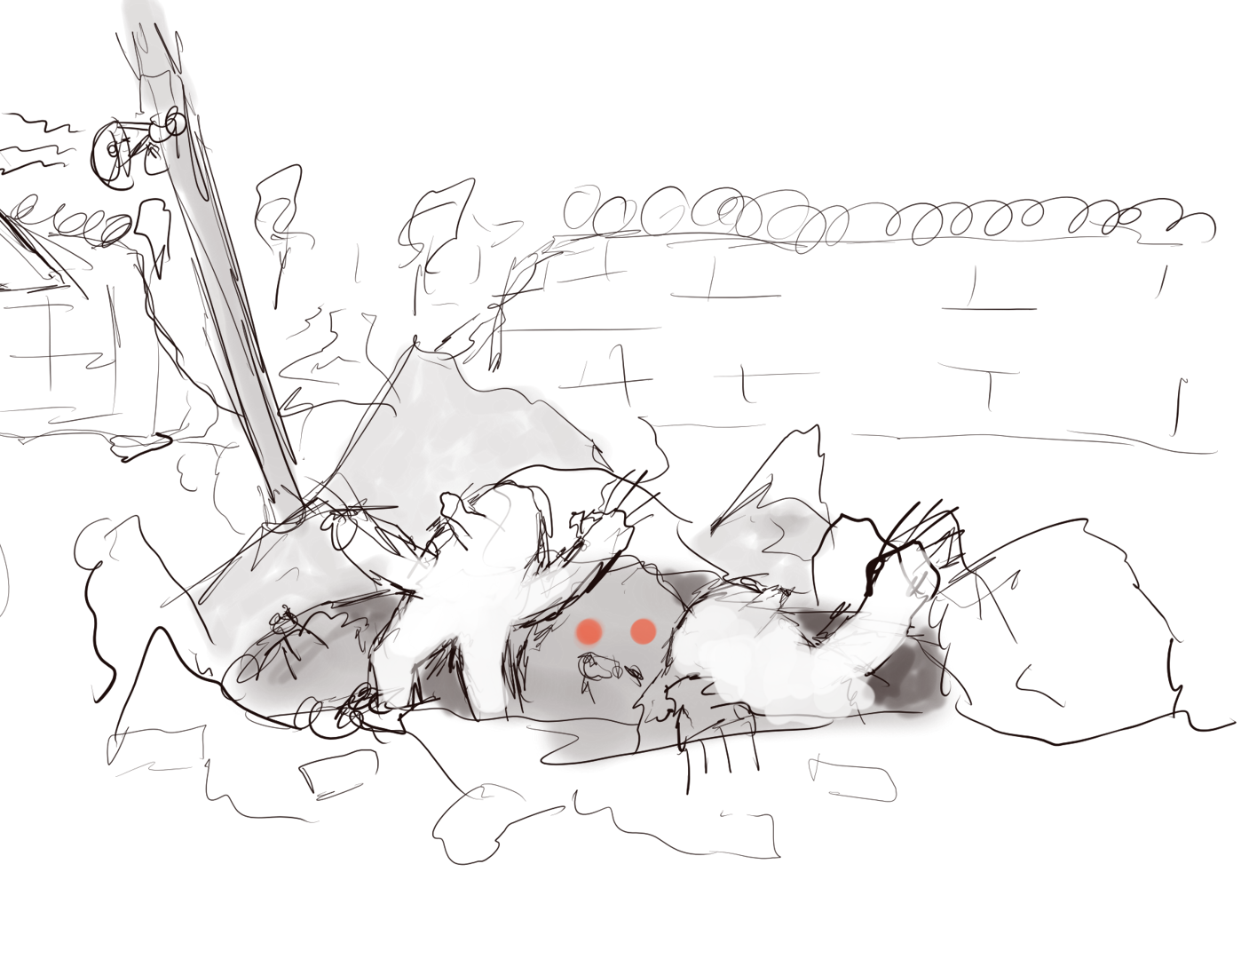
Game Summary
Giant moles have taken over the world and become the dominant species
The remaining humans are gathered in small camps and communities trying to stay alive
You play as an overly manly ex-marine trying to rescue children from a camp that just got attacked.

Slide 6
Why?
Why children?
Children seemed to make sense since you’re trying to save the future of mankind.
Why moles?
For a while we were thinking about mutant animals in general, but it ended up being a lot of work to make 3D models, so we stuck with moles.

Slide 7
Major design decisions
Camera angle: 3rd person
Game loop: Repair the helicopter, protect the children, and stay alive
Game objective: Get as much score as possible to beat other people on the scoreboard
Overall feeling: Somewhat arcadey

Slide 8
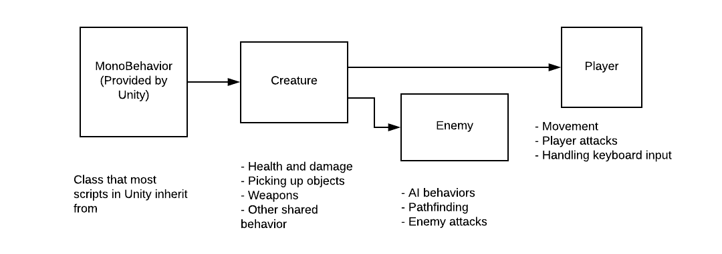
Class structure

Slide 9
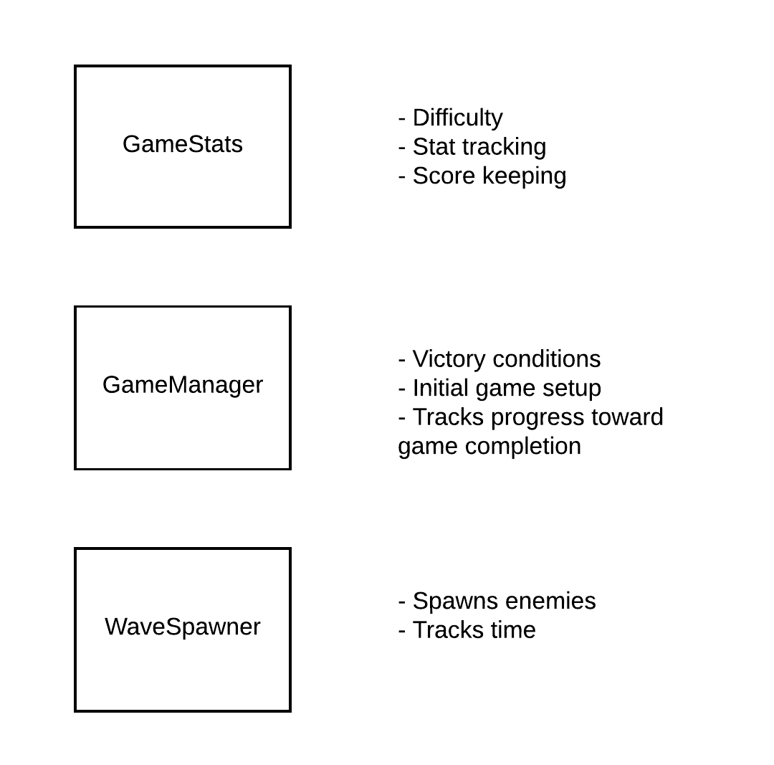
Class structure

Slide 10
Implementation - Wilbur

Slide 11

Tools and Technologies
Unity
One of the most popular game engines on the market
Used to create 3D, 2D, virtual reality, and augmented reality games
Also used in the film, automotive, architecture, engineering, and construction industries
Free for individuals and students
Used to make games such as Kerbal Space Program, Temple Run, and Hearthstone
Uses the C# programming language
Other Game Engines Considered:
Unreal Engine
Godot
Why we chose this one:
Lots of tutorials
A couple of us already knew C#
Easier than Unreal
Better at 3D than Godot

Slide 12

Tools and Technologies
Visual Studio Code
Free, open source code editor made by Microsoft
Simple and intuitive UI
Much lighter weight than Visual Studio
What we used it for
Coding (duh)

Slide 13

Tools and technologies
GitHub
Provides hosting for software version control using Git
Allows easy control of source code
Built in project management and issue tracking features
Has a plugin for Unity
Currently owned by Microsoft
What we used it for
Source control
Issue tracking

Slide 14

Blender
Blender
Free, open source 3D creation suite
Supports the entirety of the 3D creation pipeline
Modeling, rigging, animation, rendering, and motion tracking
Can also be used to make games
What we used it for
Creating the model for the enemy moles
Rigging several models
We used premade animations rather than making our own

Slide 15

Tools and technologies
Discord
Proprietary freeware VoIP application
Designed for gaming communities
Specializes in text, image, video, and audio communication
What we used it for
Keeping up to date
Sharing files and screenshots
Planning meetings

Slide 16
Challenges - Josh

Slide 17
Challenges
Finding / making assets
Rigging
Creating specific goals
Agreeing on core aspects
Learning the quirks of the game engine
Making a 3D game in general

Slide 18
Midway changes
Camera angle
Top Down -> 3rd Person
Models
Make them vs Find them
Objective
Having an objective
What the objective is

Slide 19
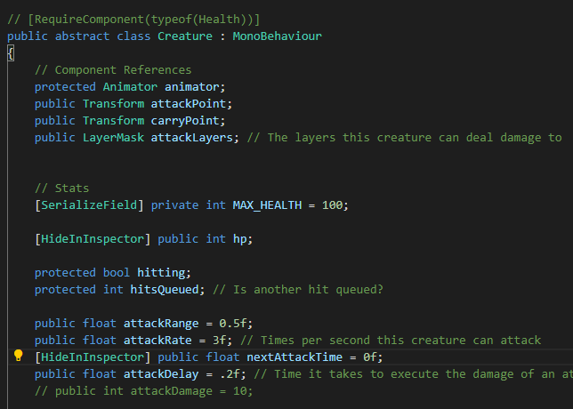
Lessons learned
Create specific, achievable goals
Environment
Enemies
Gameplay loop
Establish essential features early
End condition
Camera / Controls
Split up functionality into multiple classes
Creature Class
Establish Coding Standards

Slide 20
Nice to have features
More gameplay variety
More maps
More enemies
Unique animations
Multiplayer
Settings menu
Higher quality assets

Slide 21
Demo

Slide 22
Questions

