Slide 1



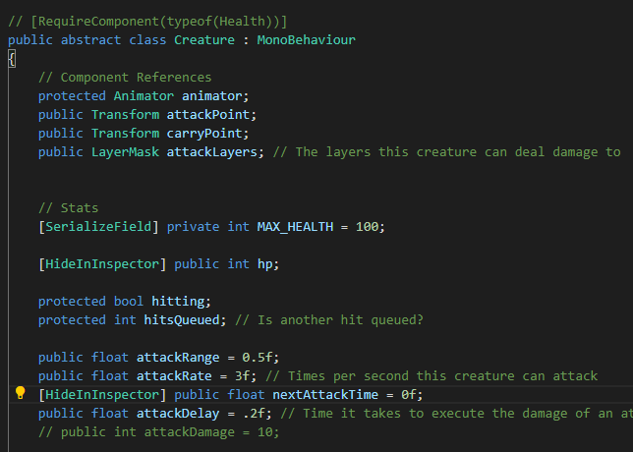
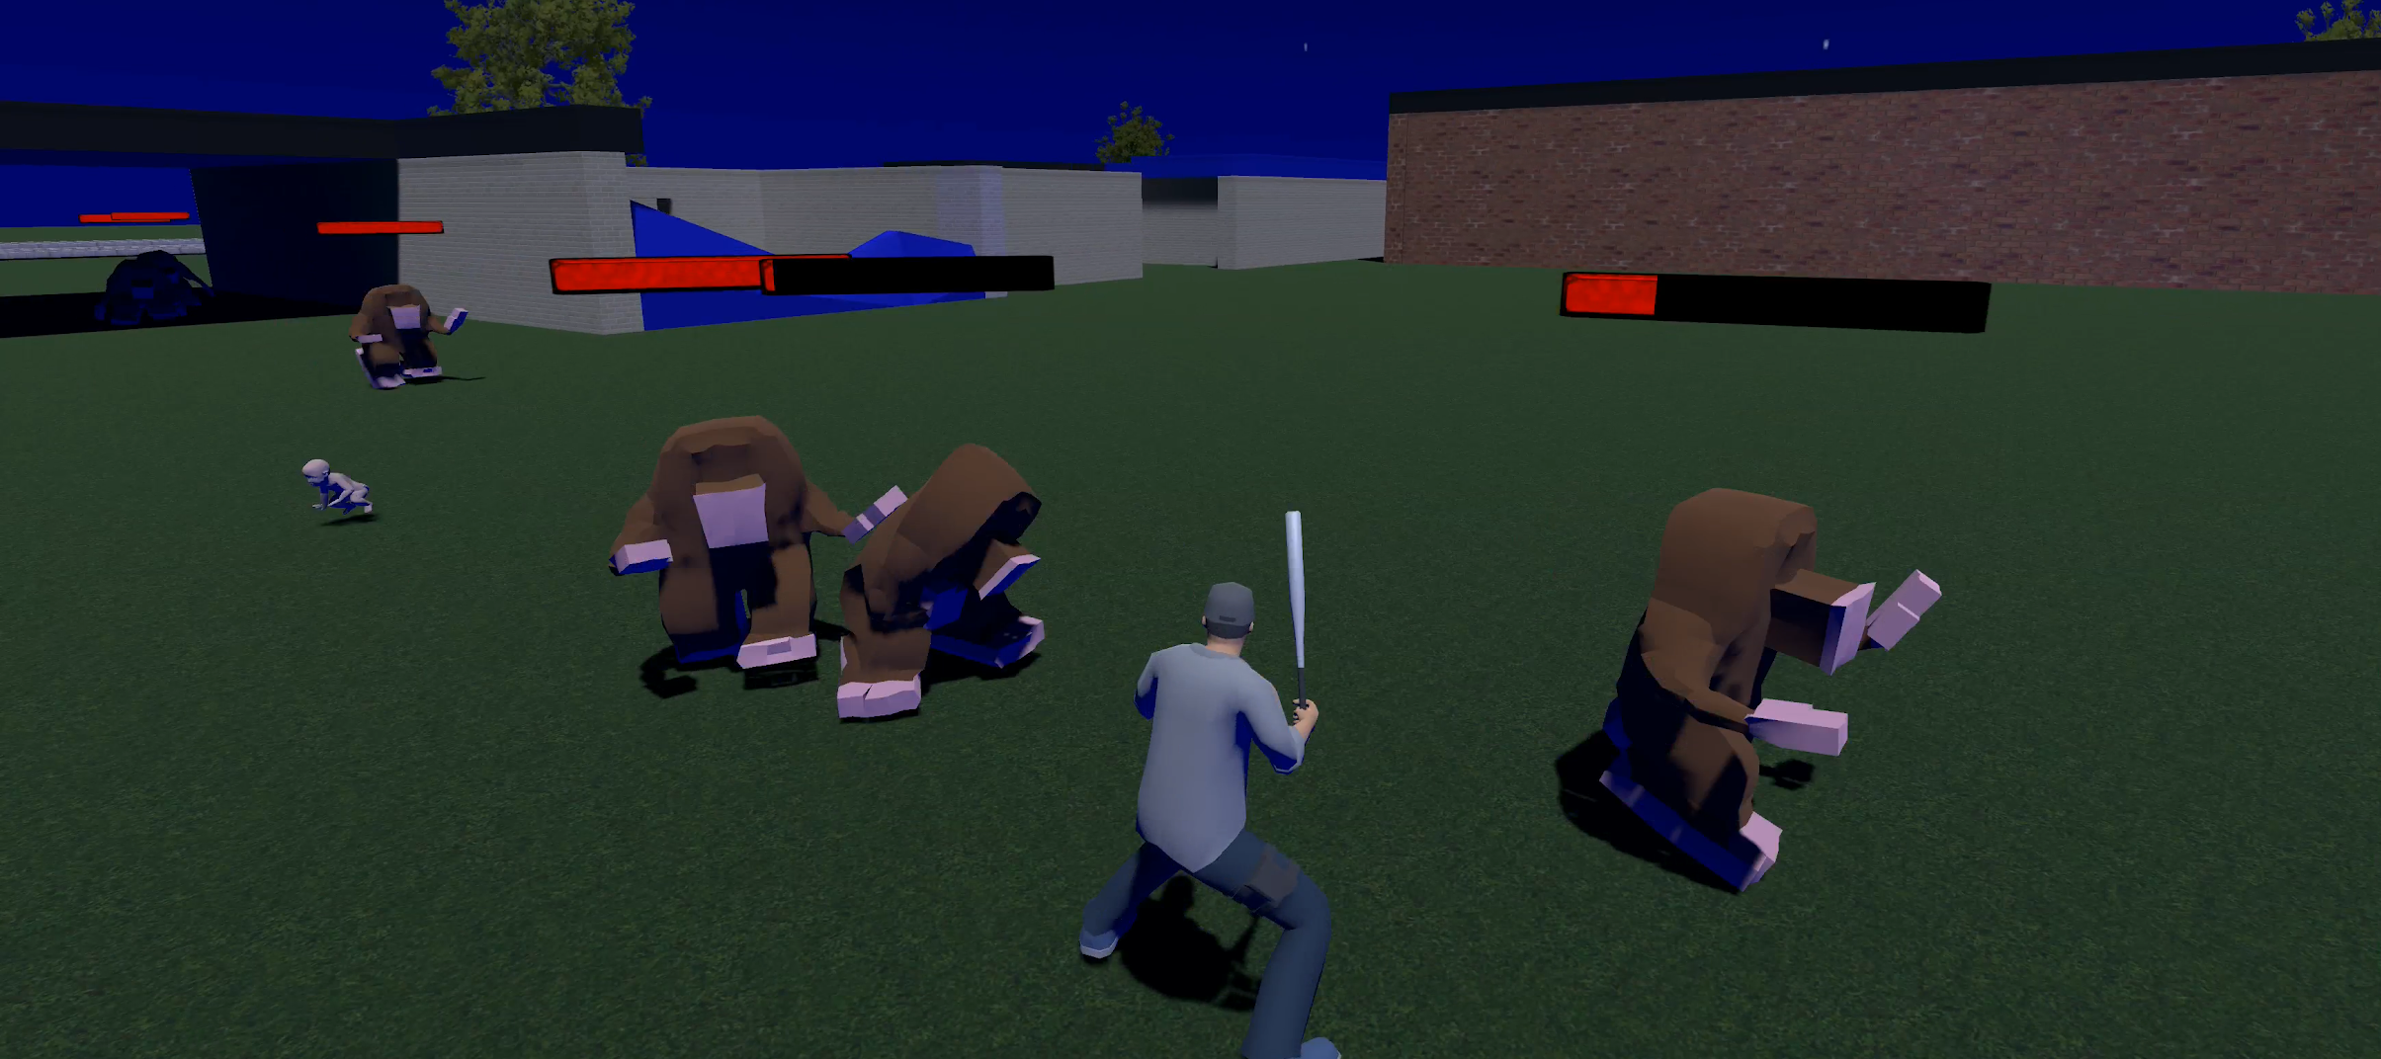
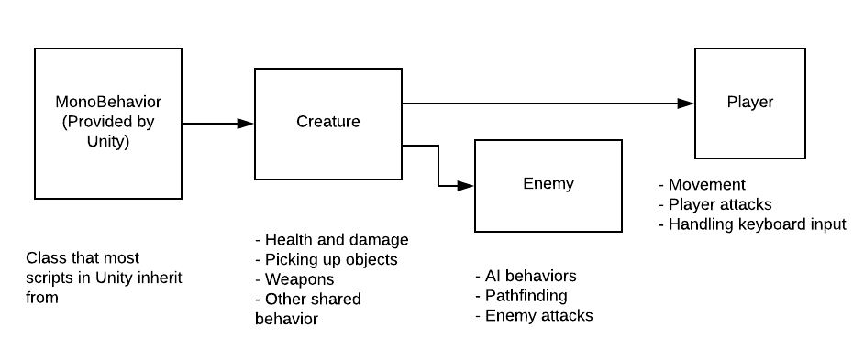
HIDE YO KIDS: A GAME ABOUT PROTECTING
KIDS AND FINDING A WAY TO ESCAPE
A CIS Capstone Project by Joshua McCabe, Wilbur McElroy, and Thomas Pope
Washburn University 1700 SW College Ave. Topeka, KS 66621
Goal
Our goal was to create a 3D action game while also learning how to develop using Unity. We wanted to create a game with a fairly small scope, but also wanted the game to be original. We strove to create a defense game that was different than the typical tower defense game.
Challenges and Lessons Learned
During development, many of our challenges arose due to having very vague, general goals and few well established features until much later in the process. We also learned that creating 3D assets is very time consuming and many of the assets we ended up using came from asset stores. To mitigate these issues in future projects, we will be sure to create specific, achievable goals, establish essential features early, and decide on firm code standards and development guidelines.
Summary
The objective of the game is to repair a helicopter while also defending children against waves of mutant moles. Once the helicopter is fixed, you have to round up the children and escape. Playing on harder difficulties, surviving more waves, and killing more enemies increases your score and has to earn you a spot on the leaderboard.
Implementation
We utilized C# for our game as that was one of the two languages native to Unity. An object-oriented approach was used when creating classes to minimize repetitive functions between similar objects. The Creature class had base functions used by all entities in the game. Player and Enemy classes were created to fine tune specific behaviors that needed to be unique.

