Slide 1
Preliminary results using methods for cell-type specific EWAS
Rebecca Forrester and Matthew Suderman

Slide 2
Rahmani E, Schweiger R, Rhead B, Criswell LA, Barcellos LF, Eskin E, Rosset S, Sankararaman S, Halperin E. Cell-type-specific resolution epigenetics without the need for cell sorting or single-cell biology. Nat Commun. 2019 Jul 31;10(1):3417. doi: 10.1038/s41467-019-11052-9.
Luo X, Yang C, Wei Y. Detection of cell-type-specific risk-CpG sites in epigenome-wide association studies. Nat Commun. 2019;10(1):3113. Published 2019 Jul 15.

Slide 3
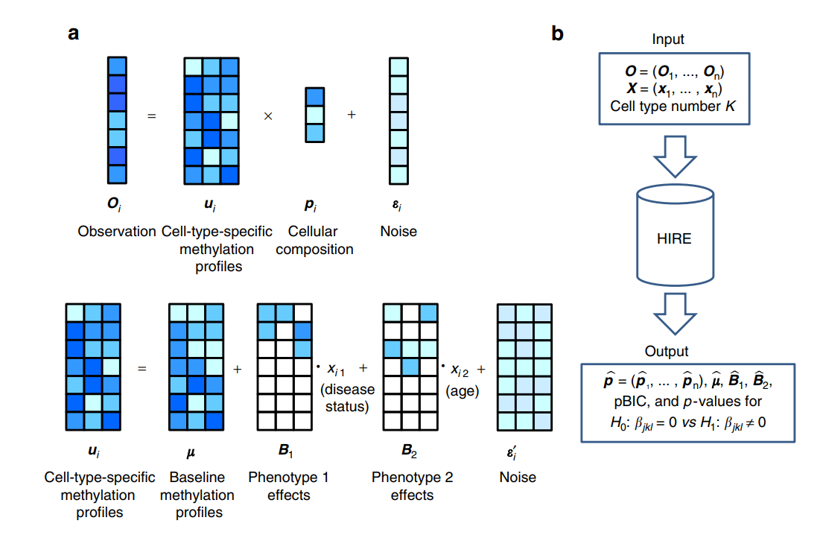
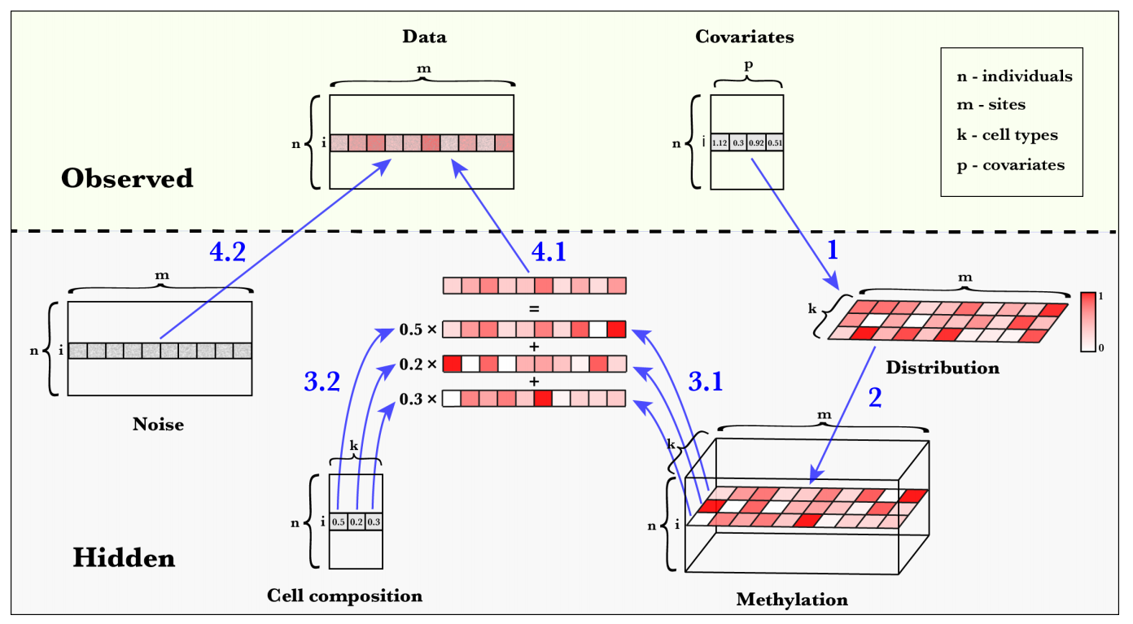
HIRE by Luo et al.
TCA by Rahmani et al.
"For completeness, we verified that TCA performs substantially better than the method by Luo et al. (Supplementary Figs. 13 and 14; see 'Methods')"

Slide 4
Dataset
Rheumatoid Arthritis (GSE42861)
354 cases and 335 controls
10,000 CpG sites
Methylation mean between 0.2 and 0.8
Most variable
Covariates: gender, smoking history

Slide 5
Cell types
Each method generates cell-type specific profiles
Comparisons generated using the most discriminative CpG sites (same as minfi for selecting CpG sites for cell count estimation)
 | Gran | CD4 | CD8 | CD19 | CD14 | CD56 | Neu | Eos
HIRE1 |  | .
HIRE2 |  | . | *
HIRE3
HIRE4 |  |  |  |  | *** | ** |  | .
HIRE5
HIRE6
TCA1
TCA2
TCA3
TCA4
TCA5
TCA6
P-value codes
0-0.001 ‘***’
0.001-0.01 ‘**’
0.01-0.05 ‘*’
0.05-0.1 ‘.’
Note that HIRE reported agreement with CD4+ and neutrophils – something to check…

Slide 6
Cell types: HIRE vs TCA
Each method generates cell-type specific profiles
Comparison using the most discriminative sites (as in minfi cell count estimation)
 | HIRE
TCA |  | CT1 | CT2 | CT3 | CT4 | CT5 | C6
 | CT1 | **|. | | | |* | | | | | |
 | CT2 | .| | **|** | **| | | | *| | **|***
 | CT3 | .| | ***| | ***|*** | | | ***|** | ***|***
 | CT4 | | | | | | | | | | | |***
 | CT5 | |* | | | * | | | | | |***
 | CT6 | ** | | | |* | | | | | |*
TCA predicting HIRE| HIRE predicting TCA
0 ‘***’ 0.001 ‘**’ 0.01 ‘*’ 0.05 ‘.’ 0.1

