Slide 1
Gwen’s and Tom’s simple guide to writing a script
Gwen Fernandes, Thomas Battram

Slide 2
Outline
Making a new R script
Commenting your scripts
What to think about before starting to script
How the top of your script should look
Making your code easier to read
Saving your scripts

Slide 3
Making a new R script
The usual R Studio screen has four windows:
CONSOLE
WORKPLCE AND HISTORY
FILES, PLOTS, PACKAGES AND HELP
R SCRIPT AND DATA VIEW (this is where you keep a record of your work. For Stata users, this would be like your do-file, for SPSS users it is like the syntax and for SAS users, the SAS program.

Slide 5
Making a new R script

Slide 6
Making a new R script

Slide 7
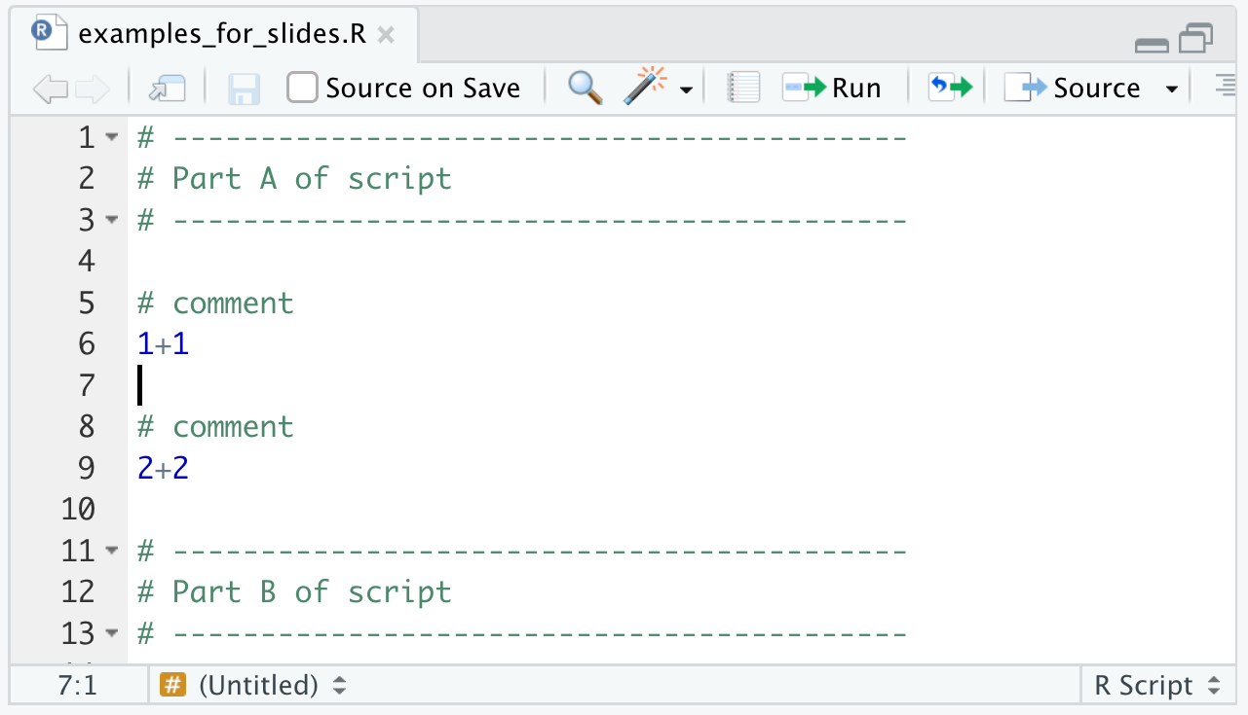
Commenting
Code with a # before it does not get run
This is useful for making your scripts much easier to read!
Comment on WHY and WHAT (to start with)
Start with many comments!!! Also, use comments to split up the script to make it clearer

Slide 8
3 steps before starting
Why am I writing this script?
What do I need to write this script?
How am I going to write this script?

Slide 9
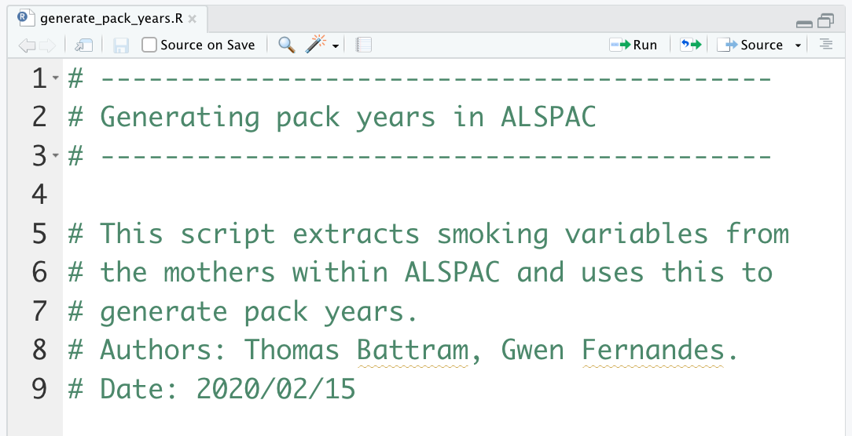
Step 1: Why am I writing this script?
Think about it and write it down!
e.g. clean a dataset OR assess association between x and y
Give the script a good name, write a descriptive title + add a couple of lines that describe the purpose of the script

Slide 10
Step 2: What do I need to write this script?
Datasets!
Using only base R can make things difficult… Packages!
Packages are made by others and are there to make your life easier
For example, reading data into R can be tricky depending on how the data is stored, but packages can make this easier!

Slide 11
Reading data into R
Depending on what form the data is in, you have to use different functions to read in the data. Data you get may be in:
excel spreadsheets
comma seperated value (csv) files
text separated value (tsv) files
spss files
stata files
images (e.g. .png files)
These need different functions to read them in, some of which are only available with certain packages – will be covered in more detail in the “managing data” session.

Slide 12
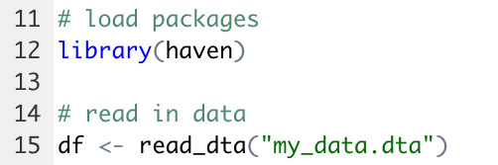

Slide 13
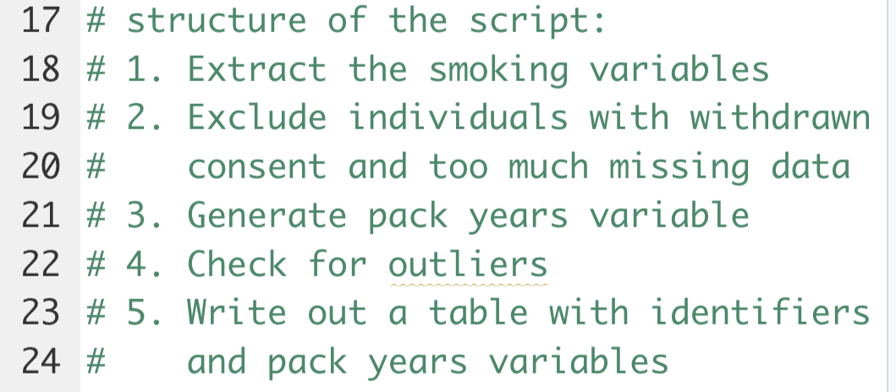
Step 3: How am I going to write this script?
Linked to why you are writing it and what you need to write it!
* Write out each step

Slide 14
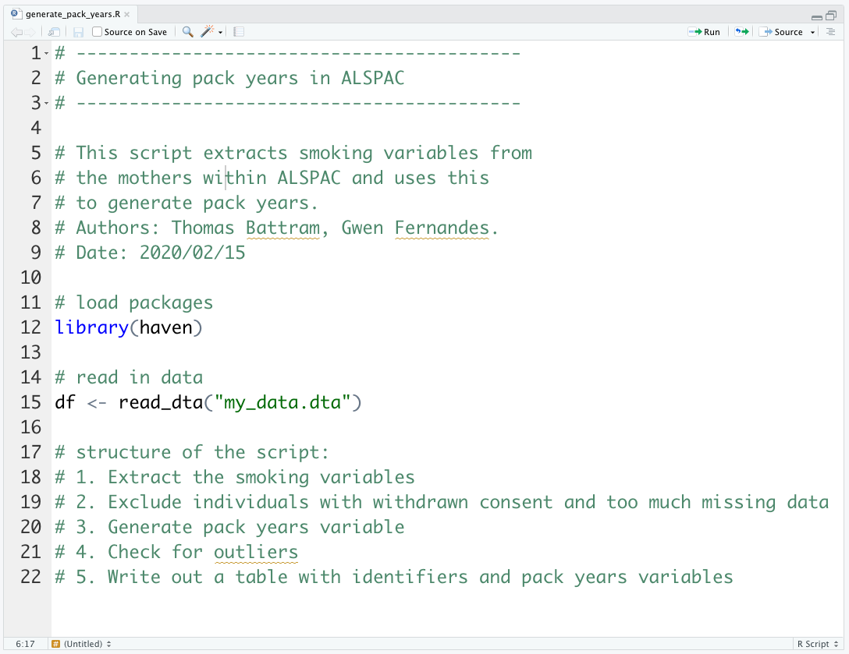
Top of the script

Slide 15
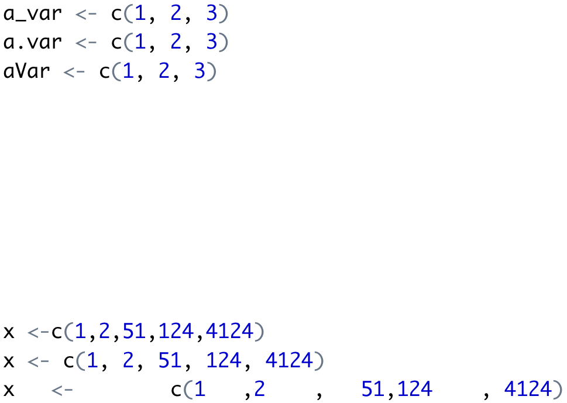
Make your code easy to read
Use a consistent style when writing code
Use spaces appropriately

Slide 16
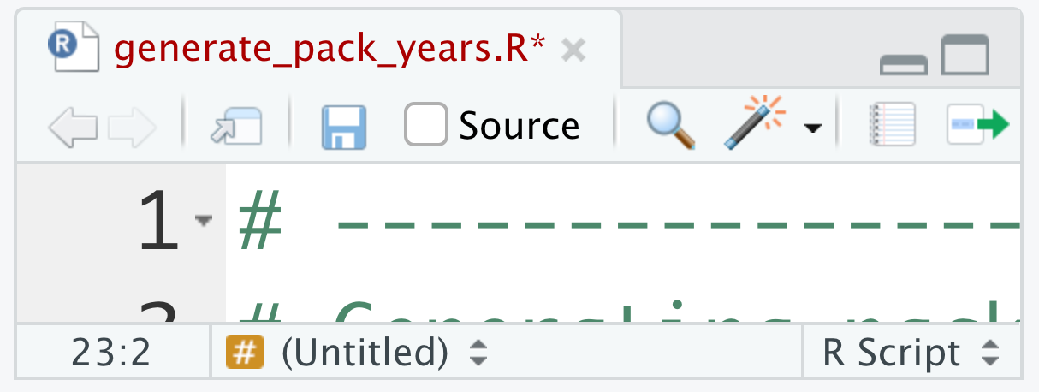
Saving scripts
It’s important to save scripts as you go and you can always come back to them and send them to other people.
Give the script a good name and save it regularly!

Slide 17
Summary
3 questions to think about before writing a script:
Why am I writing this script?
What do I need to write this script?
How am I going to write this script?
Comment your code a lot (using #)
Make your code easy to read
Save your scripts regularly

Slide 18
Git
One way to share scripts with the world (or just your collaborators) is through GitHub.
Slides are available here: https://github.com/thomasbattram/how_to_write_a_script
For the curious:
Rationale for github: https://guides.github.com/introduction/git-handbook/
Quickstart guide: https://guides.github.com/activities/hello-world/

Slide 19
On to the practical!!
Bad script
Good script

