Slide 1
Information and Numeral systems
Lecture 1

Slide 2
Connecting things
Linguistics (grammar, phonology, etc.)
Statistics and probability
Symbolic logic
Algebra and analysis
Physics

Slide 3
Plan
Information
Locus of Information
Computers
Numeral Systems
Arbitrary-Base Arithmetic

Slide 4
Information
What is information?

Slide 5
Information
Why discuss information?
Computers are devices built to process information.
Language is one of the means of representing information.

Slide 6

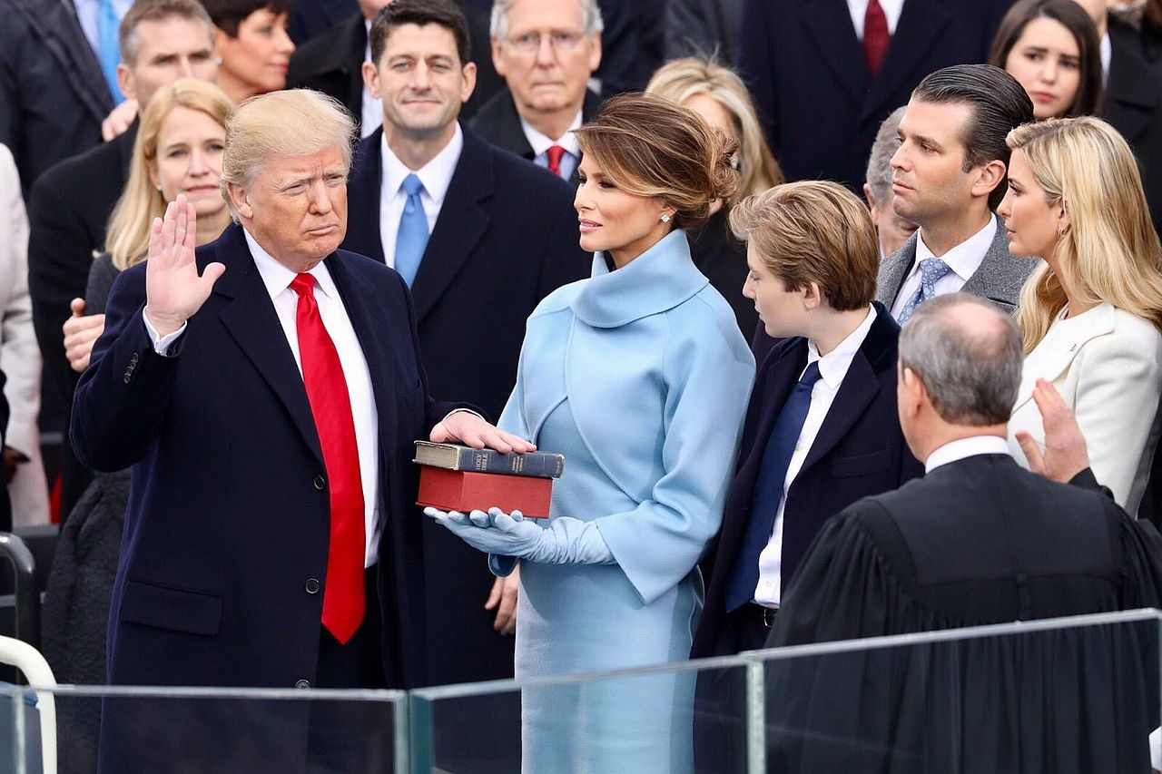
Information
Information is the resolution of uncertainty.

Slide 7
Information
Before: 2 possible outcomes
After: 1 observed outcome
Uncertainty reduced by ½
The smallest quantifiable bit of information
…called a “bit”
One bit is the information that is gained when the value of a binary random variable becomes known.

Slide 8

Information
0 bits

Slide 9
Information
Information = log₂ x, where x – number of possible outcomes
Examples:
U.S. elections: information = log₂ 2 = 1 (bit)
Russian elections: information = log₂ 1 = 0 (bit)
log_{a}b=c ⬄ a^{c}=b

Slide 10
Comprehension check
“Twenty Questions”
One player is chosen to be the answerer. That person chooses a subject (object) but does not reveal this to the others. All other players are questioners. They each take turns asking a question which can be answered with a simple “Yes” or “No.“ If a questioner guesses the correct answer, that questioner wins and becomes the answerer for the next round. If 20 questions are asked without a correct guess, then the answerer has stumped the questioners and gets to be the answerer for another round.
If a questioner guesses the correct answer after asking 20 questions, how much information has been gained from the answerer?

Slide 11
Locus of Information
Where is information located?

Slide 12
Locus of Information
Information is stored and processed by intelligent systems (such as a human brain/mind or a computer).
Information may represent observable phenomena.
Cf. cognitive linguistics: “language exists in the brain, not in the world.”
Information entropy (uncertainty) vs. thermodynamic entropy S [J/K].

Slide 13
Intelligent Systems
An intelligent system can reason with information (i.e. it can transform information to generate new information).
The laws of reasoning are studied by logic.
In the West, logic was first developed by Aristotle.
Formal logic: Boolean algebra and logical calculus.

Slide 14
0th Order Logic
AKA propositional/sentential logic.
Propositions/sentences: statements that can be true or false (“truth value”)
Propositions can be connected into compound propositions by logical connectives
The truth value of the compound proposition can be formally derived from the truth values of the constituent propositions and the characteristics of the logical connectives

Slide 15
Comprehension Check
I = “We are now in Iowa”
M = “We are now on the Moon”
A = “Everyone will get an A in this course”
Determine the truth values of propositions I, M, A
How much information does each truth value contain?

Slide 16
Logical Connectives
∧ AND(conjunction): “A AND B” is true if and only if both A is true and B is true
∨ OR (disjunction): “A OR B” is false if and only if both A is false and B is false
⊻ XOR (exclusive disjunction): “A XOR B” is true if and only if the truth values of A and B are not the same
¬ NOT (negation): “NOT A” is true if and only if A is false
→ IMPLY (implication): “A IMPLY B” is false if and only if A is true and B is false

Slide 17
Compound Propositions
X = I ∧ M = “We are now in Iowa, and we are now on the Moon”
I = TRUE, M = FALSE
By definition, conjunction I ∧ M is true if and only if both conjuncts (I and M) are true
Thus, X = FALSE

Slide 18
Compound Propositions
Y = M → I = “We are now on the Moon, therefore we are now in Iowa”
M = FALSE, I = TRUE
By definition, implication M → I is false if and only if the antecedent (M) is true and the consequent (I) is false
Thus, Y = TRUE

Slide 19
Computers
Devices that store and process information

Slide 20
Modern Computers
Electronic: works by switching electric currents without mechanical (moving) parts
Digital: processes discrete bits of information (logical values)
Programmable: can be configured to carry out arbitrary information-processing tasks

Slide 21
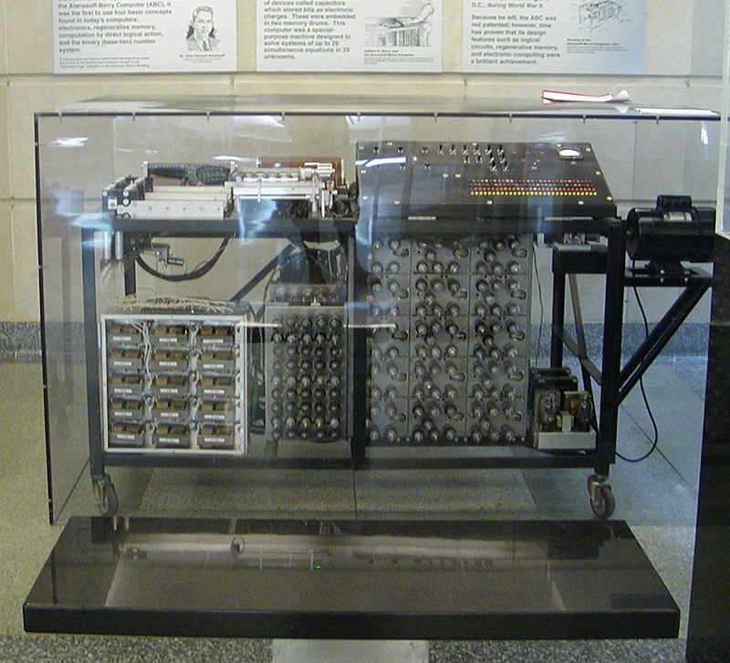
Atanasoff-Berry Computer
Electronic
Digital
NOT programmable

Slide 22
Digital Computing
Discrete bits of information are represented by electric circuits that can be switched “ON” and “OFF.”
When the circuit is “ON,” it conducts current.
When the circuit is “OFF,” it does not conduct current.

Slide 23
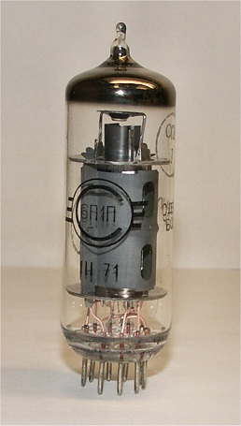
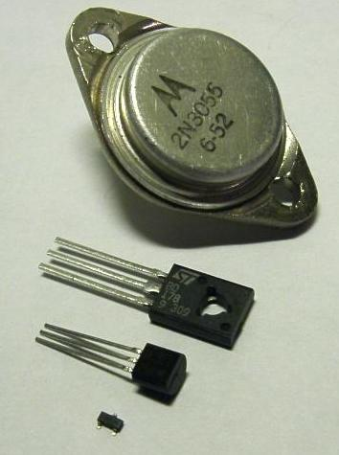
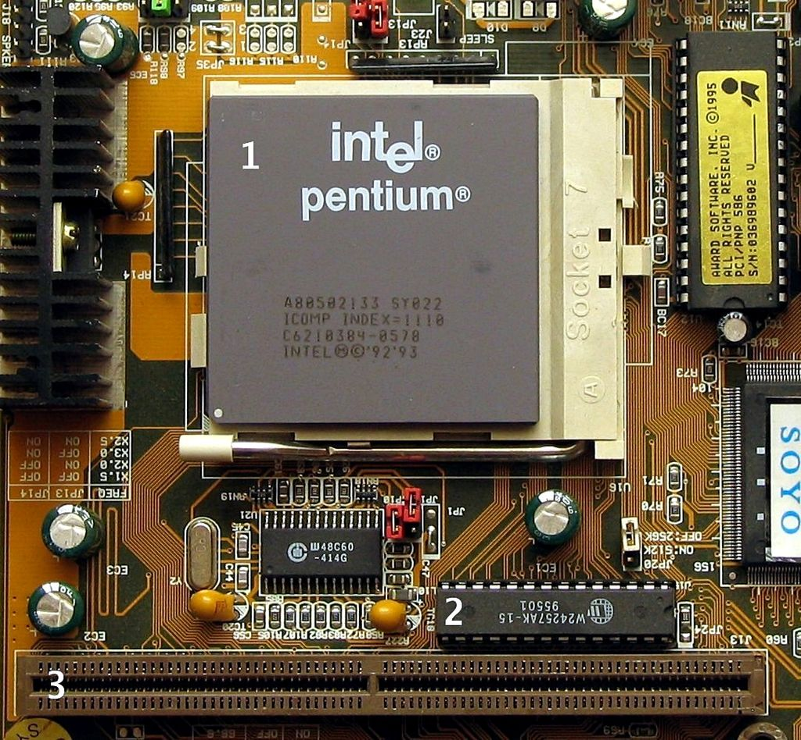
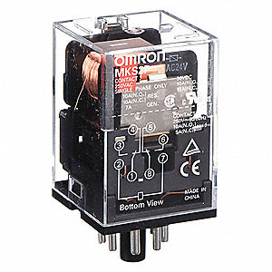

Slide 24
Programmability
Read TB Introduction:
“On Programming”
“Why Language Matters”
Von Neumann architecture:
Data and instructions (i.e. programs) are both stored as information.

Slide 25
Turing Machine
An abstract machine (mathematical model).
Infinite “tape” divided into discrete “cells”.
A “head” that positions over one cell at a time and “scans” the symbol there.
According to a finite “table” of instructions:
Erase and/or write a symbol in the cell.
Move the tape one step left or right.
Either proceed to a subsequent instruction, or halt.

Slide 26
Questions
Does a machine exist that can determine whether any arbitrary machine on its tape is “circular” (e.g., freezes, or fails to continue its computational task)?
No.
Does a machine exist that can determine whether any arbitrary machine on its tape ever prints a given symbol?
No.

Slide 27
Turing Completeness
A computational system is “Turing complete” if it can simulate a Turing machine.
A programming language that is “Turing complete” is theoretically capable of expressing all tasks accomplishable by computers.
Nearly all programming languages are Turing complete if the limitations of finite memory are ignored.

Slide 28
Central processing unit (CPU)
Fundamentally a logical device.
A is TRUE, B is FALSE. What’s A ∧ B?
Can perform numerical operations.
Need a way to represent numbers.

Slide 29
Numeral Systems
Ways of representing numbers

Slide 30
Numeral Systems
A numeral system (a system of numeration) – a writing system for expressing numbers
Roman numerals (non-positional): MMXIX
Hindu-Arabic system (positional): 2019
Positional: a digit’s value changes based on its position in the number
Big-endian: the “big end” (most significant digit) is written first
Decimal (base 10): there are ten different digits: 0,1,2,3,4,5,6,7,8,9

Slide 31
Positional numeral systems
Also known as “place-value notation”:
d – the value of the digit
p – the position of the digit in the number, with 0 being the least significant
b – the base of the numeral system (number of different digits in the system)
v – the contribution of a digit to the value of a number
v = db^{p}

Slide 32
2019
v = db^{p}
Digit d=9 is at position p=0
v = 9 × 10⁰ = 9 × 1 = 9
Digit d=1 is at position p=1
v = 1 × 10¹ = 1 × 10 = 10
Digit d=0 is at position p=2
v = 0 × 10² = 0 × 100 = 0
Digit d=2 is at position p=3
v = 2 × 10³ = 2 × 1000 = 2000
Total: 9 + 10 + 0 + 2000 = 2019

Slide 33
Comprehension check
How many bits does a four-digit decimal number (from 0000 to 9999) contain?

Slide 34
Binary system
v = db^{p}
Base b=2 (there are two digits: 0,1)
bit < binary + digit
Example: 1001₂ (or 0b1001)
Digit d=1 is at position p=0
v = 1 × 2⁰ = 1 × 1 = 1
Digit d=0 is at position p=1
v = 0 × 2¹ = 0 × 2 = 0
Digit d=0 is at position p=2
v = 0 × 2² = 0 × 4 = 0
Digit d=1 is at position p=3
v = 1 × 2³ = 1 × 8 = 8
Total: 1 + 0 + 0 + 8 = 9 (i.e. 1001₂ = 9)

Slide 35
Comprehension check
Convert 2019 to the binary system.

Slide 36
Hexadecimal System
v = db^{p}
Base b=16 (digits: 0,1,2,3,4,5,6,7,8,9,A,B,C,D,E)
Example: 7E3₁₆ (or 0x7E3)

Slide 37
Comprehension check
What is 7E3₁₆ in the decimal system?
What is AB₁₆ in the binary system?

Slide 38
Arithmetic operations in arbitrary base

