Slide 1
Representing texts and sounds in the computer
LING 516
Week 2 Overflow

Slide 2
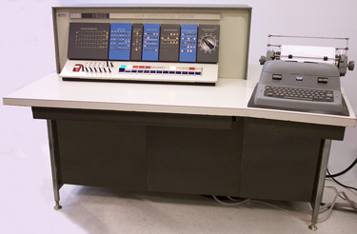

Slide 3
PROGRAMMABLE
by
is
DIGITAL
is
COMPUTER
is
ELECTRONIC
processes
log₂(x)
defined
INFORMATION
represents
PROGRAMMER
measured
using
BITS
LOGIC
equivalent
works with
equivalent
TRUTH VALUES
represented using
BINARY DIGITS

Slide 4
Texts
American Standard Code for Information Interchange (ASCII)
7 bits (can encode 2⁷=128 different characters)
2⁶ | 2⁵ | 2⁴ | 2³ | 2² | 2¹ | 2⁰
0 | 0 | * | * | * | * | *
Special characters: ASCII codes 0..31
2⁶ | 2⁵ | 2⁴ | 2³ | 2² | 2¹ | 2⁰
1 | 0 | * | * | * | * | *
Uppercase: ASCII codes 64..95
2⁶ | 2⁵ | 2⁴ | 2³ | 2² | 2¹ | 2⁰
0 | 1 | * | * | * | * | *
Math symbols: ASCII codes 32..63
2⁶ | 2⁵ | 2⁴ | 2³ | 2² | 2¹ | 2⁰
1 | 1 | * | * | * | * | *
Lowercase: ASCII codes 96..127

Slide 5
Texts
How to make a letter uppercase?
Let X be the ASCII code of the letter
Y = X AND 31₁₀ (bitwise)
 | 2⁶ | 2⁵ | 2⁴ | 2³ | 2² | 2¹ | 2⁰
g=103₁₀ | 1 | 1 | 0 | 0 | 1 | 1 | 1
31₁₀ | 0 | 1 | 1 | 1 | 1 | 1 | 1

Slide 6
Texts
How to make a letter uppercase?
Let X be the ASCII code of the letter
Y = X AND 31₁₀ (bitwise)
 | 2⁶ | 2⁵ | 2⁴ | 2³ | 2² | 2¹ | 2⁰
g=103₁₀ | 1 | 1 | 0 | 0 | 1 | 1 | 1
31₁₀ | 1 | 0 | 1 | 1 | 1 | 1 | 1
G=71₁₀ | 1 | 0 | 0 | 0 | 1 | 1 | 1

Slide 7
Why not subtract 32?
103 – 32 = 71
103 AND 31 = 71

Slide 8
Comprehension check
Consider the following hexadecimal dump of seven bytes in the computer memory:
48 69 0D 0A 42 79 65
Decode this information (i.e.: what has been represented using these bytes?)

Slide 9
Unicode
Representing letters other than the Roman alphabet
32 bits
Can represent 2³²=4,294,967,296 different characters
Is an ongoing project as support for more writing systems is added

Slide 10
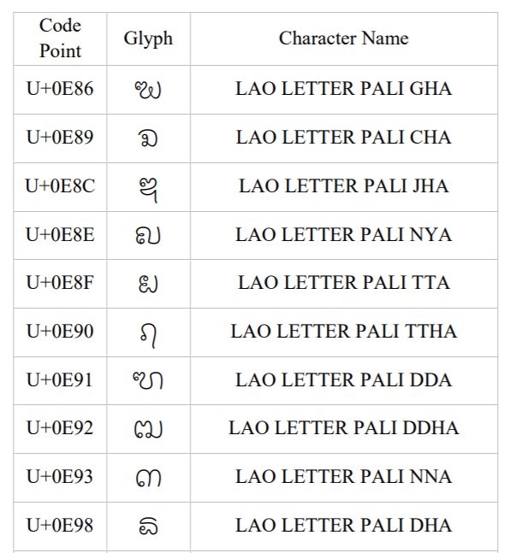
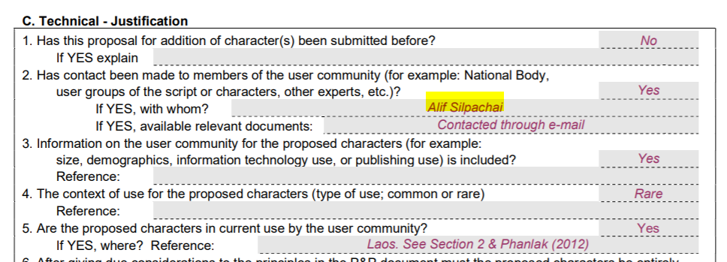
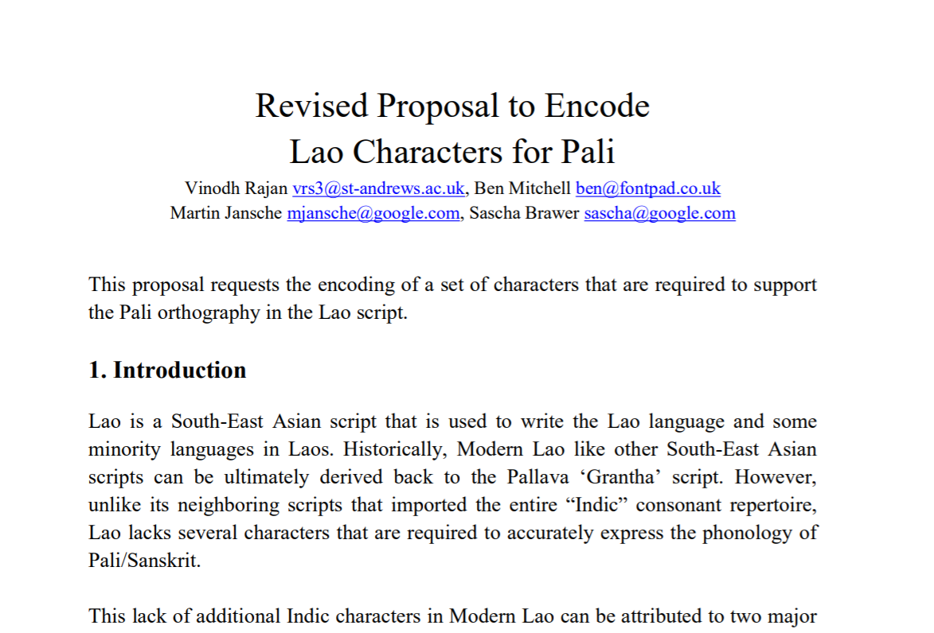

Slide 11
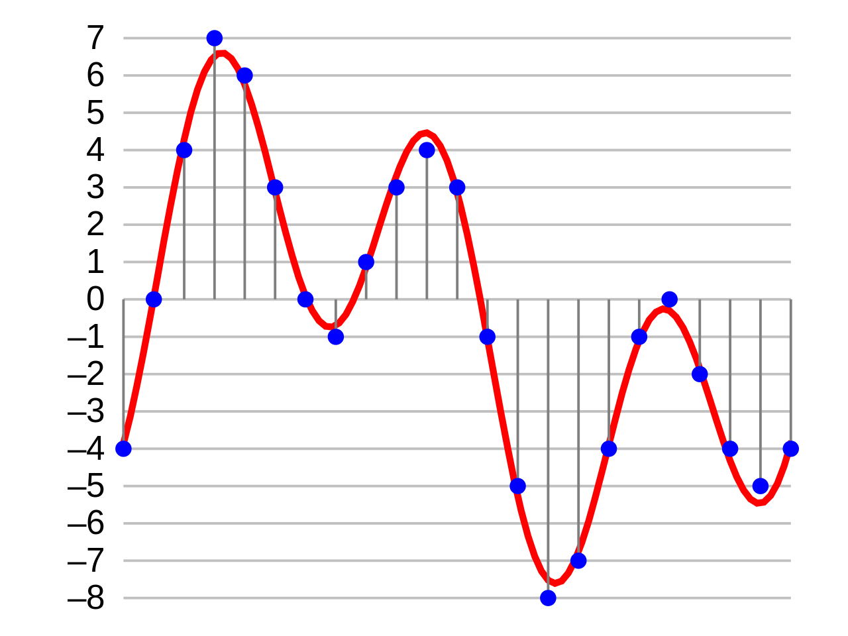
Audio

