Slide 1

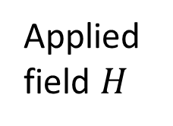
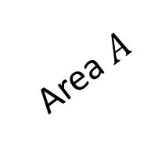
Magnetic moment
Magnetic moment
Pinning site
Applied field $H$
Area $A$
$$x$$
Net magnetic moment

