Slide 1
Security Guidelines
C/C++ Coding
C/C++ Coding
What did I need to do when...
by
Thomas Biege <thomas@suse.de>

Slide 2

... when I want to copy Strings?
do NOT use strcpy(3) or strcat(3)
instead use strncpy(3) or strncat(3)
but use them with the correct 3rd parameter (which is the size of the destination buffer)
if available use strlcpy(3), strlcat(3), they are less error prone

Slide 3
... when I want to copy binary Memory?
use memcpy(3) (POSIX standard)
take care, the third parameter is the size of the destination buffer

Slide 4
... when I want to allocate Memory?
do NoT calculate the memory size based on integers provided by the user (untrusted source)
use an upper boudary
only allow a size greater than zero

Slide 5
... when I want to do arithmetic Operations?
integers have a limited size and can therefore overflow!
be type-safe (even on different archs)!
check for upper and lower boundary, always!
type-casts from signed to unsigned can cause high values and other problems
ask the SUSE Security-Team for help!

Slide 6
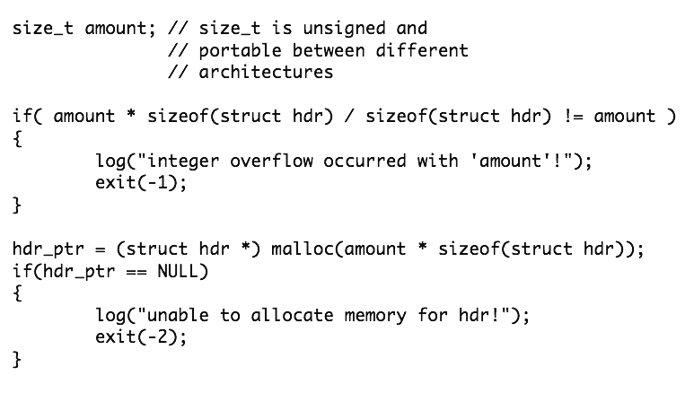
... when I want to do arithmetic Operations?
Example: ‘amount’ is untrusted input

Slide 7
... when I want to create a temporary File?
just use mkstemp(3)
or mktemp(1) in shell scripts

Slide 8
... when I want to use changing Objects?
where? filesystem, database, threads and memory, and a lot more!
filesystem: use mkstemp(3), open(2) with O_CREAT|O_EXCL, avoid symbolic names use descriptores whereever possible
lock resources like files, memory, etc.
use atomic operations (syscalls), mutex locks, etc.

Slide 9
... when I want to use Functions with varibale Parameter Size?
do NOT use the untrusted input as format string tag!
wrong: snprintf(buf, sizeof(buf), user_input);
right: snprintf(buf, sizeof(buf), “%s”, user_input

Slide 10
... when I want to spawn another Process?
clean the Environment! (clearenv(3))
and set safe values (setenv(3))
do NOT use system(3) or popen(3), instead use execle(3) or alike
close all open resources (files, directories, sockets, IPC stuff, ...), use fcntl(2) with FD_CLOEXEC

Slide 11
... when I want to pass secret Information to another Process?
do NOt use environment varibales. everyone (not on Linux) on the system can see them!
do NOT use command line parameters. everyone on the system can see them!
use IPC (pipe, unix domain socket)

Slide 12
... when I want to write a setuid Application?
DROP privileges as early as possible!
order: initgroups(3), setgid(2), setuid(2)
do NOt trust any input and check return values!
clean up environment as early as possible!
use Linux’ capabilities, drop more privileges!
ask the SUSE Security-Team for a source code review

Slide 13
... when I want to write a Network Service?
try to find an existing solution that can do the same job
do not trust any input from your socket. be paranoid!
separate your code into logical differnent processes with different privileges
ask the SUSE Security-Team for a source code review

Slide 14
... when I want to handle untrusted Input?
check range, type, size, etc.
use a white-list instead of a black-list for filtering
most modern libraries (like mysql) provide a function to escape dangerous characters
in case of a stateful protocol use a state-machine, and terminate on violations

Slide 15
... when I need to handle sensible Data?
after you are done, clean up the memory using memset(3) (compiler optimization removes asm code, use memset(3) twice with different value to be set)
encrypt data on the HDD
avoid swapping using mlock(3)
avoid core dumps using setrlimit(2)

Slide 16
... when I have to use Passwords
only store them encrypted and make this file only readable for your application
use a “password salt” to stop dictionary attacks
never send them in cleartext over the wire
force at least the usage of 6 characters, mix alpha with alphanumerical characters

Slide 17
... when I want to authenticate Entities?
check for existing solutions
be paranoid about the input provided
do not use short-cuts in your code to avoid timing-attacks, add random delays (msec)
delete credentials as early as possible
ask SUSE Security-Team for a source code review

Slide 18
... when I want to send Data over the Wire?
use SSL/TLS to protect your data
never send passwords in cleartext, use at least digest authentication and a nonce (number used once) to avoid replay attacks
if encryption is not an option, try to use at least integrity checks on the data

Slide 19
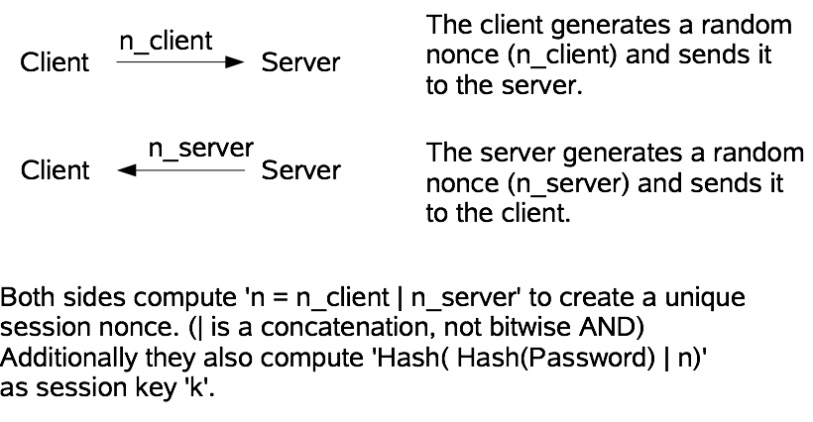
... when I want to send Data over the Wire?
a simple protocol for doing authentication only

Slide 20
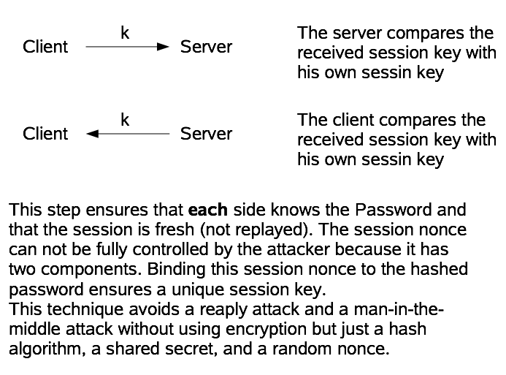
... when I want to send Data over the Wire?

Slide 21
... when I want to use SSL/TLS?
verify the certificates!
do NOT use exportable and/or weak ciphers!
key length for symmetric algo.: >= 128 bit
key length for asymmetric algo.: >= 1024 bit
if you can not verify a certificate, show the user the whole cert + fingerprint and let him/her decide.

Slide 22
... when I need to provide a random number?
use /dev/random for high security (like key generation) (... and use read(2), no buffering)
use /dev/urandom for lower security
never use predictable/low-entropy values like the system time!
avoid using a PRNG of software libraries
do NOT ship random seed with a package

Slide 23
... when I want to use Cryptography?
do NOT invent your own!!!
use existing solutions like OpenSSL, perl-Crypt*, php(4,5)-mcrypt, etc.
educate yourself about the solution provided, too much can be done wrong :(
if in doubt, ask the SUSE Security-Team for help :)

Slide 24
... when I have Questions?
just ask the SUSE Security-Team <security-team@suse.de> :)

