Slide 1
CS412 TSP Project
Parts C & D Thomas Brickhouse

Slide 2
Pseudocode & Strategy Discussion
one_tsp(graph):
Randomly choose a starting node
While there are unvisited nodes
Find the closest node
Update current path and cost
Return current path and cost
tsp_approx(graph):
While time < total time
Call one_tsp(graph)
If current_cost < best_cost
Update best path and cost
Randomly choose a node to start at
Perform a greedy traversal of the graph
If the cost of the path is the lowest seen, store it as he new optimal path
Repeat until time runs out

Slide 3
Analytical Runtime Analysis
The analytical runtime of my approximate TSP solution is Ο(𝑘 • V²)
The function one_tsp(graph) has a runtime of Ο(V²)
The function tsp_approx(graph) makes a call to one_tsp(graph), 𝑘 times, where 𝑘 is the total number of runs that fit into a given timeout

Slide 4
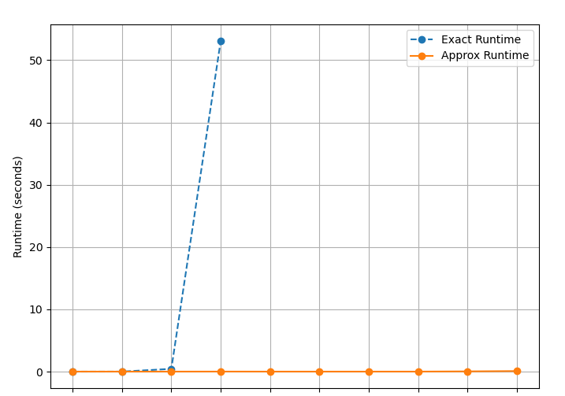
Performance Comparison
3 8 10 12 15 18 20 100 500 1000
Number of vertices in the graph
Notes:
Plots that illustrate the run-time (wall clock) performance of your exact solution versus the approximation solution on your test cases

Slide 5
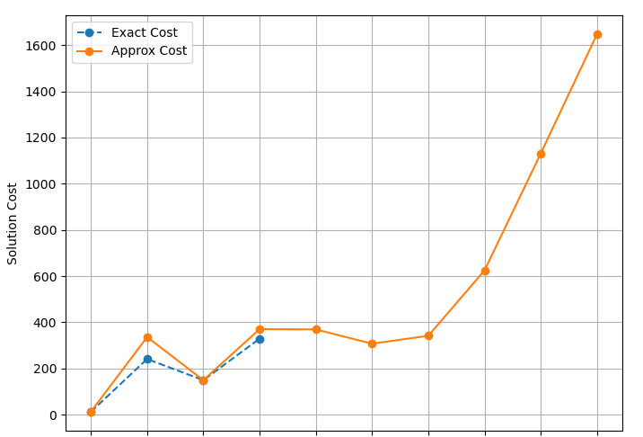
Result Comparison
3 8 10 12 15 18 20 100 500 1000
Number of vertices in the graph
Notes:
plots that compare the result/solution of your exact solution versus the approximation on your test cases. This is where you show the value achieved by both and see how well your approximation did versus the optimal solution.

