Slide 1
SPHYGOMANOMETER
WORKINGS
By Thomas Jos

Slide 2
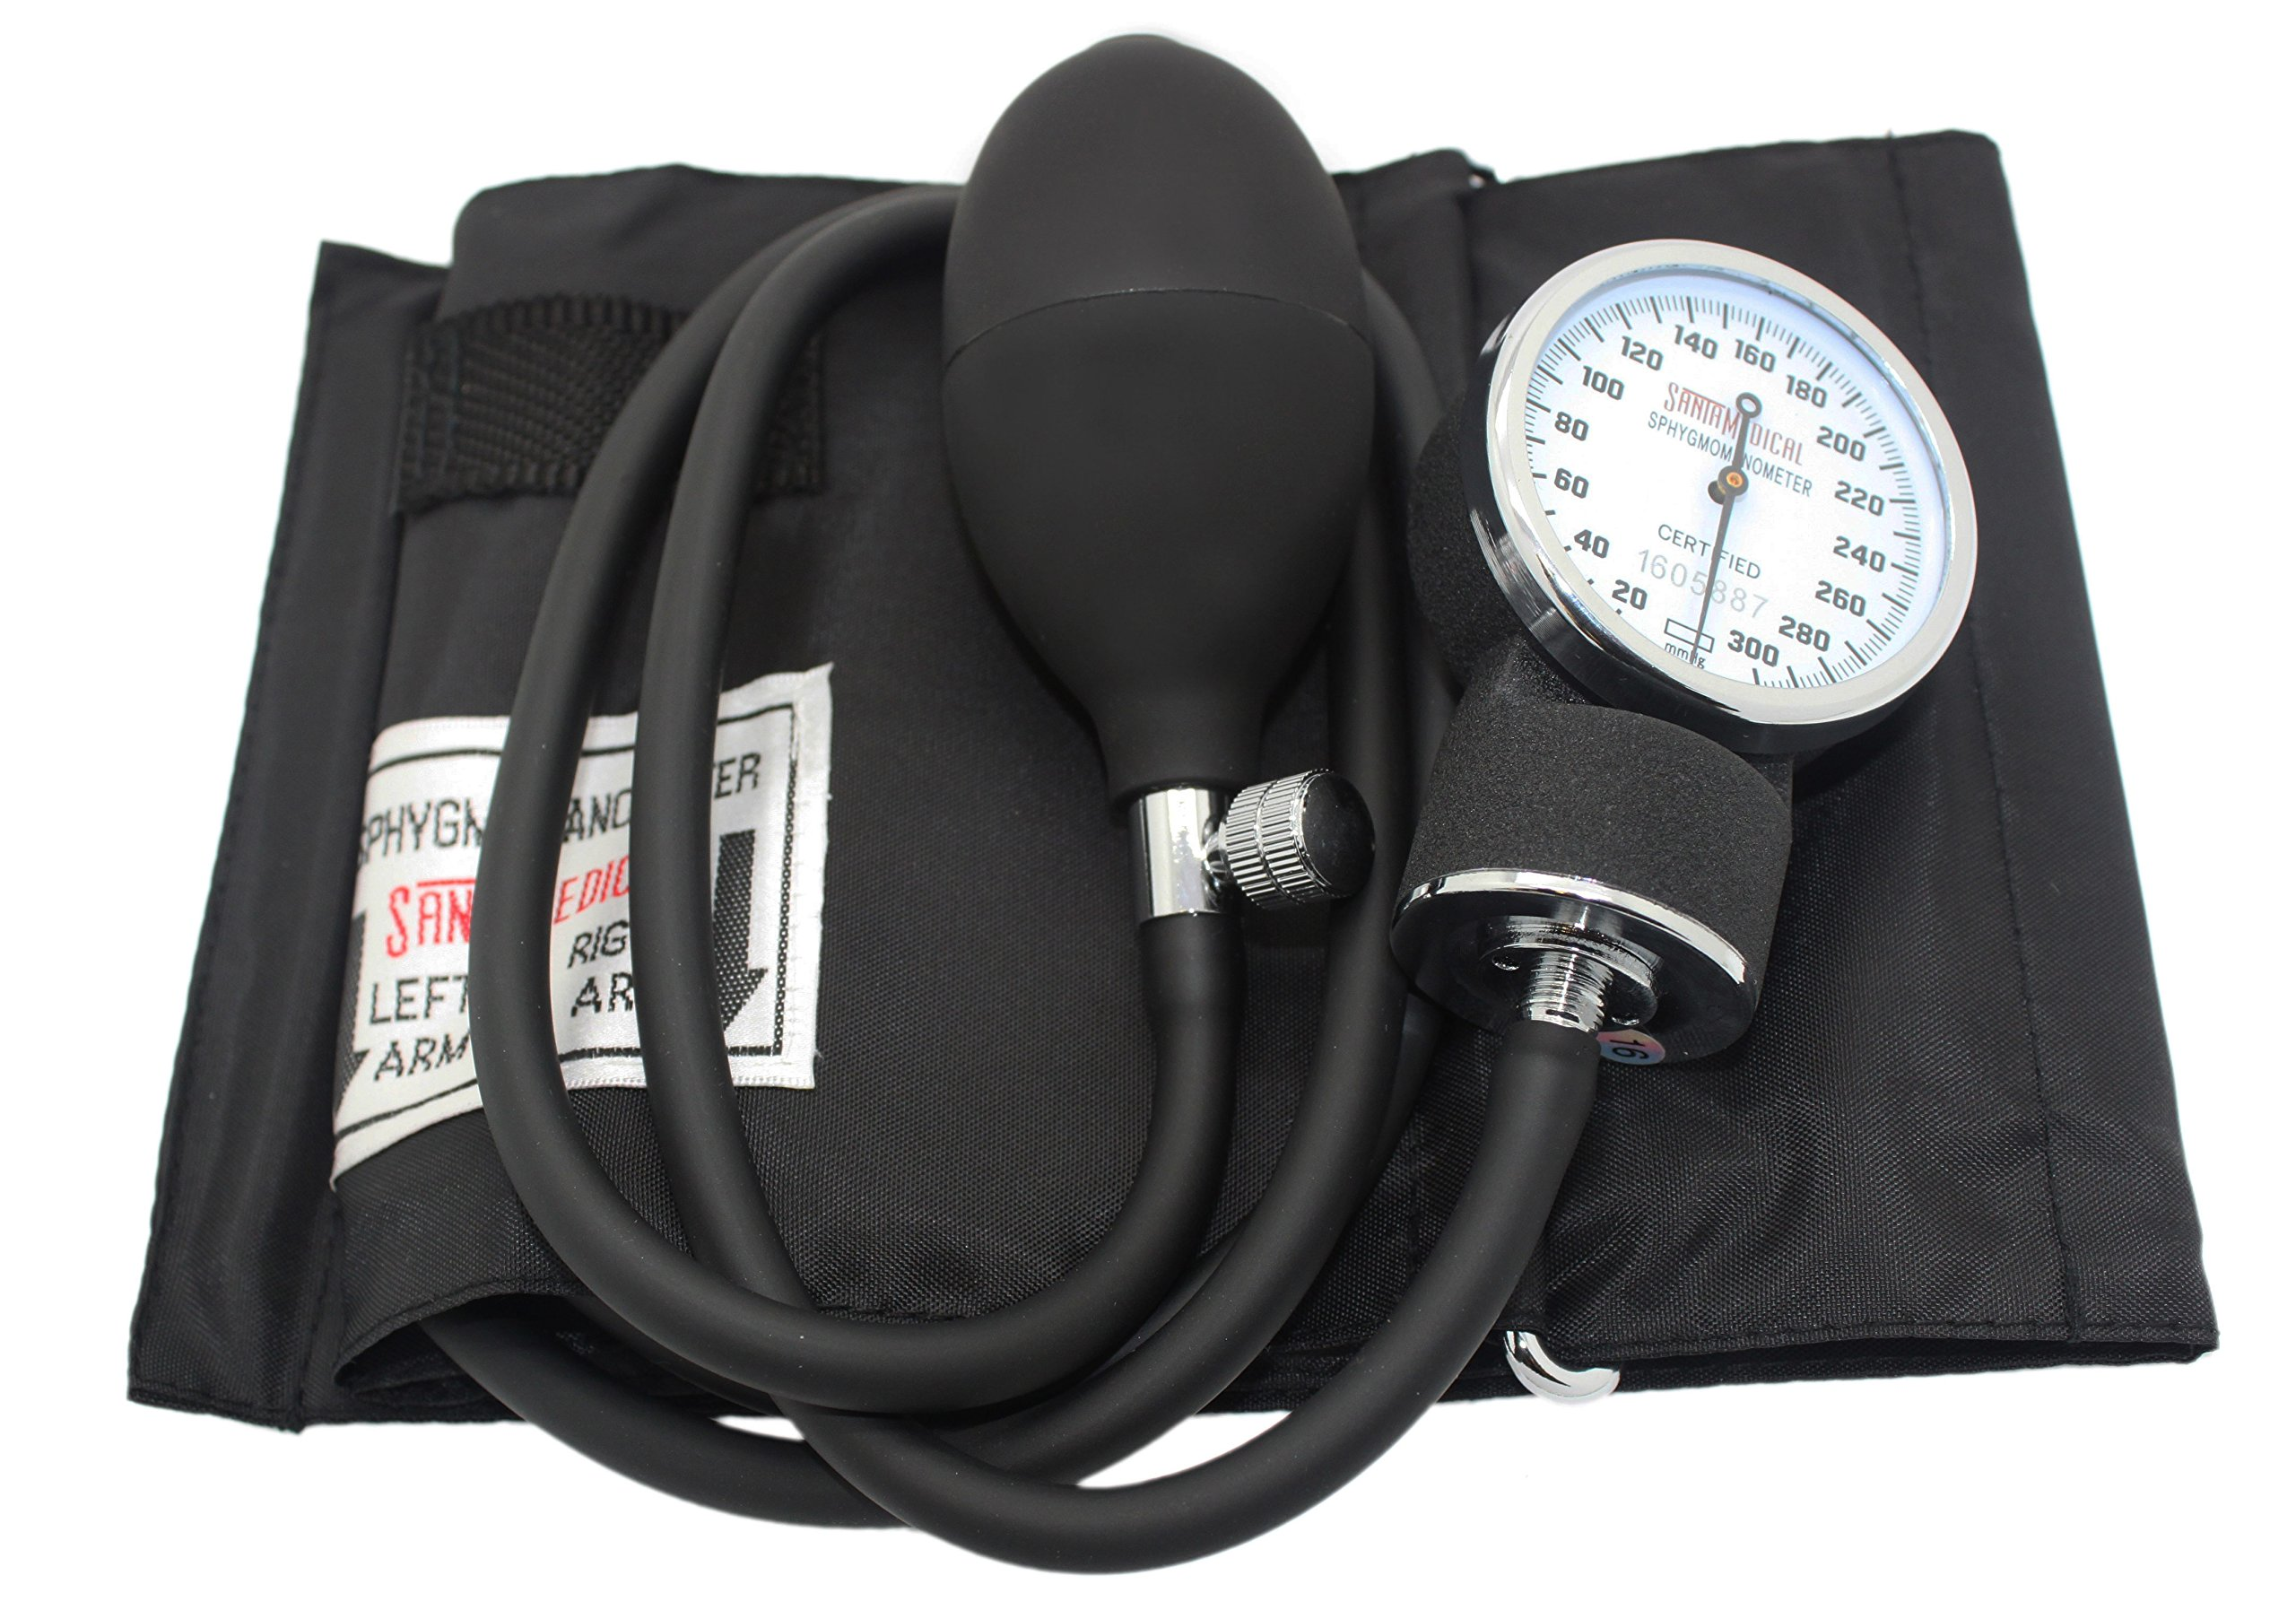
PARTS
Cuff: This is wrapped around the patient's upper arm and inflated to constrict the blood flow.
Gauge: This measures the pressure in the cuff
  Aneroid: Uses a dial and needle.
  Digital: Uses an electronic display.
Bulb and Valve: Used to inflate and deflate the cuff manually (in the case of aneroid sphygmomanometers).

Slide 3
TYPES OF SPHYGOMANOMETERS
MERCURY
ANEROID
DIGITAL
Traditional and most accurate type of blood pressure monitor.
Consists of an inflatable cuff connected to a column of mercury,
  Rises and falls with the pressure.
Medical professionals still prefer this device
  High precision.
  Phased out due to toxic Mercury
Commonly used in healthcare settings
  Portable
  Reliable
  Cost-effective
Use a dial and mechanical pressure system to give readings.
Lightweight and more affordable than mercury models
Require regular calibration to maintain accuracy.
Popular due to their convenience for home monitoring.
Ise electronic sensors and an LCD display to provide the blood pressure reading.
Automatic, inflating and deflating with a simple button press, others are semi-automatic
May be less precise than mercury or aneroid devices, especially if not used correctly

Slide 4
PROCESS OF MEASUREMENT
POSITION
INFLATION
Place cuff 1-2 inches above the antecubital fossa/ elbow pit
Pump cuff to about 160 mmHg (or 30mmHg above normal reading)or higher, release air about 3mmHG/s by using the valve
SYSTOLIC
DIASTOLIC
When you the first knocking sound (Kortokoff sounds), look at dial: this is the systolic pressure,
When knocking sound disappears, the pressure that appears is the diastolic pressure

Slide 5
BLOOD PRESSURE LEVELS
SYSTOLIC
DIASTOLIC
Blood pressure when the heart beats, usually higher
Blood Pressure measured when heart is on rest, usually lower

