Slide 1
COMP9517 Tut4
Image Segmentation

Slide 2
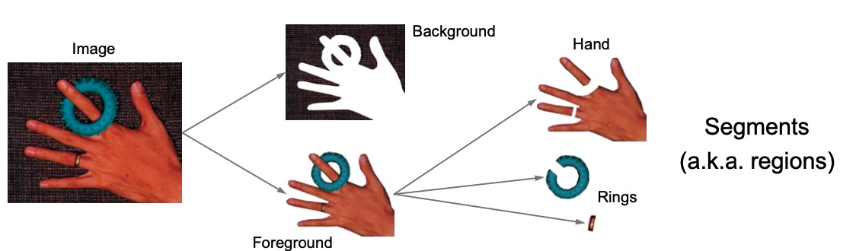
Image Segmentation
Partitioning an image into a set of meaningful segments.
Methods: Thresholding, Watershed segmentation, Conditional random field…

Slide 3
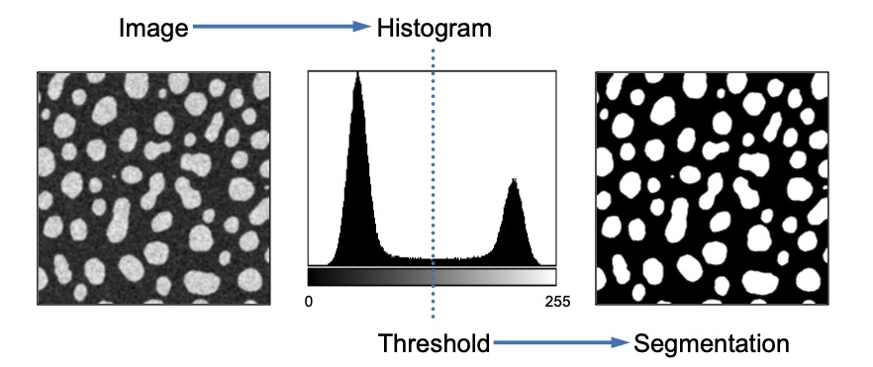
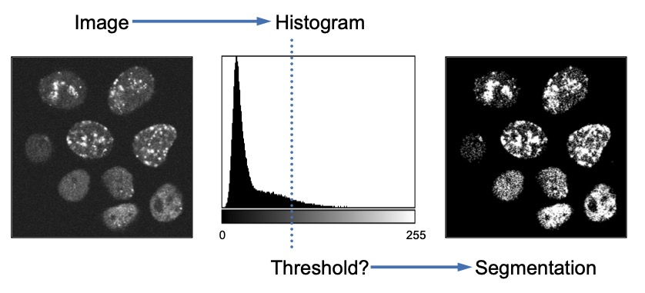


Thresholding
Pick a threshold T , set all pixels below T to be 0, and all the remaining pixels to be 255

Slide 4
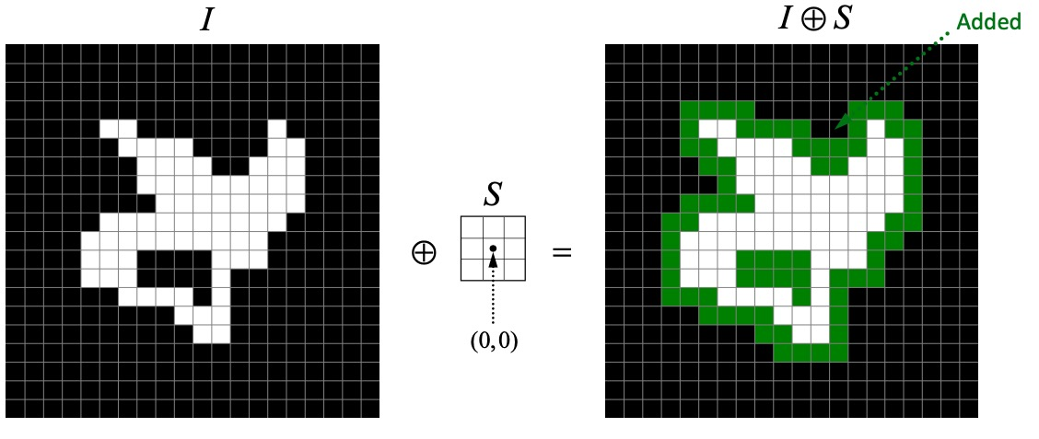
Binary Morphology
Objective: improve the image segmentation results (binary images).
Method: performed using a structuring element. The structuring element is moved over the image.
Operations:
Erosion.
Dilation.

Slide 5
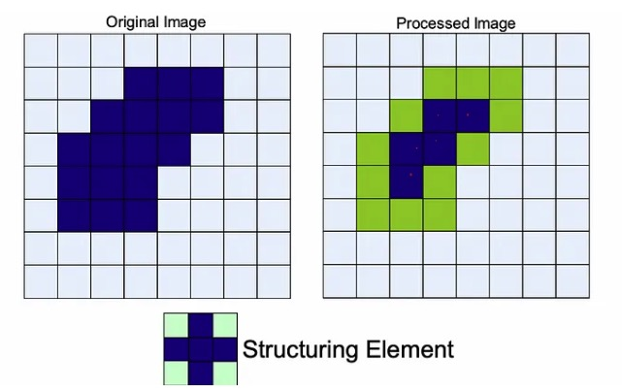
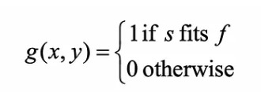
Erosion
Selecting a structuring element.
Only keep the white pixels such that the structuring element is completely contained in the image.

Slide 6
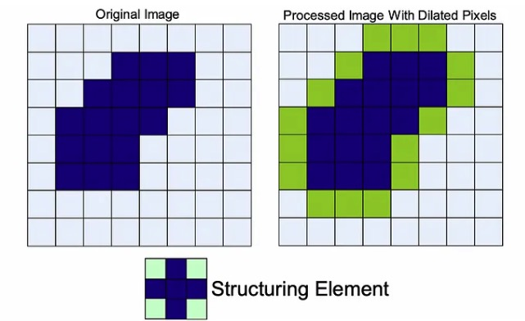
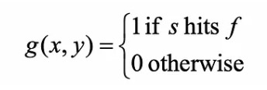
Dilation
Selecting a structuring element.
The intersection of the image with the reflected version of a structuring element is not empty.

Slide 7
Compound Operations
Opening operation: erosion followed by dilation (eliminate smaller details in the image)
Closing operation: dilation followed by erosion (eliminate the holes in the image)

Slide 8
Sources
Slides:
https://github.com/thomascong121/COMP9517_24T3
Demo:
https://github.com/bhaswara/CV_24T3

