Slide 1
SIFT
COMP9517 T3 Tut2

Slide 2
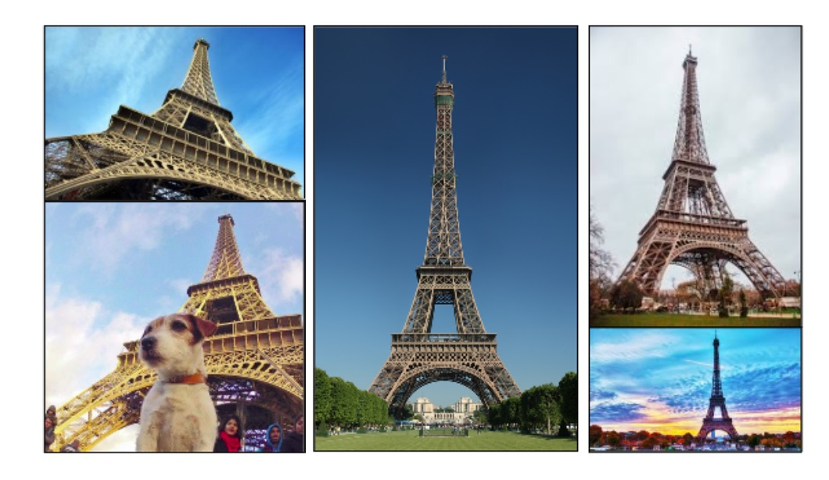
Scale-invariant feature transform (SIFT)
Detecting object with features that are invariant to scaling, rotation, affine distortion, illumination changes

Slide 3
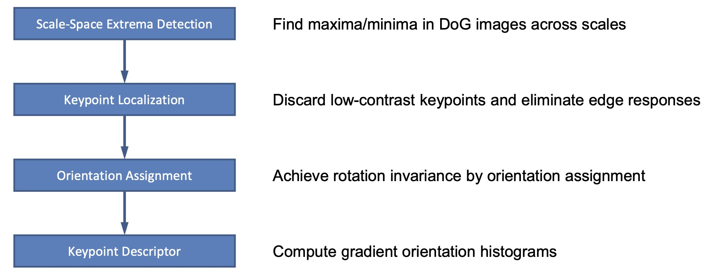
SIFT algorithm steps

Slide 4
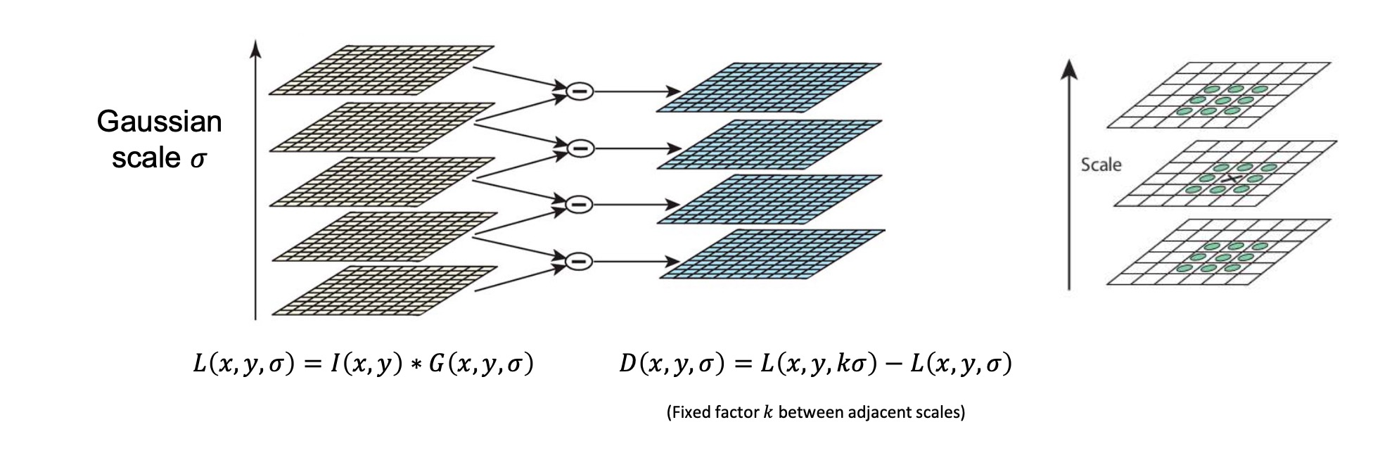
SIFT extreme detection
Extremes are stable features across all possible scales.
Series of images that are progressively blurred using a Gaussian filter.
Difference-of-Gaussian (DoG) is computed from the difference between successive Gaussian-blurred images.
Extreme Detection: Local extrema (both maxima and minima) of the DoG images are identified as potential keypoints.

Slide 5
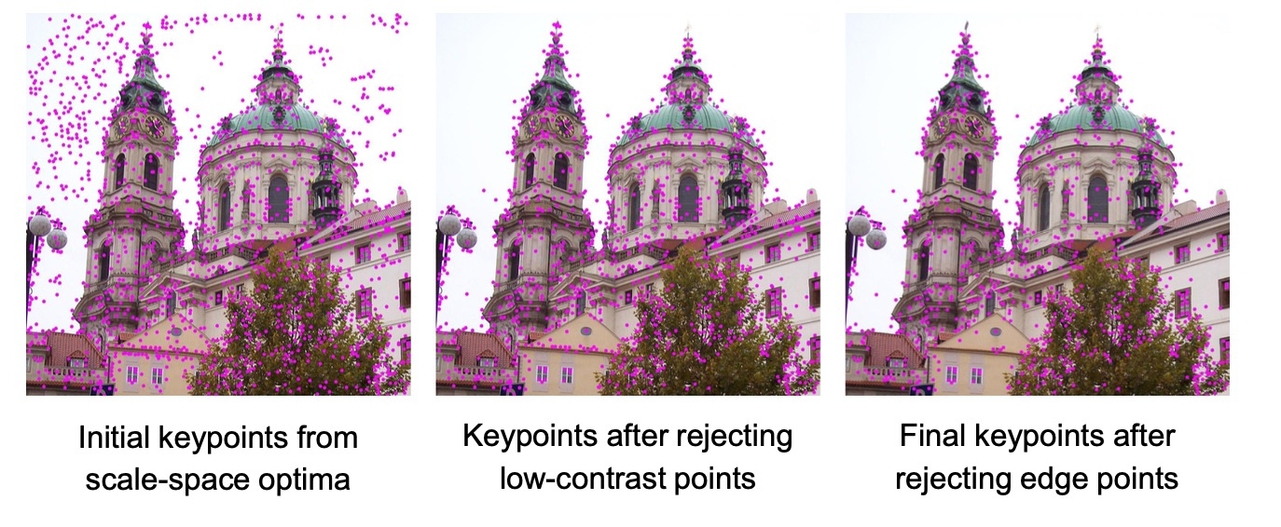
SIFT keypoint localization
Refines the initial keypoints detected from the DoG images
Thresholding: Points with low contrast (and therefore less robust to noise) are discarded using a predefined contrast threshold
Edge Response: Points that are located along edges are less stable for matching, so an edge response check (using the Hessian matrix) is conducted. If the ratio of principal curvatures is above a threshold (usually 10), the keypoint is rejected as being too edge-like.

Slide 6
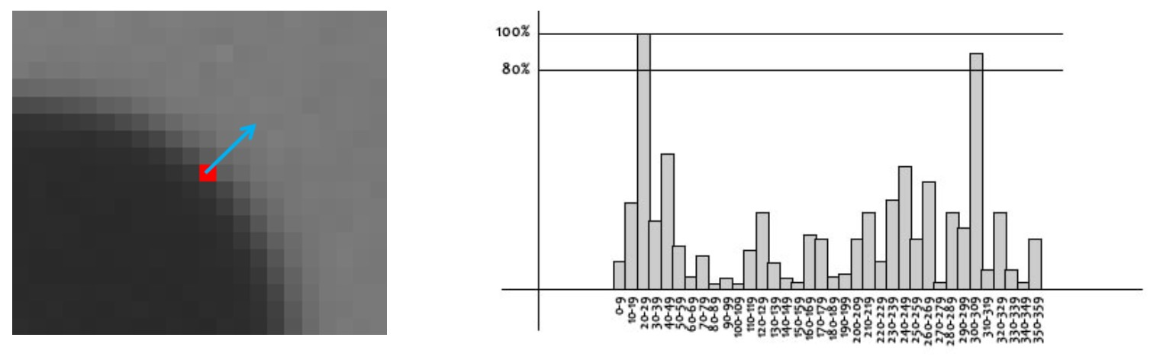
SIFT orientation assignment
Assigning a consistent orientation to each keypoint based on local image properties makes the descriptor invariant to rotation.
Local Gradient Directions: The gradient magnitude and direction are computed in a region around each keypoint in the Gaussian-blurred image corresponding to the keypoint’s scale.
Orientation Histogram: An orientation histogram is created from the gradient directions of sample points within a region around the keypoint. The peaks of this histogram correspond to dominant directions of local gradients.
Dominant Orientation: The highest peak in the histogram is assigned as the keypoint’s orientation, and keypoints can have multiple orientations if there are multiple peaks of similar magnitude.

Slide 7
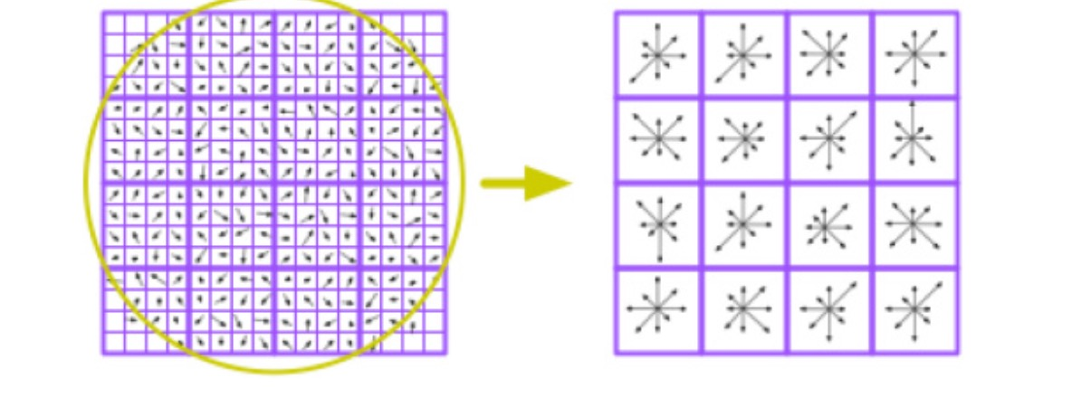
SIFT keypoint descriptor
The keypoint descriptor is created to be highly distinctive yet invariant to further changes in lighting, viewpoint, and other local geometric transformations.
Descriptor Window: A 16x16 window around the keypoint is taken, and this window is divided into 16 sub-blocks of 4x4 size.
Gradient Calculations: For each sub-block, gradients are calculated, and an 8-bin orientation histogram is created (covering 360 degrees in 45-degree increments).
Descriptor Vector: The values of these histograms are compiled into a single feature vector, creating a descriptor with 128 elements (16 sub-blocks × 8 histogram bins).
Normalization: The feature vector is normalized to enhance invariance to changes in illumination.

