Slide 1
COMP9517 Tut3
Pattern Recognition

Slide 2
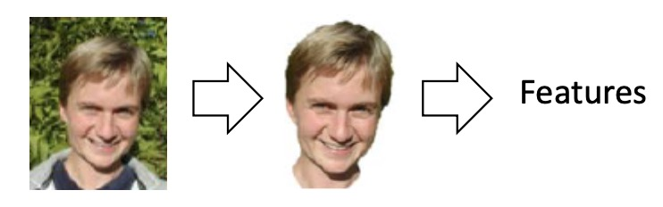
Pattern Recognition
Image Classification
Image Segmentation
Object Retrieval
…
Feature descriptors (SIFT…)
Deep learning models

Slide 3
Image Classification
Task: assigning a class label to an object.
Method:
Converting raw images into features.
Calculate the probability of the image belonging to each label using a classifier.
Pick the label with the highest probability.
K-Nearest Neighbour, Decision Tree, Stochastic Gradient Descent, Deep Learning .

Slide 4
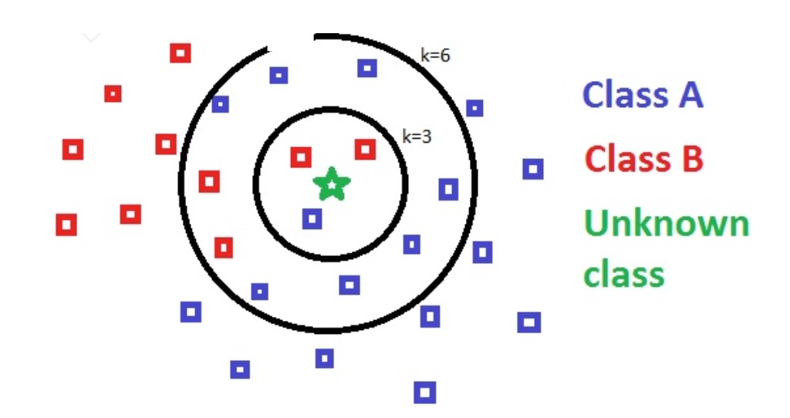
K-Nearest Neighbour
Objective: decides the class label for a sample based on the K nearest samples in the data set.
Method:
Converting raw images into features.
Form a feature space using training samples.
For each test sample, find K images that are the “closest” to it (e.g., Euclidian distance) .
Predict the majority class among the K images.

Slide 5
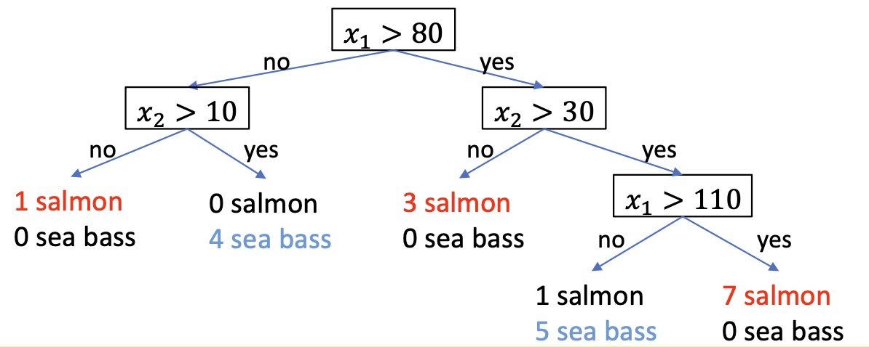
Decision Tree
Objective: Classify a sample through a sequence of questions.
Method:
Each node in the tree represents a feature.
Each leaf in the tree represents a label.
Each node could have several branches.
Tree construction: which feature to split.

Slide 6
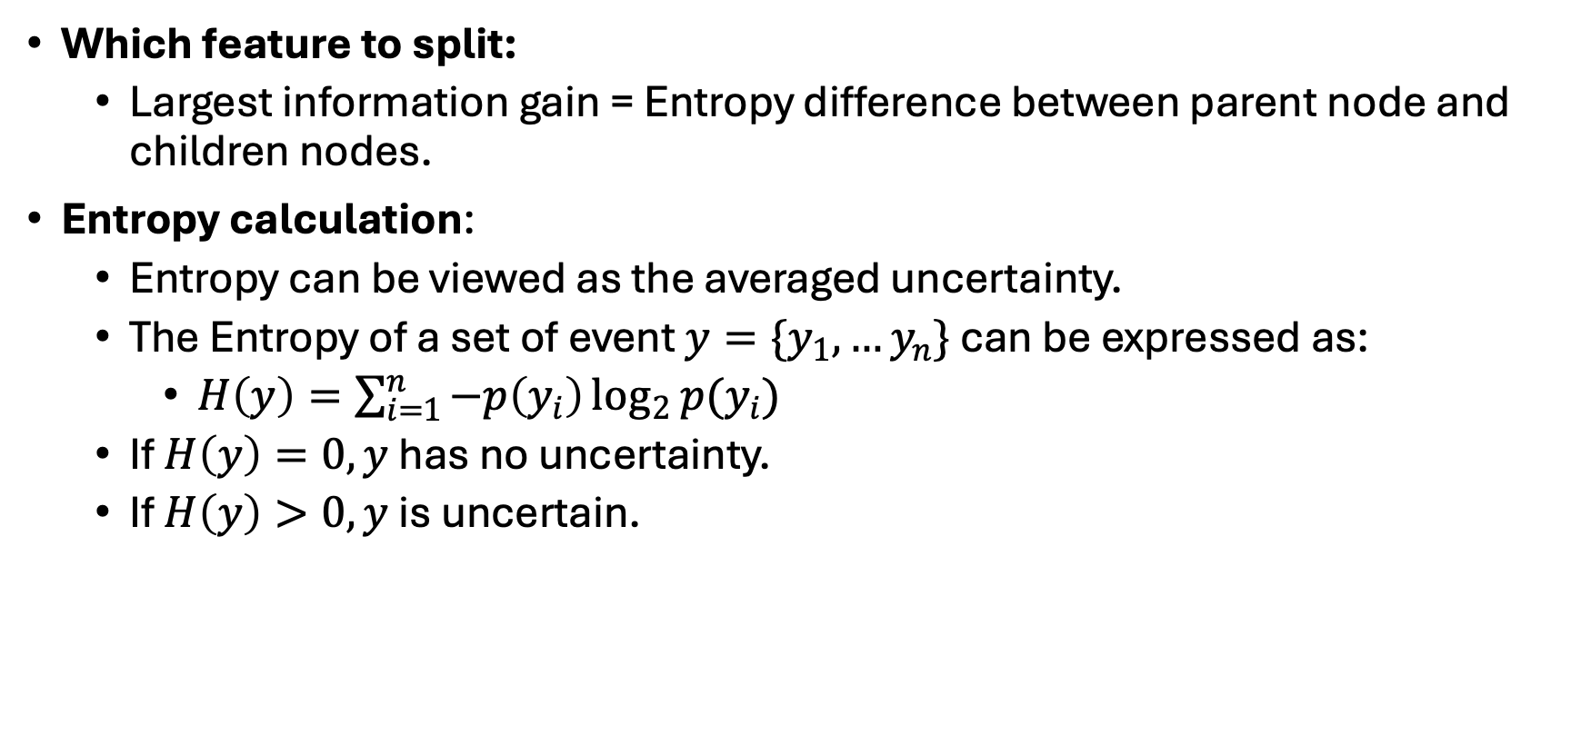
Decision Tree
Which feature to split:
Largest information gain = Entropy difference between parent node and children nodes.
Entropy calculation:
Entropy can be viewed as the averaged uncertainty.
The Entropy of a set of event $y=\{y_{1},…y_{n}\}$ can be expressed as:
$H\left(y\right)=\sum_{i=1}^{n}{−p\left(y_{i}\right)\log_{2}{p(y_{i})}}$
If $H\left(y\right)=0, y$ has no uncertainty.
If $H\left(y\right)>0, y$ is uncertain.

Slide 7
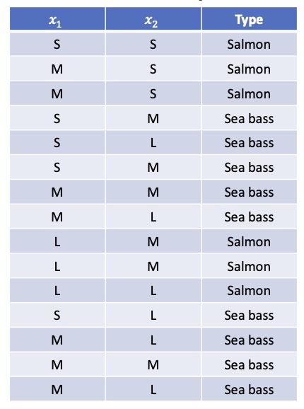
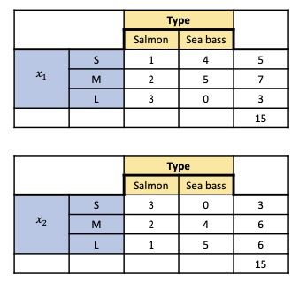
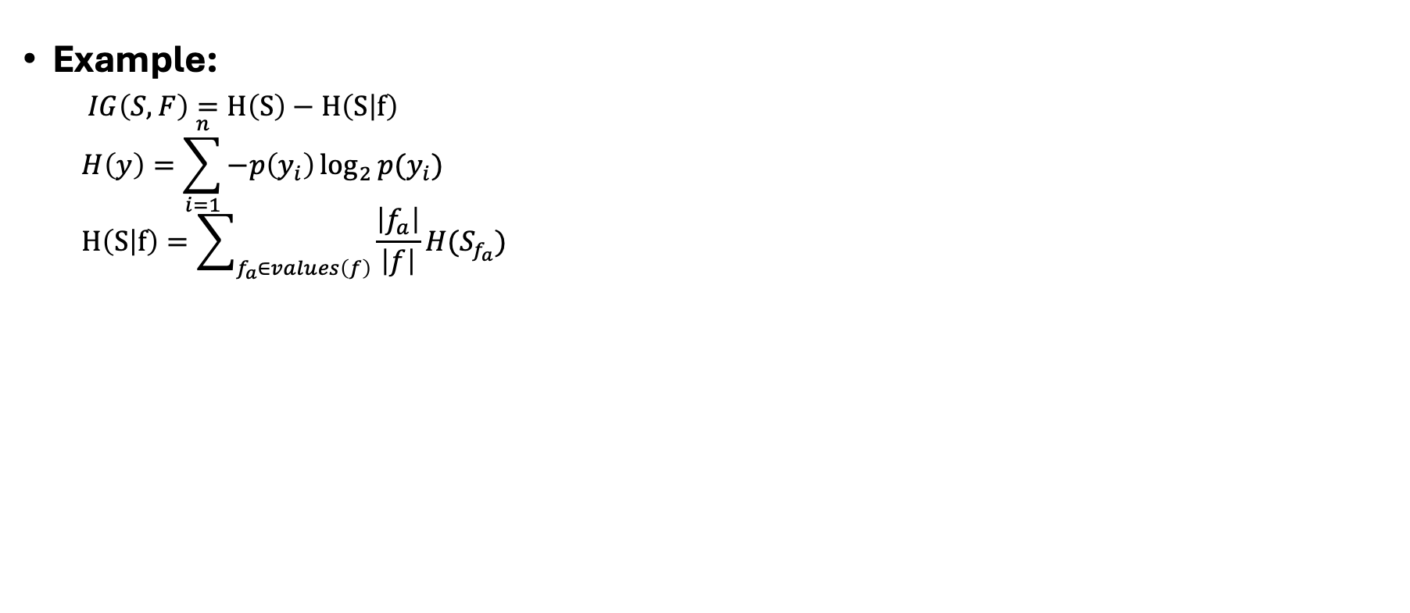


Decision Tree
Example:
$IG\left(S,F\right)=H\left(S\right)−H\left(S | f\right)$
$$H\left(y\right)=\sum_{i=1}^{n}{−p\left(y_{i}\right)\log_{2}{p(y_{i})}}$$
$$H\left(S | f\right)=\sum_{f_{a}∈values\left(f\right)}{\frac{\left|f_{a}\right|}{\left|f\right|}}H(S_{f_{a}})$$
Feature1: length=$x_{1}∈\{S,M,L\}$
Feature2: width=$x_{2}∈\{S,M,L\}$

Slide 8
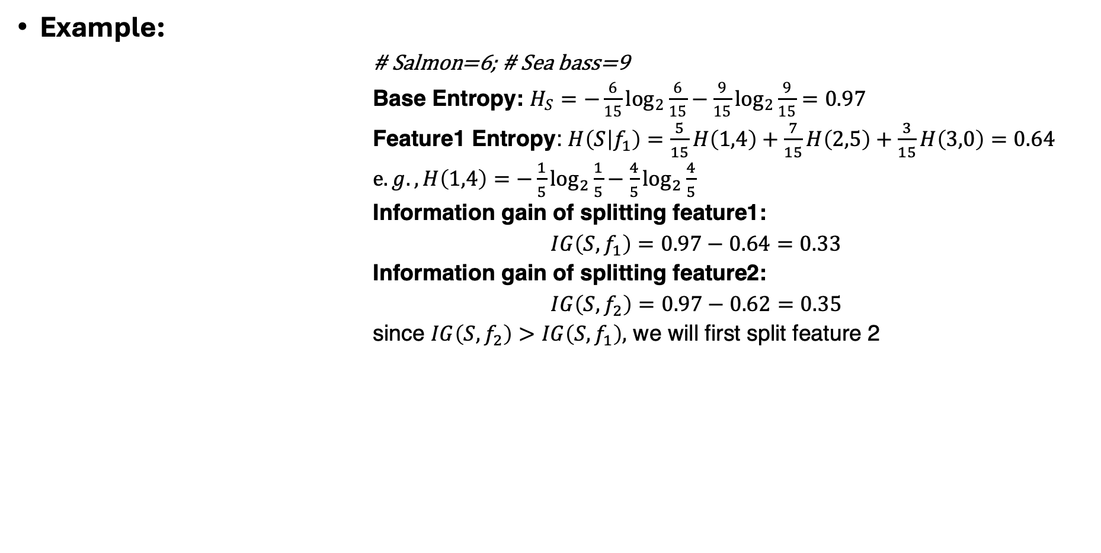
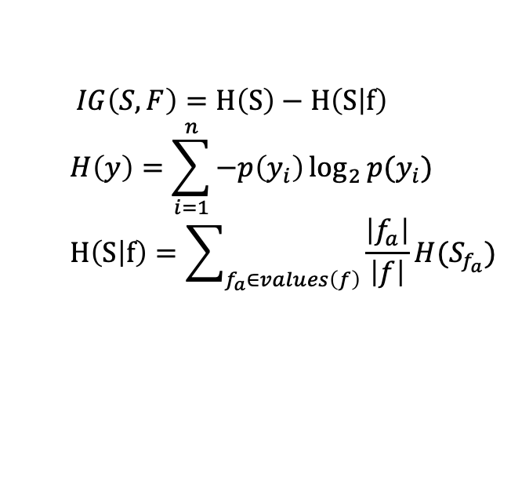
Decision Tree
$IG\left(S,F\right)=H\left(S\right)−H\left(S | f\right)$
$$H\left(y\right)=\sum_{i=1}^{n}{−p\left(y_{i}\right)\log_{2}{p(y_{i})}}$$
$$H\left(S | f\right)=\sum_{f_{a}∈values\left(f\right)}{\frac{\left|f_{a}\right|}{\left|f\right|}}H(S_{f_{a}})$$
Example:
# Salmon=6; # Sea bass=9
Base Entropy: $H_{S}=−\frac{6}{15}\log_{2}{\frac{6}{15}−\frac{9}{15}\log_{2}{\frac{9}{15}}}=0.97$
Feature1 Entropy: $H\left(S | f_{1}\right)=\frac{5}{15}H\left(1,4\right)+\frac{7}{15}H\left(2,5\right)+\frac{3}{15}H\left(3,0\right)=0.64$
$e.g., H\left(1,4\right)=−\frac{1}{5}\log_{2}{\frac{1}{5}−\frac{4}{5}\log_{2}{\frac{4}{5}}}$
Information gain of splitting feature1:
$IG\left(S, f_{1}\right)=0.97−0.64=0.33$
Information gain of splitting feature2:
$IG\left(S, f_{2}\right)=0.97−0.62=0.35$
since $IG\left(S, f_{2}\right)>IG\left(S, f_{1}\right),$ we will first split feature 2

Slide 9
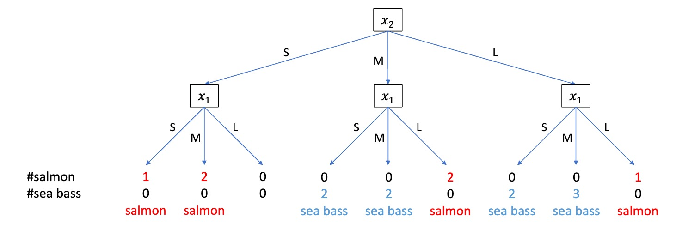
Decision Tree

Slide 10
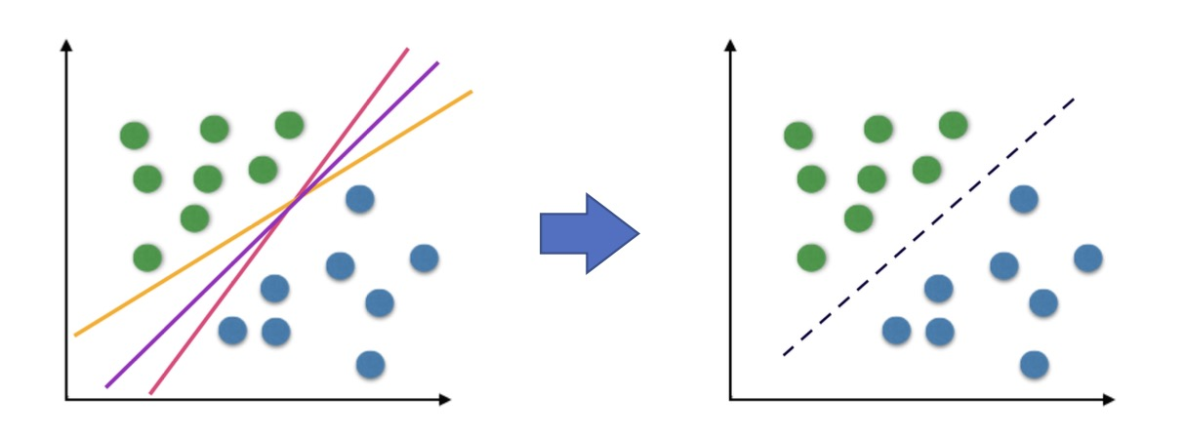
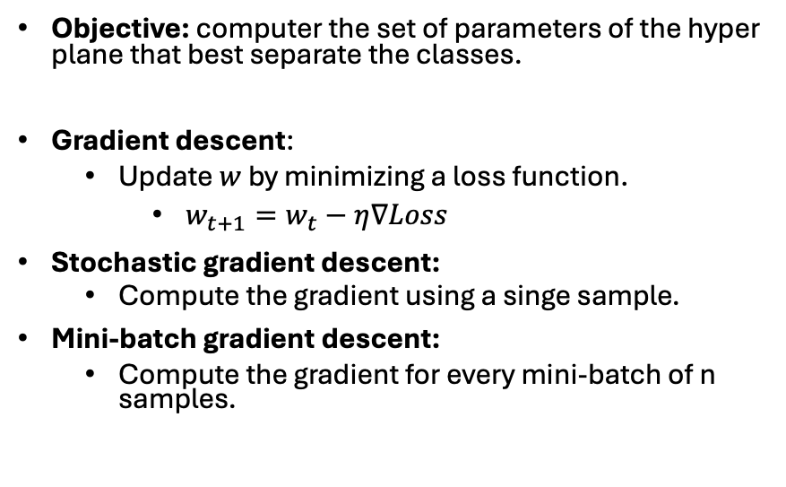
Stochastic Gradient Descent
Objective: computer the set of parameters of the hyper plane that best separate the classes.
Gradient descent:
Update $w$ by minimizing a loss function.
$w_{t+1}=w_{t}−η∇Loss$
Stochastic gradient descent:
Compute the gradient using a singe sample.
Mini-batch gradient descent:
Compute the gradient for every mini-batch of n samples.
$$y_{i}=w^{T}x_{i}+b$$
https://scikit-learn.org/1.5/modules/generated/sklearn.linear_model.SGDClassifier.html

Slide 11
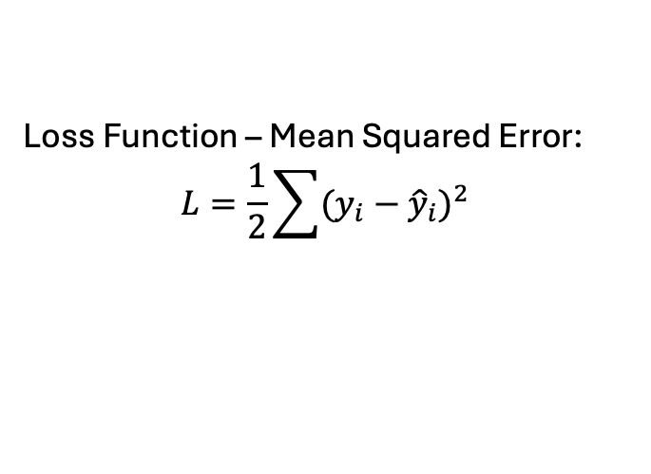
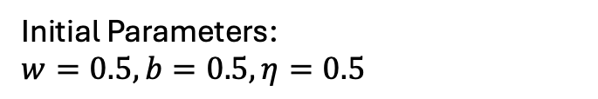
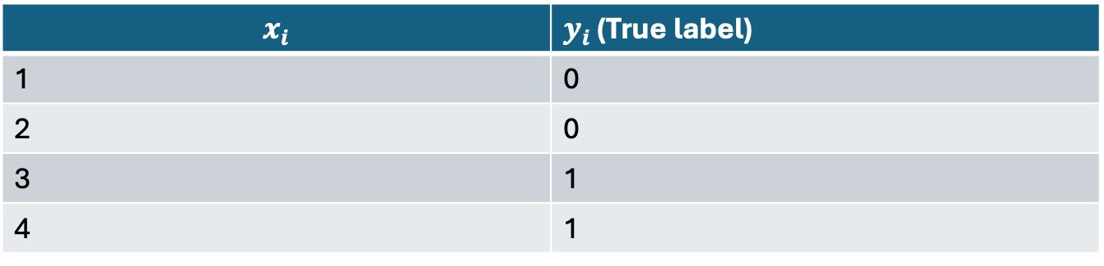
Stochastic Gradient Descent A Simple Two-Class Classification Task
$$y_{i}=w^{T}x_{i}+b$$
$$x_{i}$$ | $y_{i}$ (True label)
1 | 0
2 | 0
3 | 1
4 | 1
Initial Parameters:
$w=0.5, b=0.5,η=0.5$
Loss Function – Mean Squared Error:
$$L=\frac{1}{2}\sum{{(y_{i}−{\hat{y}}_{i})}^{2} }$$

Slide 12
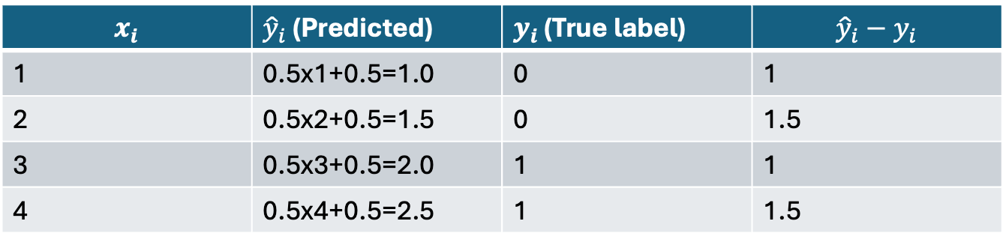
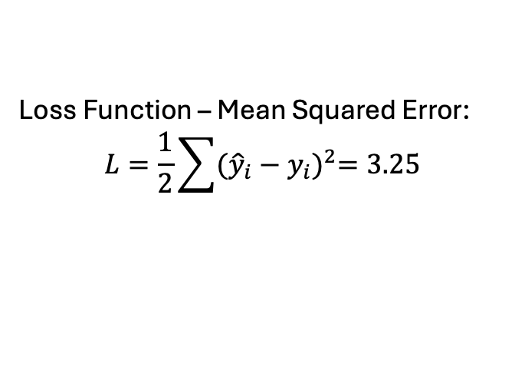
Stochastic Gradient Descent
$$y_{i}=0.5x_{i}+0.5$$
$$x_{i}$$ | ${\hat{y}}_{i}$ (Predicted) | $y_{i}$ (True label) | $${\hat{y}}_{i}−y_{i}$$
1 | 0.5x1+0.5=1.0 | 0 | 1
2 | 0.5x2+0.5=1.5 | 0 | 1.5
3 | 0.5x3+0.5=2.0 | 1 | 1
4 | 0.5x4+0.5=2.5 | 1 | 1.5
Initial Parameters:
$w=0.5, b=0.5,η=0.5$
Loss Function – Mean Squared Error:
$$L=\frac{1}{2}\sum{{({\hat{y}}_{i}−y_{i})}^{2}=3.25 }$$

Slide 13
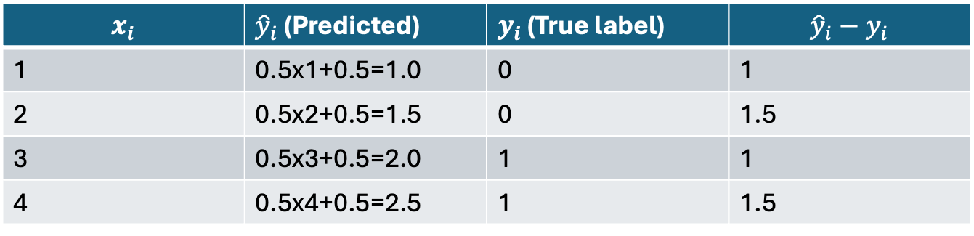
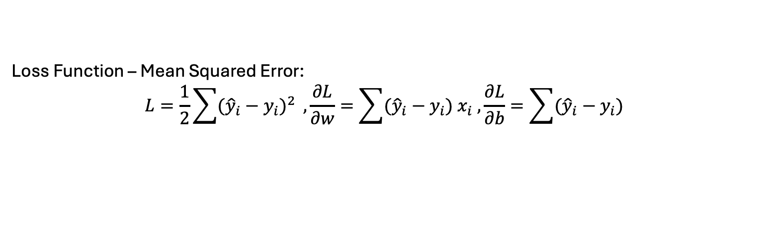
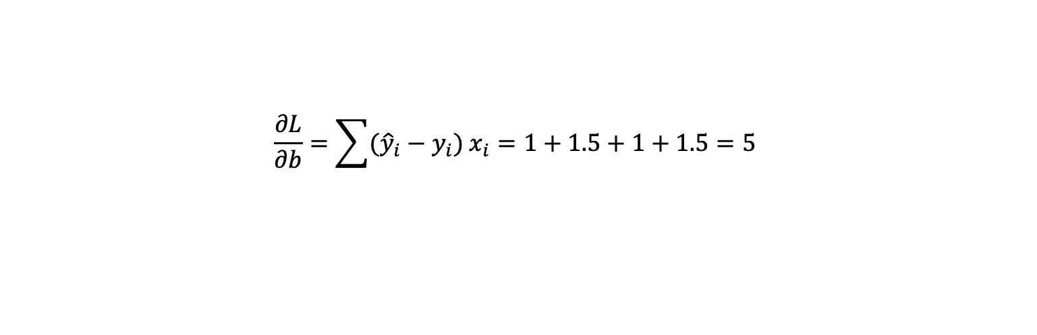
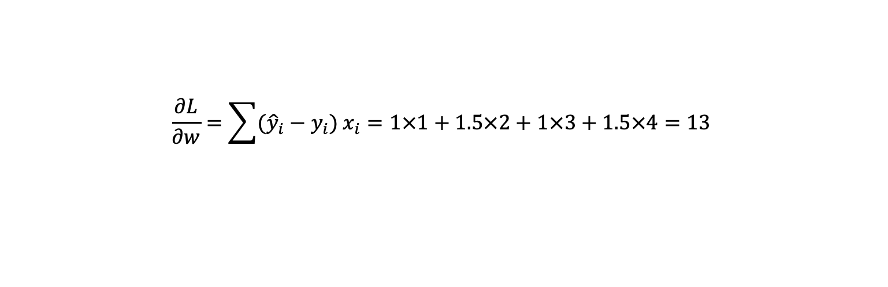
Stochastic Gradient Descent
Loss Function – Mean Squared Error:
$$L=\frac{1}{2}\sum{{({\hat{y}}_{i}−y_{i})}^{2} }, \frac{∂L}{∂w}=\sum{{({\hat{y}}_{i}−y_{i})}^{ }x_{i} ,\frac{∂L}{∂b}=\sum{{({\hat{y}}_{i}−y_{i})}^{ }}}$$
$$x_{i}$$ | ${\hat{y}}_{i}$ (Predicted) | $y_{i}$ (True label) | $${\hat{y}}_{i}−y_{i}$$
1 | 0.5x1+0.5=1.0 | 0 | 1
2 | 0.5x2+0.5=1.5 | 0 | 1.5
3 | 0.5x3+0.5=2.0 | 1 | 1
4 | 0.5x4+0.5=2.5 | 1 | 1.5
$$\frac{∂L}{∂w}=\sum{{({\hat{y}}_{i}−y_{i})}^{ }x_{i}=1×1+1.5×2+1×3+1.5×4=13 }$$
$$\frac{∂L}{∂b}=\sum{{({\hat{y}}_{i}−y_{i})}^{ }x_{i}=1+1.5+1+1.5=5 }$$

Slide 14
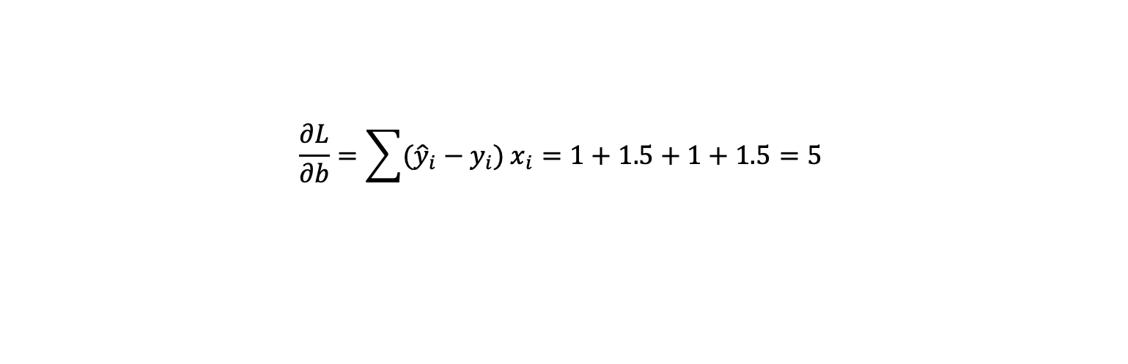
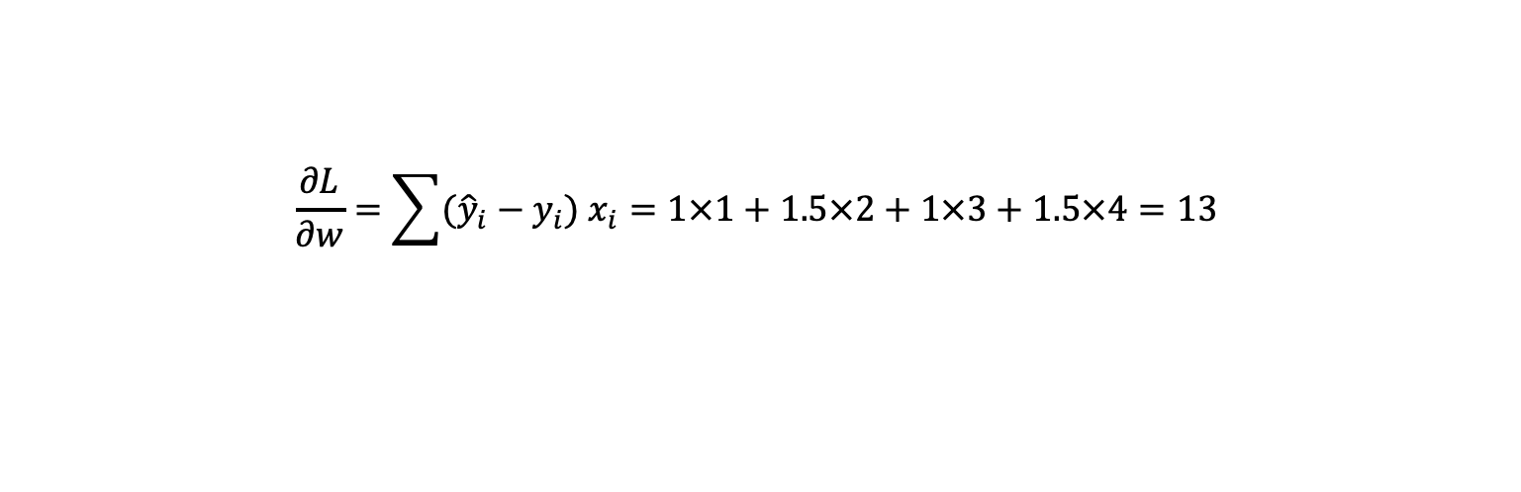
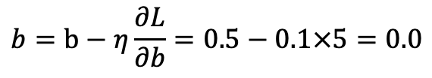
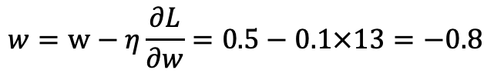
Stochastic Gradient Descent
$$\frac{∂L}{∂w}=\sum{{({\hat{y}}_{i}−y_{i})}^{ }x_{i}=1×1+1.5×2+1×3+1.5×4=13 }$$
$$\frac{∂L}{∂b}=\sum{{({\hat{y}}_{i}−y_{i})}^{ }x_{i}=1+1.5+1+1.5=5 }$$
$$w=w−η\frac{∂L}{∂w}=0.5−0.1×13=−0.8$$
$$b=b−η\frac{∂L}{∂b}=0.5−0.1×5=0.0$$
We repeat these steps iteratively until the loss is minimized.

