Slide 1
ScrapStats: An Application Hosted in the Cloud
Thomas Sato
CS 529 Cloud App Development
Willamette University
December 2024

Slide 2
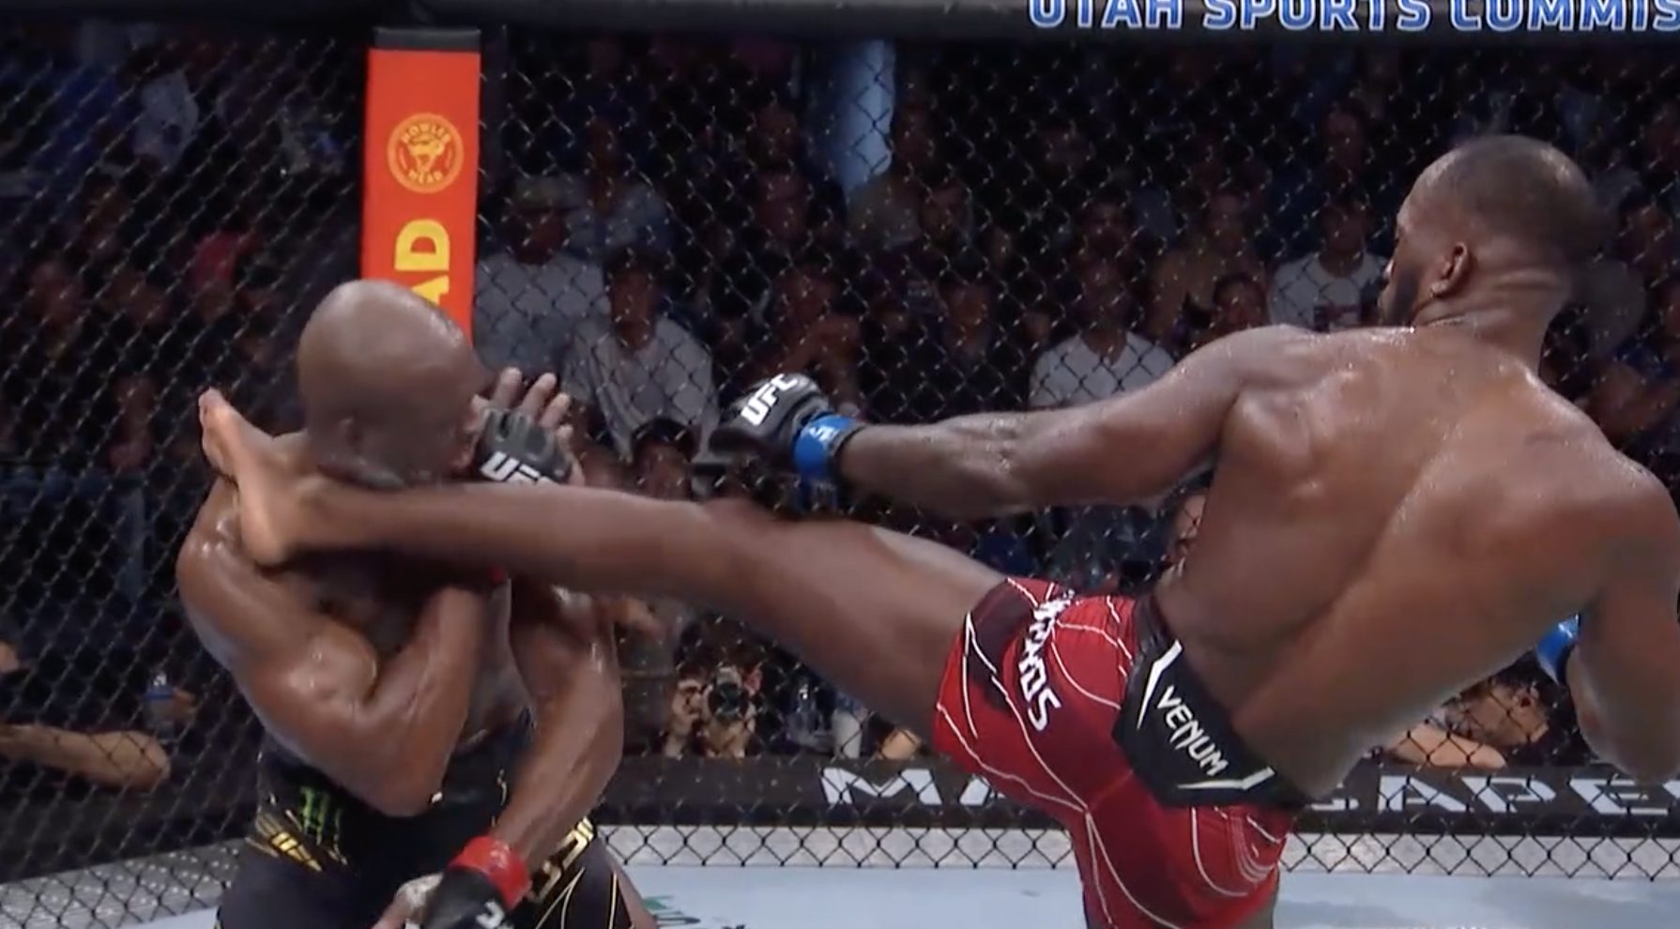
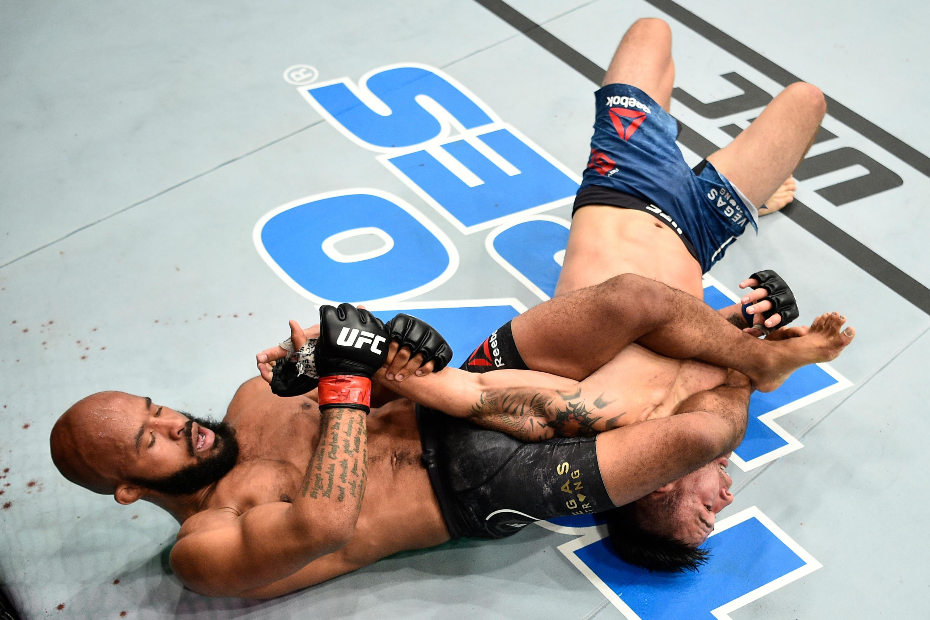
Mixed Martial Arts (MMA)
A mixing of the Martial Arts: Boxing, Jiu Jitsu, Muay Thai, Wrestling, etc.
Win by KO, submission, or decision

Slide 3
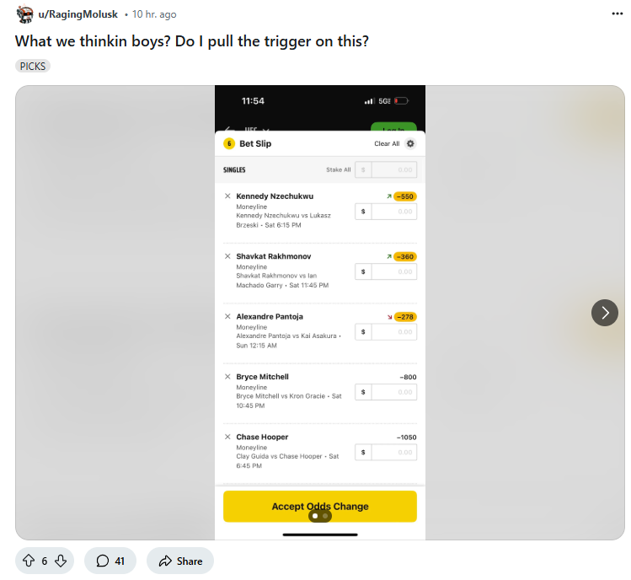
Predicting a Winner
Sports betting
How to predict? Need data
Web scraping
Fighter statistics
Fight statistics

Slide 4
How to do this in the Cloud?
HTTP POST request
Front End
(User Experience)
HTTP Web API Gateway
Prediction Results
Fight statistics
AWS SageMaker Model Endpoints
AWS Lambda
(Data Processing)
MySQL Database
(MMA Fighter Data)
Data retrieved is inputted into a machine learning model that returns a prediction
Database call and prediction are handled in the same Lambda function

Slide 5
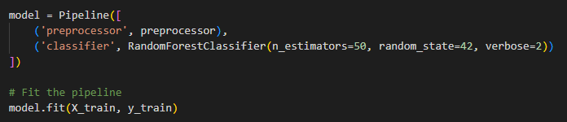
“Machine Learning”
1) Predict post-fight statistics (input = fighter stats)
Random Forest Regressor
2) Predict win probabilities (input = fighter stats + fight stats)
Random Forest Classifier
Very rudimentary; more time and energy for better result

Slide 6
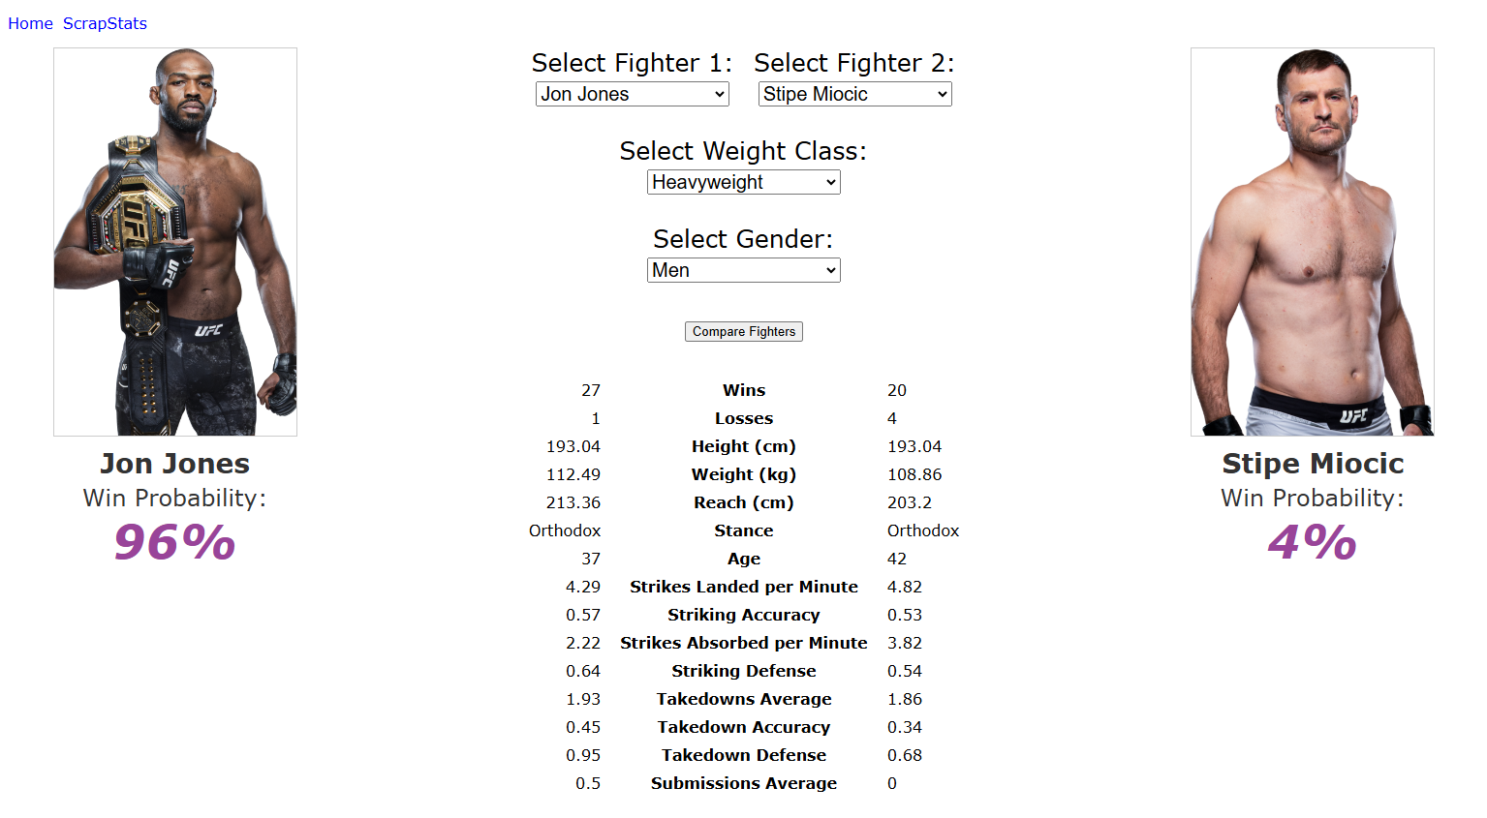

Slide 7
Test on UFC 309
Note: Win probabilities are switched
9 out of 11 correct predictions
Jon Jones | 96 | 4 | Stipe Miocic
Charles Oliveira | 68 | 32 | Michael Chandler
Bo Nickal | 52 | 48 | Paul Craig
Viviane Araujo | 46 | 54 | Karine Silva
Mauricio Ruffy | 74 | 26 | James Llontop
Jonathan Martinez | 16 | 84 | Marcus McGhee
Jim Miller | 58 | 42 | Damon Jackson
Marcin Tybura | 64 | 36 | Jhonata Diniz
Mickey Gall | 58 | 42 | Ramiz Brahimaj
Bassil Hafez | 10 | 90 | Oban Elliott
Veronica Hardy | 22 | 78 | Eduarda Moura

