Slide 1


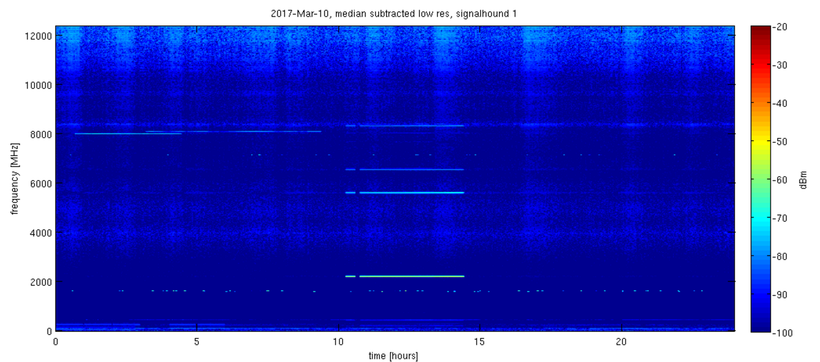
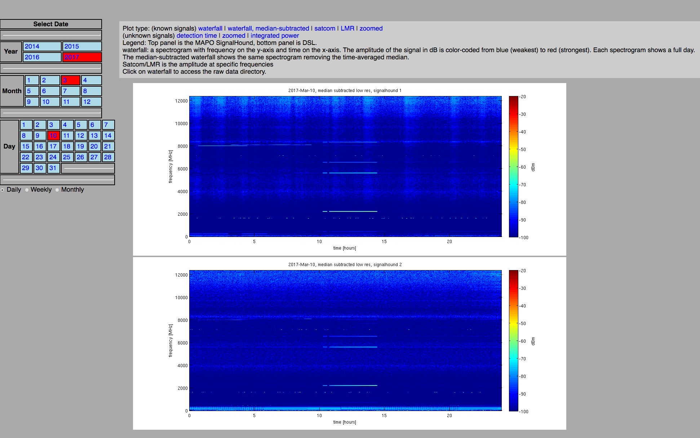
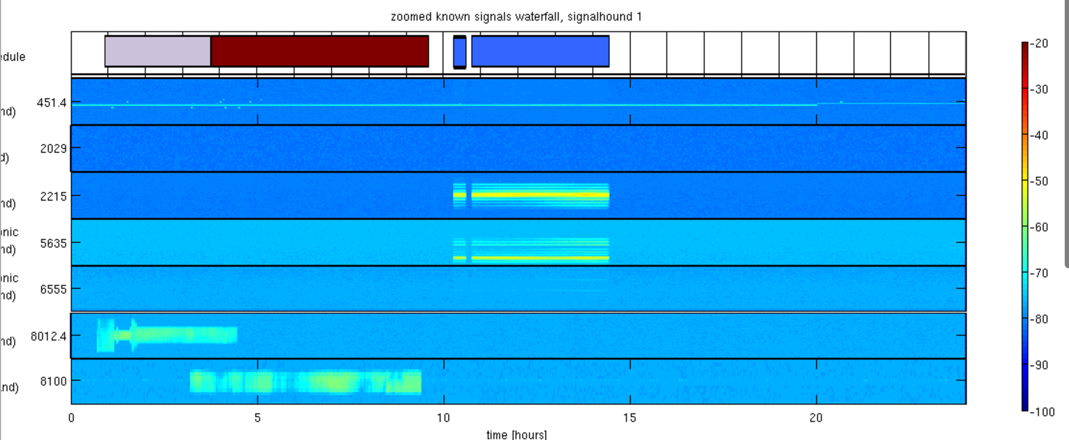
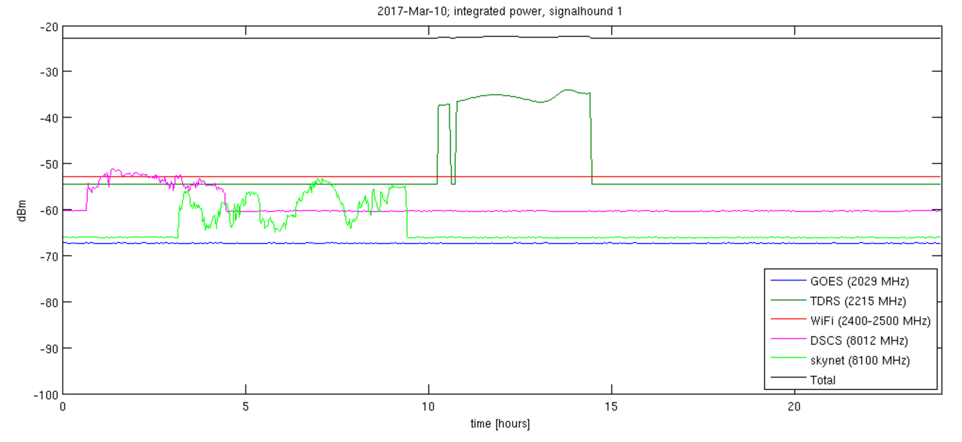
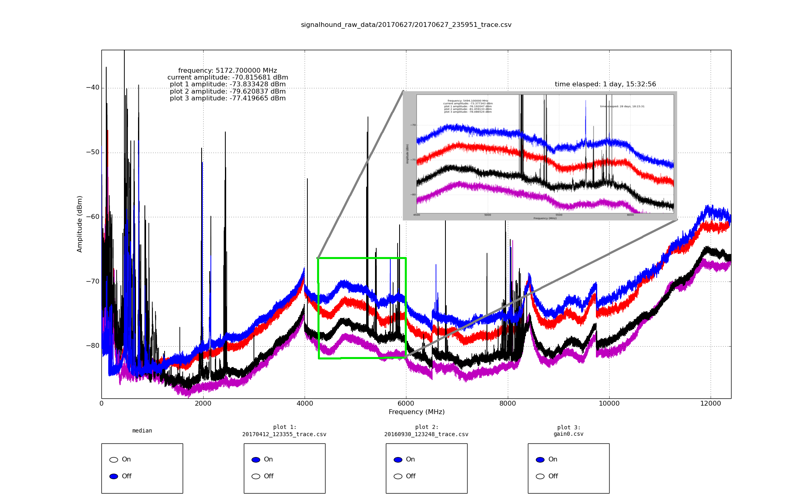
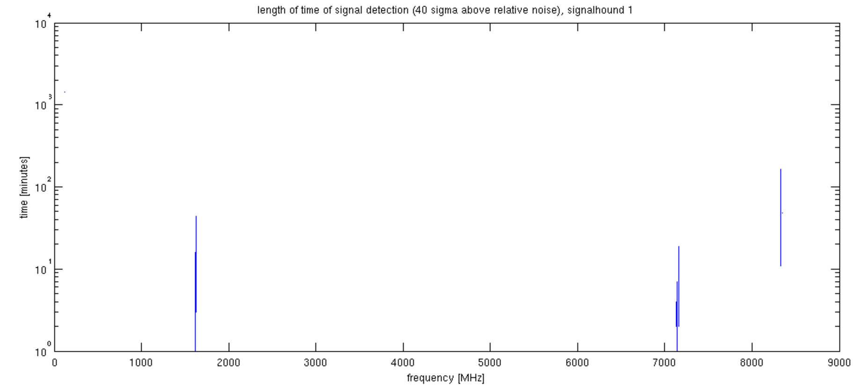
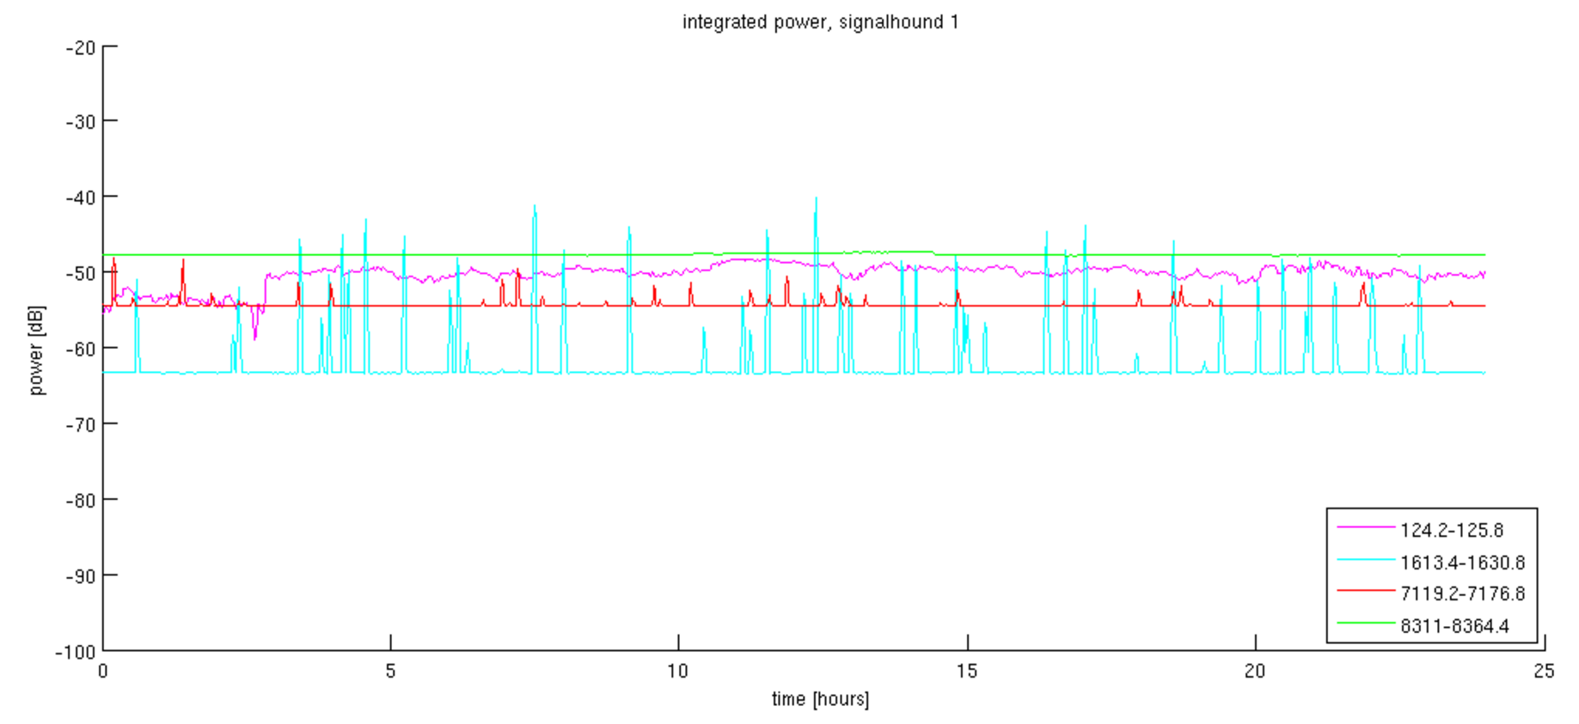
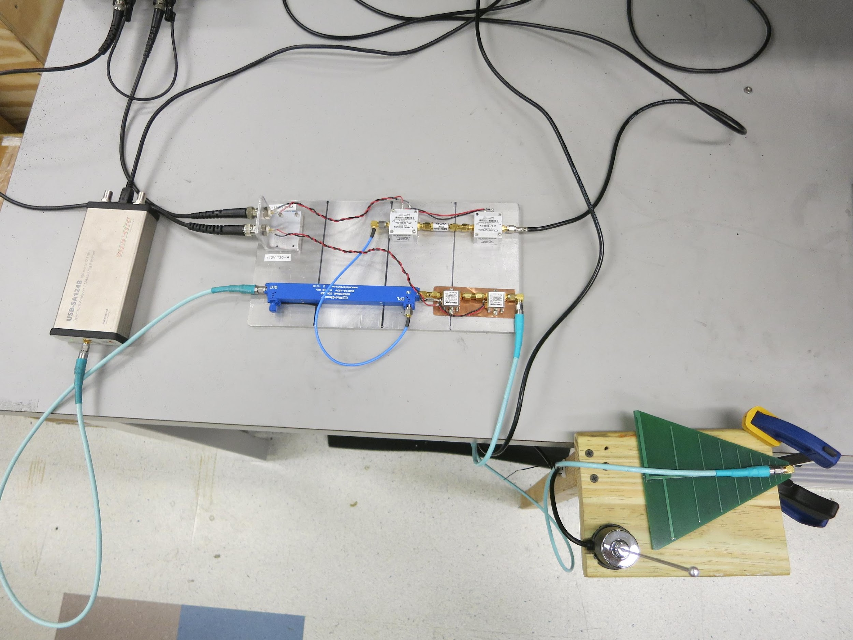
Electromagnetic Interference Analysis with a SignalHound Spectrum Analyzer
Thomas Culp, Kirit Karkare, Denis Barkats
Introduction
CMB experiments targeting B-modes from inflationary gravitational waves or gravitational lensing require extremely clean observing sites in order to measure faint, nanoKelvin-level sky signals. Man-made radio frequency interference (RFI) at observatories can potentially contaminate science measurements: while CMB receivers are nominally sensitive to ~40-300 GHz, various mechanisms can couple out-of-band radiation into science channels. At the Amundsen-Scott South Pole Station we have deployed SignalHound¹ spectrum analyzers coupled to a broadband antenna to monitor the 0-12.4 GHz band. This frequency range is sensitive to RFI from satellite communications² (GOES, Skynet, DSCS) and land mobile radio (LMR).
We present an automated data acquisition system, a web-based data browser, and an algorithm that detects transient RFI which could be used to flag potentially-contaminated CMB data.
Data Acquisition and Visualization
The SignalHound is a compact, inexpensive spectrum analyzer that can be programmed to sweep a specified frequency range with variable resolution and save the resulting spectrum in a .csv file. We have written Linux and Windows scripts to automatically take a spectrum (0-12.4 GHz at 0.2 MHz resolution) every 2 minutes.
Real-time diagnostic plots are often useful when troubleshooting on-site. We have developed lightweight software to display saved spectra and compute median spectra over user-specified ranges of time. This allows for real-time calibration and facilitates identification of spurious or time-variable features compared to a baseline.
Data Browser
We have developed a web-based data browser³ to visualize the large quantities of archival spectra. It allows easy paging between various plots (spectrograms, zoom plots, integrated power) over different timescales (daily, weekly, and monthly) for several years of data. Plots are auto-generated to accommodate incoming spectra.
A
B
Types of Plots
A: Waterfall Spectrograms
These plots show the full spectral range (0-12.4GHz) on the Y-axis as a function of time on the X-axis. Transient activity affecting many frequencies or baseline changes are easily visible. The time axis can show a day, a week or a month.
B: Zoom Plots
Since we have a priori knowledge about the frequencies used by radio transmitters on station, we generate plots targeting these known channels. Since they are generally narrowband, these channels would otherwise be lost in the waterfall plots. The plots clearly indicate activity in these bands and allow comparison to expected satellite communication schedules provided by the U.S. Antarctic Program³.
C: Integrated Power Plots
The bandwidth of various communication bands can vary. For each identified band, we find the total integrated power across all relevant channels for easy comparison.
D: Detection Time Plots
When transient signals appear above the noise floor, we track and plot the length of time they stay on.
C1
D
In action: the SignalHound data visualization takes spectra .csv files and displays them in real time. The inset image shows one of the program’s interactive features: zooming on portions of the spectra.
SignalHound Setup
C2
USB to computer
Signal Detection Algorithm
Occasionally signals appear outside of the known transmitter frequencies. To identify these, we have developed a transient peak detection algorithm:
The noise floor median power and variance across the spectrum for 24 hours are computed.
Points lying 20 standard deviations above the noise floor are flagged as spurious.
The algorithm has proven capable of detecting all known signals as well as other unknown signals. We create additional zoom plots, detection time plots, and integrated power plots (see bottom 2 plots to the right) for the signals flagged by the algorithm.
850-6500MHz antenna
The top 3 plots are standard waterfall (A), zoom (B), and integrated power (C1) plots for known South Pole RFI. The last 2 bottom plots display the detection time for blindly-detected signals (D) and their integrated power (C2).
0.1-14GHz
amplifier circuit
450-470MHz
antenna
12.4GHz Signalhound
Spectrum analyzer
Relevance to CMB Stage 4
As next-generation experiments increase in sensitivity and expand to more observing sites, RFI monitoring will become increasingly important for flagging potentially-contaminated data or for determining suitability of a site for observations. Our RFI monitoring system (hardware and software) is lightweight, field-tested, and capable of identifying both known and unknown signals. Similar systems can be easily deployed at other CMB observing sites. Instructions for replicating this setup will be made available on a public website.
The front-end hardware (antenna, amplifiers and coaxial cables) coupled to the SignalHound are all off-the-shelf components.
References
1: http://signalhound.com
2: https://www.usap.gov/technology/contentHandler.cfm?id=1935
3: http://bicep.rc.fas.harvard.edu/southpole_info/EMI_WG/

