Slide 1



FUNDS MANAGER
YVY CAPITAL × INTELI — SPRINT 2
Dashboard Prototype Review
AUGUST 22, 2026
Notes:
Open by framing the deck as a short introduction to the live dashboard demonstration. Emphasize that the review covers a working prototype using synthetic and aliased data.
[Sources]
- YvY_Capital_Inteli_Sprint_2_Presentation_Template.pptx.pdf (cover composition and photograph)
- Official Inteli and YvY Capital logo images supplied with the task
- Current translated Funds Manager dashboard

Slide 2
02
SPRINT 2 REVIEW
TODAY'S REVIEW
A concise path from Sprint 2 intent to the live demonstration.
01
Sprint 2 objective
06
02
Priority users and use cases
03
Product flow
review moments
04
Dashboard preview
05
Current data and KPI coverage
06
Sprint 3 next features
Inteli x YvY Capital | Funds Manager | Sprint 2
02
Notes:
Set the expectation that this is a five-to-seven-minute orientation. The dashboard demonstration follows immediately after slide 10.
[Sources]
- Current translated Funds Manager dashboard
- Sprint_2_W1_Progress_Report_Inteli_YvY_Capital.pdf
- YvY_Capital_Inteli_Sprint_2_Presentation_Template.pptx.pdf

Slide 3
03
SPRINT 2 REVIEW
SPRINT 2 MADE THE PRODUCT DIRECTION TESTABLE
Validated needs became an interactive dashboard baseline.
PRIMARY OBJECTIVE
IN SCOPE
Turn product needs into a reviewable interface before production development begins.
-
Nine live dashboard sections
-
Executive and Analyst journeys
-
Responsive interactions and demo states
OUT OF SCOPE TODAY
Production connectors, certified financial calculations, authentication and enforced RBAC.
The result is a shared baseline for partner feedback, acceptance criteria and the Sprint 3 backlog.
EXIT EVIDENCE
A partner-reviewable prototype and a Sprint 3 backlog grounded in verified behavior.
Inteli x YvY Capital | Funds Manager | Sprint 2
03
Notes:
Explain that Sprint 2 reduces ambiguity before deeper implementation. The interface is functional for review, but it is not a production application and does not imply partner approval.
[Sources]
- 2026_TAPI_YvY_Capital_Inteli_ENGLISH.docx
- Sprint_1_Delivery_Roadmap_Inteli_YvY_Capital.pdf
- Sprint_2_W1_Progress_Report_Inteli_YvY_Capital.pdf
- Current translated Funds Manager dashboard

Slide 4
04
SPRINT 2 REVIEW
TWO USERS, TWO DECISION PATHS
The prototype separates portfolio exploration from controlled data review.
01
EXECUTIVE / MANAGEMENT
02
DATA / INVESTMENT ANALYST
Understand the portfolio before making a decision.
Assess whether a data run can proceed safely.
-
Monitor portfolio and fund status
-
Identify data-quality issues
-
Explore allocation and holdings
-
Quarantine and validate records
-
Review performance and comparisons
-
Trace local publication and lineage
SHARED NEED
Trustworthy context before action - with assumptions and data status visible.
Inteli x YvY Capital | Funds Manager | Sprint 2
04
Notes:
Describe the two priority audiences. Executives explore portfolio signals; Analysts review quality, validation and traceability. The role selector in the prototype changes the journey, not production authorization.
[Sources]
- 2026_TAPI_YvY_Capital_Inteli_ENGLISH.docx
- Special Projects -4o year.docx
- FEATURE_GUIDE.pdf
- Current translated Funds Manager dashboard

Slide 5
05
PRODUCT FLOW
TWO JOURNEYS CONVERGE ON TRUSTED DECISIONS
Every step shown below is present and navigable in the current prototype.
EXECUTIVE JOURNEY
Overview
Funds
Allocation
Performance
Compare
Portfolio signal
Select a fund
Filter holdings
Review risk
Internal and peers
ANALYST JOURNEY
Import
Structure
Anomalies
Validate
Runs & lineage
Select fixture
Check shape
Inspect issues
Publish locally
Trace evidence
CURRENT BOUNDARY
Production data and partner thresholds are not connected yet.
VERIFIED TODAY
Navigation, drill-down and workflow interactions use synthetic data.
Inteli x YvY Capital | Funds Manager | Sprint 2
05
Notes:
Use this slide to transition naturally to the live demo. Walk the Executive lane first, then mention the Analyst lane and its local synthetic publication boundary.
[Sources]
- Current translated Funds Manager dashboard
- FEATURE_GUIDE.pdf
- Sprint_2_W1_Progress_Report_Inteli_YvY_Capital.pdf

Slide 6
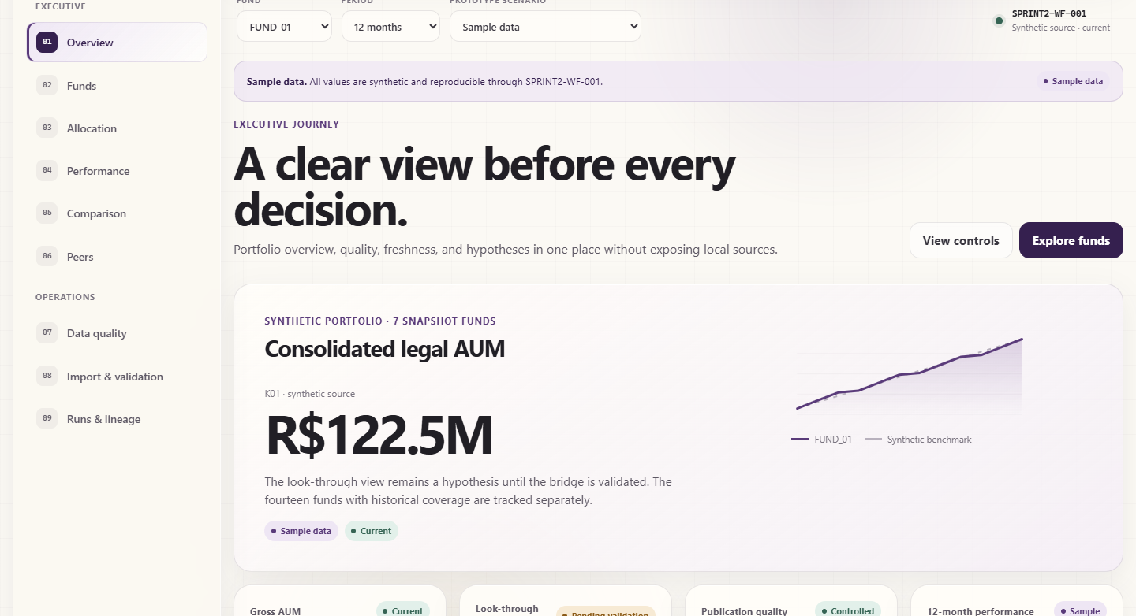
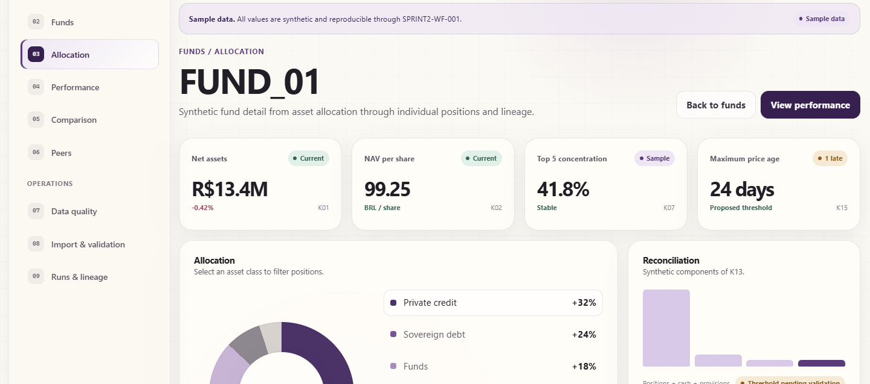
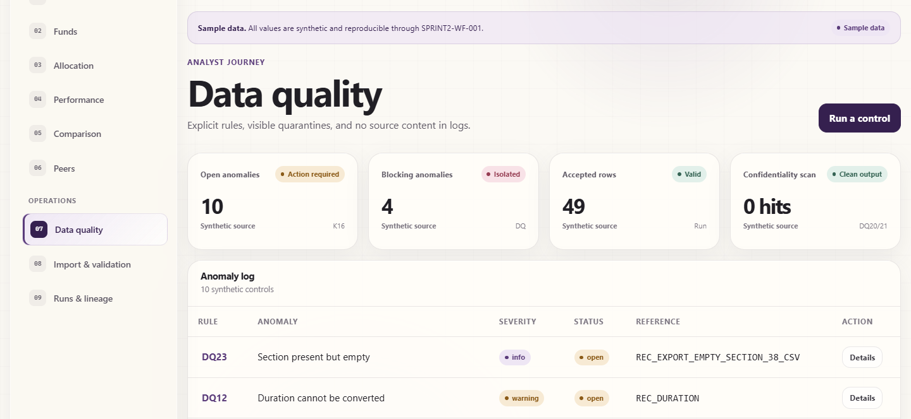
06
DASHBOARD PREVIEW
A WORKING INTERFACE IS READY FOR LIVE DEMO
Current English screens, captured from the running prototype.
ALLOCATION DRILL-DOWN
FUND AND PERIOD FILTERS
QUALITY SCENARIOS
Inteli x YvY Capital | Funds Manager | Sprint 2
06
Notes:
Keep this slide brief. Point to filters, the allocation-to-holdings interaction and data-quality states, then move directly into the live demonstration after the deck.
[Sources]
- Current translated Funds Manager dashboard, captured locally on August 22, 2026
- Screens shown: Executive Overview, Allocation and Data Quality

Slide 7
07
CURRENT COVERAGE
COVERAGE IS BROAD, DATA REMAINS SYNTHETIC
Scope is measurable; business certification and partner thresholds are still pending.
LIVE SECTIONS
DEMO STATES
ALIASED FUNDS
9
10
14
Executive and Operations views
Current, late, incomplete, error and more
Seven with detailed snapshot coverage
DATA FAMILY
VISIBLE TODAY
CURRENT STATUS
Portfolio & fund
AUM, NAV, allocation, holdings and freshness
SAMPLE DATA
Analytics
Performance, risk, internal and peer comparison
SAMPLE / PENDING
Control & evidence
Quality, anomalies, run status and lineage
SYNTHETIC RUN
Inteli x YvY Capital | Funds Manager | Sprint 2
07
Notes:
Use the three scope metrics to show that the prototype is substantial while remaining transparent about data maturity. Do not present sample KPI values as certified portfolio results.
[Sources]
- Current translated Funds Manager dashboard
- DATA_DICTIONARY.pdf
- FEATURE_GUIDE.pdf
- Sprint 2 KPI catalogue and serving contract
- Sprint_2_W1_Progress_Report_Inteli_YvY_Capital.pdf

Slide 8
08
TECHNICAL DIRECTION
THE PROTOTYPE ALREADY FOLLOWS THE TARGET DATA FLOW
The current interface consumes controlled synthetic outputs rather than source files.
Source data
Ingestion
Curated data
Business logic
Dashboard
Authorized exports
Manifest + parsing
Silver / Gold / Serving
KPI + quality rules
Executive + Analyst
Not connected
Local proof
Contracts defined
Partially implemented
Interactive prototype
GOVERNANCE & QUALITY
Quality, traceability, reproducibility and privacy by design
Production orchestration, storage, identity and authorized source access remain pending.
Inteli x YvY Capital | Funds Manager | Sprint 2
08
Notes:
Explain the architecture in one sentence: source exports are intended to become governed curated outputs before the application reads them. Today, the dashboard consumes a synthetic Serving contract and the pipeline is a local proof.
[Sources]
- 2026_TAPI_YvY_Capital_Inteli_ENGLISH.docx
- Plan_interne_YvY_Capital_Sprints1_5.pdf
- Sprint 2 architecture.md and contracts
- Sprint_2_W1_Progress_Report_Inteli_YvY_Capital.pdf

Slide 9
09
SPRINT 3 PLAN
SPRINT 3 BUILDS THE DATA FOUNDATION
Documented controls become a reproducible and testable pipeline.
PLANNED - NOT YET VISIBLE IN THE CURRENT DASHBOARD
01
02
03
04
INGEST
CURATE
CONTROL
PROVE
-
Idempotent pipeline
-
Silver and Gold layers
-
Coded quality rules
-
Manifests and lineage
-
Parse portfolio exports
-
Governed Serving outputs
-
Quarantine and privacy gates
-
Repeatable reconciliation tests
SPRINT 3 OUTCOME
A deterministic path from authorized input to controlled application-ready data.
Inteli x YvY Capital | Funds Manager | Sprint 2
09
Notes:
Describe Sprint 3 as the transition from documented rules and local proofs to a repeatable pipeline. These capabilities are planned and are not represented as visible in the current dashboard.
[Sources]
- Plan_interne_YvY_Capital_Sprints1_5.pdf
- Sprint 2 backlog_sprint3.md
- Sprint 2 architecture.md
- Sprint 2 source_matrix.md
- Sprint_2_W1_Progress_Report_Inteli_YvY_Capital.pdf

Slide 10
10
SPRINT 3 PLAN
SPRINT 3 CONNECTS THE APPLICATION ALPHA
The validated interface becomes the front end of governed data outputs.
NEXT CHECKPOINT
01
Governed outputs replace static sample data
What changes next?
Connect the interface to repeatable Serving contracts.
02
Real states and validated calculations
Persist selections, deepen drill-downs and certify KPI logic.
Pending partner review and data-source confirmation
03
Automated evidence and acceptance tests
Run history, integration checks and Analyst validation become repeatable.
Planned - not yet visible
Next checkpoint: connect the validated interface to a reproducible data pipeline and deliver the first application alpha.
Inteli x YvY Capital | Funds Manager | Sprint 2
10
Notes:
Close on the concrete next checkpoint rather than a generic thank-you. Ask for the partner decisions that unblock source access, KPI conventions, thresholds and the application alpha scope.
[Sources]
- Plan_interne_YvY_Capital_Sprints1_5.pdf
- Sprint 2 backlog_sprint3.md
- Sprint_1_Delivery_Roadmap_Inteli_YvY_Capital.pdf
- Sprint_2_W1_Progress_Report_Inteli_YvY_Capital.pdf

