Slide 1
Old Use cases
Case 1: User Alice wants to upload a doc, hello.txt
Alice creates hello.txt in her SecureBox (SB) folder: C:/securebox/hello.txt
SB creates folder secure_hello in C:/Dropbox
SB create symmetric key hello_key and encrypts hello.txt into hello.txt.crypt
SB moves hello.txt.crypt into C:/Dropbox/secure_hello
SB encrypts hello_key into hello_key.alice.crypt using Alice’s public key
SB moves hello_key.alice.crypt into folder C:/Dropbox/secure_hello/.sb
Case 2: Alice wants to synch her files on her other computer “PC2”
On PC1, she has C:/securebox/hello.txt
On PC2, she has D:/Dropbox and D:/securebox
Dropbox downloads folder secure_hello sur PC2: D:/Dropbox/secure_hello
SB sees a .sb folder, decrypts D:/Dropbox/secure_hello/.sb/hello_key.alice.crypt
SB decrypts D:/Dropbox/secure_hello/hello.txt.crypt using hello_key
SB moves hello.txt into D:/securebox
Case 3: Alice wants to share hello.txt with Bob
On PC1, she has C:/securebox/hello.txt and C:/Dropbox/secure_hello/hello.txt.crypt and C:/Dropbox/secure_hello/.sb/hello_key.crypt
Alice goes to Dropbox and shares folder secure_hello with Bob
Bob accepts and Dropbox creates on Bob’s computer E:/Dropbox/secure_hello
SB sees a .sb folder in E:/Dropbox/secure_hello
SB determines that it can’t use hello_key.alice.crypt to decypher hello.txt.crypt
SB creates folder pub_key in E:/Dropbox/secure_hello/.sb and copies Bob’s public key there: E:/Dropbox/secure_hello/.sb/pub_key/bob.pub
On Alice’s computer, Dropbox creates C:/Dropbox/secure_hello/.sb/pub_key/bob.pub
On Alice’s computer, SB decrypts hello_key.alice.crypt, encrypts it wtih bob.pub and places it in C:/Dropbox/secure_hello/.sb/hello_key.bob.crypt
Dropbox creates E:/Dropbox/secure_hello/.sb/hello_key.bob.crypt
SB recognizes the new key and decrypts hello.txt.crypt
SB copies hello.txt into E:/securebox/hello.txt
Note: To share C:/securebox/hello.txt Alice had to go to her Dropbox client and share C:/Dropbox/secure_hello. This is not ideal! Alice should initiate the sharing from the SecureBox client (which in turn would instruct Dropbox to share…). Similarly, Bob receives a Dropbox sharing notification, for a folder with an awkward name. Not nice.

Slide 2
Case 3: Alice wants to share hello.txt with Bob
Alice runs SB board and calls ‘share folder’ on hello
SB leads Alice to a Dropbox web page where she can share folder _SecureBox_helloid with Bob
Bob accepts and Dropbox creates the folder on Bob’s computer E:/Dropbox/_SecureBox_helloid
SBdeamon sees that there is a _SecureBox_helloid folder, but that it has no file _SecureBox_helloid/_users/bobid
SBdeamon saves Bob identity into _SecureBox_helloid/_users/W_bobid
SBdeamon on Alice computer detects W_bobid, reads Bob public key in this file, use it to encrypt the key of folder hello and replaces the file W_bobid by a proper file bobid, that contains this encrypted key
SBdeamon on Alice computer also adds Bob identity to is contact list in settings.config.friends
The rest is as Case 2: Bob opens SB board
SB on Bob’s computer detects that _SecureBox_helloid is inside Dropbox, but that helloid is not in its local folderList; it reads _SecureBox_helloid/_originalname and reads “hello” and diplays it
Bob sees folder ‘hello’ marked as not synchronized locally – he presses ‘synchronize folder’
SB asks Bob where to save ‘hello’ locally, she chooses a location (e.g. E:/hello)
SB uses Bob private key to decrypt the folder key inside _SecureBox_helloid/_users/bobid
SB adds an entry for helloid inside folderList
SBdeamon on Bob’s computer will detect the new entry in settings.config.folderList, scan _SecureBox_helloid/_files and decrypt it into E:/hello
Note that if Bob was already in Alices’s contact list before, steps 4-7 can be bypassed because SB on Alice computer already knows Bob public identity, and already create _users/bobid (the second part of step 6). Therefore, at step 2, SB also shows the contact list and Alice could have selected Bob inside it if it was there.
Note: Alice was directed to a Dropbox page to share C:/Dropbox/_SecureBox_hello.id This is not ideal! Alice should initiate the sharing from the SecureBox client (which in turn would instruct Dropbox to share…). Similarly, Bob receives a Dropbox sharing notification, for a folder with an awkward name. Not nice.
Changes inside folder hello
One of the users, for example Alice on PC2, makes some changes (add/remove/modify some files inside hello)
SBdeamon on this computer detects the changes by comparing the folder tree to some memory trace inside SB private folder, and propagate these changes (while encrypting) to the local D:/Dropbox/_SecureBox_helloid/_files folder
Dropbox will propagate these changes to the _SecureBox_helloid/_files folder on every other computer (C:/… and E:/…)
SBdeamon on these other computers will detect the changes by comparing with the memory trace in its private folder, and propagate them (while decrypting by using the folder key) to C:/hello and E:/hello
New Use cases
Note that SBdeamon is constantly running, while specific actions (such as registering a new folder) are triggered by user calls.
Installation 1: Alice installs SecureBox on her computer
SB creates its config files inside its private directory
SB generates a unique ID (aliceid) for Alice and an RSA key
SB the private key is saved in userkey/private.id and the public key in userkey/public.id
Case 1: User Alice wants to upload a folder, hello
Alice calls SB ‘register’ routine on folder hello (hello can be anywhere on her computer)
SB creates a unique ID (helloid) for this folder and a key, it stores them and the path to hello in a ‘Folder’ object, saved in settings.config.folderList
SB creates inside Dropbox main folder a new folder _SecureBox_helloid, with inside, _originalname file, _users and _files folder
SB encrypts the folder key and saves it into _SecureBox_helloid/_users/aliceid, along with Alice public identity
SBdeamon will detect the new entry in settings.config.folderList, scan hello and encrypt it into _SecureBox_helloid/_files
Installation 2: Alice installs SecureBox on her other computer “PC2”
The process is similar, but instead of generating a new ID and key for Alice, Alice must copy the file userkey/private.id onto PC2 and locate it when prompted by SB installer.
Case 2: Alice wants to synch her files on her other computer “PC2”
On PC1, she has C:/Dropbox
On PC2, she has D:/Dropbox
Dropbox downloads folder _SecureBox_helloid sur PC2: D:/Dropbox/_SecureBox_helloid
Alice opens SB board
SB detects that _SecureBox_helloid is inside Dropbox, but that helloid is not in its local folderList; it reads _SecureBox_helloid/_originalname and reads “hello” and diplays it
Alice sees folder ‘hello’ marked as not synchronized locally – she presses ‘synchronize folder’
SB asks Alice where to save ‘hello’ locally, she chooses a location (e.g. D:/hello)
SB uses Alice private key to decrypt the folder key inside _SecureBox_helloid/_users/aliceid
SB adds an entry for helloid inside folderList
SBdeamon will detect the new entry in settings.config.folderList, scan _SecureBox_helloid/_files and decrypt it into D:/hello

Slide 3
Classes
Identity = the identity of a user
ID (a unique identifier)
First name
Last name
Device (not used)
Key (RSA private key, or only the public part)
Isprivate (Boolean)
Config = the configuration variables that won’t change with time
dropboxdir
Folder = information on a given folder being currently synchronized
CurrentState = variables that change with time
ID (a unique identifier)
Originalname (a name that won’t change, even if the local folder name will change)
Path (current local path)
amOwner (not used)
Key (folder key, not encrypted)
folderList (list of Folder objects)
…
friendList (list of Identity objects)
…
ID
Originalname
Path
amOwner
Key
ID
Originalname
Path
amOwner
Key
TakkedKey = the public identity of a user + the folder key encrypted for him
ID
First name
Last name
Device
Key
Isprivate = False
ID
First name
Last name
Device
Key
Isprivate = False
Lockedkey
Identity
ID
First name
Last name
Device
Key
Isprivate = False

Slide 4
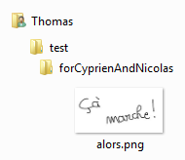
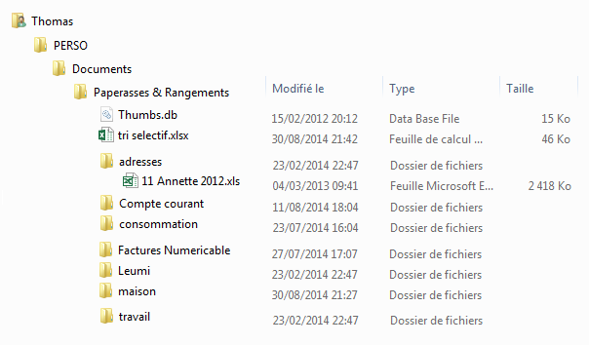
Files
Local synchronized folders can be anywhere on the computer

Slide 5
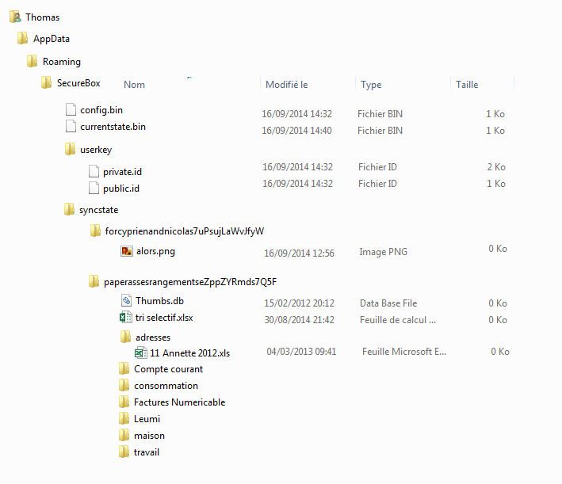
Files
SecureBox private working folder
Config object
CurrentState object
Identity object (user identity, field isprivate=true)
Identity object (user identity, field isprivate=false)
state of the synchronized files after the last synchronization:
unique folder IDs guarantee that two folders won’t have the same name
it is necessary to have such memory to resolve conflicts (e.g. if
file A appears on the cloud but not locally, should it be removed
on the cloud, or crated locally?)

Slide 6
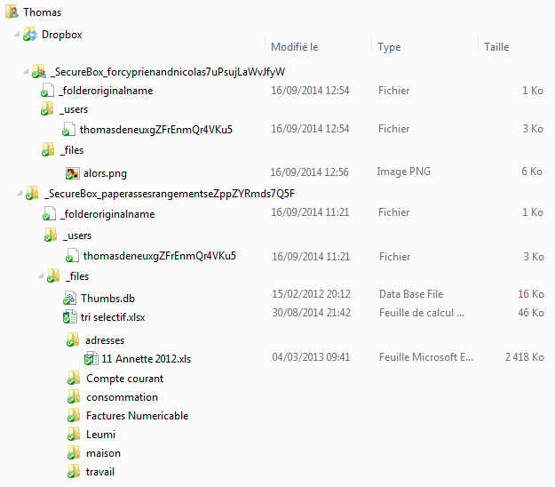
Files
Encrypted files are created inside special Dropbox folders
Special folder name includes the folder ID
_folderoriginal file just contains the folder original name
_users folder contains information about users sharing the folder
each file inside contains a TaggedKey object and the name is a user ID; also, when a new user accesses to the folder but does not have its key yet, it drops inside _users a file with name W_userID that contains an Identity object with his public identity; the SB deamon of any user who has the folder key will detect such file and replace it by the proper userID containing a TaggedKey object, with the folder key encrypted using the new user public key
_files folder contains the encrypted files, following the same tree as in the original folder

