Slide 1
Maven
Thomas Dreßen BitAix GmbH

Slide 2
Library1.jar
Library2.jar
MyFirstClass.java
compile
MyFirstClass.class
MySecondClass.java
MySecondClass.class
MyFirstClass.java
MySecondClass.java
MySecondClass.class
compile
test
Test.java
Test.class

Slide 3
Library1.jar
Library2.jar
MyFirstClass.java
compile
MyFirstClass.class
build
JAR
WAR
MySecondClass.java
JAR
MySecondClass.class
JAR
EAR
MyFirstClass.java
JAR
WAR
MySecondClass.java
MySecondClass.class
deploy
build
compile
test
Application Server
Test.java
Test.class

Slide 4
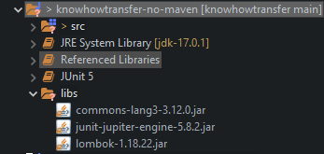
Before Maven
Test.java
MyFirstClass.java
Javac –classpath …..
Librarys.jar
Librarys.jar
Librarys.jar
Librarys.jar
Test.class
MyFirstClass.class
Javac –jar …..
JAR
Javac –jar …..
WAR
jar cvf my.ear .
EAR
Copy EAR File to deployment folder
Application Server

Slide 5
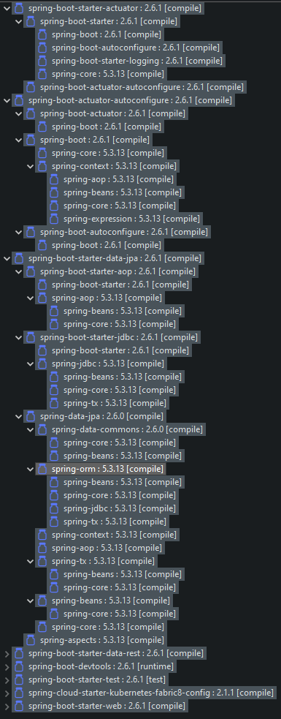
Before Maven – Beispiel Spring Libs

Slide 6
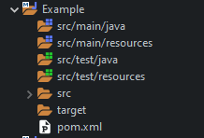
Maven Folder Structure

Slide 7
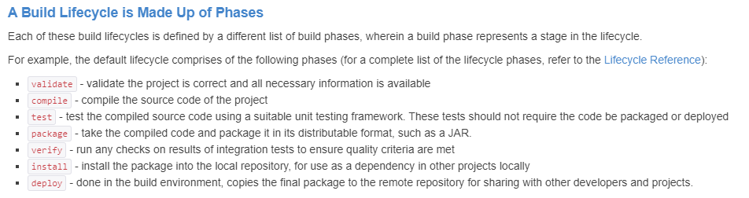
Maven Lifecycle

Slide 8
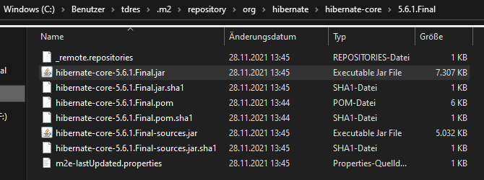
https://mvnrepository.com/
3
Repository
->Hibernate-core.jar
Nexus
download
download
2
http://192.1......
download
Repository
->Hibernate-core.jar
download
1
.m2
.m2
Maven Intallation
C:\User…\.m2\repository
Maven Intallation
C:\User…\.m2\repository
settings.xml
settings.xml
Developer 1
Developer 2

Slide 9
Maven „clean“
Live Session ->D:\knowhowtransfer\Maven\MultiExample\multiexample> Ausführen mit und ohne clean Zeiten vergleichen

Slide 10
Maven Snapshot / Update Snapshot
Live Session

Slide 11
Nexus
http://192.1......
Repository
MyApplication
uses
AppDepSnapshot.jar
.m2
.m2
C:\User…\.m2\repository
C:\User…\.m2\repository
AppDepSnapshot.jar
Developer 1
Developer 2

Slide 12
Nexus
GIT
http://192.1......
Repository
Jenkins
AppDepSnapshot.jar
push to GIT
MyApplication
Dev 2 modifies
uses
*
AppDepSnapshot.jar
.m2
.m2
C:\User…\.m2\repository
C:\User…\.m2\repository
AppDepSnapshot.jar
AppDepSnapshot.jar
Developer 1
Developer 2

Slide 13
Speedup Maven build Ideas
mvn -T 1C install -pl $moduleName -am —offline

Slide 14
Dirty Tricks
Manually replace JAR in EAR or WAR File

