Slide 1



NeurIPS - Ariel Data
Challenge 2025:
4th Place Winning Solution
Thomas Dueholm Hansen
Notes:
Recommending picking out he most interesting and important parts from your documentation.

Slide 2





Who am I?
PhD in computer science, Aarhus University
(2008 - 2012)
Postdocs: Tel Aviv University and Stanford University
Assistant professor: Aarhus University
Associate professor: The University of Copenhagen
Specialty: Algorithms
Quantitative analyst at Nordea, fixed income (2019)
Quantitative trader at Nordea, FX spot (until 2022)
Extended sabbatical: Learning about machine learning
Kaggle

Slide 3
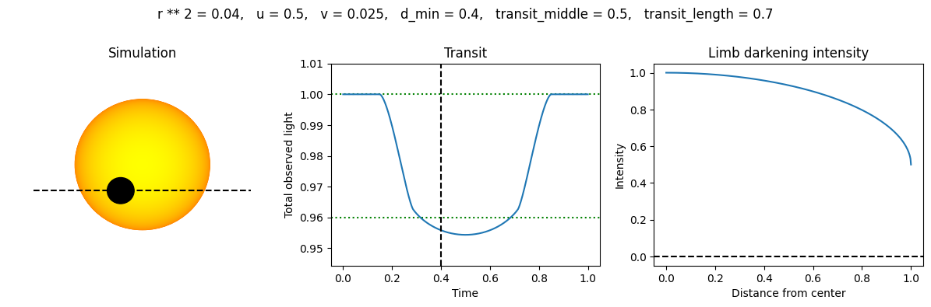
Problem description
Problem: Estimate the radius of the planet for a range of wavelengths.
Purpose: Understand the composition of the atmosphere.

Slide 4
Summary
Explicit simulation of a planet moving in front of a star (with JAX)
Non-trivial optimization of a model with a small number of parameters
Simple, independent models for:
    Transit depth: Linear regression
    Standard deviation: Neural network
Principal component analysis

Slide 5
Model overview
Preprocessing
Initial solution
Explicit simulation
Transit depth estimation
Uncertainty estimation
Principal component analysis
Ensemble

Slide 6
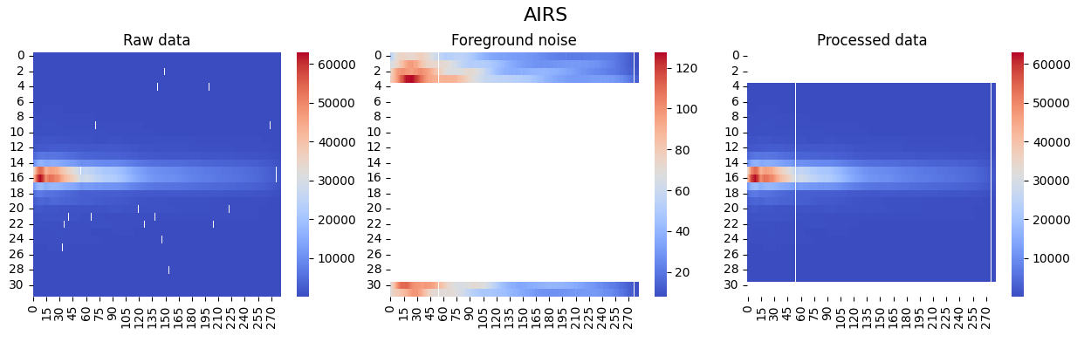
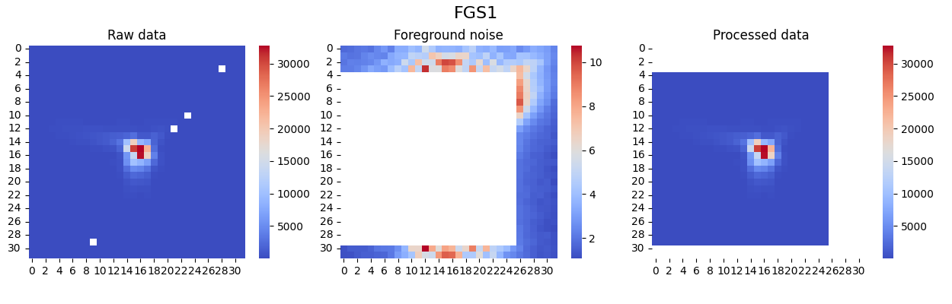
Preprocessing
Calibration as suggested by organizers
Hot and dead pixels replaced by linear interpolation
    4 neighbors for FGS1, 2 neighbors for AIRS
    Except 4 most important pixels for AIRS: Discard entire wavelength
Discard outliers
Subtract foreground noise
    Inspired by last year’s 1st place solution

Slide 7
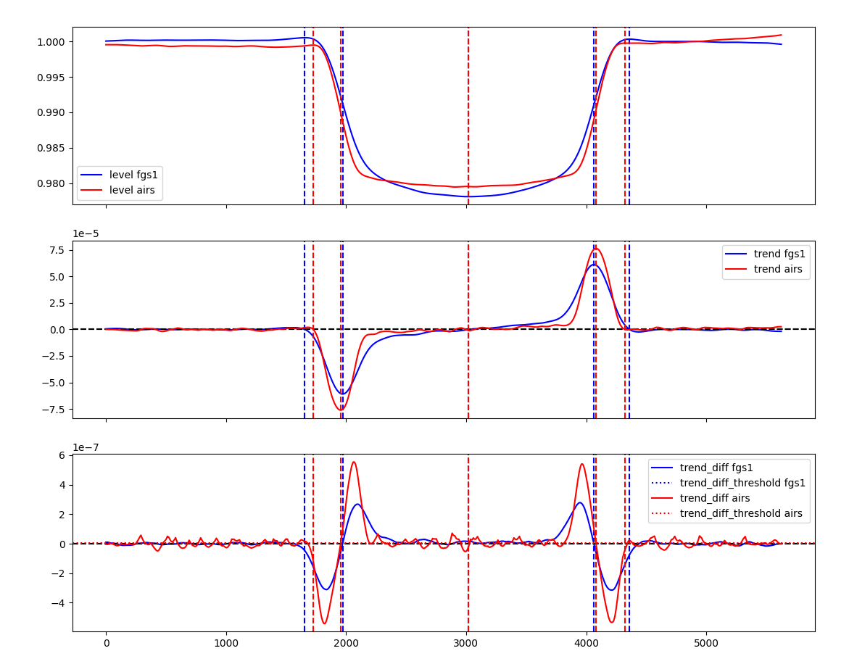
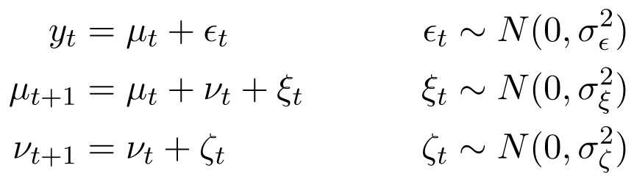
Initial transit window estimation (baseline solution)
  AIRS data: Sum over spectrum
  Kalman Smoother applied to Local Trend Model:
  Breakpoints:
    Transit start
    Most negative trend
    Transit middle
    Most positive trend
    Transit end

Slide 8
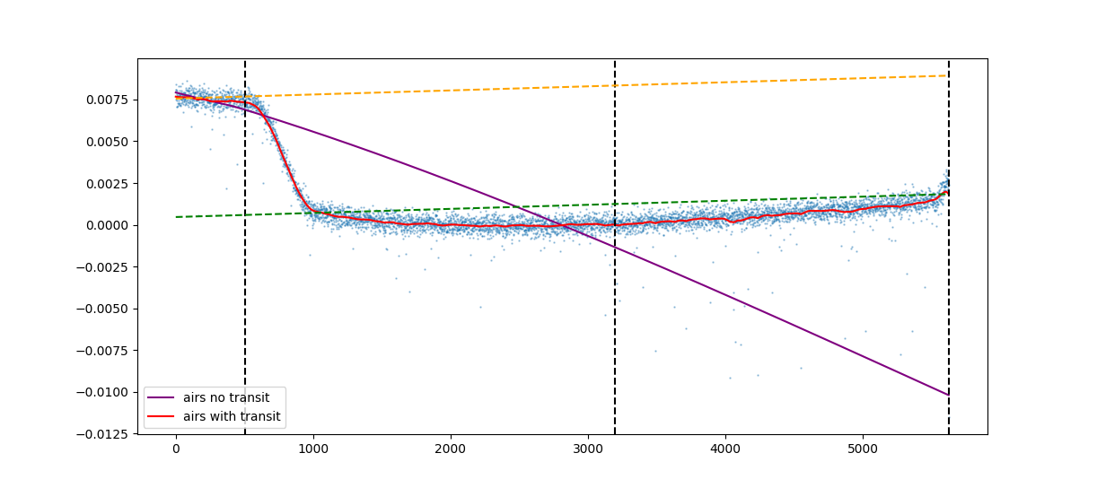
Initial depth estimation (baseline solution)
  Remove transit data and reapply Kalman Smoother
  Transit depth: Gap between level with and without transit data
  Incomplete transits: Linear approximation

Slide 9
Explicit simulation of limb darkening
Limb darkening: Lower intensity toward the edge (limb)
Computation with JAX: Discrete integral over layers of the star, scaled by intensity
    Memory intensive, the computational bottleneck for my solution

Slide 10
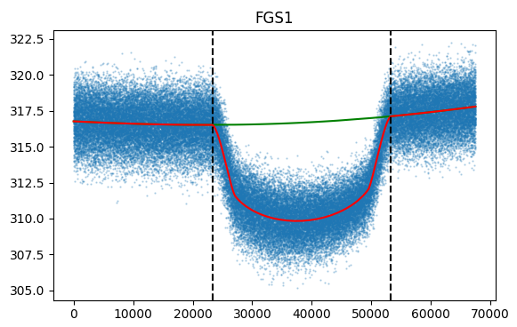
Full model
    Full model (Inspired by last year’s 1st and 2nd place solutions):
    Components:
        Star intensity
        Transit
        Gain drift: Variation of the detector’s gain over time and across different wavelengths

Slide 11
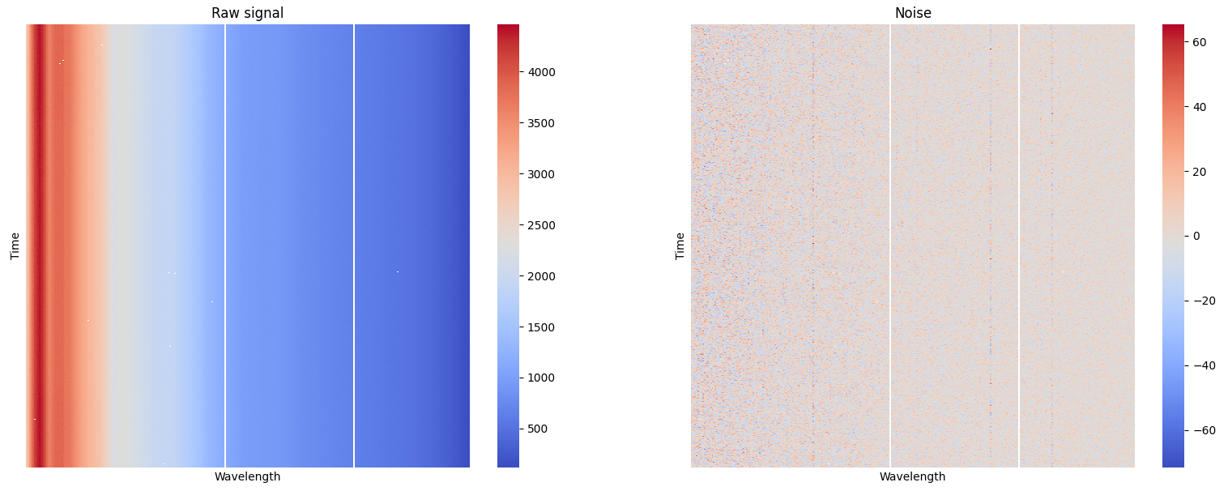
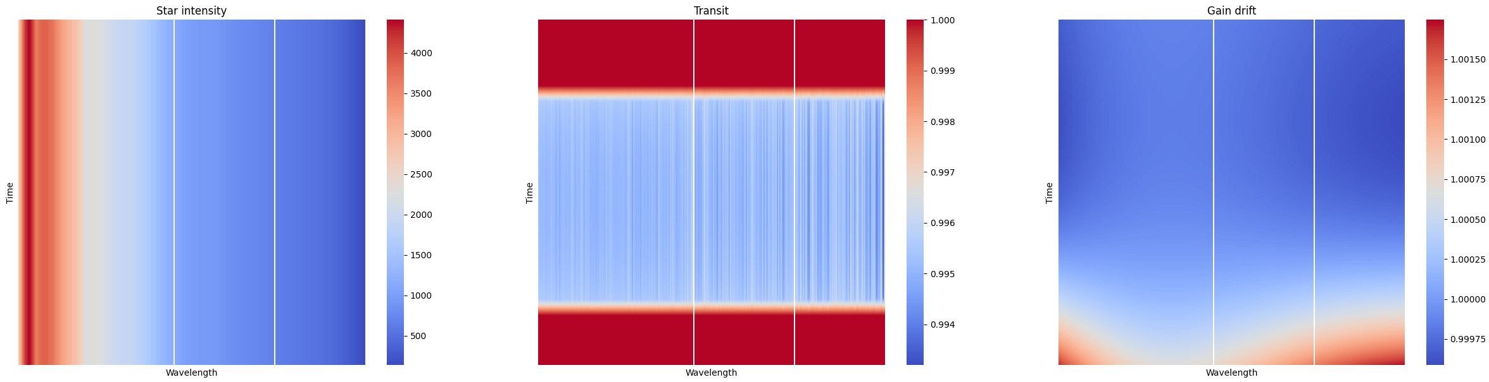
Full model
=
+
*
*
*

Slide 12
Parameter optimization
    Naive parameter optimization has poor performance
    Do it carefully: 10 stages
    Stages 1-3: No spectrum
      Identify d_min, t_min, t_length
    Stage 4: Broadcast parameters to full spectrum
      Freeze u
      Separate polynomial f for every wavelength. No I or g.
    Stages 5-10: Alternate between optimizing gain drift and transit
    f and g are polynomials of degree 4, I is a scalar for every wavelength
    f, g, and u are regularized
    Parameters for I and g are derived with linear regression

Slide 13
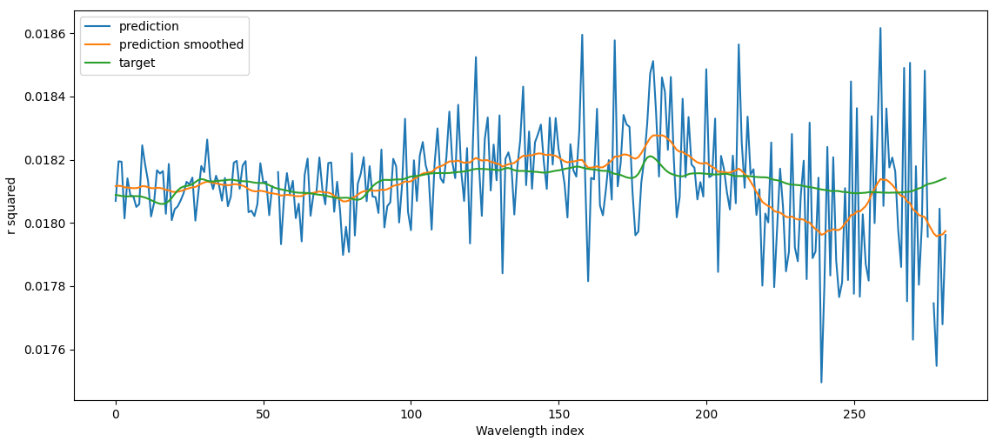
Spectrum smoothing
    Predictions of r squared are noisy
    Use a Kalman Smoother to reduce noise
      This handles missing wavelengths

Slide 14
Final depth estimation
The final prediction of r squared is produced with linear regression
FGS1: 1 feature
    r squared for FGS1 from stage 3
AIRS: 3 or 4 features
    The mean of the spectrum from stage 10, broadcasted to all wavelengths
    r squared for AIRS from stage 3
    The spectrum from stage 10 with its mean subtracted
    Possibly: A principal component analysis (PCA) transformation of the above centered spectrum
Outliers: Don’t use the 18 planets with the worst errors

Slide 15
Uncertainty estimation
The standard deviation of r squared is computed with small neural networks, one for FGS1 and one for AIRS
7 features for FGS1
11 features for AIRS
Example features:
    Predicted r squared values, produced with 5-fold cross validation with 3 repetitions
    Parameters u, t_length, d_min
    Planet multiplicity, and differences in r squared predictions for the same planet
    Standard deviation of the spectrum

Slide 16
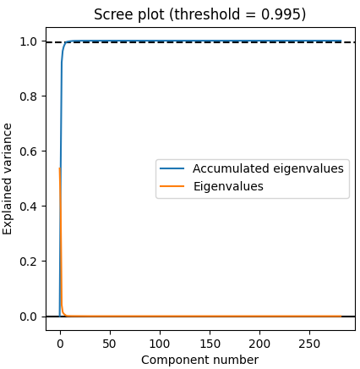
Principal component analysis (PCA)
Principal component analysis reveals that the target spectrums are mostly explained by a few components
I approximate each predicted spectrum with the best combination of the 7 most significant components with linear regression
The transformed PCA spectrum is used as a feature, if the Euclidean distance to the original spectrum is at most 0.0015
    This covers about 90% of the training data
    Two sets of models are trained from scratch, with and without PCA features

Slide 17
Ensemble
Each model is trained independently with five different seeds
Predictions and standard deviations are averaged from these five models
Total number of models: 10
    5 without PCA features
    5 with PCA features

Slide 18
Score progression
Version | Public LB | Private LB
Kalman Smoother | 0.404 | 0.400
Limb darkening simulation | 0.575 | 0.566
PCA features | 0.584 | 0.582
Improved hyperparameters | 0.588 | 0.584
Standard deviation scaled by 1.1 | 0.590 | 0.587

Slide 19
Computation time
Local computation times with an RTX 5090:
    Preprocessing: 17 minutes
    Initial depth estimation: 1 minute
    Depth estimation with limb darkening: 3 hours and 35 minutes
    Model training: 11 minutes
Bottleneck: Memory usage for transit computation
    This step can likely be improved, possibly with a small custom kernel

Slide 20
Conclusion
Optimization of a bespoke model is tedious and does not generalize to other problems, but it can work well for a particular problem
    General framework for bespoke models?

Slide 21
Summary

Slide 22
Summary
Key insights:
  Importance of high quality features: The small number of planets made it easy to overfit.
  The possibility of directly simulating the problem
Biggest advantage:
  Using JAX made it easy to implement math heavy simulation and specialized optimization
Most fun:
  Animation of a planet moving in front of a star
  Making the transit function: A small piece of code that uses both jax.lax.stop_gradient and jax.checkpoint
  Successful use of principal component analysis

Slide 23
Question and Answer

