Slide 1

PAVO
An introduction and overview

Slide 2
Package aim
A flexible and integrated workflow for working with spectral and spatial colour data.

Slide 3
History & team
~2011 -> Inception
2013 -> v0.5. Maia et al. (2013) original paper
~2013 -> I joined. v 1.0.
~2017 -> Hugo aboard
~2019 -> v2
Present -> v2.9.0
Thomas White
Hugo Gruson
Rafael Maia
Chad Eliason
Pierre-Paul Bitton
Matthew Shawkey
Stephanie Doucet

Slide 4
Installation
current release
install.packages("pavo")
development version
remotes::install_github("rmaia/pavo")

Slide 5
Workflow
Organisation
Visualisation
Analysis

Slide 6
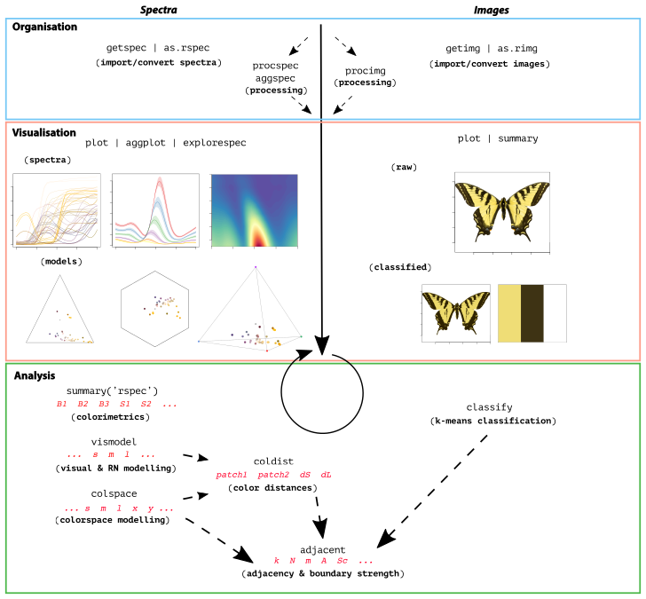
Workflow

Slide 7
Quick aside
PAVO’s Rich ‘generic’ system
plot(),
summary(),
merge()
is.rspec(), as.rspec()
...works on most stuff

Slide 8
Organisation

Slide 9
Visualisation

Slide 10
Analysis: spectral

Slide 11
Analysis: visual modelling
Most-used
vismodel() – estimating cone/quantum catches for RN and colourspace models
colspace() – implementing colourspace models.
Generic n-dimensional, Hexagon, ‘categorical’ space (Troje), COC, CIE models
coldist() & bootcoldist() – calculating colour distances (all models/spaces)

Slide 12
Analysis: visual modelling
Others
classify(), adjacent() – estimating cone/quantum catches for RN and colourspace models
colspace() – implementing colourspace models.
Generic n-dimensional, Hexagon, ‘categorical’ space (Troje), COC, CIE models
coldist() – calculating colour distances (all models/spaces)

Slide 13
Analysis: visual modelling
Utility
sensmodel() – modelling receptor absorbances
sensdata() — checking out the build-in data (raw or plotted)

Slide 14
Newish stuff summary (up to v.2.9.0)

Slide 15
TODO
sensmodel() expansion for alternate methods
various QOL improvements
What do you want?

Slide 16
Today’s goal
Develop a sense of the major functionality of PAVO and spectrometry-based methods,
via some representative biological questions

Slide 17
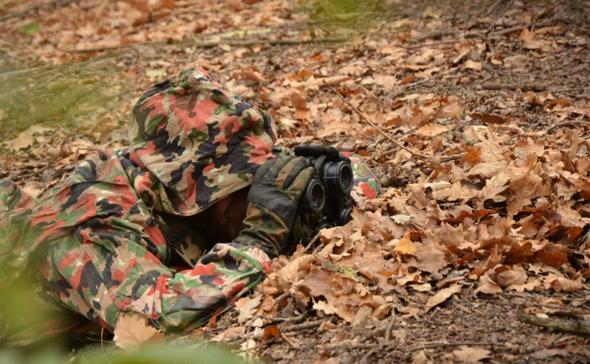
Today: question-driven examples
(1) Spectral/physical
(2) Discrimination
(3) Perceptual distance
Kemp et al. (2015). An integrative framework for the appraisal of coloration in nature.
The American Naturalist, 185(6), 705-724.

Slide 18
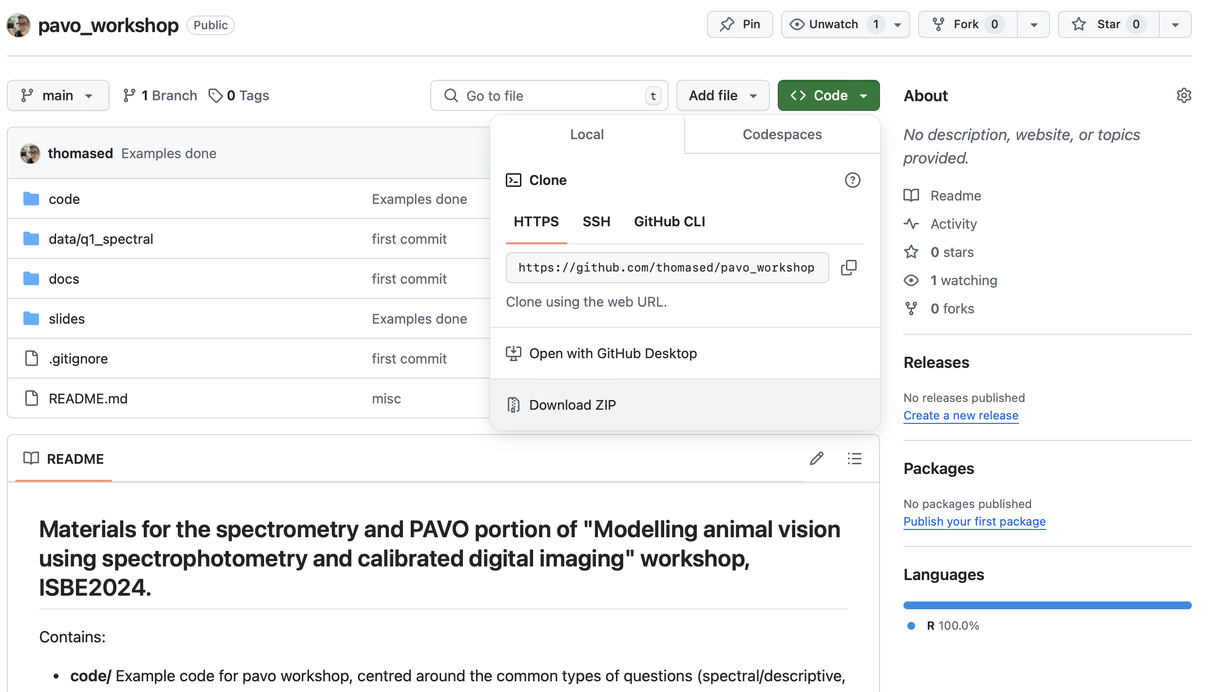
Today: question-driven examples
https://github.com/thomased/pavo_workshop

